Slide 1
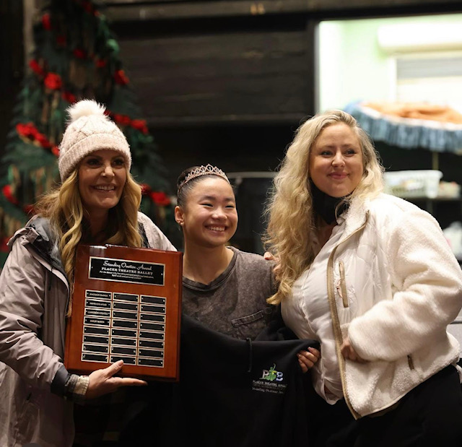
Shelby
Shelby is an 11th grade CV Student who performed in the Placer Theatre Ballet Nutcracker as Chinese Tea, Spanish Chocolate, and a Flower. She also received the Standing Ovation Award for exemplifying PTB values such as hard work, exceptional dedication, and personal conduct.

