Slide 1
Governing Board Annual Training
October 20, 2022

Slide 2
AGENDA
01
02
03
Clarksville Charter School Recap
Brown Act and Conflict of Interest (Form 700) with Jennifer McQuarrie
Financial Training with Jim Surmeian
04
05
Big Ideas:
Overarching Themes for GB
with Bryanna Brossman
Board Evaluation Process and Updates
with Darcy Belleza
Notes:
WHEN READY PLACE AGENDA ITEMS HERE

Slide 3
01
CLARKSVILLE CHARTER SCHOOL RECAP

Slide 4
Clarksville Charter School
CHARTER TERM
COUNTIES
AUTHORIZING DISTRICT
WASC
El Dorado, Amador, Alpine, Sacramento, and Placer County
Renewal 2025
Buckeye Union School District
Accredited through June 30, 2027
Notes:
Jenell discuss how communicate with authorizing district, relationship, etc.

Slide 5
SLO’S
Navigators of the Digital World
Self-Directed
Personalized Learners -
Independent Critical Thinkers
Responsible Citizens
Effective Communicators
MISSION
Clarksville Charter School ensures an individualized Learning Plan for each student is developed with both teacher, parent, and student with a focus on learning style fostering learning based on the student's natural interests and abilities. We are here to serve, support, and inspire the community within our school and all families on an educational journey with their children.
VISION
Clarksville Charter School develops the individual gifts of students to become critical thinkers, responsible citizens, and innovative leaders prepared for academic and real-life success in the 21st century.

Slide 6
02
BROWN ACT AND CONFLICT OF INTEREST WITH
Jennifer McQuarrie

Slide 8
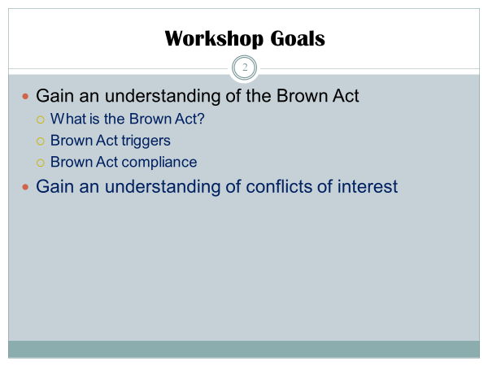

Slide 9
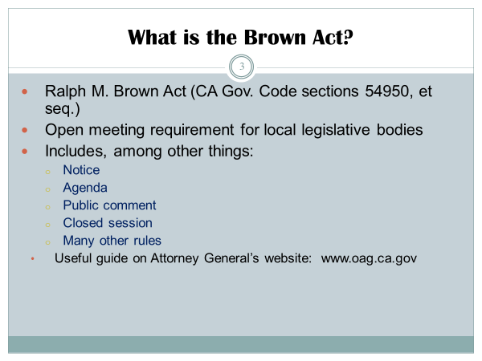

Slide 10
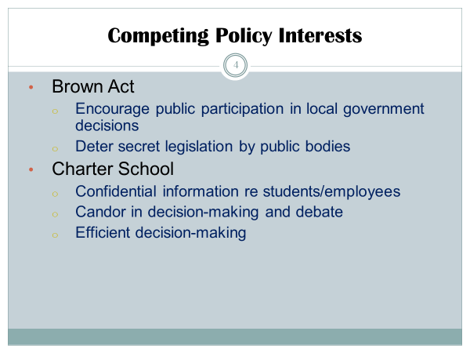

Slide 11
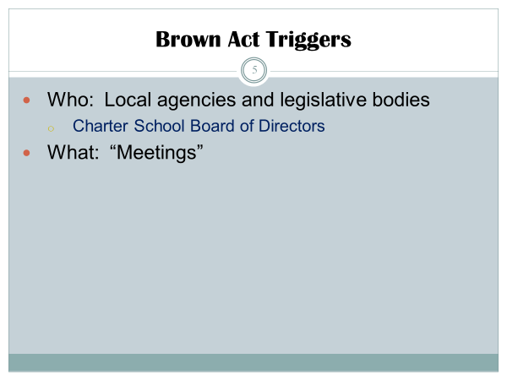

Slide 12
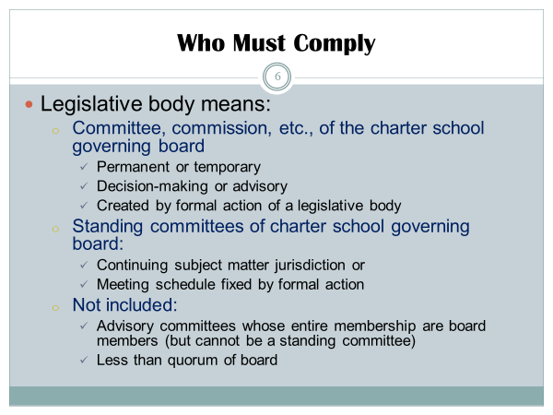

Slide 18
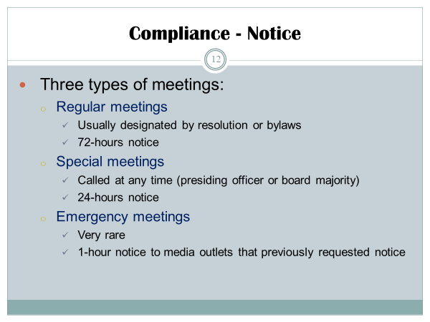

Slide 21
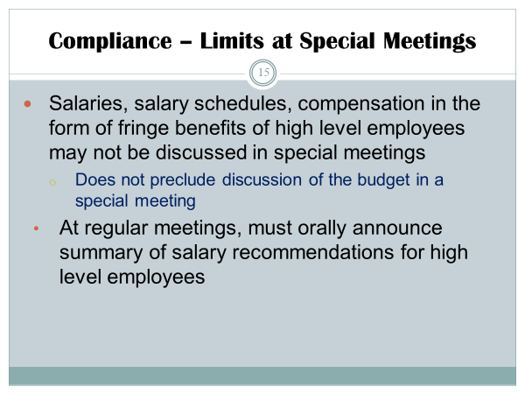

Slide 22
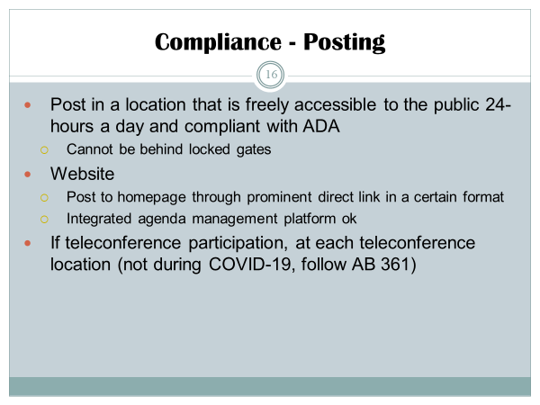

Slide 23
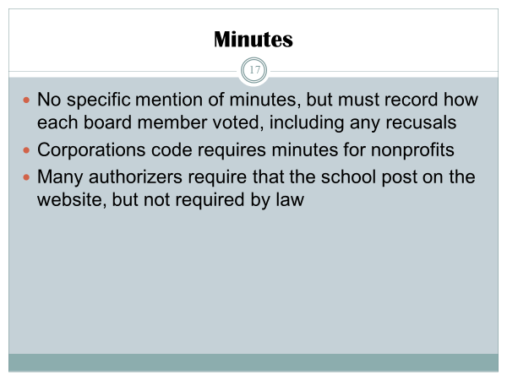

Slide 24
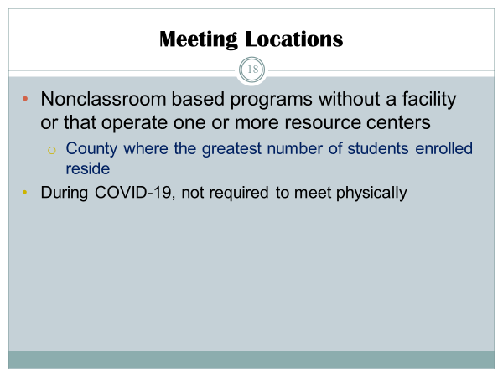

Slide 25
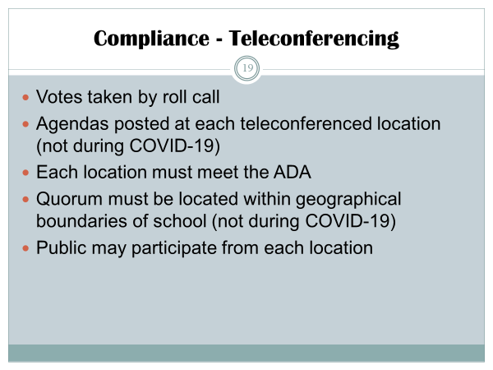

Slide 29
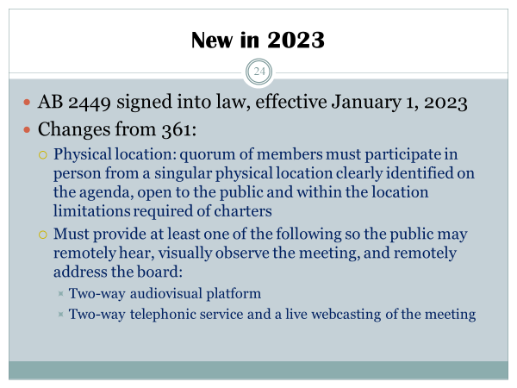

Slide 30
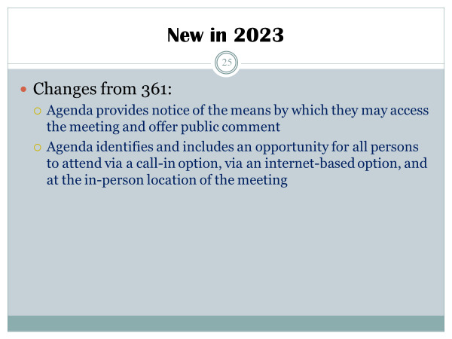

Slide 31
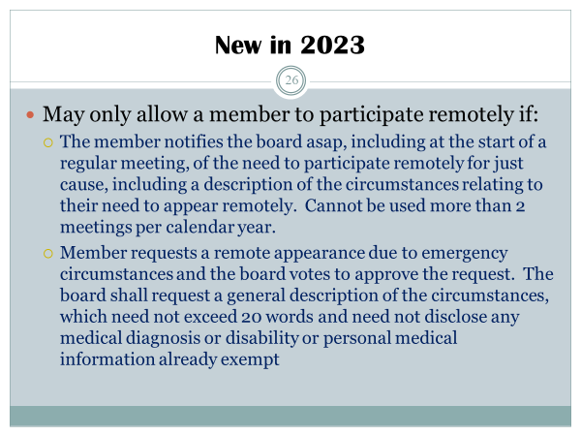

Slide 32
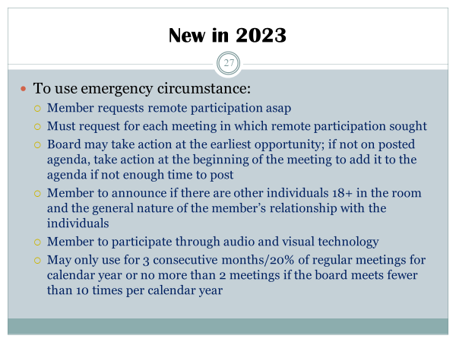

Slide 33
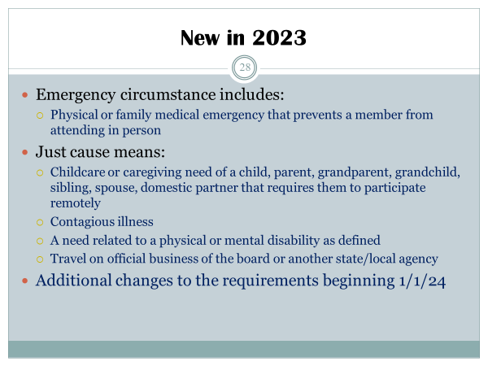

Slide 34
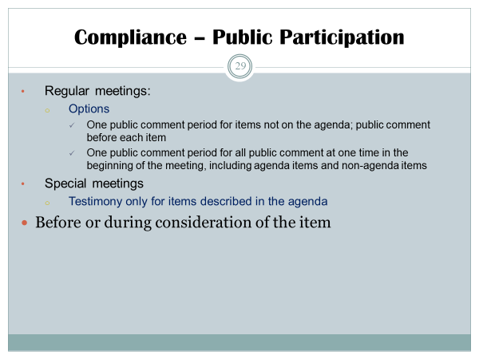

Slide 35
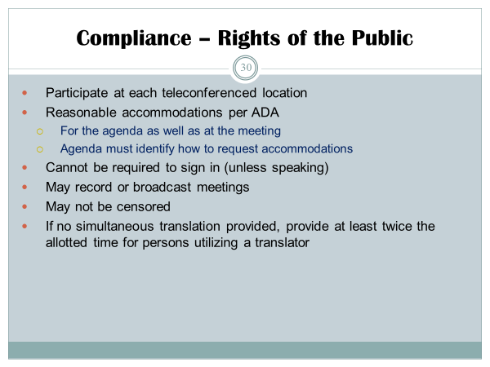

Slide 37
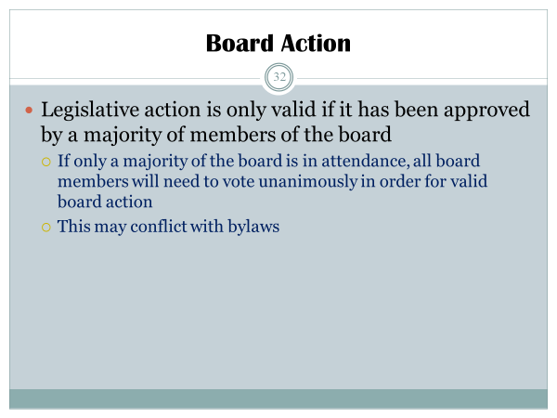

Slide 40
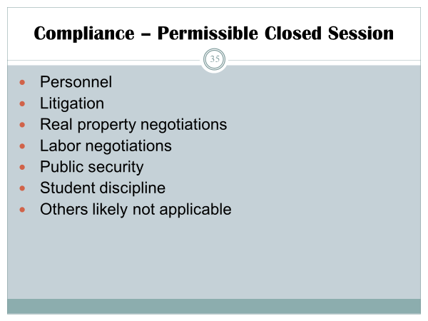

Slide 41
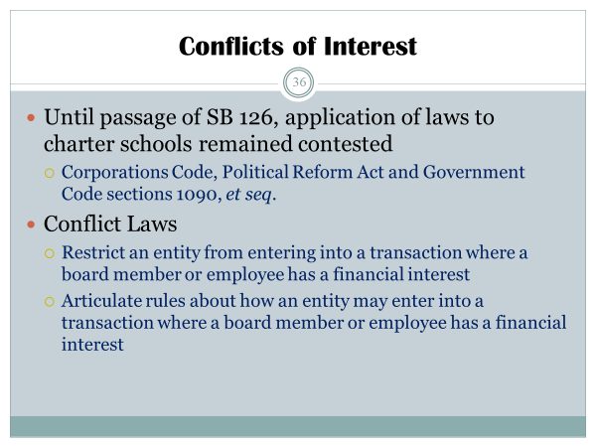

Slide 42
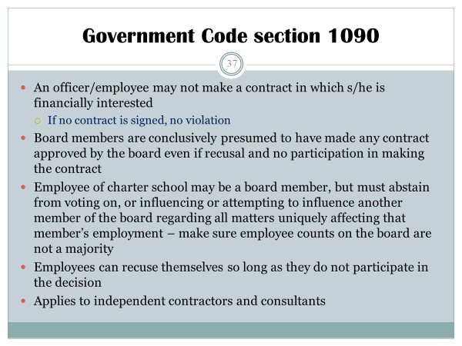

Slide 45
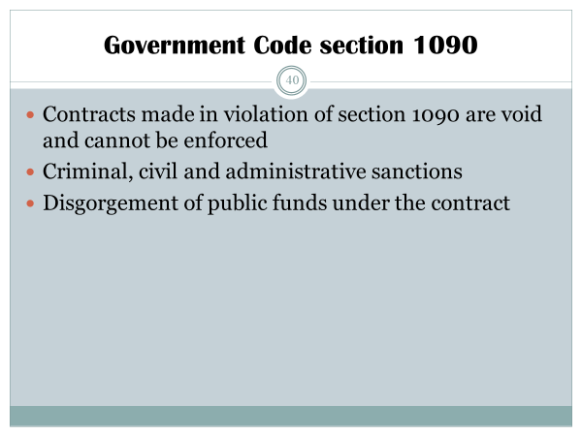

Slide 46
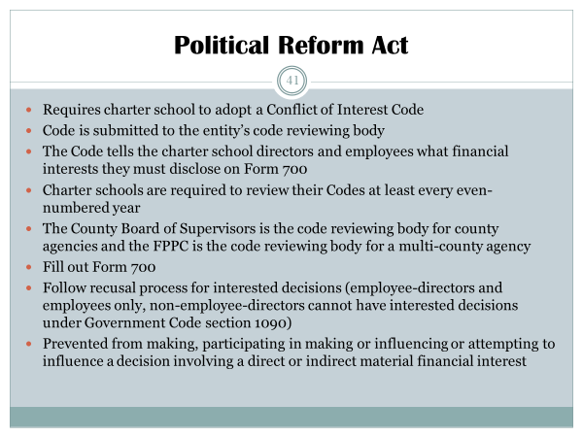

Slide 47
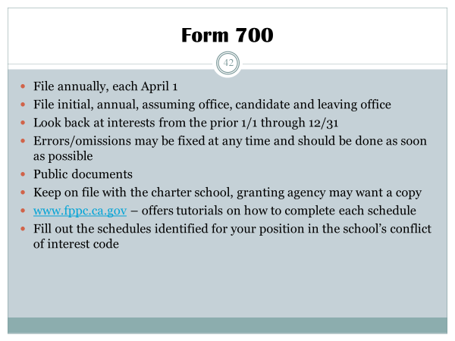

Slide 48
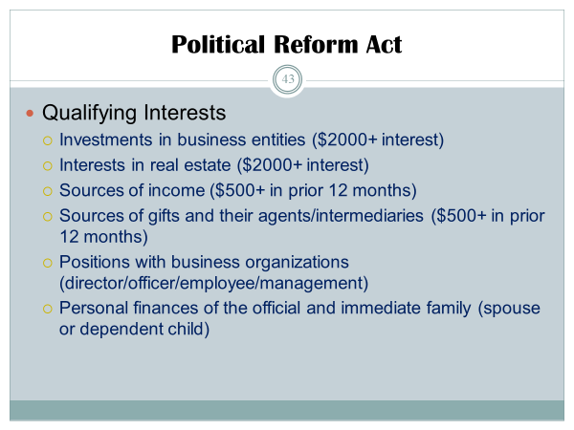

Slide 49
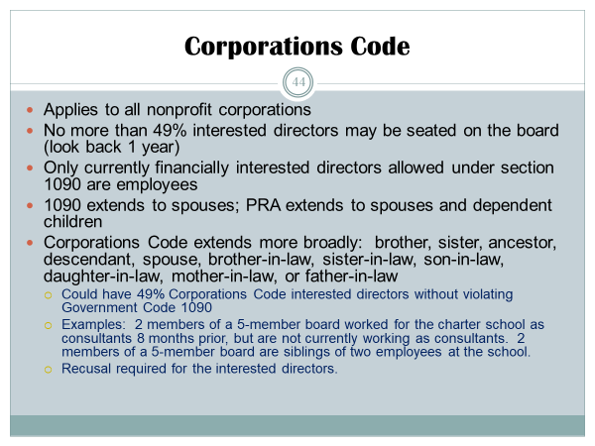

Slide 50
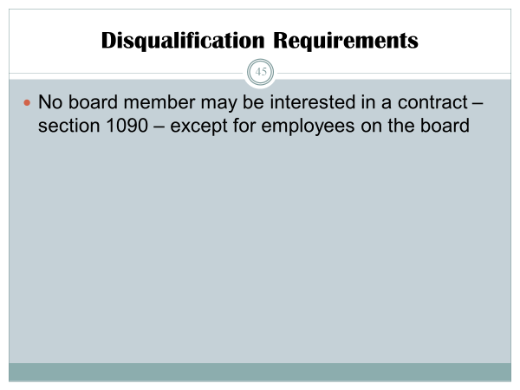

Slide 51
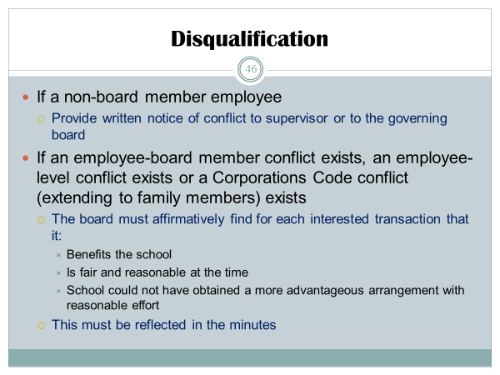

Slide 52
03
FINANCIAL TRAINING with Jim Surmeian
Notes:
With JIM

Slide 53
Charter Finance for Board Members
October 2022

Slide 54
Agenda
Reading the Financial Package
Funding Basics
Funding Determination

Slide 55
I. READING THE FINANCIAL PACKAGE

Slide 56
Financial Package Elements
The financial statement package provided on a monthly basis is intended to give both a retrospective and prospective view of the organizations financial condition. The main elements included in the monthly package include:
Monthly Cash Flow/Forecast
Budget vs. Actual
Statement of Financial Position
Statement of Cash Flows
AP Aging
Monthly Check Register

Slide 57
Monthly Cash Flow/Forecast
The monthly forecast is main management tool and intended to answer the following questions:
How do future costs compare to what we have been spending?
Are we on track to end the year with a surplus?
Will we have enough cash to meet our spending needs?
How do our current expectations compare to the original budget?

Slide 58
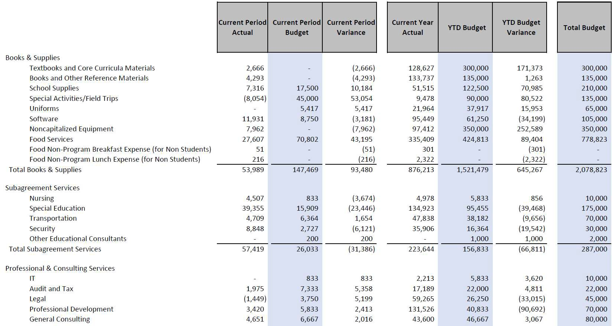
Budget vs. Actual
The Budget vs. Actual is a historical review of what the school spent in the current month and year-to- date as compared to what was originally budgeted.
NOTE: This report does not take mid-year revisions or changing estimates into account. For estimates based on current information, refer to the forecast.

Slide 59
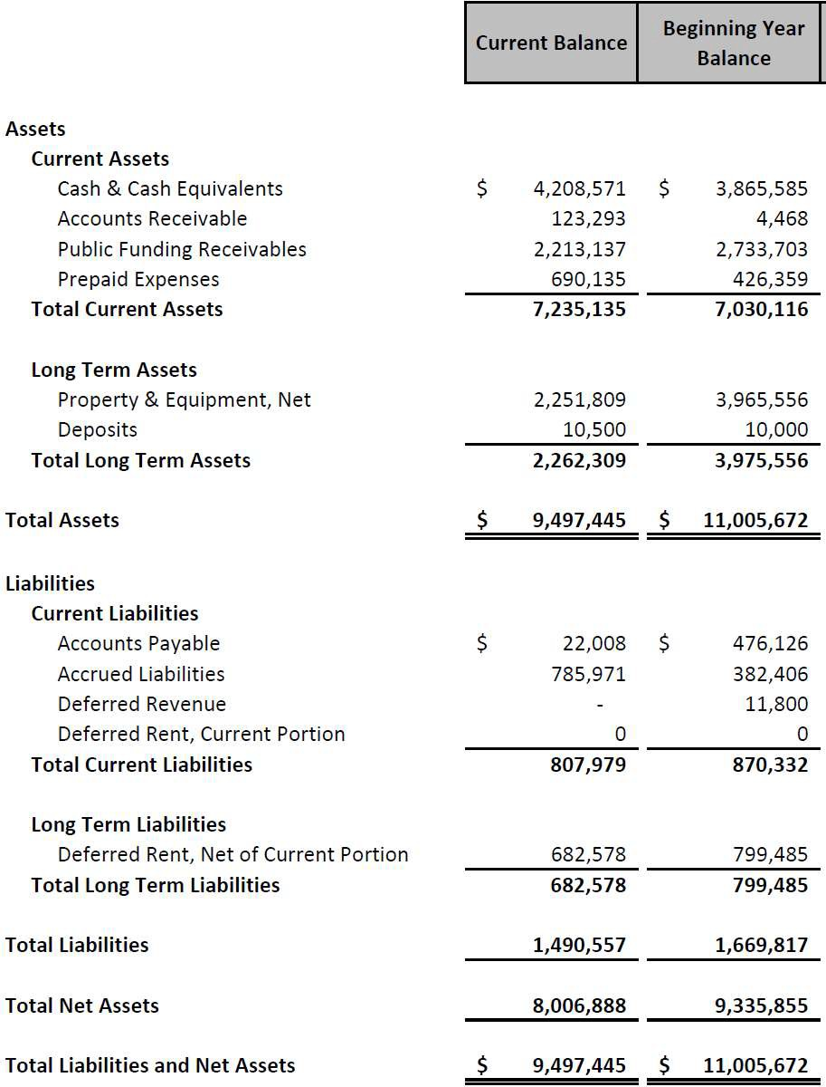
Statement of Financial Position
The Statement of Financial Position (or “Balance Sheet” in the for-profit environment) shows the school’s assets, liabilities and net assets as of a single point in time.
This iswhatyou ownandwhatothers
owe you
Cash Balance
≠
Fund Balance
This iswhatyou owetoothers
This is yournetworthor “fund
balance”

Slide 60
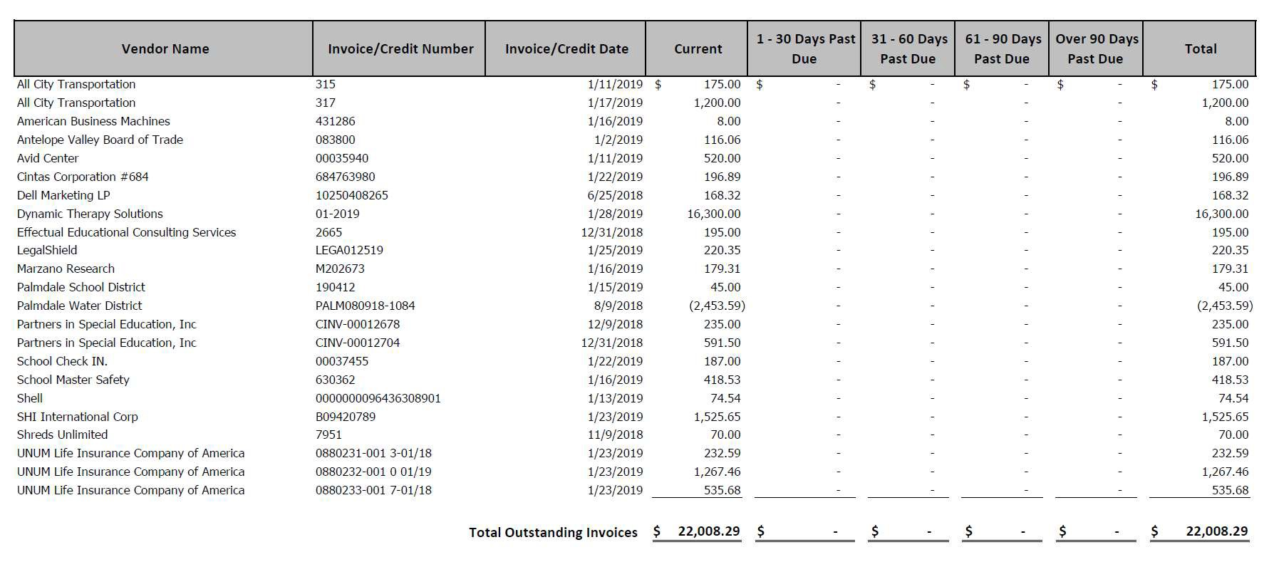
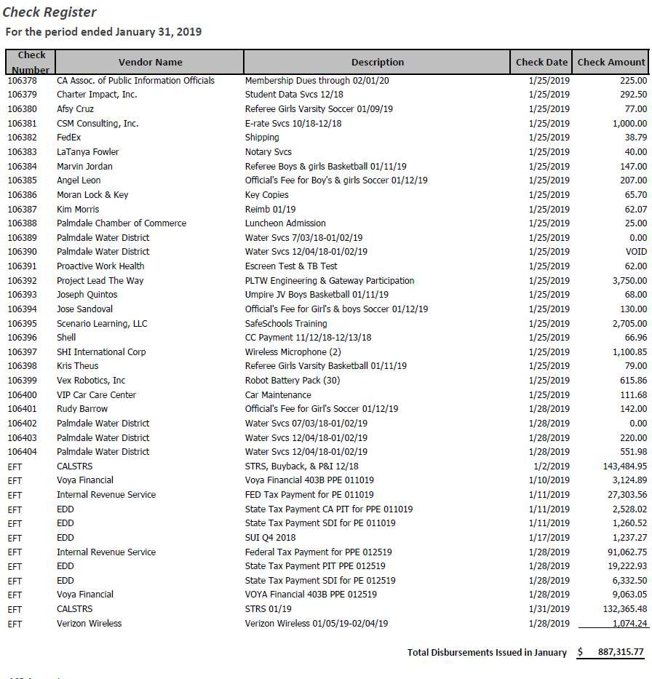
AP Aging & Check Register
These two schedules are provided to the Board for oversight purposes. They are intended to be used for transparency purposes rather than analysis.
Check Register
This shows all checks written during the reporting period (typically the prior month).
AP Aging
This shows all outstanding invoices due to vendors and how old
they areas of a point in time.

Slide 61
II. FUNDING BASICS

Slide 62
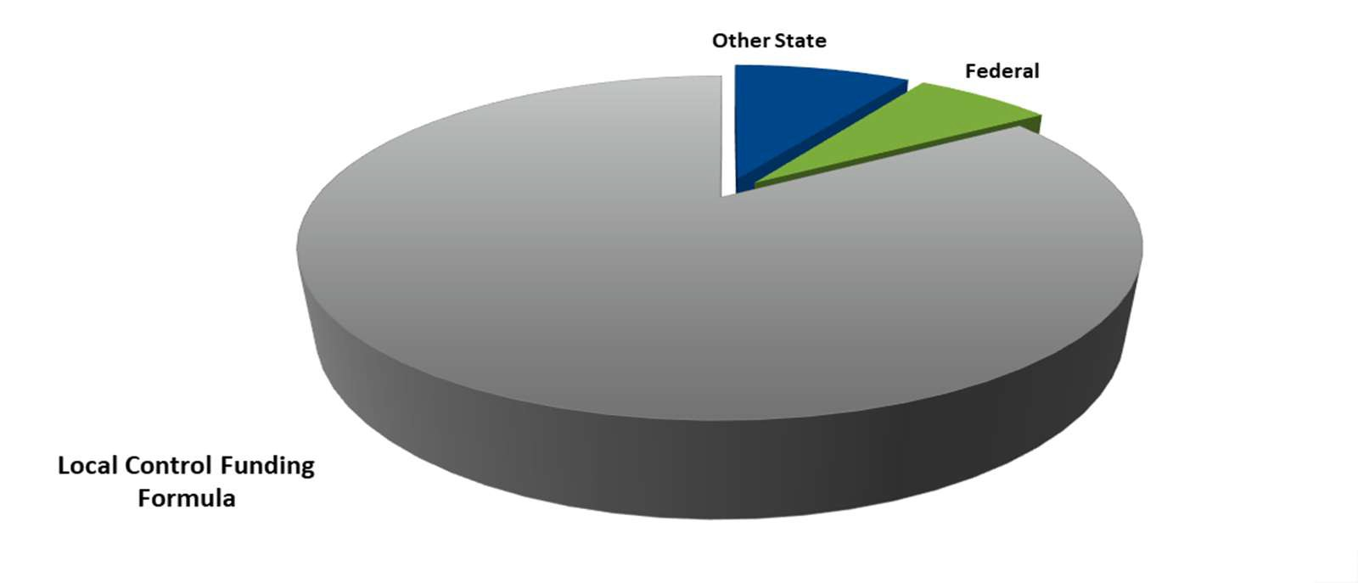
Revenue Sources
86.7%
Local Control Funding Formula (“LCFF”)
8.9%
Other State Revenue
4.4%
Federal Revenue
0.0%
Fundraising and Grants
10

Slide 63
Local Control Funding Formula
Main source of school funding
Provides additional funding for “high need” students
Low Income (or Free/Reduced Price Meal Eligible or Title I)
English Learner
Foster Youth
The “UNDUPLICATED” count of above groups has significant impact
School spending accountable to stakeholders through the Local Control Accountability Plan or “LCAP”

Slide 64
Local Control Funding Formula
Segments of LCFF:
Base Grant + Add-Ons
Grade | Base Grant | Add-On | Total
TK-3 | $ 9,132 | $ 950 | $ 10,082
4-6 | $ 9,270 | $ - | $ 9,270
7-8 | $ 9,544 | $ - | $ 9,544
9-12 | $ 11,061 | $ 288 | $ 11,349
Supplemental
20% Bonus for all Unduplicated Students
Concentration
50% Bonus Unduplicated
Students Over 55%

Slide 65
Other State Revenue
Funding Source | Amount per Student
Special Education (AB602) | $ 820
Lottery | $ 228
Mandate Cost Block | $ 18 - $ 50
Other State Revenue | varies
Other revenue from the State often provides funding for specific purposes and can vary widely based on program participation.
While these funds supplement the core LCFF funding, many have required applications, restrictions on spending, and may vary from year to year.

Slide 66
Federal Revenue
Funding Source | Amount per Student
Special Education | $ 125
Title Funds | varies
ESSER II & III | varies
Federal revenue almost always comes with significant restrictions and non-financial programmatic requirements.
Many of the grants are less predictable in both award amounts and timing of payments.
Federal revenue can be a great supplement but schools should be fully aware of all requirements prior to applying for or accepting funds.

Slide 67
III. FUNDING DETERMINATION

Slide 68
SB740 Spending Requirements
At least 40 percent of total public revenues must be spent on Instructional Certificated Salaries and Benefits, AND
At least 80 percent of total revenues must be spent on Instruction and Instruction-Related Services, AND
The Pupil to Teacher Ratio (PTR) cannot exceed:
25 to 1 or
Equivalent PTR of the largest unified school district in county or counties in which the charter school operates

Slide 69
SB740 Funding Levels
Funding Level | Certificated Salary and Benefits | Instructional Sepnding (incl. cert. salaries and benefits) | Pupil : Teacher Ratio
100% | = or > 40% AND | = or > 80% AND | 25:1
85% | = or > 40% AND | = or > 40% | N/A
70% | = or > 35% AND | = or > 80% | N/A
Zero | < 35% OR | < 60% | N/A

Slide 70
IV. STATE RESTRICTED ONE-TIME GRANTS

Slide 71
Clarksville – State One-Time Grants
▸ Expanded Learning Opportunity (ELO)
▸ A-G Completion Grant
▸ Educator Effectiveness Block Grant (EEBG)
▸ Arts, Music & Instructional Materials Block Grant (new for 22-23)
▸ Learning Recovery Emergency Block Grant (new for 22-23)

Slide 72
Clarksville - ELO
▸ The ELO Grant was provided to give students additional learning programs developing the academic, social, emotional, and physical needs and interests of our pupils.
▸ Despite the establishment of these funds, only 15% of the total funds can and should be used for remote learning. The other 85% must be used for In-Person Instruction.
▸ Most of the NCB schools were provided more than 15% of the funds already; it will be up to our school staff to develop IPI opportunities for our pupils.
20

Slide 73
Clarksville– A-G Completion
▸ The A-G Completion Grants are a follow on to the PGSGP grants, which were to set aside funding to engage students toward the successful completion from High School
▸ The one item that is different vs. PGSGP is that there is a Learning Loss component associated with COVID-19.
▸ LEAs will be responsible for developing plans to help Unduplicated Students achieve success, using the funds for curriculum, salaries, etc…

Slide 74
Clarksville – EEBG
▸ Funding to each school provided based on the number of FTE’s the school has multiplied by about $2,400 per FTE
▸ Eligible for all Certificated and Classified Staff
▸ Offered in addition to any Title II Funding a school may have
▸ Practices and strategies that reengage pupils and lead to accelerated learning.
▸ Can also include Coaching and Mentoring of Staff

Slide 75
Clarksville – Amount Granted
Federal Grants
State Grants
$1,637,628 (est.)
$2,309,494 (est.)

Slide 77
04
BOARD OF DIRECTORS
RESPONSIBILITIES, NORMS, AND ROLES with Bryanna Brossman
Notes:
Bryanna

Slide 78
BOARD RESPONSIBILITIES
Nonprofit board members have two basic responsibilities—support and governance.
The easiest way to stay in compliance with the law is to follow what is commonly referred to as “The 3 D’s.”
The Duty of Care
The Duty of Obedience
The Duty of Loyalty
Notes:
Nonprofit board members have two basic responsibilities—support and governance—each requiring different skills and expertise. In the role of "supporter" board members bring contacts to the organization and act as ambassadors to the community. Equally important, the "governance" role involves protection of the public interest, being a fiduciary, selecting the executive director and assessing his/ her performance, ensuring compliance with legal and tax requirements, and evaluating the School’s work.

Slide 79
Duty of Care
Board member shall:
Perform the duties as a member
Serve on any committee of the board in good faith believes to be in the best interests of the the School and with such care
Reasonable inquiry, as an ordinarily prudent person
Notes:
Bryanna

Slide 80
Duty of Obedience
Board Members have a duty to:
Adhere to the Schools governing documents (articles of incorporation, bylaws and board-established governing policies)
Ensure the School’s purpose is carried out, and to ensure that funds are used for lawful purposes.
Comply with state and federal laws relating to the conducting of the organization’s business.
Notes:
Bryanna Examples include the Internal Revenue Code, tax and financial requirements, state-specific statutes for fairs and/or nonprofit corporations, withholding obligations, and applicable state and federal registration requirements.

Slide 81
Duty of Loyalty
Board Members have a duty of complete, undivided loyalty to the School.
Put the interests of the School first
Avoid using their position or organizational assets in a way that would result in pecuniary or monetary gain for themselves, for any family member, or for other organizations with which the board member is affiliated.
Notes:
Bryanna

Slide 82
BOARD NORMS
Focusing on all students
Adherence to the Brown Act
Demonstrating respect
Creating transparency
Communicating openly
Listening actively
Keeping commitments
Being collaborative
Taking the time needed to govern effectively
Encouraging everyone’s ideas and point of view
Notes:
Board Norms

Slide 83
Governing Board Documents
ARTICLES OF INCORPORATION
BYLAWS
Board Positions at a Glance
President - The board president presides over the meetings, sets goals and objectives with the board and ensures they are met, and serves as the contact for board issues.
A set of formal documents filed with the state of California to legally document the creation of a corporation. The Statement of Information must be updated with the State every other year and whenever the officers change.
Treasurer - The treasurer serves as the President in their absence, manages the Board’s review of and action on its financial responsibilities, and participates in the annual audit.,
Serve as the operating manual for an organization’s board of directors.
Secretary - The secretary is responsible for overseeing note taking during the meetings, sign board approved minutes, and sign any board approved resolutions, memorandoms, and agreements.
Notes:
Make sure that board member receive a copy of both prior to board meeting.

Slide 84
05
BOARD EVALUATION PROCESS with Darcy Belleza
Notes:
Darcy

Slide 85
UPCOMING DATES FOR GB SELF-EVALUATION AND BOARD GOALS
DISCUSSION:
GB SELF-EVALUATION
GB DISCUSSES SELF-EVALUATION
DISCUSS BOARD GOALS AND PROGRESS
DISCUSS BOARD GOALS AND PROGRESS
20
19
25
OCTOBER
JANUARY
MAY
8
9
DECEMBER
MARCH
BOARD APPROVAL OF GB SELF-EVALUATION
DISCUSSION: PROPOSED GB SURVEY FOR PARENTS, STUDENTS AND COMMUNITY PARTNERS
SEND GB EVAL SURVEY TO PARENTS, STUDENTS AND COMMUNITY PARTNERS
BOARDS RECEIVE FEEDBACK AND COMPLETE SELF-EVALUATION FOR MAY GB MEETING
DISCUSS BOARD GOALS AND PROGRESS

Slide 86
06
BOARD GOALS with Darcy Belleza
Notes:
Darcy

Slide 87
22/23 Board Goals Timeline
October: Create board goals
December - March: Track progress towards goals
May: Evaluate outcomes and improvements towards goals
June: Discuss new goals or continued goals for 23/24 school year

Slide 88
Board selects a goal(s) in areas:
Effective Governance and Foundational Documents
Academic Performance Monitoring
Budget and Finance
Board Operations and Relations
Personnel and Staffing

Slide 89
SMART Goals
Specific: Goal should be clear and concise
Measurable: Goals should specify criteria for evaluating accomplishment
Attainable: Goals should be realistic, achievable, challenging and aggressive
Relevant: Goals should be aligned with the schools’ real needs and priorities
Time-Bound: Goals should specify the time frame in which they are to be achieved
Notes:
The annual goal–setting exercise is only as beneficial as the goals are sound and well written. The SMART system is a set of five criteria that boards can use to ensure each goal is clear and actionable. An explanation of each follows: Specific Goals should be clear and precise. Questions to answer: What is the goal? Why does it exist? Who is responsible for achieving it? When is this goal to be met? Which specific tasks are needed to accomplish the outcome? Measurable Goals should specify criteria for evaluating accomplishment. Questions to answer: How much? How many? How you will know it has been accomplished? Attainable Goals should be realistic, achievable, challenging, and aggressive. Relevant Goals should be aligned with the school’s real needs and priorities. Time-Bound Goals should specify the time frame in which they are to be achieved. Question to answer: When? Above all else, remember to keep it simple. Goals are only helpful if they are useable

Slide 90
Personnel and Staffing
Board discusses goals in relation to the main topic
Board creates an action plan for each board member or collective
Board creates an action plan for the School to assist with achieving their goal
Board and School will report out at next GB Meeting of progress of goal
Board Member #1:
Assist in marketing the school to promote more staff hiring and community partners in the more rural counties within the charter
Board Member #2:
Research social media/advertising to increase awareness of school for new employee recruitment and community partners
All Board Members:
Attend school sponsored, community events to make connections to share desire of a more increase of both staff and Community Partners within rural communities
Create a survey/social media posts to gain feedback of families within more rural communities
Board Member #3:
Meet with school staff to discuss current hiring practices and Community Partner outreach
Meet with Family Liaison team to discuss more support for rural areas
By August 2023, the school will broaden the staff and community partners for the 23-24 School Year
Notes:
darcy

Slide 91
22-23 UPDATES
Moratorium on new non-classroom based charter schools continues until January 1, 2025
CA state budget for 22-23 includes the highest level of guaranteed funding for TK-12 education
TK eligibility: for 22-23 children whose 5th birthday is between September 2 and February 2 are eligible

Slide 92
Assembly and State Bill Updates
AB 101: Ethnic Studies
AB 361
SB 1100: Orderly conduct of open meetings
AB 2158: Ethics Training
Ethnic Studies required for graduation. Beginning with the 25-26 school year, charter schools with a high school must offer at least one-semester course in ethnic studies
Amended Brown Act to allow remote board meetings during a proclaimed state of emergency
Amended Brown Act to permit the presiding officer of the board or designee to remove an individual for disrupting a board meeting
Adds LEA GB Members to the list of public officials who are required to receive at least two hours of ethics training every two years
Topics: bribery, conflict of interest, gifts and travel
Notes:
AB 181

Slide 93
Thank you for your time and dedication supporting our school, community and support for school choice!

