Slide 1
~Executive Director Report~
September 2022

Slide 2
Back to School & August PD
Enrollment
Communication
Department & Program Updates
Score Reports
Agenda

Slide 3
Welcome to the 2022-2023 School Year!
August 1- All Staff Returned
August 2- All Staff Meeting
August 9- All Staff Professional Development
Meeting the Needs of Diverse Learners
August 8-12 Team Meetings
August 15- First Day of School

Slide 4
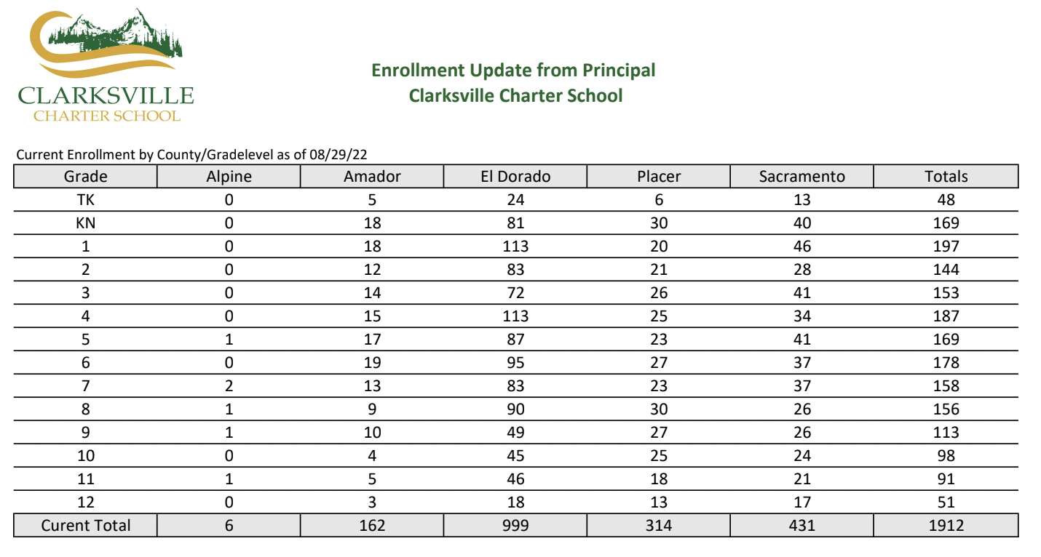
Enrollment Goal Met

Slide 5
Improving Communication

Slide 6
Staying up to date….
Staff Communication
Departments contribute content and then our Assistant Director of Instruction does an amazing job of preparing the weekly bulletin that is emailed out to all staff every Monday at 10am!

Slide 7
A place where staff feedback is received and used for improvement!

Slide 8
Spreading the News…..
Communication to Families
Written by our family liaisons, this weekly newsletter goes out to all families and teachers. Offers advice for homeschool families, lists upcoming events, important dates, resources, instructions, updates, etc… It is a wealth of information!

Slide 9
Our Own Podcast
“RUN to listen!!!! I enjoyed every single episode! I have a 7th and 8yth grader and grandbabies in early elementary. The Learning to Read was SPOT on and wish I would have had the info in my beginning days”
-Annette, Parent

Slide 10
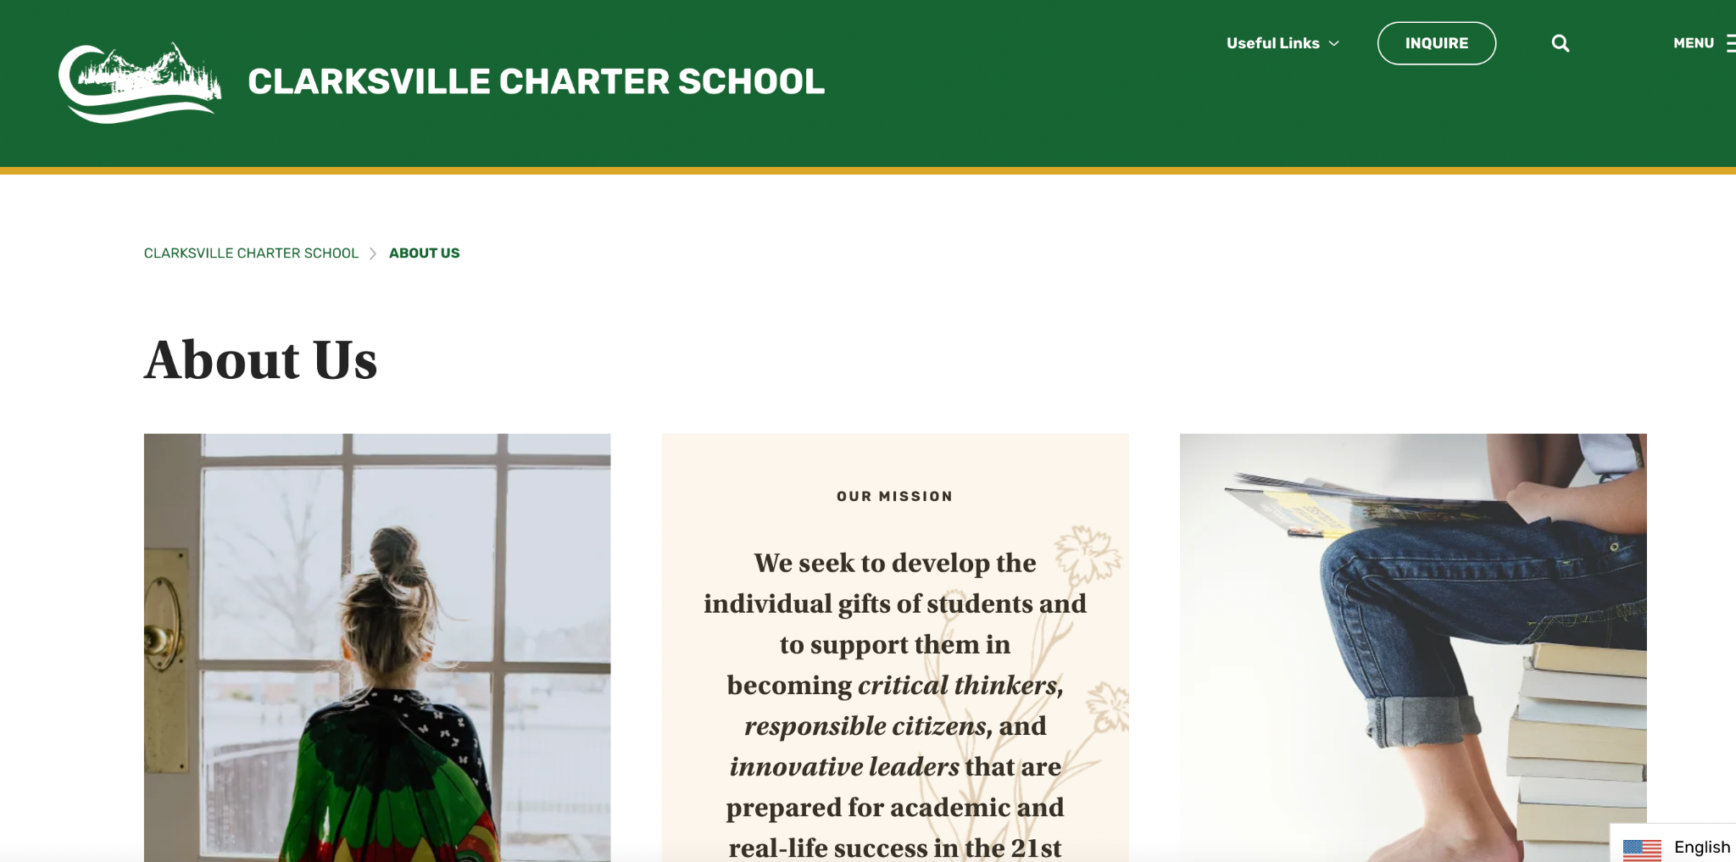
Website Updates
Going through page by page and helping to create more of an experience
Phase 1 & 2
Provide information and resources

Slide 11
Department & Program Updates

Slide 12
Family Liaisons
Here to Help!
A great team!
Orientation Meetings
Homeschool Helper
Social Media

Slide 13
Instructional Materials
Orders
The teams have processed close to 8500 so far this year
Products are about 12 business days out!
Services are being processed for September start dates!
1200 chromebooks that have been distributed!

Slide 14
Special Education & Student Support
SPED Department Updates:
9 new case managers
2 Compliance Coordinators
2 Assessment Program Specialists
2 Teacher Program Specialists
1 additional School Nurse
456 Current Special Education Students
HST sped/student support website has been updated with all new department information and more still coming : )
Student Support Department Updates:
Live Virtual Academic and Social-Emotional Tiered Interventions
83 students in the first cycle
SST’s & 504’s
Student’s in Crisis Team
Acceleration and Retention Requests
New Intervention Teacher

Slide 15
2022-2023 Offerings
Staff Wellness Program
All Access Curriculum
New Curriculum Specialist
EL Classes
Dual Enrollment Program
586 students enrolled in classes!
53 total class offerings
Total Session 1 registrations: 472
Clarksville Registrations: 145
-Staff Book Club
-Sync Up Lessons
-Resources on
Homeschool Helper
-Coffee & Conversations
Session 1 starts September 12!

Slide 17
SGCA
Charter Service Organization
Services Provided by Sequoia Grove
Community Partners (Vendors)
Ordering
Curriculum Services
Library Services
Enrollment
Records
Compliance
Student Information Services
Business Services
Payroll
Medical Benefits
CEO- Royce Gough
Board composition & reporting

Slide 18
Achievement

Slide 19
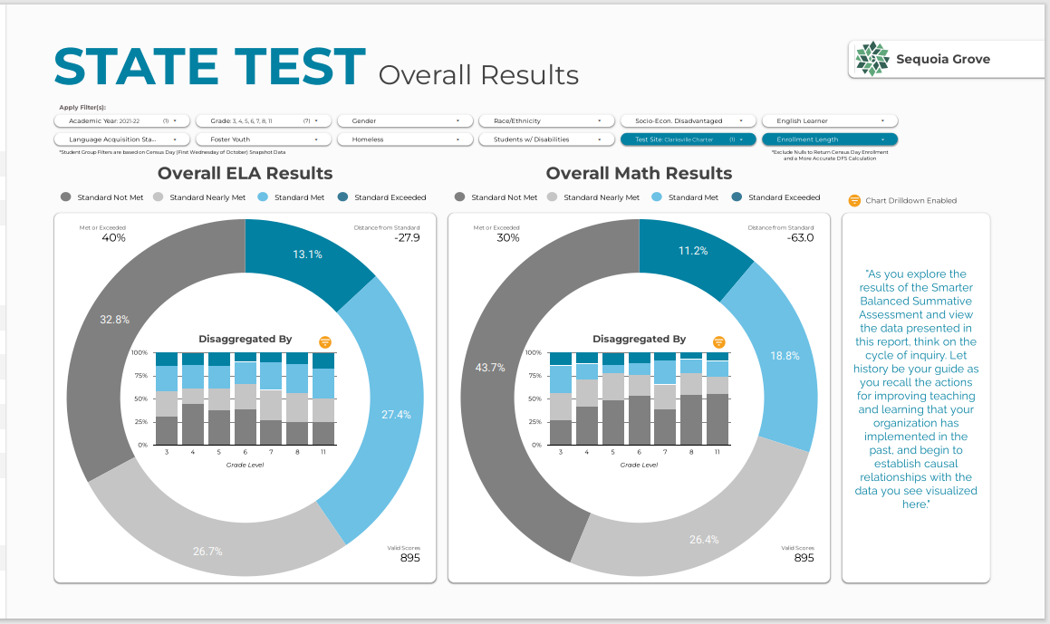
State Test Results - Clarksville
Speaker
Department/ Topic
Clarksville
ELA
Standard Met or Exceeded - 40%
Standard Nearly or Not Met - 60%
Math
Standard Met or Exceeded - 30%
Standard Nearly or Not Met - 70%

Slide 20
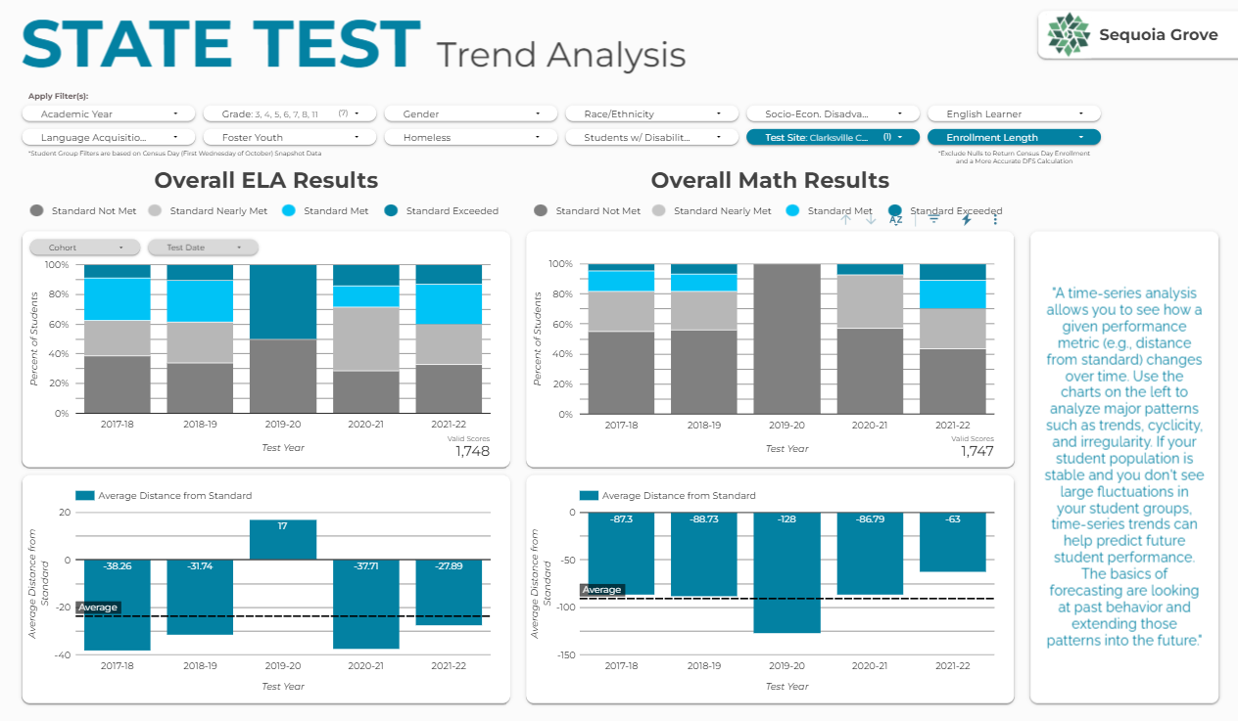
Distance From Standard - Clarksville
Kristie Nicosia
Assessment
The upward trend over time is good news!
This trend is good news!

Slide 21
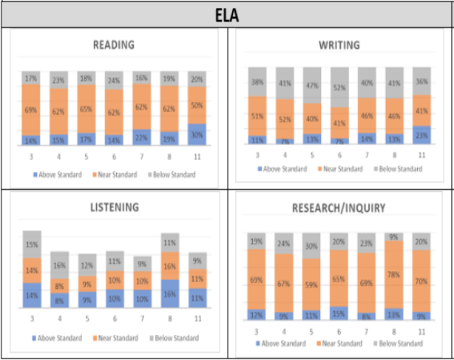
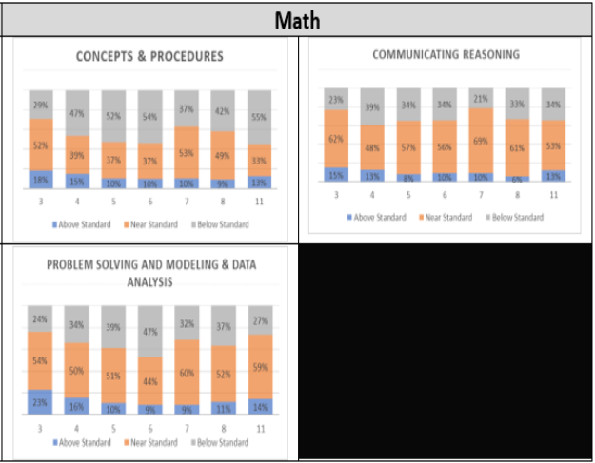
Opportunities for Growth - Clarksville
Kristie Nicosia
Assessment
ELA
Math

Slide 22
Thank You
We appreciate your service to our school. We are looking forward to a great year together!

