Slide 1
LCAP
&
LCFF

Slide 2
What is best for our school?
Notes:
Thank you for your time to learn more about the Local Control Funding Formula referred to LCFF and the Local Control Accountability Plan referred to the LCAP these systems require that Educational Partners have input on plans that are developed and on how state funds are spent in a our schools.

Slide 3
Educational Partners
STUDENTS
PARENTS/ GUARDIANS
COMMUNITY MEMBERS
STAFF
Notes:
Educational Partners include Students, Parents/Guardians, Staff, and Community Members

Slide 4
What is the
Local Control Funding Formula (LCFF)?
Base Grants
Every student generates a base grant which funds basic educational costs, such as: employee salaries, building costs, and instructional materials.
Supplemental Grants
Low income, English learners, and foster youth/homeless, generate more funding above the base grant (20%).
Funding is to increase and improve services for the specified groups above to improve achievement.
Concentration Grants
Districts with more than 55% low income, English learners, or foster youth/homeless receive an additional 50% of the base grant.
Our school does not qualify for concentration grants
Notes:
For the past several years California schools have been funded under a system called the Local Control Funding Formula- LCFF. Local control funds are comprised of 3 types of funds. The Base Grant is tied to how many students attend the school. The other two type of funds are Supplemental and Concentration Grants which are generated by English Learners, Foster Youth, and Low Socioeconomically disadvantaged pupils for funding purposes. These students are often are referred to as unduplicated. This is because if a student is in more than one of these specially funded groups they are only counted once. Schools that have exceptionally high unduplicated population receive the concentration grant. Our school is not eligible for these funds.

Slide 5
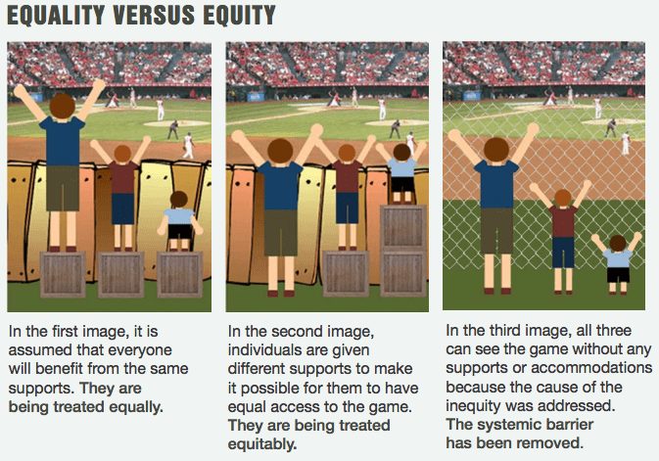
Unduplicated Pupils
FOSTER YOUTH
ENGLISH LEARNERS
lOW SOCIOECONOMICALLY DISADVANTAGED
Notes:
The state looks at Equity vs. Equality and recognizes that each person has different circumstances and allocates the exact resources and opportunities needed to reach an equal outcome. LCFF Funds are primarily focused towards providing the additional resources required for unduplicated students to reach their full potential of academic success.

Slide 6
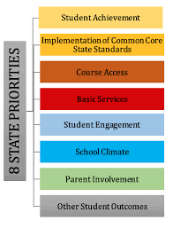
What is the lcap?
3 year plan
Updated annually
Goals
Actions
Notes:
The LCAP is a 3 year year plan for improving student outcome that is aligned with the state priorities California's 8 priorities are shown here. The LCAP must have actions implemented to reach the goals, these actions are supported by Base and supplemental grant funds to meet the needs of all students.

Slide 7
What is best for our schools?
Metrics and Measures
State testing
Attendance Information
Suspension Rates
California Dashboard
Educational Partner Input
Value your Opinion!
LCAP Survey
Advisory Committees
Board Meetings
Notes:
To develop goals and actions of the LCAP schools consider metrics, measures and educational partner input. State testing, attendance information, suspension rates, and California Dashboard help us understand how students are performing academically and how well they are navigating the school environment. Educational Partner input Is used to determine the communities priorities and is also an important consideration in the development of the LCAP. There are many ways for Educational partners to share ideas. Parents and guardians, students, staff members, and community members are asked to complete an annual LCAP survey and attend local board meetings to share their ideas and suggestions. We also encourage our educational partners to serve on school and district advisory committees. Additionally ideas can always be shared with our school administrators.

Slide 8
THANK YOU!
Notes:
We value and appreciate the contributions of our school Educational Partners. The voice of our community combined with our shared commitment to student success will make today's students become tomorrow's leaders.

