Slide 1
Executive Director Report
February 2022

Slide 2
AGENDA
Enrollment
January Professional Development
Testing
Academic Decathlon
Field Trips
Form 700
2022-2023 School Year Planning Timeline

Slide 3
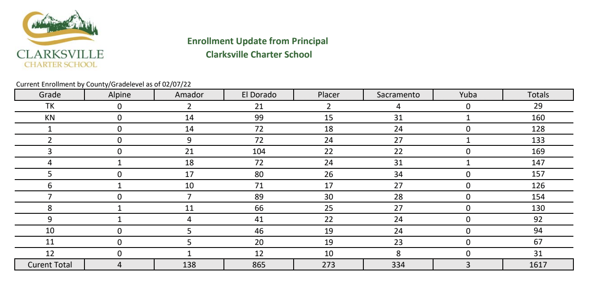
ENROLLMENT

Slide 4
Inspiration with Paula Taylor
Amazing breakout sessions hosted by our staff
Connecting with colleagues
Survey results were very positive
It was a meaningful &
encouraging day

Slide 5
Winter Testing Participation Rates
Star Reading Assessment:
Clarksville: 71%
Feather River: 72%
Lake View: 64%
Winship: 63%
SBAC Math Interim Assessments:
Clarksville: 76%
Feather River: 85%
Lake View: 78%
Winship: 81%

Slide 6
Interim Assessment Methodology
01
02
03
Plan
Assess
Based on Fall Star scores, we identified areas in grades 3-8 and 11 that fell below 50% mastery
We matched those learning targets in the Smarter Balanced system to administer Interim Assessment Blocks
Implement
“The experience of both taking the math interims, and seeing student results has been extremely valuable for my students and their learning coaches. Together we have created plans to address areas for growth and feel confident and successful when they take the CAASPP in the spring.” –Tori Greer, HST
Based on those assessment results, we are working on a data-driven plan for identified areas of growth to increase growth in Math - some teachers already implementing!

Slide 8
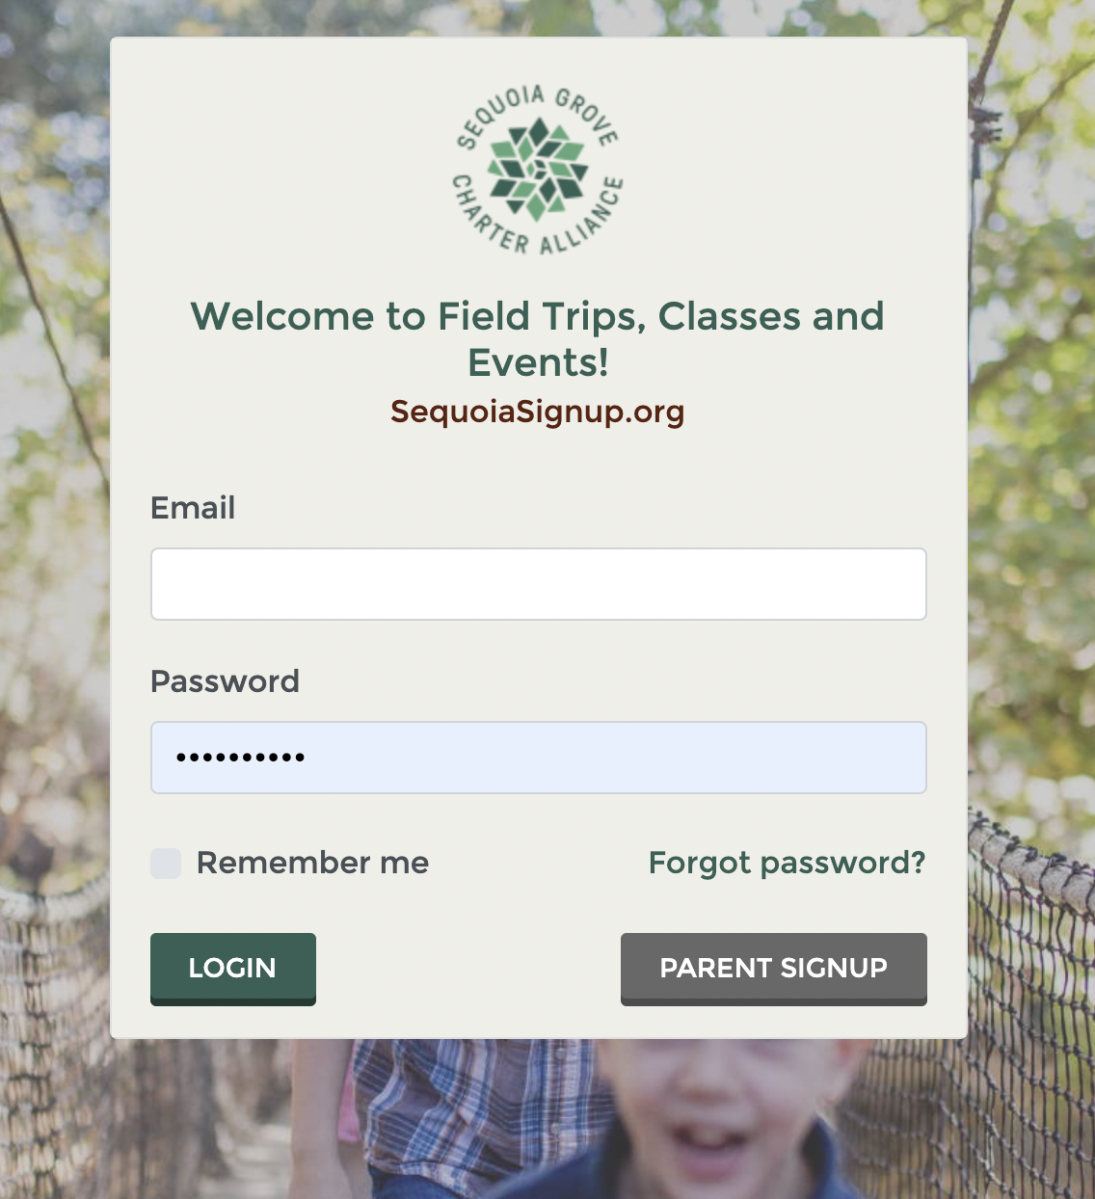
FTCE site is live!
Session offered at PD so teachers could learn how to plan and post field trips
Families can start registering for field trips
Information for parents sent out in Sequoia Scoop

Slide 9
Form 700- Statement of Economic Interest
Every elected official and public employee who makes or
participates in making governmental decisions is required to
submit a Statement of Economic Interests, also known as the
Form 700.
The Form 700 provides transparency and ensures accountability
in governmental decisions on an annual basis. The Form 700
packet will be mailed to each of you with a stamped return
envelope. You need to complete the Form 700 and then place it in
the mail. Please return your signed Form 700 by February 28th.
*Reminder:
Form 700s require a wet signature!

Slide 10
STAFFING & ENROLLMENT TIMELINE FOR 21-22 SCHOOL YEAR
February
Intent to return for staff
22-23 Calendar
March
Staff Hiring
Open Enrollment starts 3/25
April
Open Enrollment ends 4/25
April 6th- ordering cut off
1
3
5
2
4
6
July
Start of new fiscal year
Last week of July- New teacher training
May
New enrollments processed
Returning students Master Agreements signed for 22-23 school year
Last day of school 5/25
June
End of 21-22
School Year
‹#›

Slide 11
Thank You Board!
Your support of our school is appreciated. Thank you for your dedication, sharing your time and talents and having a heart for our homeschool families.

