Slide 1
State of the Schools: Winter 2022
Notes:
A

Slide 2
Notes:
Jenell
Mid year update of where we are and where we are going
We have done this report in the past a the January PD but because there are so many great presenters and opportunities for staff, we thought we would add it to todays staff meeting

Slide 3
Updates from your School Leadership
Vision, Values, History
Sequoia Grove Charter Alliance
Instructional Materials & Community Partners
Library & Tech Services
Enrollment & Sub Group Numbers
Staffing & Organization
Title I, SPED & Student Support
Programs
Family Liaisons
Charter Renewal Dates
Accountability
WASC & Audits
Fiscal Overview
Looking Forward
Notes:
Jenell
Here is what we will be covering

Slide 4
Four schools working together as one
Notes:
A

Slide 5
Our charters seek to develop the individual gifts of students to become critical thinkers, responsible citizens, and innovative leaders prepared for academic and real-life success in the 21st century.
A Shared Vision
Notes:
A

Slide 6
What We Value
Building Relationships
Respecting Staff
Valuing Parents
Choice in Education
The Homeschool Heart
Notes:
A

Slide 7
The four charters were originally part of the Inspire Charter Schools network.
Two years ago, all of the schools became separate non-profits with their own board of directors. Staff either were assigned to schools or worked in a new non-profit to provide services to the schools.
The schools then contracted with “Inspire District Office” to provide a variety of services.
Inspire District Office-Inspire Charter Services- Provenance- Think Suite
That organization went out of business June 30, 2021. A group of employees formed The Axia Group to serve 2 former schools in Central.
Four of the schools in the North formed our own Charter Alliance to share resources and move forward with a unified identity. Sequoia Grove Charter Alliance.
A Quick History
How we got here
Notes:
Jenell
Explain school boards a bit

Slide 8
Sequoia Grove Charter Alliance
Charter Service Organization
Four schools are members
First year of existence, still learning and growing
Created by the schools, for the schools
Opened two new offices
Hired & trained all new staff
Created many new processes
Transitioned tech
Meet weekly to discuss schools needs
Notes:
Jenell

Slide 9
Charter Service Organization
Business Services
Accounts Payable
Human Resources
Payroll
Benefits
Community Partner Services
Compliance
Curriculum Support
Enrollment
Library Services
Ordering
Records
Student Information Services
Tech Services
Notes:
A- thank you to all of the CSO staff for the hard work launching a new organization

Slide 10
Charter Tech Services
Contracted with Sequoia Grove to provide tech services to the schools
Manage tech store and shipping of tech to students
Assist with staff and student tech problems
Manage all accounts such as Zoom, Hello Sign, etc…
Manage all testing devices
Helped with the transition from the Inspire domains to a new domain
Notes:
A

Slide 11
Instructional Materials Update
Community Partners Update
Total number of orders processed to date
30,000+
Total number of community partners added
909
Notes:
Jenell

Slide 12
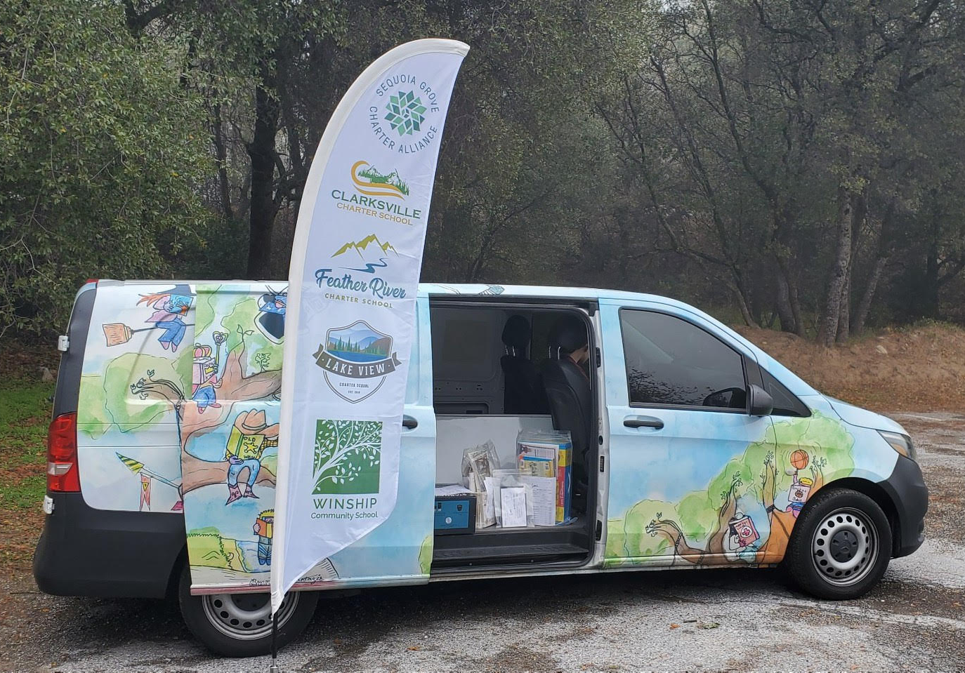
Library Update
Titles currently in circulation available for check out:
16,725
hundreds added each week
E-books:
200
Items currently checked out:
1573
New locations added for a total of 14 mobile library sites across all of our counties
Clarksville Resource Center is open and ready to go for use by Clarksville families
Notes:
Jenell

Slide 13
Since July 1, the Ordering Team, Community Partners, and Library Services:
have implemented new software systems
created new policies
have new workflows
trained new staff in an extremely short amount of time
We are incredibly proud of the instructional materials teams and the teachers, working together to make sure we're able to support our families in the way they deserve
We've been able to make changes to processes that were different from the way things had always been done which was a challenging transition, but ultimately it has resulted in faster turnaround times for orders and community partner onboarding while still allowing us to maintain a high level of care and service for everyone involved.
Notes:
A

Slide 14
Growth of Our Schools
School | Enrollment January 2021 | Enrollment January 2022 | Increase in Students
Clarksville | 1172 | 1585 | 413 students
Feather River | 1088 | 1840 | 752 students
Lake View | 465 | 645 | 180 students
Winship | 110 | 302 | 192 students
Total Increase of Students between the 4 Schools from 20-21 to 21-22:
1537
Notes:
Jenell
Started discussion of growth goals for next year but we do not anticipate the kind of growth we had this year
Steady and sustainable growth
You can always find a monthly enrollment report by school broken down by grades and counties in the ED report in the board packets

Slide 15
Current Sub Groups Numbers
 | High School | English Learners | Special Ed. | Homeless/ Foster Youth
Feather River Charter School | 21% (380) | 6% (114) | 10% (189) | 1.2% (23)
Clarksville Charter School | 18% (282) | 1.8% (30) | 9.6% (162) | 1.5% (26)
Winship Community School | 0 | 11.4% (34) | 5.7% (17) | 1.3% (4)
Lake View Charter School | 12% (74) | 0.6% (4) | 7.9% (53) | 1.3% (9)
Totals | 736 | 182 | 421 | 62
Notes:
A

Slide 16
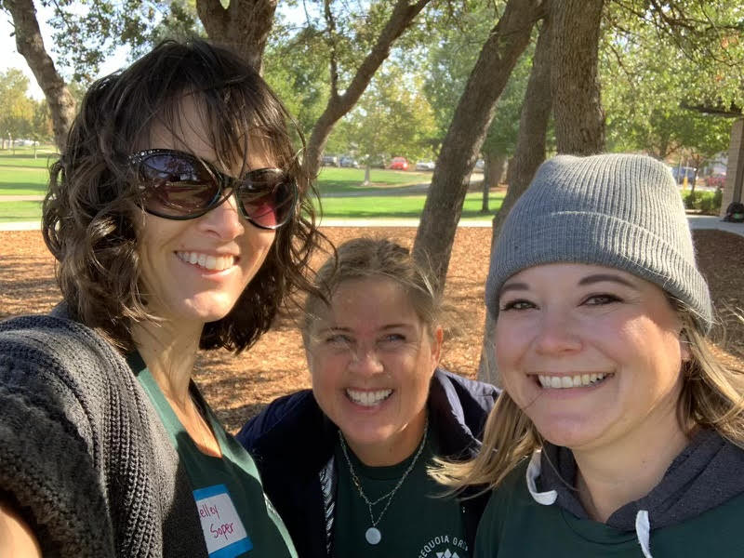
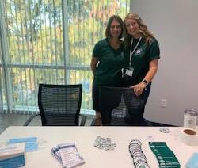
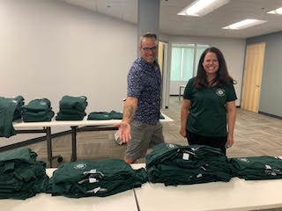
We have the BEST Staff!!!
Staffing
School | Staff Members
Feather River | 97
Clarksville | 87
Lake View | 39
Winship | 17
Total Schools | 240
CSO | 37
Total | 277
Schools have a Memorandum of Understanding in place to allow for staff sharing between the schools
Notes:
Jenell

Slide 17
Organizational
Structure
Going into this year, there was a whole new Organizational Chart with a restructure of most departments
Many new positions were added, new staff hired and returning staff stepping into new roles
A heartfelt thank you to all of our staff for being flexible, understanding and keeping a positive attitude through all of the changes with the schools and adding the CSO.
There are not plans to do any major overhauls in structure or staffing for next year. Yay!
We will continue to refine where needs are and where we can improve our services and plan how we can fill those with existing or new staff.
We are entering the time for Planning forms for our existing employees and planning for 22-23 hiring.
Notes:
A

Slide 18
Title One Programs
Addition of Title 1 Specialist to strongly support our most at-risk students, including
Foster/Homeless Youth
ELD students
Any student at risk of failing out of school due to circumstances beyond their control
Ramping up processes for more robust support and monitoring of these students
Notes:
A

Slide 19
SPED & Student Support
Big transition this year with the school split. Both departments were restructured.
Many new staff members to our schools
Megan and Jamie are doing an amazing job focusing on the specific needs of our students and planning processes and programs to meet those needs
Notes:
Jenell

Slide 20
Special Education
2021 Recap
440 Students served in our Special Education Programs
this number changes daily
393 students served virtually, 24 served in person
68 completed sped assessments
22- 504 Assessments completed and/or in process
WELCOME 2022!
Current Numbers
Currently serving 455 students and counting
33 pending Initial IEP students
97 Current Assessments due within 60 days
Notes:
J

Slide 21
Student Support
2021 Recap
130+ students served with reading, writing, and math live interventions. Sign ups have almost doubled each cycle!
40+ students served with SEL/Counseling sessions
53 SST Meetings and 43 504 Meetings held
WELCOME 2022!
Cycle 3 of live interventions is underway with 109 students currently signed up.
Cycle 4: Sign ups currently happening. 100+ seats filled, but we still have some room in Tier 1 live interventions and some Tier 2 live interventions
Notes:
J

Slide 22
All-Access Subscriptions
Reading Eggs
Grammarly (3-12)
Tutor Me (9-12)
TTRS (TK-5*)
Gizmo (9-12):
Nearpod
Moby Max (TK-8)
Freckle Math (all)
Accelerated Reader (all)
Brain Pop
Notes:
A- survey out to collect feedback

Slide 23
New Programs Started
Highlighting Diversity
Lifting marginalized voices
Providing diverse perspectives
Celebrating various cultures and history
Creating spaces for understanding and inclusion
Inviting staff and families into action steps for growth
Sequoia Grove California Cadet Corps unit, 434th Battalion, activated in August 2021
16 cadets in the program, most have already earned promotions
3 new CTE Pathways in HSVA and 3 through SCOE
14 NHS Members 10th-12th Grade
21 NJHS Member 7th-9th Grade
Notes:
Jenell
Ronni, Sara Infante & Danielle Baumunk
Elizabeth Platt
Shannon, Linda & Reece

Slide 24
High School Growth
* New Course Outlines
* A focus on Career Training with Reece offering resources and career chats
* New Dual Enrollment program with 4 classes in the fall, with 88 students taking an
average of 2 classes each.
* Concurrent Enrollment: Total college courses taken in the fall (DE + CE) = 438
Total students taking a college course this fall = 143
High School Goals
* Working with the College Board to offer AP, PSAT and SAT tests in the coming year.
* Planning for a live graduation ceremony 5/31/22 at Memorial Auditorium
* Coming soon: new College Opportunity program
Notes:
A

Slide 25
High School Virtual Academy
Average # of Classes per Student: 2.6
Number of Unique Classes: 50
Unique Students Enrolled Per School
Total Classes Ordered By School
School | Students
Clarksville | 100
Feather River | 178
Lake View | 19
Monarch River | 87
Winship | 1
Yosemite Valley | 210
Total | 595
School | Classes
Clarksville | 212
Feather River | 455
Lake View | 30
Monarch River | 253
Winship | 1
Yosemite Valley | 598
Total | 1549
Year 2 of HSVA Program
Notes:
Jenell

Slide 26
Junior High Virtual Academy
Fall 2021
Enrollment | 324
Unique Students | 153
Classes | 14
Average Class Size | 23
Spring 2022
Enrollment | 285
Unique Students | 142
Classes | 13
Average Class Size | 22
Year 2 of JHVA Program
Notes:
A

Slide 27
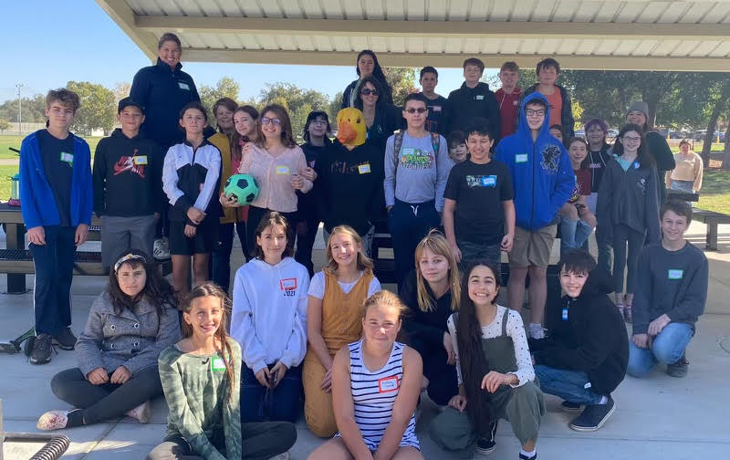
January & February Offerings
Teen Events
El Dorado Teen Bowling, 1/13
Virtual Art Club, 1/18
Cool Hiking Club, 1/21
Virtual Art Club, 1/25
Auburn Hiking Club, 1/28
Virtual Art Club, 2/1
Cameron Park Teen Skatepark Meet Up, 2/2
Broadway Anastasia, 2/3
Cool Hiking Club, 2/4
Virtual Art Club, 2/8
Snowshoe Field Trip, 2/8
Skatetown Field Trip, 2/9
Chico Teen Game Day, 2/10
Roseville Teen Park Meet Up, 2/14
Ukiah Hiking Club, 2/16
Notes:
Jenell

Slide 28
Adventure Academy
Session 1
Enrollment | 105
Unique Students | 88
Classes | 6
Session 2
Enrollment | 305
Unique Students | 234
Classes | 18
Session 3
Enrollment | 215
Unique Students | 178
Classes | 14
Year 1 of Adventure Academies
Notes:
A

Slide 29
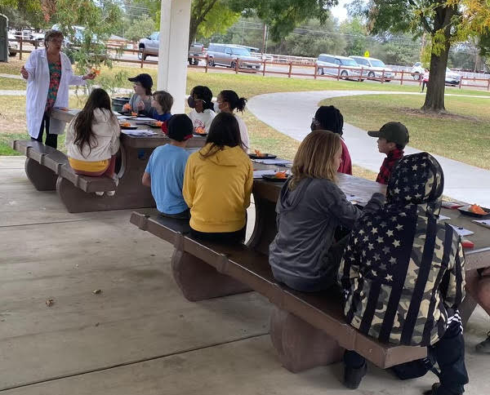
Clubs
Session 1 Info:
Number of Clubs Offered - 5
Number of Students who attended a Club in Session 1: 170 students
Number of Clubs offered at specific Grade Levels:
Session 2 Info:
Number of Clubs Offered - 13
Number of Students who attended a Club in Session 2: 211 students
Number of Clubs offered at specific Grade Levels:
Grade | Tk/K | 1at | 2nd | 3rd | 4th | 5th | 6th | 7th | 8th | 9-12th
# of Clubs | 2 | 2 | 2 | 3 | 5 | 5 | 5 | 4 | 4 | 1
Grade | Tk/K | 1at | 2nd | 3rd | 4th | 5th | 6th | 7th | 8th | 9-12th
# of Clubs | 6 | 7 | 7 | 7 | 10 | 10 | 11 | 11 | 11 | 4
Notes:
Jenell

Slide 30
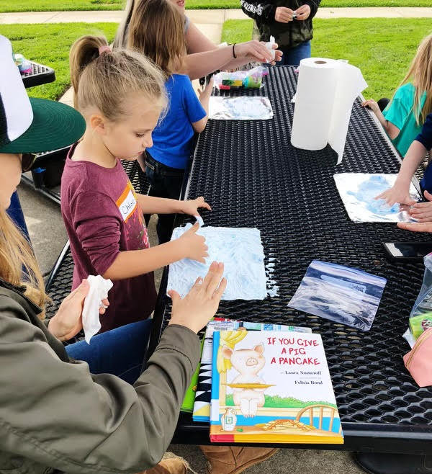
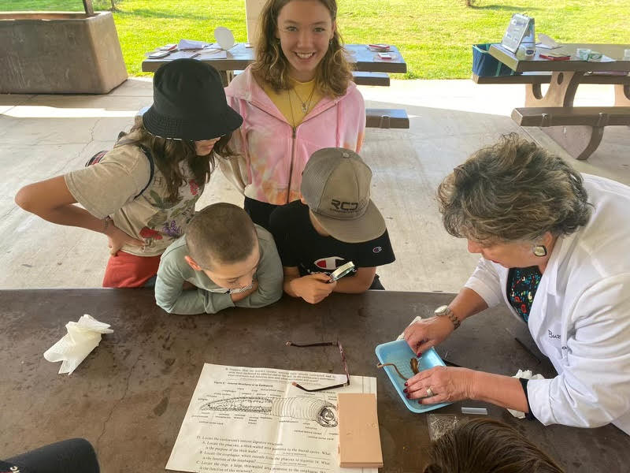
Clubs
Session 3 Info: Number of Clubs Offered - 14
Number of Students who attended a Club in Session 3: 246 students
Number of Clubs offered at specific Grade Levels:
Session 4 Info:
Number of Clubs Offered Session 4 - 9
Number of Students who attended a Club in Session 4- Starts Jan. 17th (No info available yet) Number of Clubs offered at specific Grade Levels:
Grade | Tk/K | 1at | 2nd | 3rd | 4th | 5th | 6th | 7th | 8th | 9-12th
# of Clubs | 7 | 7 | 8 | 5 | 6 | 7 | 9 | 9 | 9 | 4
Grade | Tk/K | 1at | 2nd | 3rd | 4th | 5th | 6th | 7th | 8th | 9-12th
# of Clubs | 5 | 6 | 6 | 6 | 5 | 5 | 4 | 4 | 4 | 4
Notes:
Jenell

Slide 31
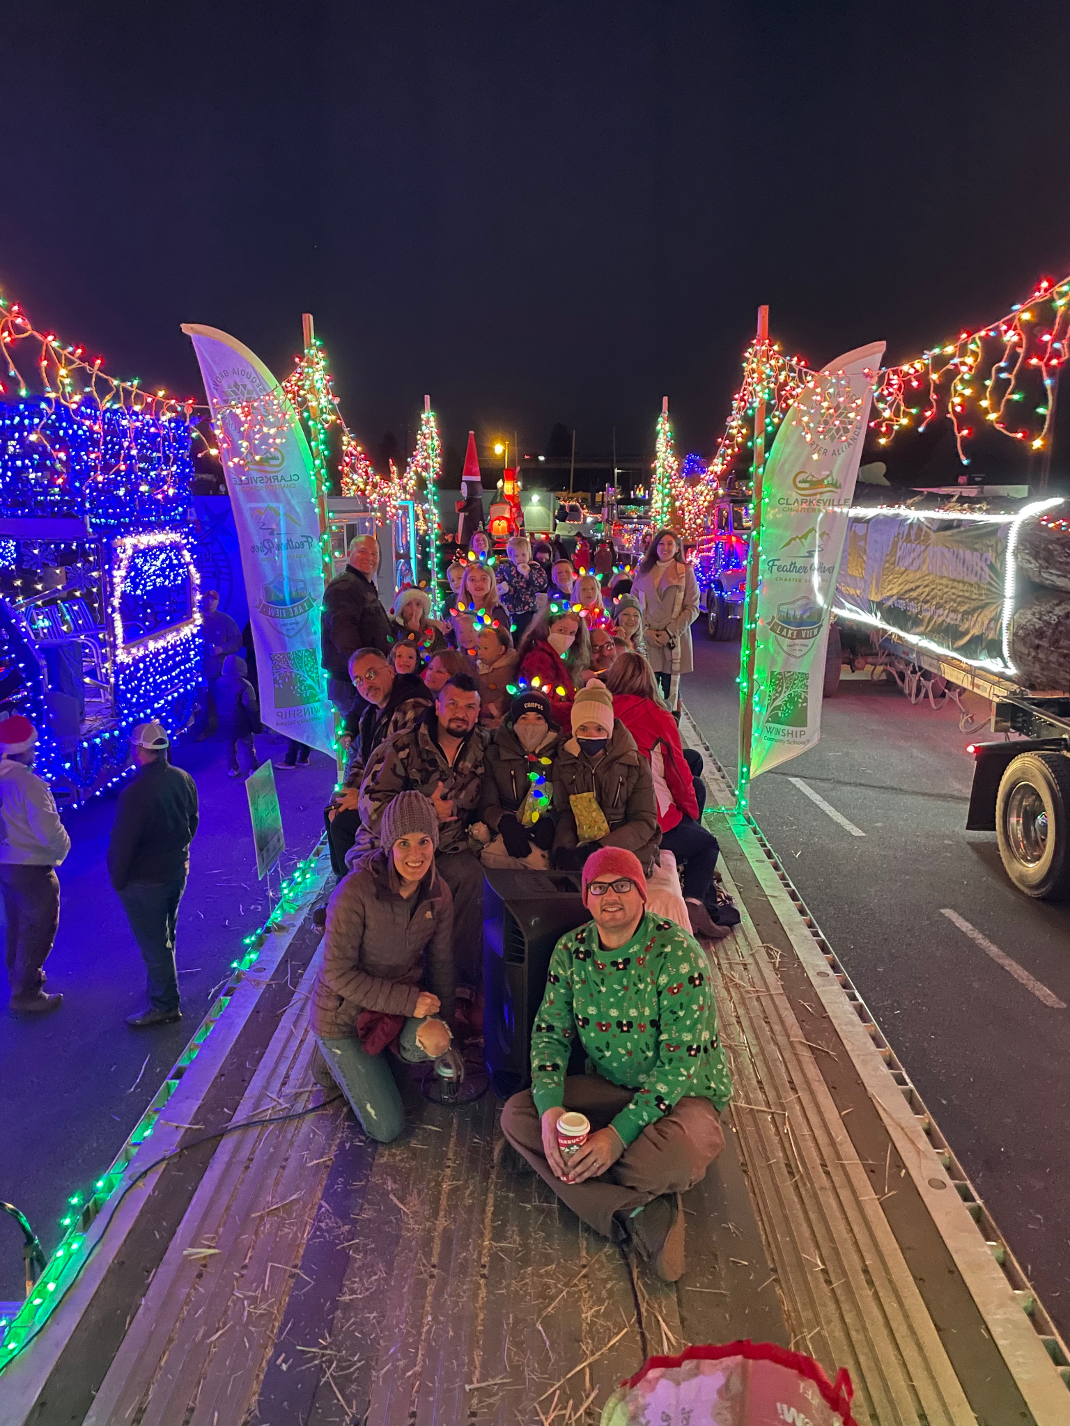
Family Liaisons
From one to a team!
Liaisons in different regions to best serve our families
Rebecca-Amador
Morgan- Elk Grove
Cassie- Mendocino
Heather- Orangevale
Rosemary- El Dorado
Beka- Butte Co
Offered 30+ park days separate from Adventure Academy or Clubs
Support and share with current families and families interested in homeschooling
Manage social media & family communication (Sequoia Scoop)
Provide Parent Education Opportunities & Field Trips
Notes:
Jenell

Slide 32
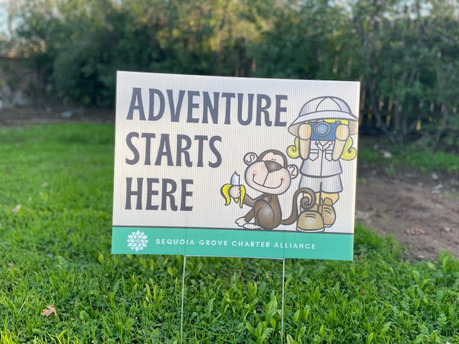
Feather Flags, Yard Signs, Pop up tents, PPE supplies all available for staff to use for park days and events
Notes:
Jenell

Slide 33
Charter Renewal Dates
Lake View - June 30, 2024
Clarksville - June 30, 2025
Feather River & Winship - June 30 , 2026
Notes:
A

Slide 34
LCAP Goals
Goal 1
Goal 2
Goal 3
Continue to develop plans and utilize data to strengthen student achievement for all students (general education, foster youth, homeless, English learners, and students with disabilities).
Promote a safe, healthy and engaged learning environment for all.
Increase the number of students who are High School, College, Career and life ready.
Participation in all internal and state required tests is crucial to the addressing of our goals, as reflected on our state dashboards, and for accountability as required by our charter authorizers. We need your help to encourage families to participate!
Notes:
A

Slide 35
WASC Updates
Lake View Self-Study
Spring 2022
Feather River Mid-Cycle Review
Spring 2022
Notes:
Jenell

Slide 36
FCMAT Update
All initial requested documents were submitted last Fall by all schools and Inspire.
This Fall we have submitted all additional financial documents requested for both schools.
Currently we are submitting attendance, work samples and master agreements for a random pull of students.
FCMAT audit process could take another year or two.
Feather River
&
Clarksville
Notes:
Jenell

Slide 37
Annual Audits
Each year our schools participate in an annual external audit with an audit firm selected by the school boards
Audits evaluate both fiscal and compliance aspects of our schools
2020-21 Audits are complete and will be presented at February Board Meetings
The auditors submit a list of random students in each school and we are required to provide the following for each of them:
Master Agreements & Addendums
Work Records
Proof of Residency
Proper Credentialing of Teacher is reviewed as well
Often changes that are made in practices and procedures are the result of auditor recommendations
Having clean audits with no findings is always the goal!
Notes:
A- top
Jenell- The auditors
Critical to keep information and stay on top of paperwork, even for kids who were there for a short time/1 LP

Slide 38
Fiscal Overview
Sequoia Grove team handles payroll, accounts payable, human resources, benefits
Charter Impact is the back office company that helps with our budgets and processes payroll and bills
Dr. Johnson is the Chief Fiscal Officer for the schools this year and she oversees:
State and Federal Funding- many new funding streams this year to keep track of
Cash Flow management
Fiscal Reporting
Budget development with Executive Directors
She has also helped develop many processes in our transition:
Interviewing & Hiring Process
Onboarding Process
MOU Tracking & Billing
Purchase Requests
Invoice Coding
Billing between schools
Notes:
A
By bringing a lot of this in house, we have a lot more oversight and ability to see what exactly is going on, have constant access to all of the information which is much more healthy for our schools

Slide 39
Looking Forward
Notes:
Jenell

Slide 40
Making our schools the best that they can be….
Focus on building relationships within our staff
Continue collaboration with CSO to meet the needs of the schools
Evaluate and strengthen departments, programs, practices and systems
Identify & hire needed positions
Budget wisely & keep schools financially sound
Long term strategic planning
Improve student achievement and our Dashboards
Increase awareness and support for mental health and self-care
Improve web presence and tools
Stay focused on students and the heart of homeschooling
Notes:
A 1-5
Jenell 6-10

Slide 41
Thank you for growing with us!

