Slide 1
Regular Board Meeting
September 15, 2021
Clarksville Charter School

Slide 2
01
BACK TO SCHOOL
02
NEW PROGRAMS
TODAY’S AGENDA
03
ASSESSMENT UPDATE
04
ENROLLMENT UPDATE
05
ORDERING UPDATE
06
COVID-19 UPDATE
Growing Together
High School, CTE, AVA, Cadet Corps
With Kristie Nicosia
View the latest numbers
Ordering Stats for our school
Regarding Governor’s Measure

Slide 3
GROWING TOGETHER!
We welcomed students back on Monday, August 16th.
It’s going to be a beautiful year!

Slide 4
NEW ACADEMIC & ENRICHMENT PROGRAMS FOR 2021-22

Slide 5
ADVENTURE ACADEMY
Academic enrichment program that supports & supplements core content instruction for students in TK-8th Grades.
AVA classes will not replace a student’s core curriculum, but instead will add educational adventure to their learning plan
4 week sessions starting September 13
HSTs can teach in our 4-week sessions for a stipend
There will be virtual and in person options
Notes:
ED

Slide 6
SYNC UP & DIL
Launched Instructional Opportunities for all students with their teacher of record
Instructional Admin provided open and go lessons for all HSTs
Launched a daily opportunity for all 4th-8th graders via Zoom to learn about technology began August 16th
Notes:
ED: Leah Palmer, is leading a 20-minute zoom from 2:00 - 2:20pm Monday-Friday for all 4-8th grade students. The topics span graphic arts, digital animation, print design, color theory, online digital posters, and graphic design. Students Feel free to join as they are able -- no sign-ups needed. HSTs each make their own schedule and share it with their roster.

Slide 7
CA CADET CORPS
Leadership opportunity open to all 7th-12 grade students.
The Mission of the CACC is to provide students with a quality educational & leadership development program that prepares students for success in college or the workforce.
Reach out to Elizabeth Platt for more Info
Notes:
ED

Slide 8
HIGH SCHOOL PROGRAMS
With Shannon Breckenridge

Slide 9
HIGH SCHOOL SPECIAL ENROLLMENT
With Shannon Breckenridge
CONCURRENT
DUAL
Choice of colleges
Wider variety of courses
CTE opportunities
Family manages enrollment and transcripts
In courses mixed with college students
Offered in our partnership with Yuba College
Pre-selected courses, college GE focus
Limited to homeschooling high schoolers
Supportive professors hand-picked to work with high school students.
Notes:
Shannon Presents

Slide 10
CAREER TECHNOLOGY EDUCATION
Open to 7-12th graders
Enriched by CCGI + Earn & Learn Partners
3 Ways to CTE:
HSVA
Edmentum and Edynamic Learning
Community College
CTE events will be shared out in the Sequoia Scoop on Tuesdays
Notes:
Shannon Presents

Slide 11
ASSESSMENT UPDATE
With Kristie Nicosia

Slide 12
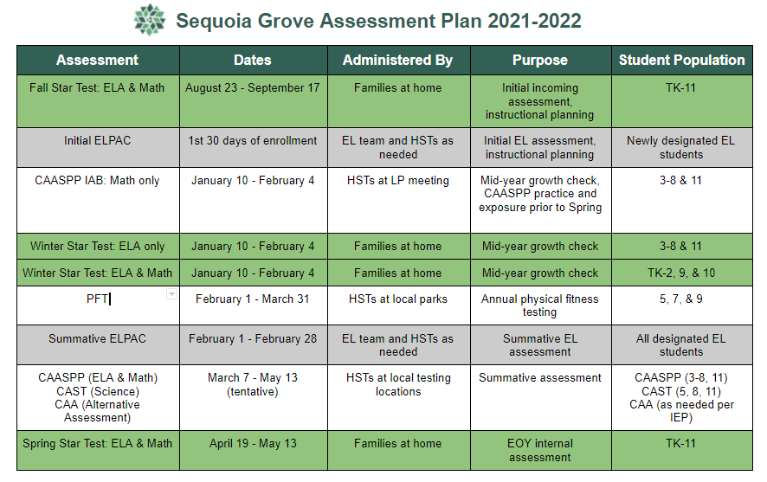

Slide 13
Fall STAR Testing Participation
School | Reading | Math
Clarksville | 52% | 59%
Feather River | 49% | 57%
Lake View | 46% | 59%
Winship | 44% | 54%
The Fall Star testing window closes Friday, September 17, 2021.
Notes:
Shannon Presents

Slide 14
ENROLLMENT UPDATE
CURRENT
IN-PROCESS
OPENINGS
WAITLIST
1520
40
75
5
93% OF A GOAL OF 1655

Slide 15
ORDERING UPDATE
With Stephanie Terrell

Slide 16
ORDERING UPDATE
8958
5482
3476
Orders Placed
Orders Processed
Orders in the Queue
Totals across Sequoia Grove Schools ~ 2 1/2 weeks out
Notes:
Steph: (Numbers are total across 4 schools) Processing Average of 400 orders per day across the 4 schools. Orders are processed in batches by vendor to expedite the processing time.

Slide 17
COMMUNITY PARTNER
ONBOARDING
Returning vendors were reactivated with a 30-day grace period
New vendor Applications sent beginning 9/1
In-process of auditing and deactivating vendors who have not responded to the 30 day grace period
Notes:
ED

Slide 18
COVID-19 Updates
For any staff member who has not demonstrated verification of COVID-19 Vaccination*:
Weekly Testing: Any staff meeting in-person at least once a week with another staff member or family
Intermittent Testing: Any staff member meeting in-person intermittently must test negative within 72 hours before meeting
COVID Tests will be provided for staff by the school
*Plan is vetted through Legal Council
Notes:
ED

Slide 19
THANK YOU!

