Slide 1
CLARKSVILLE CHARTER SCHOOL
High School CCI
LCAP Expanded Learning Opportunities (ELO) Grant
April 29, 2021

Slide 2
HIGH SCHOOL
Shannon Breckenridge

Slide 3
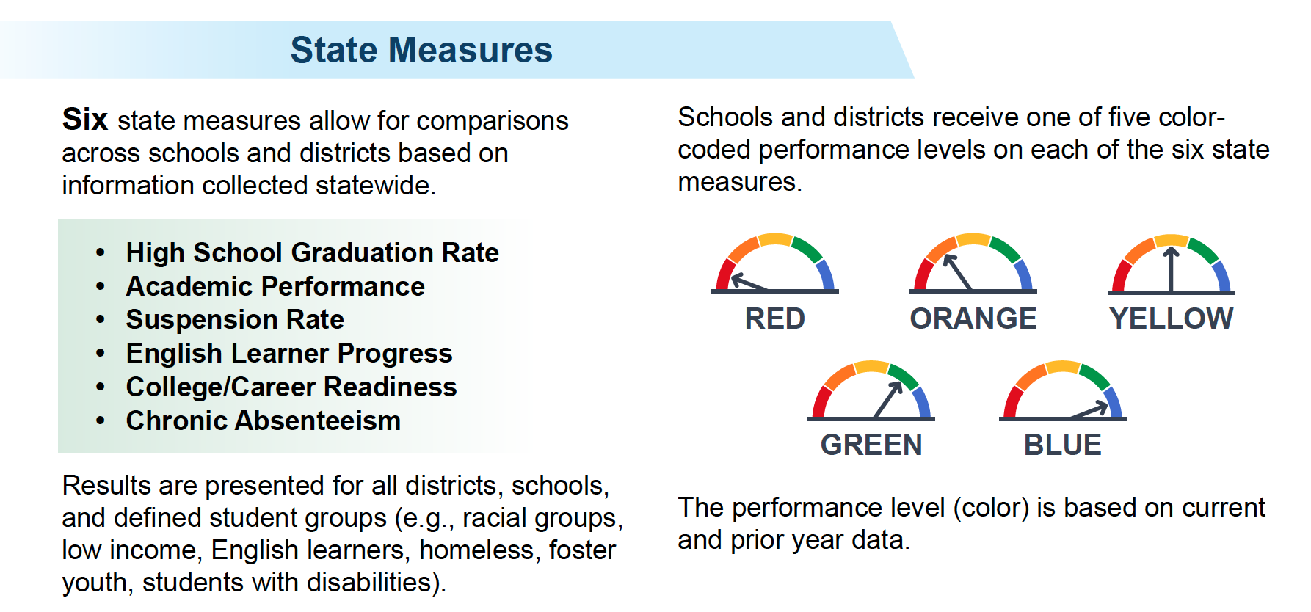
CCI Indicator
Goal: Improve the percentage of our students who are deemed “Prepared.”
Notes:
As one of the six state metrics for determining the health of our school, we constantly seek to improve the percentage of our students who are considered “Prepared”

Slide 4
Where Are We Now?
Clarksville Charter School CCI Indicator | Prepared | Approaching Prepared | Not Prepared
2020 (cohort of 56) | 12.5% | 21.4% | 66.1%
2019 (cohort of 28) | 35.7% | 17.9% | 46.4%
2018 (cohort of 19) | 5.3% | 47.4% | 47.4%
These are the current numbers that we will work on improving.

Slide 5
How Is It Judged?

Slide 6
Here’s What We’re Doing...

Slide 7
21-22 School Year...NEXT Steps
Update the IGP process to include CCI
Free 9th - 12th counselor advisory courses
Continued training & communication

Slide 8
Opportunities for Growth
Certificate of
Biliteracy
CTE & Internships
Military & Leadership
College Courses
AP
Expand HSVA classes with credentialed CTE teachers & Internships for capstone courses.
Gain authorization with College Board to offer AP testing.
Add AG World Languages I-IV to our catalog.
Offer HSVA courses in these areas to meet the 2-year requirement.
Continue with concurrent enrollment and develop dual enrollment opportunities.

Slide 9
STAKEHOLDER ENGAGEMENT

Slide 10
Parent Feedback
How concerned are you about your child’s mental well-being?
Is the school effective in strengthening and promoting academic achievement of all students?
How effective is the school in providing a safe, healthy, and engaged learning environment for all students?
Is the school effective in providing information on how to help your child plan for college and career after high school?
Notes:
Examples of Questions on LCAP for Family Feedback

Slide 11
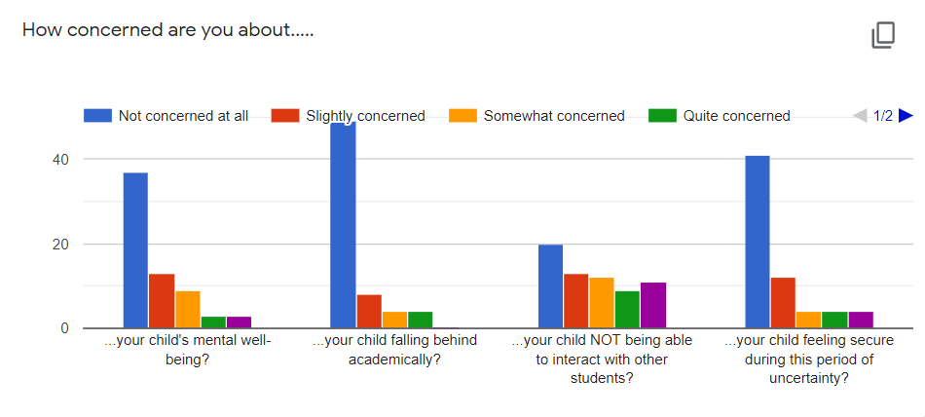
These are some concerns parents may have raised about their children as a result of the novel Coronavirus (COVID-19).
Notes:
Examples of parent feedback….
How concerned are you about:
Your child’s mental well-being?
Your child falling behind academically?
Your child NOT being able to interact with other students?
Your child feeling secure during this period of uncertainty?

Slide 12
Student Feedback: Grades 4th- 12th
I feel safe and connected to my school.
My school provides me with the materials I need to learn such as textbooks and learning materials to meet my educational needs.
My school works with my parent/guardian to help me do my best in school.

Slide 13
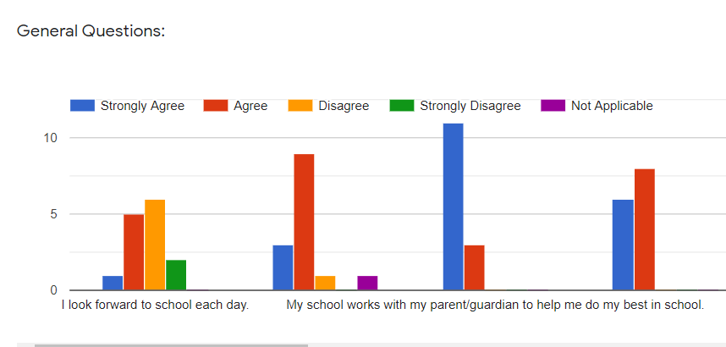
Student Feedback
Grades 4th-12th
Notes:
I look forward to school each day.
I feel safe and connected to school.
My school works with my parent/guardian to help me do my best in school.
My school provides me with the materials I need to learn such as textbooks and learning materials to meet my educational needs

Slide 14
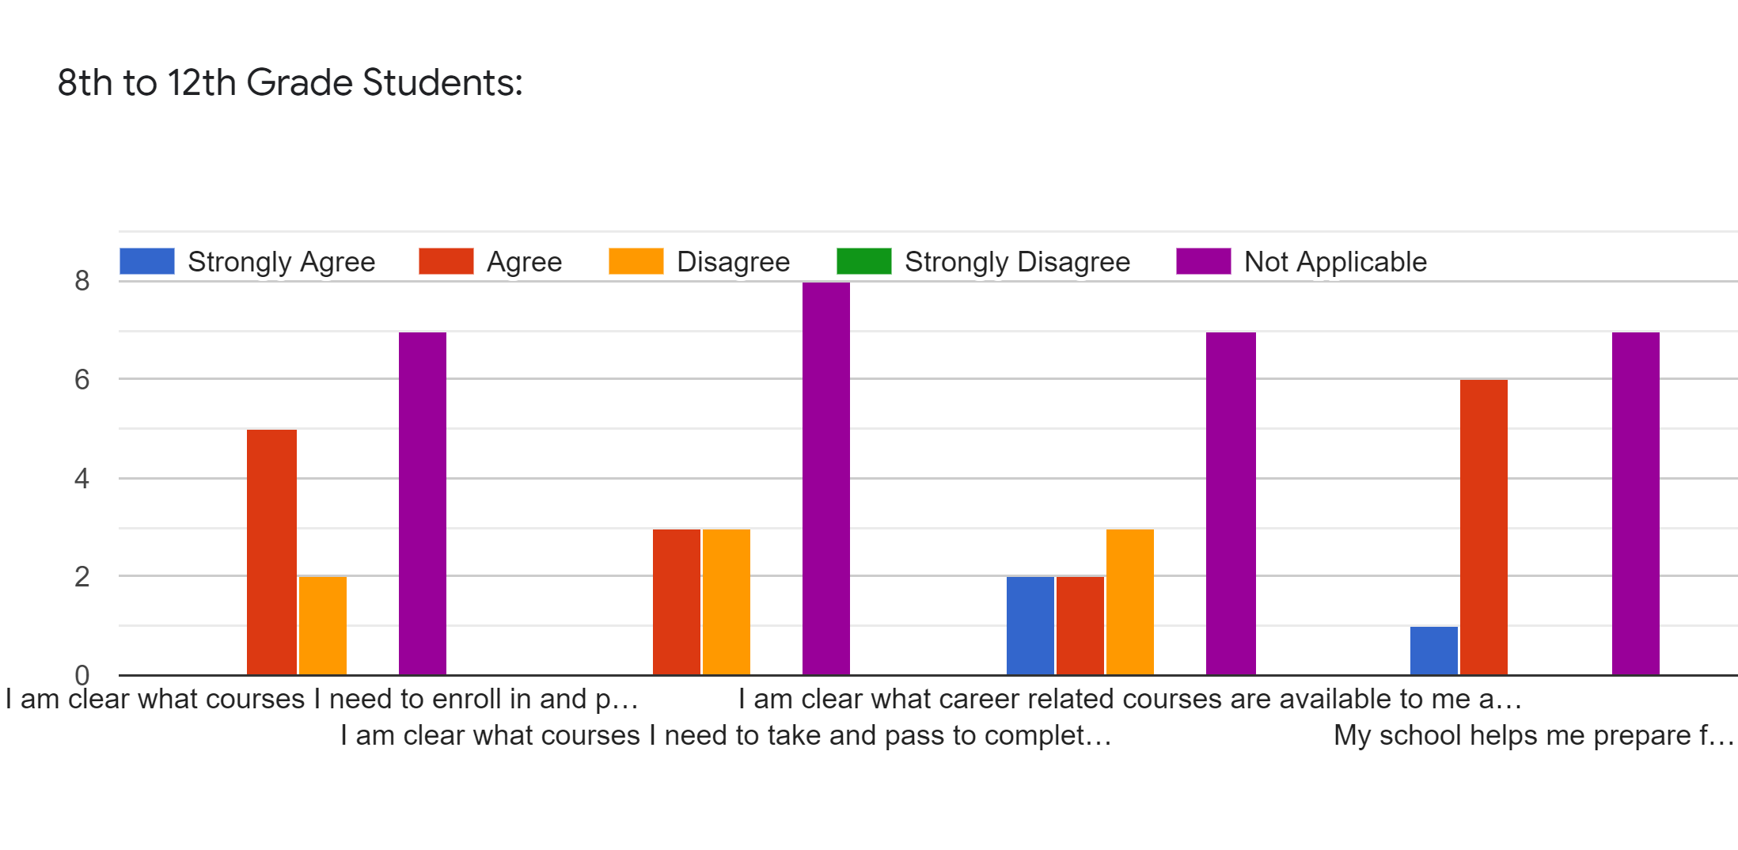
Feedback from 8th-12th Grade Students
Notes:
I am clear what courses I need to enroll in and pass to graduate from high school in 4 years.
I am clear what courses I need to take and pass to complete the UC A-G requirements.
I am clear what career related courses are available to me at school.
My school helps me prepare for future college and/or career paths.

Slide 15
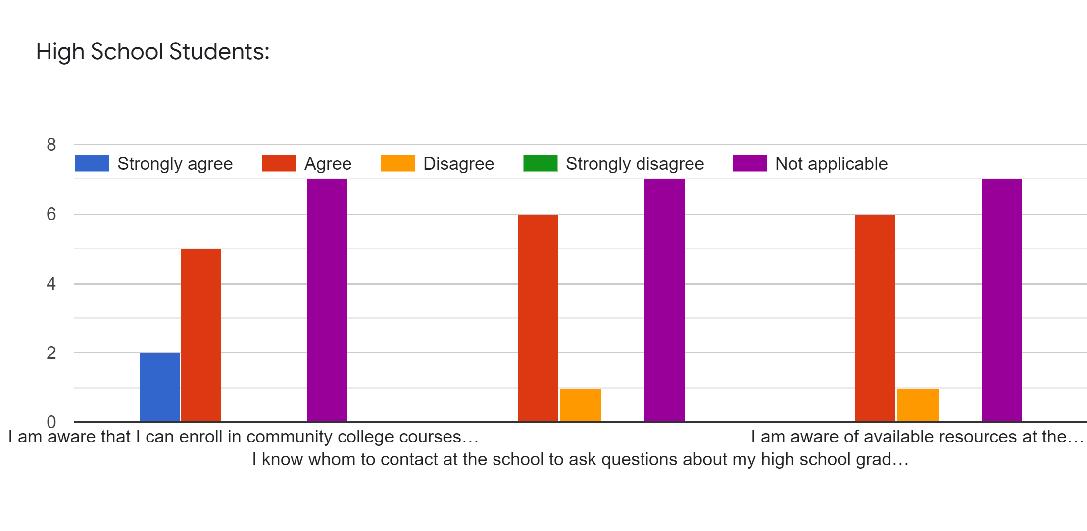
Feedback from High School Students
Notes:
I am aware that I can enroll in community college courses while I am still in high school and earn credits for college and high school.
I know whom to contact at the school to ask questions about my high school graduation status.
I am aware of available resources at the school to help me graduate form high school with my cohort (4 years).

Slide 16
Staff Feedback
Which state priorities should be the focus of school resources?
Parent Involvement ( Efforts to seek parent input and participation) 60.4%
Basic Services (Teacher credentials, instructional materials) 56%
Course Access (Student access to broad course of study) 53.8%
Notes:
Which state priorities should be the focus of school resources? Pick top 3.
Parent Involvement ( Efforts to seek parent input and participation) 60.4%
Basic Services (Teacher credentials, instructional materials) 56%
Course Access (Student access to broad course of study) 53.8%

Slide 17
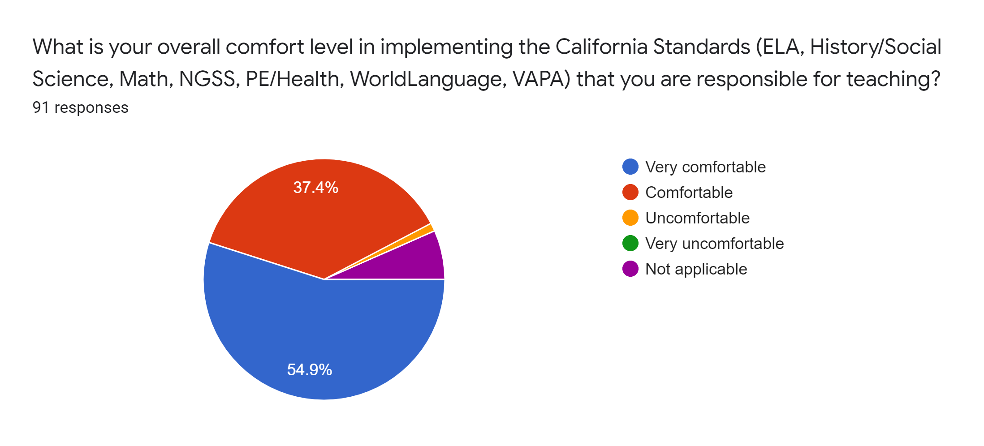
Staff Feedback to the Question
Notes:
What is your overall comfort level in implementing the California Standards (ELA, History/Social Science, Math, NGSS, PE/Health, WorldLanguage, VAPA) that you are responsible for teaching?

Slide 18
Goal #1
CCS will continue to develop plans, and utilize data to strengthen student achievement for all students.
ACTIONS:
Professional Learning related to student learning needs particularly for English learners, foster youth, students who qualify for free or reduced lunch and students with disabilities
Implement and assess formative and interim assessments
Increase the number of live or synchronous classes/ workshops for Elementary level grades
Purchase additional technology
Hire and maintain certificated staff to provide online/synchronous instruction, programs and support
Purchase of resources to support Student Services Department

Slide 19
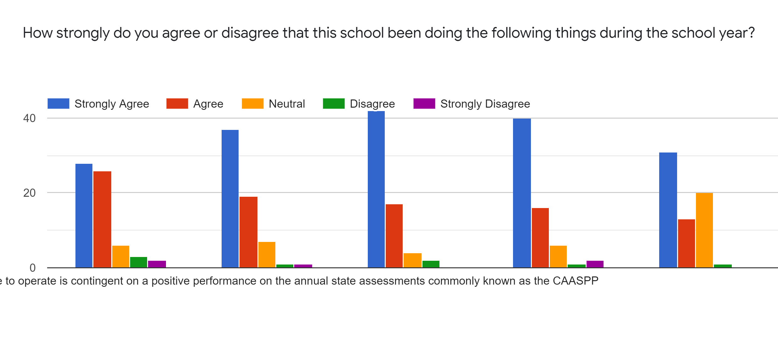
Parent Feedback for Goal #1
Notes:
How strongly do you agree or disagree that this school been doing the following things during the school year?
1. I am aware that our school is a charter school and the ability to continue to operate is contingent on a positive performance on the annual state assessments commonly known as the CAASPP.
2. The school is effective in strengthening and promoting academic achievement of all students.
3. Letting you know how your child is progressing academically.
4. Providing information on your expected role at your child’s school.
5. Providing information on how to help your child plan for college and career after High school. (middle and high school only)

Slide 20
Goal #2
ACTIONS:
Fund support staff for unduplicated student support
Hire certificated staff to provide online/synchronous instruction, programs and support for our English Learners
Fund new integrated website for staff, students and families
Fund School Counselor/SSD Coordinator
Hire Guidance Tech
CCS will promote a safe, healthy, and engaged learning environment for all.

Slide 21
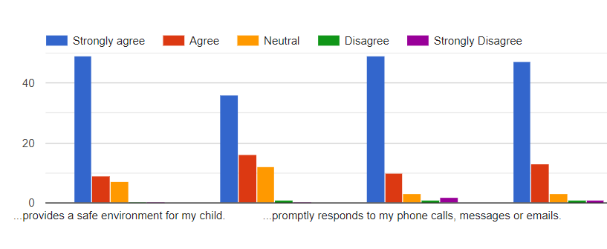
Parent Feedback For Goal #2
Notes:
How effective is the school in providing a safe, healthy, and engaged learning environment for all? This school....
Provides a safe environment for my child.
Has high expectations for all students.
Promptly responds to my phone calls, messages, or emails.
Encourages me to be an active partner with the school in educating my child.

Slide 22
Goal #3
ACTIONS:
Increase number of course offerings in college and career indicators
Provide College Readiness Assessments and Preparatory Workshops
Increase the number of students who are High School, College, Career and Life Ready.

Slide 23
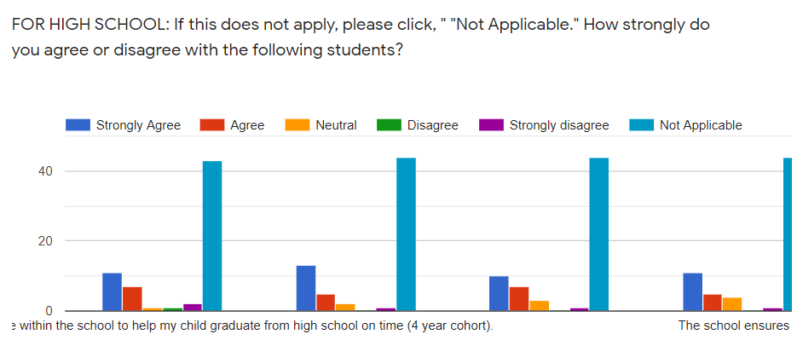
Parent Feedback For Goal #3
Notes:
FOR HIGH SCHOOL: If this does not apply, please click, " "Not Applicable." How strongly do you agree or disagree with the following statements?
I am aware of available resources within the school to help my child graduate from high school on time (4 year cohort).
I am well informed about my child’s high school progress toward graduation.
The school prepares students for future college and/or career paths.

Slide 24
WHAT’S NEXT!

Slide 25
LCAP Draft: Reflect feedback from Stakeholders
Surveys from Parents, Students and Families
Board Member Feedback
Upcoming Public Hearings
Meetings with ELAC
Meetings with Departments and School Staff: certificated and classified
Administration
SELPA

Slide 26
TIMELINE
21-22
School Year
MAY
JUNE
22-23
23-24
Draft placed on school’s website with public hearing at May board meeting.
Presented to school board for approval: Local Control Accountability Plan 21-24 and Annual Update 19-21
Continual process reflecting and refining LCAP for current school year.
Reflect on prior year’s LCAP with data driven decision making to increase academic achievement.
Reflect on prior year’s LCAP with data driven decision making to increase academic achievement.

Slide 27
Assembly Bill 86:
Expanded Learning Opportunities (ELO) Grant
Provide supplemental instruction and support in a tiered framework that bases universal, targeted and intensive sports or students
Academic
Social-Emotional
Other integrated student supports
Provides services through engaging learning experiences
Notes:
Learning recovery plan that provides supplemental instruction, support ford social and emotional well-being to: unduplicated, SWD, student at rise of abuse, neglect, or exploitation, disengaged students, below grade level, those who did not enroll in diner for the 20-21, credit deficient, HS at risk and other students identified by certificate staff.

Slide 28
Seven Supplemental Instruction and Support Strategies
ELO Grant Plan
Extending instructional learning time
Accelerating progress to close learning gaps through the implementation, expansion, or enhancement of learning supports
Integrated student supports to address other barriers to learning
Community learning hubs that provide students with access to technology, high-speed internet, and other academic supports
Supports for credit deficient students to complete graduation or grade promotion requirements and to increase or improve students’ college eligibility
Additional academic services for students
7. Training for school staff on strategies to engage students and families in addressing students’ social-emotional health and academic needs
Notes:
50% in May 2021 and remaining in Aug. 2021
An LEA may use IPI funds to pay salaries for certificated or classified employees providing in-person instruction or services. AB 86 did not limit "salaries" to personnel costs associated with new or expanded services. Salaries may also include stipends or "hazard pay."
An LEA may use IPI funds for any eligible expenditures from the start of the 2020–21 fiscal year on July 1, 2020, through August 31, 2022. All expenditures, including reimbursements, must be linked to an allowable use.

Slide 29
ELO Grant Funding
$731,637

Slide 30
THANK YOU!

