Slide 1
MOVING FROM ANXIETY TO RESILIENCY
PTSA PRESENTATION 2018

Slide 2
TEENS TODAY: THE GOOD NEWS
MORE EDUCATED & AWARE OF THEIR EXTENDED WORLD
MORE OPEN MINDED & CONCERNED ABOUT THEIR COMMUNITY AND WORLD
SMOKING CIGARETTES LESS
FEWER DRUNK DRIVING INCIDENTS
DECLINE IN TEENAGE PREGNANCIES & STIs
OVERALL PHYSICALLY SAFER

Slide 3
TEENS TODAY: THE NEW CONCERNS
INCREASED ACCESSIBILITY TO OTHER TOBACCO PRODUCTS (VAPING/JUULING/MARIJUANA)
INCREASED PRESCRIPTION DRUG ADDICTIONS
INCREASED FINANCIAL RELIANCE ON PARENTS/FAMILIES
SLEEP DEPRIVATION
TEENS MORE TECH SAAVY…OFTEN MORE THAN PARENTS
NEW COLLEGE/JOB REALITIES
SEEK VIRTUAL ATTENTION

Slide 4
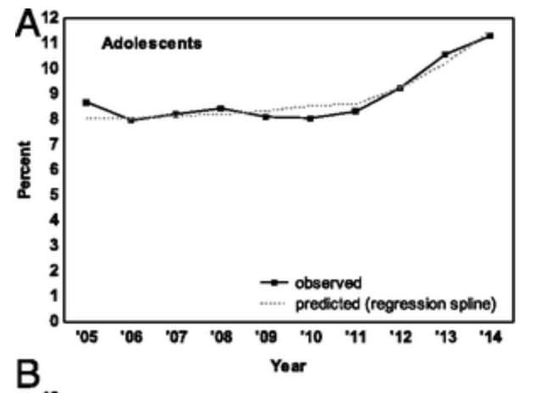
TEENS TODAY: THE NEW CONCERNS
SINCE 2005, ALMOST A 40% INCREASE IN FEELINGS OF ANXIETY AND DEPRESSION.
A HUGE SPIKE HAS OCCURRED SINCE 2010
HOWEVER, STRESS DOES NOT EQUAL ANXIETY

Slide 5
WHY THE INCREASE?
&

Slide 6
TECHNOLOGY CAN ALSO OVERWHELM ADULTS
GONE ARE THE “DIARY UNDER THE BED” DAYS
GONE ARE THE “FACEBOOK ONLY” DAYS
ONLY 1/3 PARENTS FREQUENTLY SPEAK TO THEIR CHILDREN ABOUT ONLINE SAFETY. EVEN FEWER FREQUENTLY MONITOR USAGE.
SCHOOLS DO NOT ENGAGE STUDENT DISCUSSIONS ABOUT HEALTHY TECHNOLOGY PRACTICES.

Slide 7
ESSENTIAL STRATEGY: RESILIENCY
REMINDER: STRESS DOES NOT EQUAL ANXIETY

Slide 8
STRATEGIES
Brave v. Risky
Liberty v. No Limits
Private v. Secret
Trust v. Faith
Forgive v. Excuse
Caring v. Worrying
Authentic Attention v. Virtual Attention
“I’ll Take Care of It” actually increases anxiety, despite best intentions

Slide 9
STRATEGIES: EXAMPLE
Boundary setting that relies upon individuals to take personal responsibility for thoughts and actions in age appropriate ways. The following are some criteria for establishing and enforcing cyber safe house rules:
Consider internet access and smart phones as a rite of passage – not a right.
No secrets, no surprises. Transparency is mandatory.
Explain why the rule exists and how they benefit individuals and the family
Regulate schedule and access to cyber tools
Unplug phones at a designated time in the evening
Establish and enforce consequences for rules violations
Clean slate. Once a consequence has been enforced give your child a clean slate, expressing confidence in your child’s ability to stand corrected.
Establish family-approved app list

Slide 10
HOW PCHS SUPPORTS RESILIENCY: ACADEMIC SUPPORT
TUTORING/ STUDY CENTER
ACADEMIC COUNSELORS
504 PLANS/ IEPs
ONLINE LEARNING
PALI ACADEMY
COLLEGE COUNSELORS
ONLINE LEARNING SYSTEMS (SCHOOLOGY & INFINITE CAMPUS)
TEACHER OFFICE HOURS
TEACHER EVALUATIONS

Slide 11
HOW PCHS SUPPORTS RESILIENCY: SOCIO-EMOTIONAL WELLNESS
PEER MEDIATION
MENTAL HEALTH COUNSELORS/ SCHOOL PSYCHOLOGIST
RESTORATIVE JUSTICE DEANS OFFICE
FULL TIME NURSE
THERAPEUTIC CLASSROOM
STUDENT-LED ORGANIZATIONS/ COMMUNITY DAYS
STUDENT SUPPORT PROGRAMS (LGBT, OUR HOUSE, ANGELS AT RISK)
MINDFULNESS PROGRAMS & PRACTICES
BOARD GOALS

Slide 12
FAMILIES
STUDENTS
PALI
Your children are the experts about their thoughts and actions. Together we must educate the child so they can learn how to become trustworthy and take responsibility for their own thoughts and actions.

