Slide 1
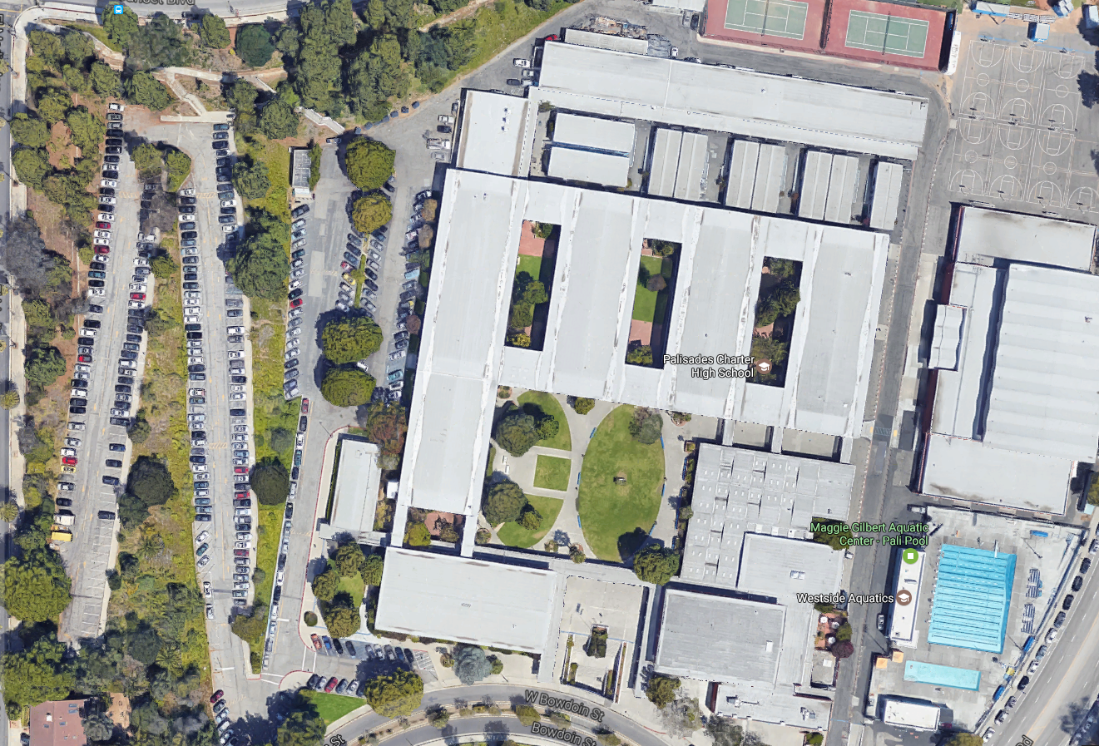
Security Checkpoints – Checking for student ID with proof to leave
Greeters – Handing out reunification forms
Checkers – Checking ID vs. Emergency Card
Reunification Area – After ID Check and receipt of student call slip, Last Name lines of A-K & L-Z
PSA
Student Check-in
Student
Personnel Staging Area – Available staff report for assignment
Check-in
Checkers
Greeters
Greeters
Reunification

