Slide 1
PALISADES CHARTER HIGH SCHOOL

Slide 2
RED= LOW PERFORMANCE
BLUE = HIGH PERFORMANCE

Slide 3
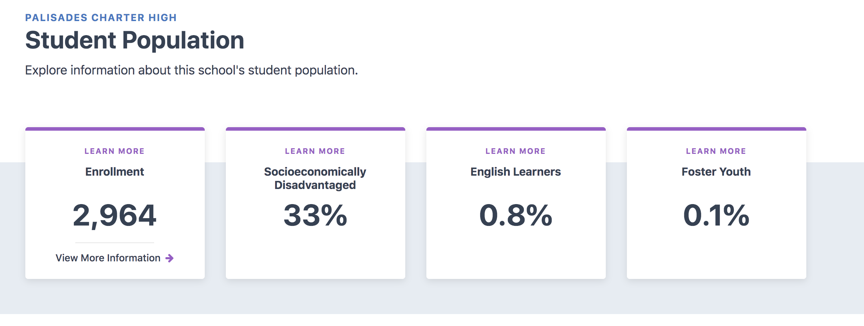

Slide 4
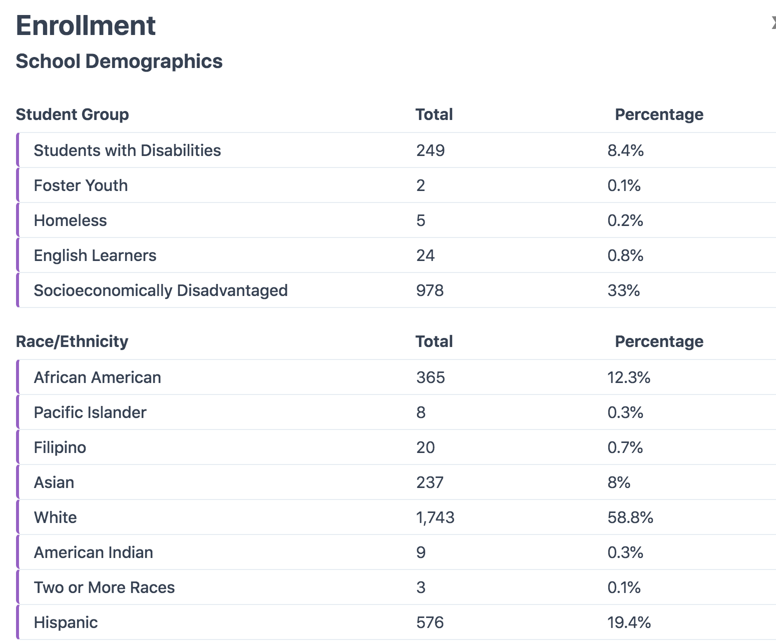
PALI’S DEMOGRAPHICS

Slide 5
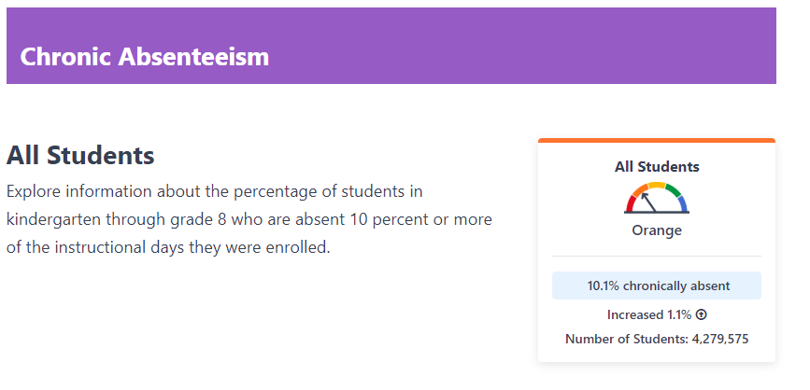

Slide 6
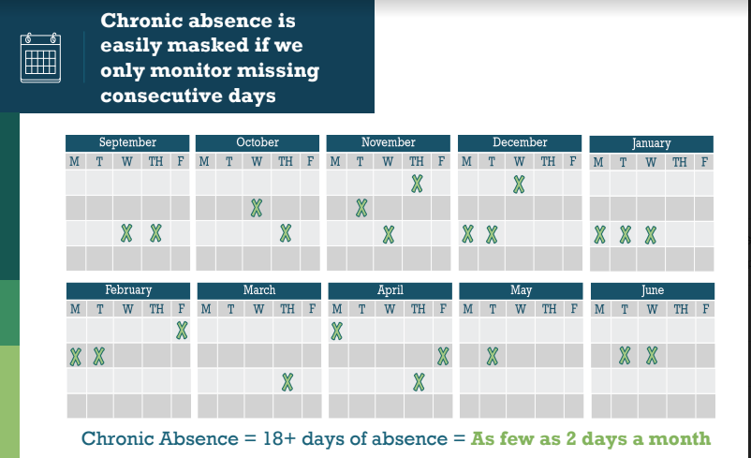

Slide 7
Data quest (2018-2019)

Slide 8
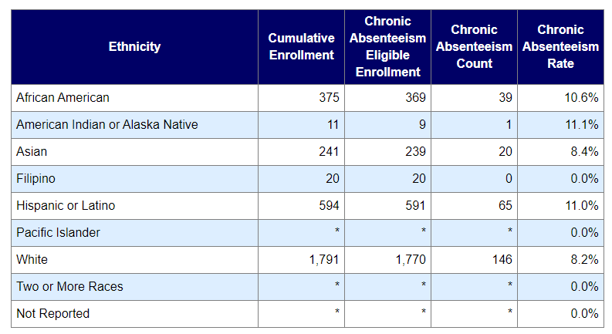

Slide 9
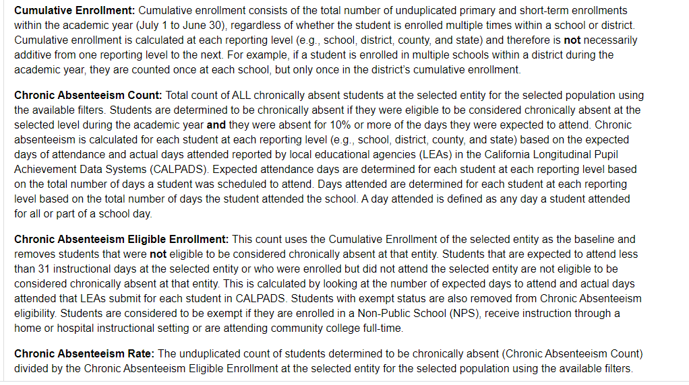

Slide 10
School attendance review team (SART)

