Slide 1
Palisades Charter High School
Admissions Process for PCHS
Prepared by: Tami Christopher-Hooker, M.Ed PCHS Director/Assistant Principal Admissions and Attendance

Slide 2
PCHS Preference Order
Per PCHS Charter the preference order is as follows: 1. Residents, those who reside in Pacific Palisades, Topanga and parts of Brentwood 2. Brothers and sisters of current and continuing students 3. Students graduating from Paul Revere Charter Middle School and Paul Revere Magnet 4. Family members of PCHS staff 5. Students who reside within LAUSD boundaries 6. All Other Applicants in the state of California

Slide 3
PCHS Admissions Process
10/1/2018-2/20/2019 Submit the initial application
March 4, 2019 Potential PCHS families notified of acceptance and next steps
Step #1 FOR ALL families complete OLR (Online Registration) by March 18, 2019 (initial deadline)
Proof of residency (residents ONLY) April 8-11th , 2019

Slide 4
Why OLR???
It’s 2019!!
Utilizing more functions of IC
Linking multiple families in IC
Uploading some documents (i.e. Immunization records or transcripts)
Receiving parent verification of receiving and reading PCHS Parent and Student Handbook, upload Emergency Card Information, and other information collected each school year
Orientation Day 2019 ONE piece of paper to collect Free And Reduced Lunch Form

Slide 5
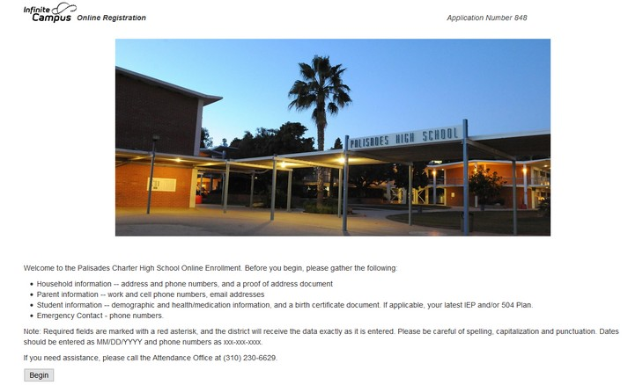
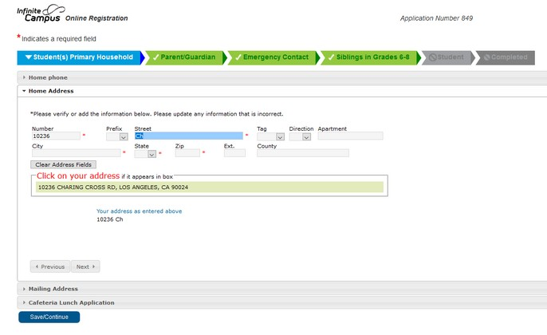
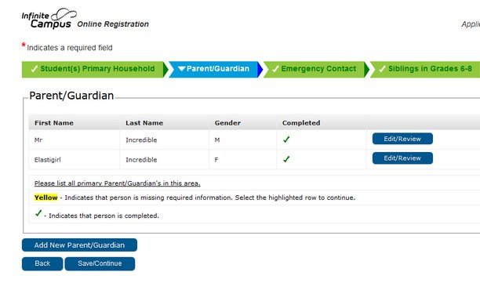
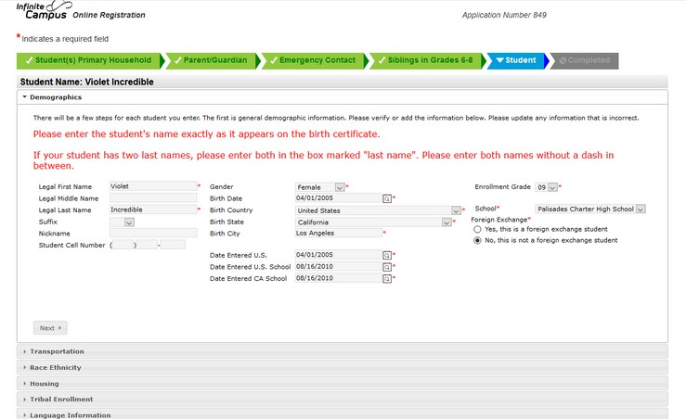
INFINITE CAMPUS ONLINE REGISTRATION

Slide 6
OLR for Our NEW to Pali Parents
Each tab requires information
There are also places for document uploads (birth certificate, report card, 2 utility bills or immunization)
Process takes 30-45 mins to complete

Slide 7
OLR Processing for Pali
Each application reviewed
Family member accounts are linked together
Accounts are approved, placed on hold or denied

Slide 8
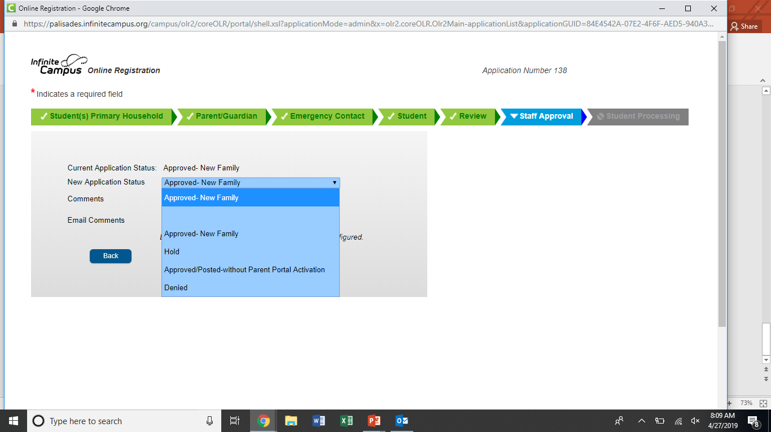

Slide 9
OLR Processing for Pali
Pali staff input NEW students into IC

Slide 10
New to Pali OLR Numbers (as of April 24, 2019)
713 Approved Families (9th – 678, 10th – 18, 11th – 13, 12th – 4)
50 Families on Hold (9th – 46, 10th – 2, 11th – 1, 12th – 1)
Hold = need information/documents, families have been contacted (target PRMS families)

Slide 11
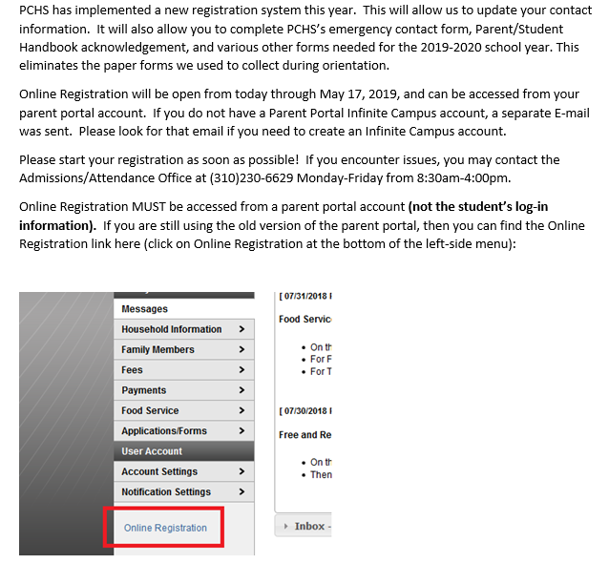
OLR for Returning Pali Families
Families have from 4/26-5/17/2019 to complete
Ensuring parents access Parent Portal
No documents to upload (verification of information)
Potentially invite more families from the waitlist

Slide 12
Attendance Question
Impact of Coachella on Senior Attendance???
Coachella, April 12th – ADA 86%
Senior Ditch Day, April 11th – ADA 77%
Monday, April 9th – ADA 94%
(ADA = Average Daily Attendance)

