Slide 1
FY18-19 budget
YPI Charter Schools, Inc

Slide 2
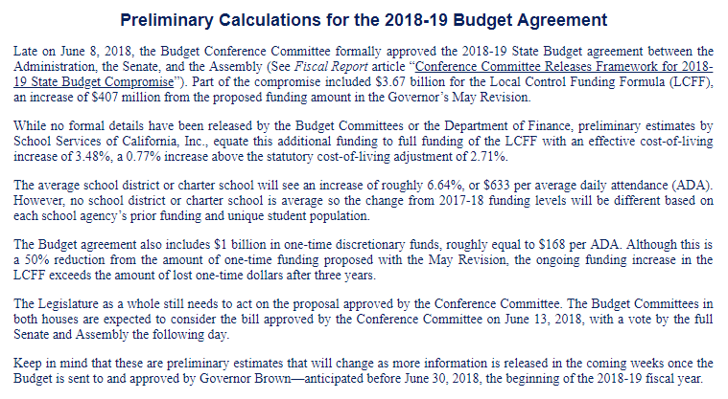
Revenue Assumptions
One time funding of $168 per ADA
LCFF fully funded with 3.48% COLA
SB740 assumes funding at 75%

Slide 3
Revenue Assumptions
Enrollment / ADA
BCCS – 374 / 360.91 or 96.5%
MORCS – 340 / 328.10 or 96.5%
High School – 276 / 260.82 or 94.5%
Unduplicated Count
BCCS – 84%
MORCS – 96%
High School – 81%
LAUSD – 83.5%

Slide 4
Expense Assumptions
Salaries
2% increase to the teacher salary table
MORCS
Additional full time custodial
Addition of part time supervision aid
Central Admin
35% of Ruben’s salary to be allocated to CA
Addition of Data Director
Addition of Senior Director of Program
Addition of IT support (Charles Harvey)
High School
4 new teachers FY18-19
Coordinator of School Culture and Climate
STRS increase from 14.43 % to 16.28%
Health Insurance Costs are estimated based on the new proposed rate structure

Slide 5
Expense Assumptions
Rent
BCCS ($10,300 a month)
Prop 39 for MORCS ($28K for one month)
M&O for MORCS ($194K for 11 month) + $60K for Utilities
M&O contract assumes 3 years
Prop 39 for High School ($259K) + $10K for Prom Rental
$63K rent for Central Admin
MORCS Prop 1D repayment loan
3% interest
30 years
Starting 12/01/2019
Capital Expense
BCCS - $100K
Continuing using 1 bus to bring students to MORCS
Indirect Cost – allocated based on the number of students.

Slide 6
Expense Assumptions
ExED contracts:
Management and Accounting Services :
$218,468 - 2% increase
CALPADS:
$8,323 per school
CASH Flow needs
BCHS will need to borrow up to $450K from BCCS in FY18-19 and up to $300K in FY19-20. All of the funds would be repaid before FY20-21.

Slide 7
Central Admin – Summary Budget

Slide 8
BCCS – Summary Budget

Slide 9
MORCS– Summary Budget

Slide 10
HS– Summary Budget

