Slide 1
MORCS Construction Pictures

Slide 2
Black top was removed

Slide 3
Back wall of the underground parking lot

Slide 4
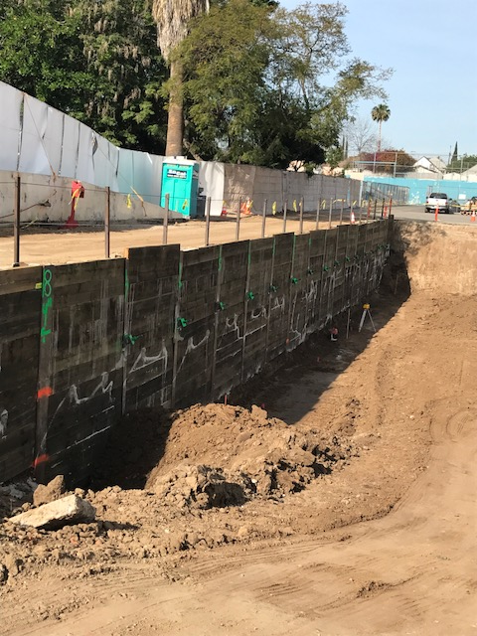

Slide 5
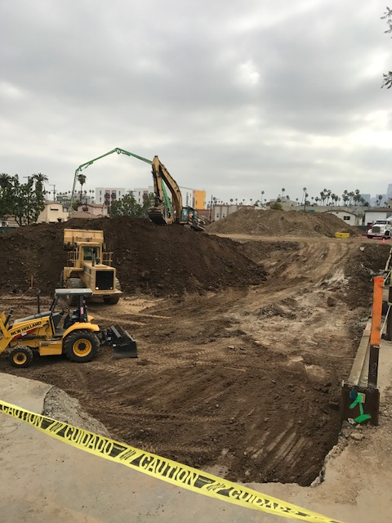
Excavating the underground parking lot

Slide 6
We found concrete and brick foundations

Slide 7
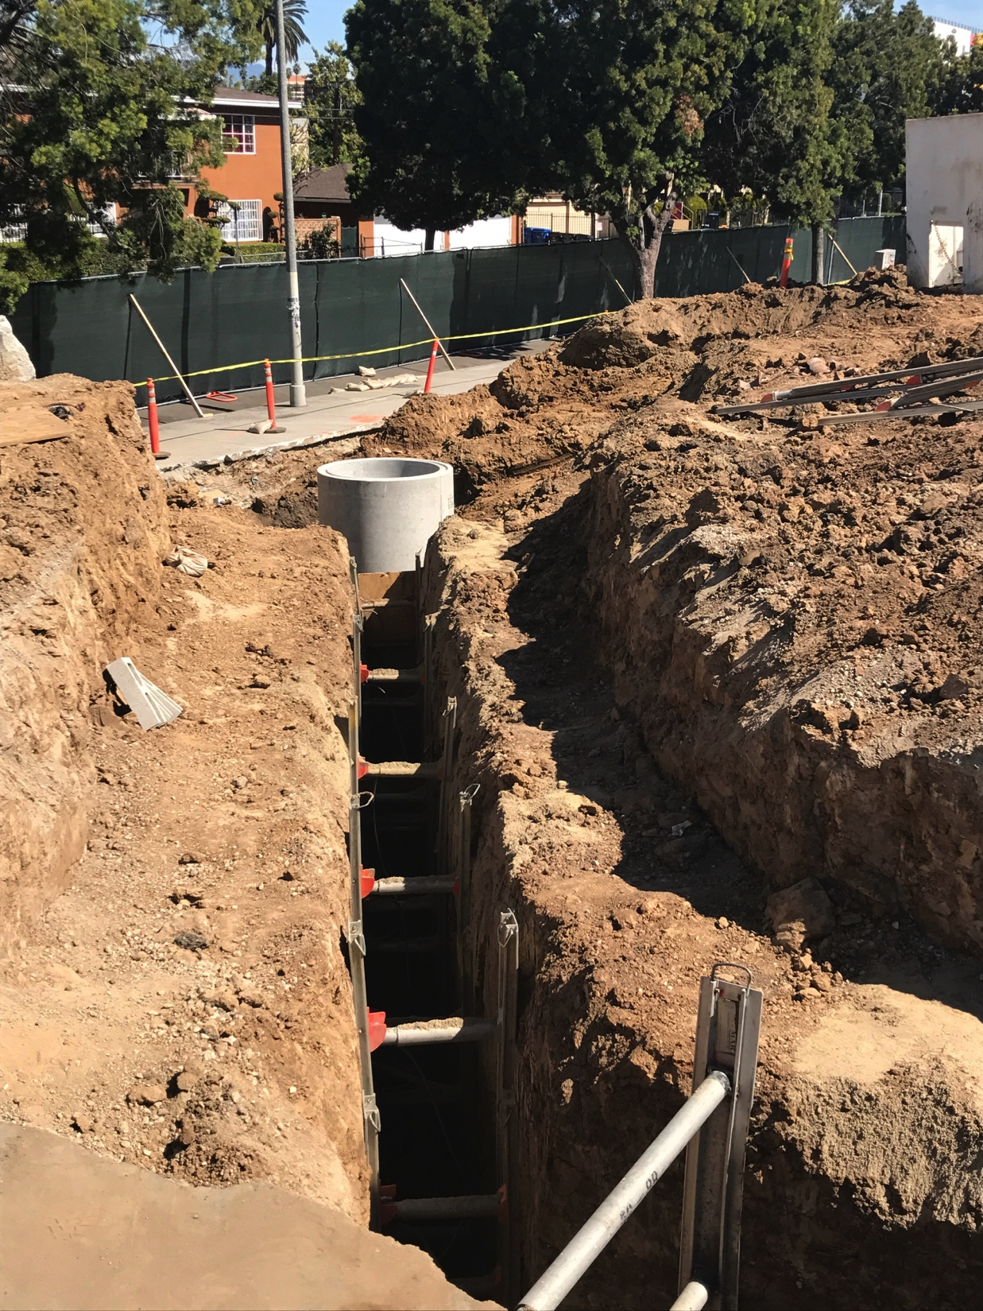
Sewer line installation

Slide 8
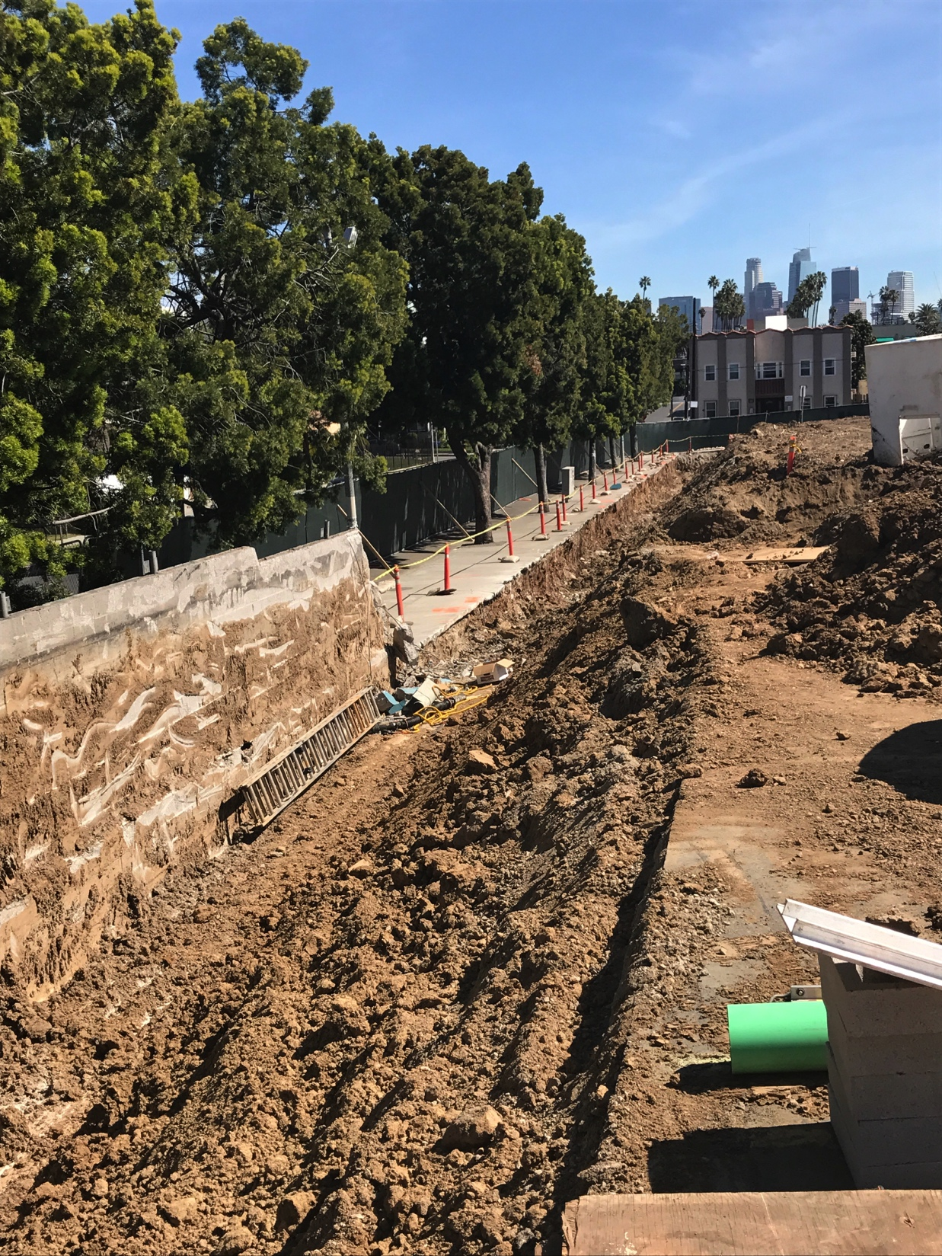
Removing retaining wall that was damaged on 11th street
And the remaining portion of the wall for our project.

Slide 9
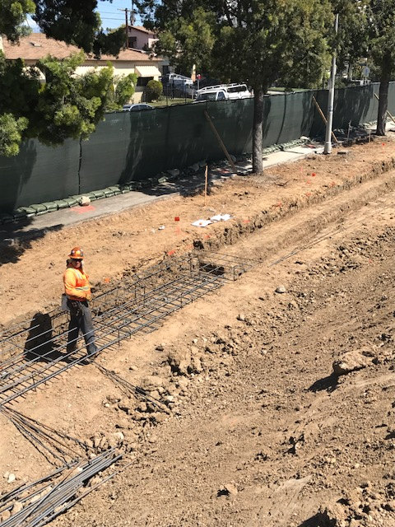
New Retaining Wall

Slide 10
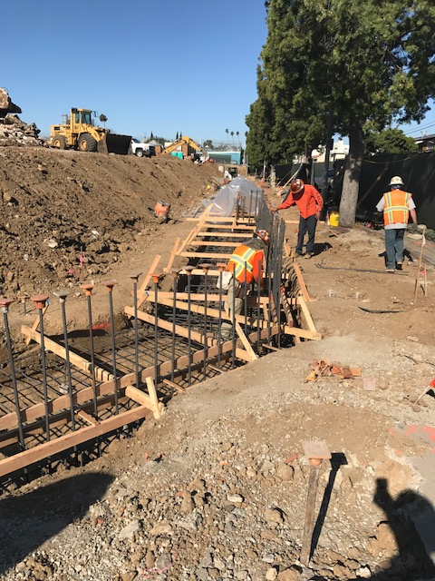

Slide 11
Concrete footings for the retaining wall

Slide 12
We found a storm drain that runs the length of the underground garage
encased in concrete and bricks while preparing to correct the soft ground.

