Slide 1
Open Food Bid: MORCS SFA

Slide 2
Food Bid Proposals
RFP was made public and sent on November 3.
Bids were submitted by November 8, 2016 at 4pm.
Vendors:
Better 4 You Meals
Fresh Start Meals
Unified Nutrimeals
Notes:
Agenda for Morning PD – Student Travel Cards, Attendance, Time-Off and Sub Requests, Breakfast in the Classroom (BIC)

Slide 3
Food Tasting November 15-17 All 3 Sites
Participating Vendors:
Better 4 You Meals
Royal Dining
Unified Nutrimeals
Participating Stakeholders:
Parents
Teachers
Student leadership
Admin
Notes:
Agenda for Morning PD – Student Travel Cards, Attendance, Time-Off and Sub Requests, Breakfast in the Classroom (BIC)

Slide 4
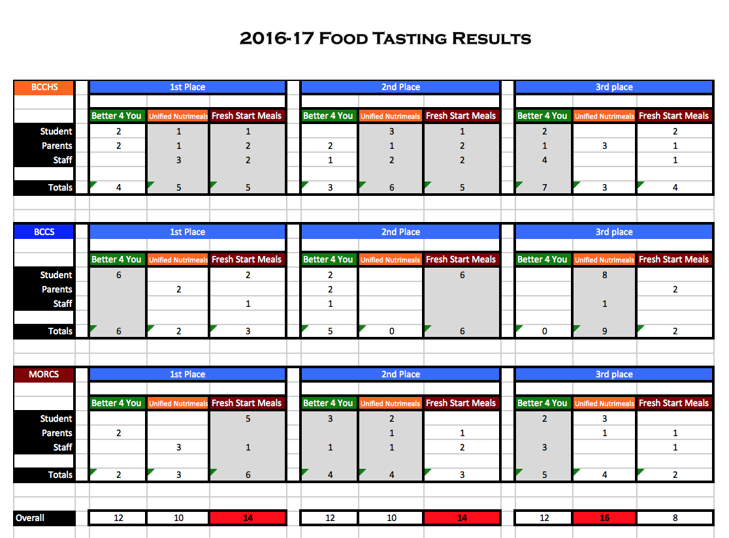
Notes:
Agenda for Morning PD – Student Travel Cards, Attendance, Time-Off and Sub Requests, Breakfast in the Classroom (BIC)

Slide 5
Food Pricing
Participating Vendor Prices:
Better 4 You Meals
$1.70/student for breakfast
$2.85/student for lunch + commodities ($10,000/month)
Fresh Start Meals
$1.60/student for breakfast
$2.85/student for lunch
Unified Nutrimeals
$1.80/student for breakfast
$2.90/student for lunch
Notes:
Agenda for Morning PD – Student Travel Cards, Attendance, Time-Off and Sub Requests, Breakfast in the Classroom (BIC)

Slide 6
Recommendation:
Better 4 You Meals for breakfast, snack and lunch
Rationale:
Votes of stakeholders following food tasting
Commodities saves money
Pricing
Service and History
Notes:
Agenda for Morning PD – Student Travel Cards, Attendance, Time-Off and Sub Requests, Breakfast in the Classroom (BIC)

