Slide 1
FY15-16 additional expenses
One time funds received in FY15-16
BCCS - $190K
MORCS - $160K
Proposed expenditure
MORCS - $120K
6th grade science books - $18K
Computers - $95K
Computer carts - $7K
BCCS - $154K
6th grade science books - $18K
Computers - $126K
Computer carts - $10K

Slide 2
FY16-17 budget
YPI Charter Schools, Inc

Slide 3
Revenue Assumptions
FY16-17 one time funding - $237 per FY15-16 P2 ADA
Gap Closure based on DOF rates

Slide 4
Revenue Assumptions
Enrollment / ADA
BCCS – 370 / 357.05
MORCS – 330 / 318.45
High School – 160 / 152.80
Unduplicated Count
BCCS – 87.83%
MORCS – 97.35%
High School – 89.73%
LAUSD – 80%

Slide 5
Expense Assumptions
Salaries
4% teacher salary table increase
BCCS
Additional SPED teacher
MORCS
EL Specialist teacher
Central Admin
Compliance coordinator
Data coordinator
High School
6 new teachers FY16-17, 2 new teachers FY17-18
STRS increase from 10.73% to 12.58%
403 (b) match for Classified staff
H&W expense increase by 5% plus new staff
CTE Grant has not been included in the preliminary budget (expected to generate about $30K of revenue per campus)

Slide 6
Expense Assumptions
High School – PCSGP
Books and student materials - $133K
Used i-Macs, computer carts and chrome books - $34K
Rent
BCCS increased by $6K
Prop 39 for MORCS ($134K)
Prop 39 for High School ($76K)
$40K rent for Central Admin
Capital Expense
BCCS
adding one or two bathrooms for staff
Finalize main office building construction
Continuing using 2 buses to bring students to MORCS
Indirect Cost – allocated based on the number of students.

Slide 7
Expense Assumptions
ExED contracts:
Management and Accounting Services :
$199,700 - 5% increase (3% COLA and 2% enrollment increase)
Grant Support
$6,000 for supporting GEAR UP, School Climate and CTE grants
CALPADS:
$8,000 per school

Slide 8
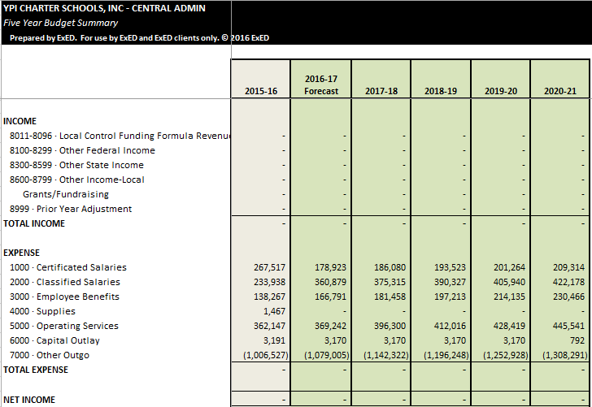
Central Admin – Summary Budget

Slide 9
BCCS – Summary Budget

Slide 10
MORCS– Summary Budget

Slide 11
HS– Summary Budget

