Slide 1

YPI Charter Schools
2024-25 State Budget Update
June 2024
Notes:
I have the unenviable task of trying to explain this year’s state budget proposal. Suffice it to say that this year, in particular, it is not straightforward and I may butcher some of the details. I will rely heavily on School Services of California. which had its annual May Revision webinar on Tuesday. As part of their materials they always prepare a Board-Ready presentation, so most of the slides you will see come from that. Let’s dig in.

Slide 2
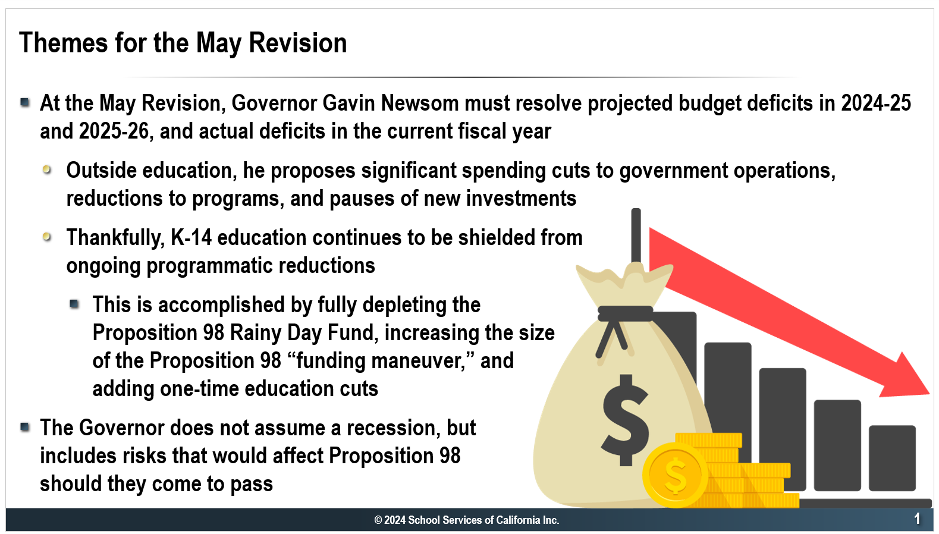
The 23/24 state budget over-allocated Proposition 98 by
Notes:
The governor and the legislature have massive budget deficits to resolve, both in the current year and the next two years. The governor’s May revision, like the January proposal, aims to shield K-14 education from ongoing programmatic reductions, fully depleting the Proposition 98 Rainy Day Fund and proposing a controversial funding maneuver to avoid cuts to education. Meanwhile, outside of education, he proposes significant spending cuts to governmental operations and programs and pauses new investments.
As with every budget, this budget contains some risks, but not to the level we felt last year when we didn’t know what our 2022 tax receipts would be. A key risk is that the state and national economies are in a slow growth pattern and may grow more slowly that the May Revision assumptions.

Slide 3
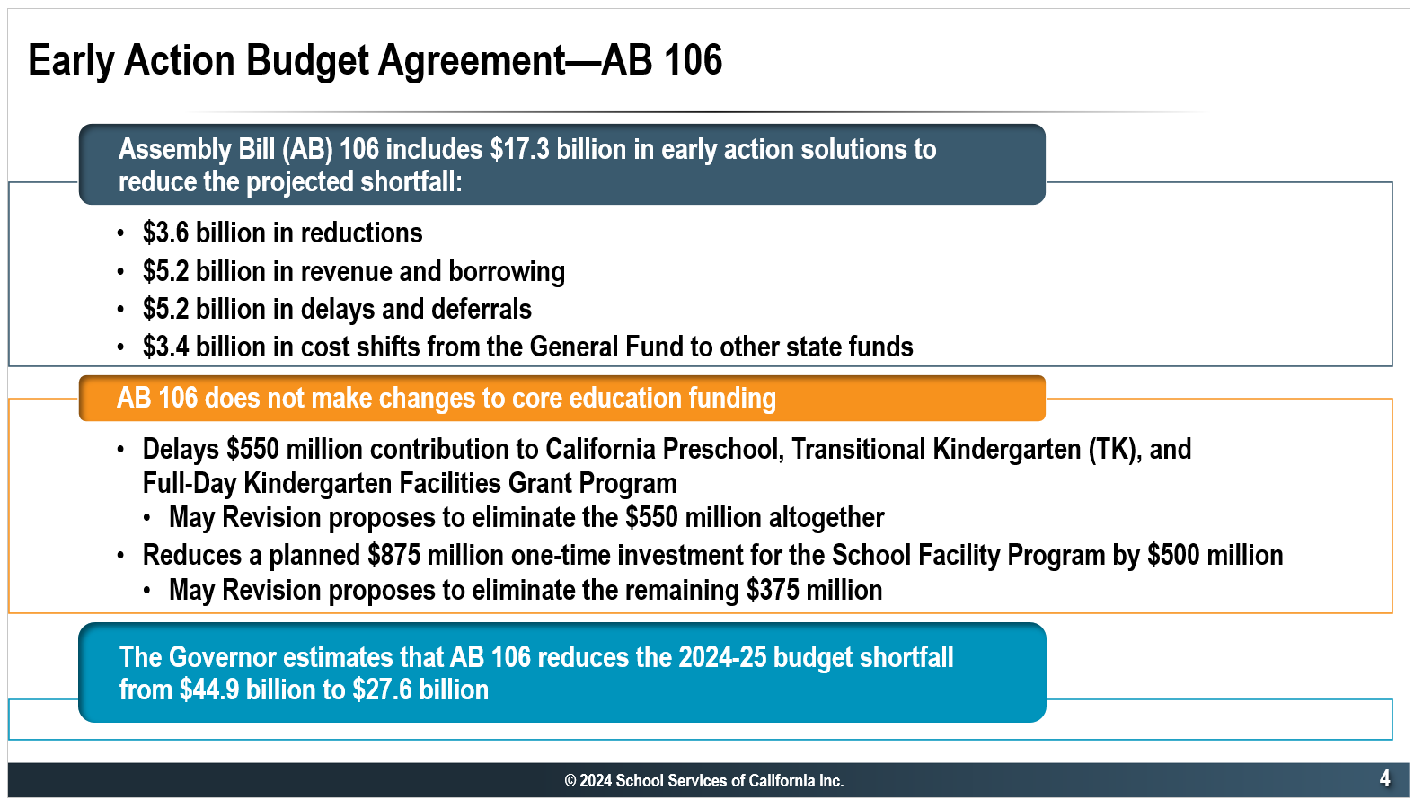
Notes:
Back in January, the governor said we had a budget problem of $45 billion. The legislature and governor got together to take some early actions to be able to reduce the size of the gap they are trying to close down to $28B. The $17B in solutions they found did not make changes to core education funding at the time but the May Revision does eliminate some items. However, these items don’t directly impact charter schools.

Slide 4
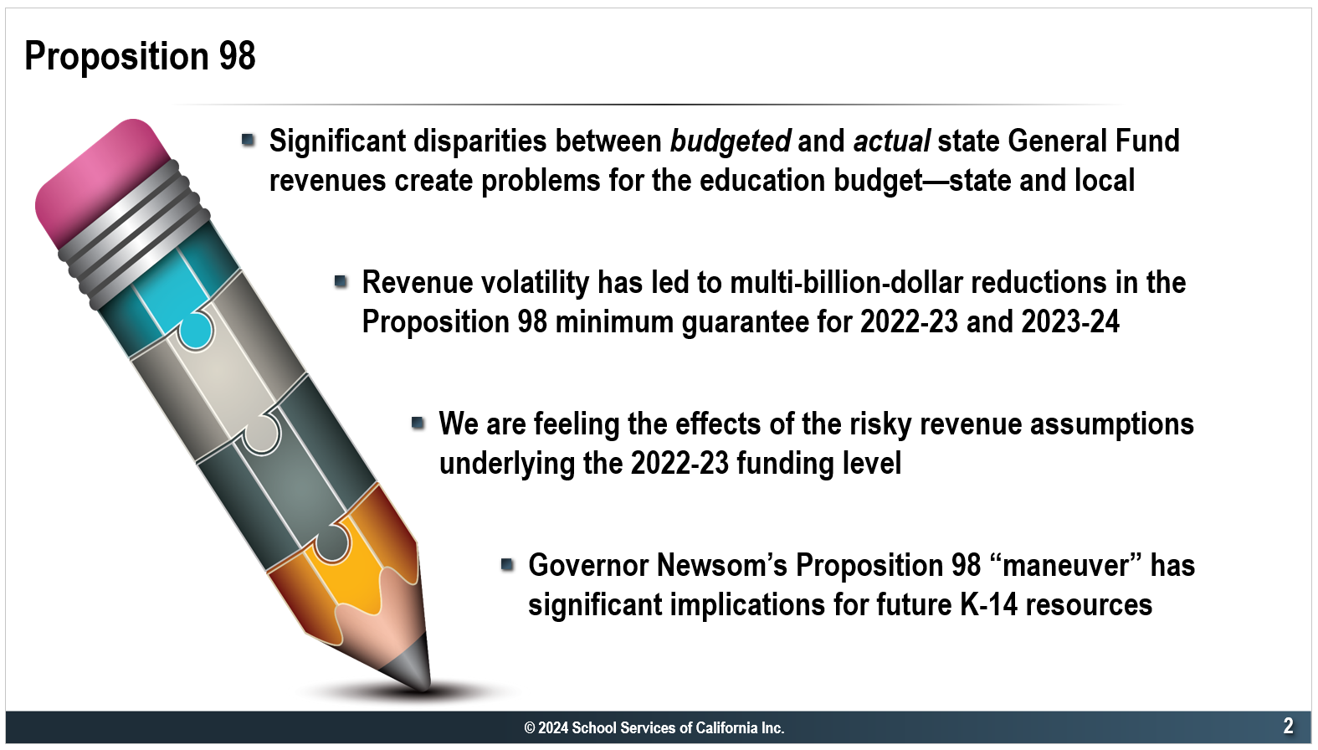
Notes:
When the legislature adopted the state budget last year, they were missing a key piece of information. Because of the IRS extension to the April 15 deadline to file 2022 taxes, the state did not know how much tax receipts from calendar year 2022 would be. It turns out that the revenue assumptions were way out of whack with actual receipts and that means Proposition 98, which mandates a minimum percentage of the state budget to be spent on K-12 education and community colleges to ensure stable and adequate funding for public schools, for last school year and this was funded beyond the minimum by $8.8B.

Slide 5
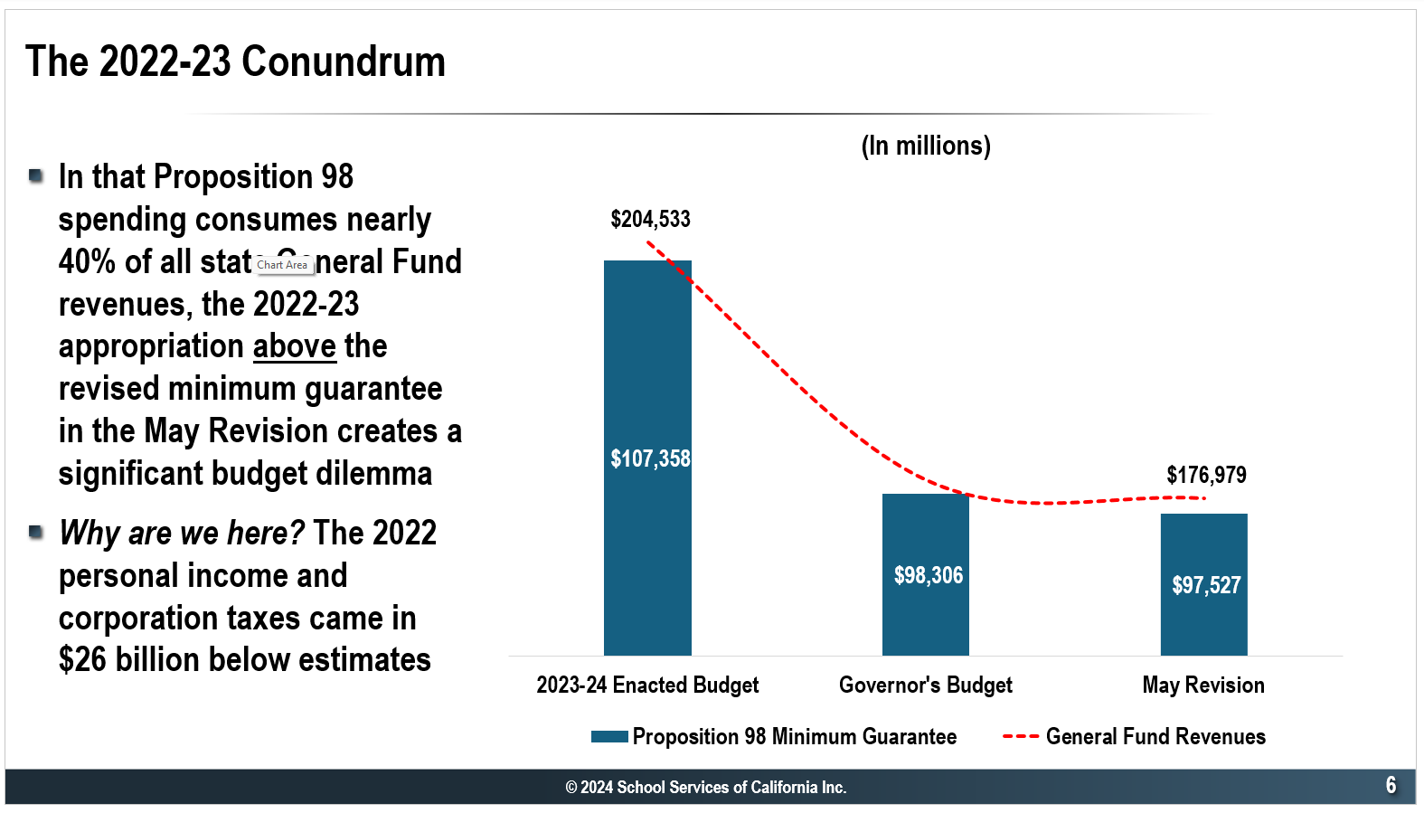
Notes:
This is posing a big issue for the state. The state estimated that the the minimum guarantee for 22/23 was going to be $107.4 billion dollars. The governor’s estimates now are that the 22/23 guarantee is not $107.4 billion. It’s 97.5 billion To address that allocation to districts and charters above the calculated minimum guarantee, the governor is proposing what the LAO dubs the Prop 98 maneuver. Since the state budget cannot accommodate this extra allocation, ue, the Newsom Administration proposed spreading the net impact ($8.8 billion) over five years with annual payments from non-Proposition 98 funds, starting in 2025-26. Importantly, these payments will not affect the calculation of the minimum guarantee, which is causing a great deal of controversy, because it conflicts with certain Proposition 98 funding formulas that would require this $8.8 B to be part of the calculation.
How this all play out remains to be seen and how it plays out will have implications for your funding.

Slide 6
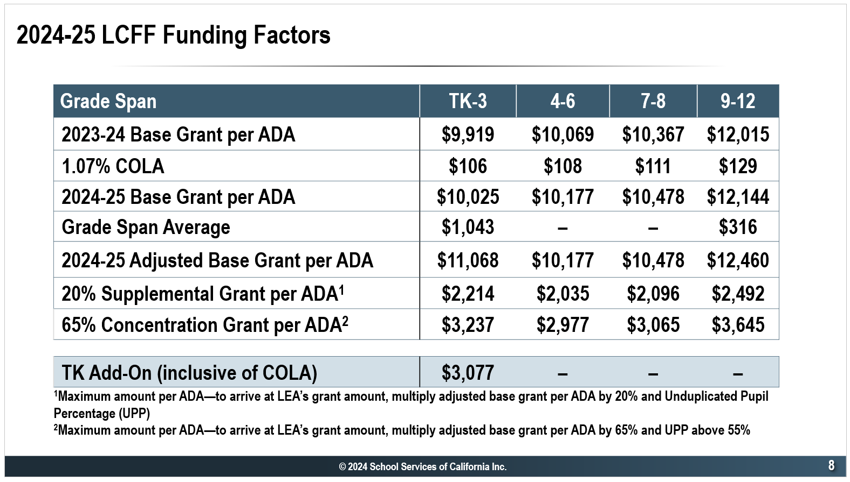
Notes:
By dipping into the education rainy day fund, the governor is able to maintain K-14 programs and fund the 1.07% statutory COLA. This slide show how the 1.07% COLA impacts the base grant for 24/25 and the additional LCFF funding factors. On the next slide, we’ll see what these #s translate to for your school.

Slide 7
What does the LCFF Mean for YPI Charter Schools?

Slide 8
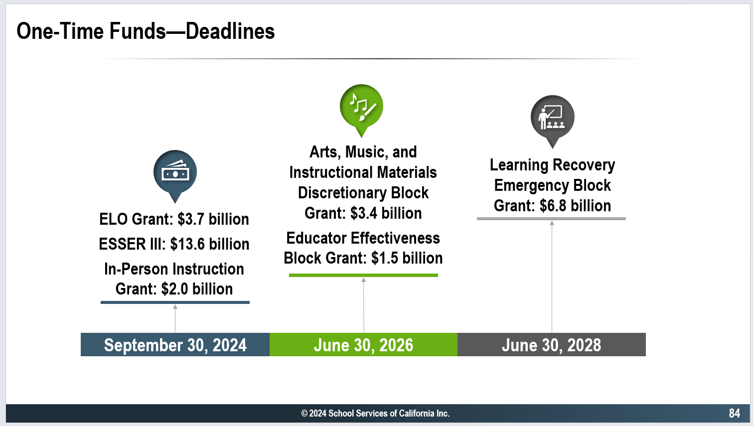
Notes:
All year long, I’ve been talking about the one-time funding that will be going away. This slide shows when the remaining big buckets of one-time funding will expire.

Slide 9
BCCS One-Time Funds Summary
After 23/24, $1,003K remaining; 24/25 budget will use $636K of the balance, leaving $367K for future years

Slide 10
MORCS One-Time Funds Summary
After 23/24, $1,026K remaining; 24/25 budget will use $567K of the balance, leaving $459K for future years

Slide 11
BCCHS One-Time Funds Summary
After 23/24, $264K remaining; 24/25 budget will use $175K of the balance, leaving $89K for future years

Slide 12
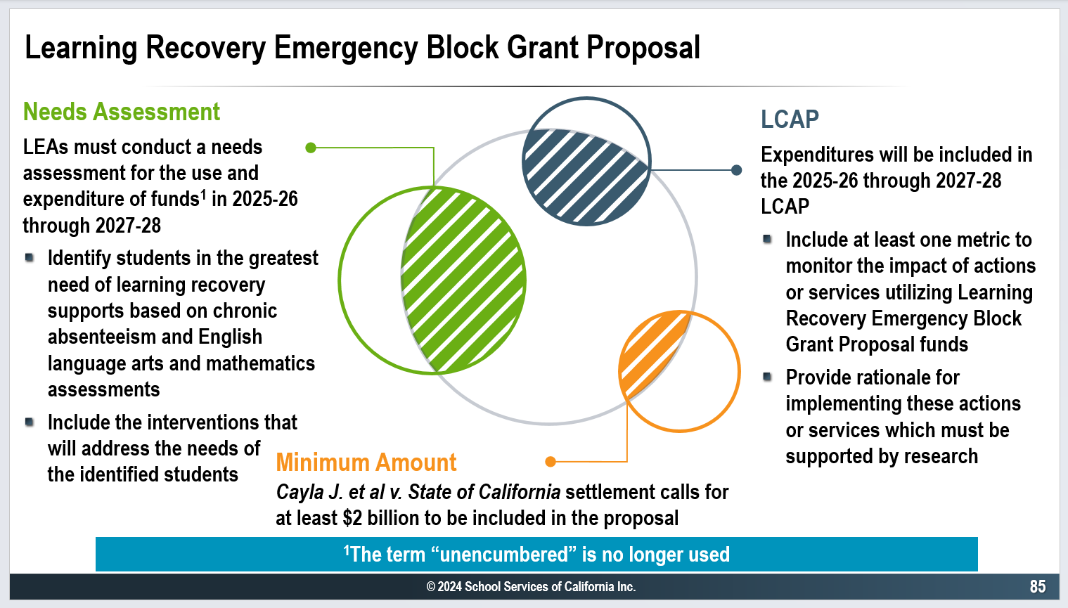
Notes:
Importantly, the May Revision includes a proposal that would require any Learning Recovery Emergency Block Grant funds still remaining in 25/26 to be used in accordance with a needs assessment. As you saw, both schools will have some learning recovery block grant funding unused as of 6/30/24 so if this proposal passses, the ways they could use the remaining funds could become more restricted.

Slide 13
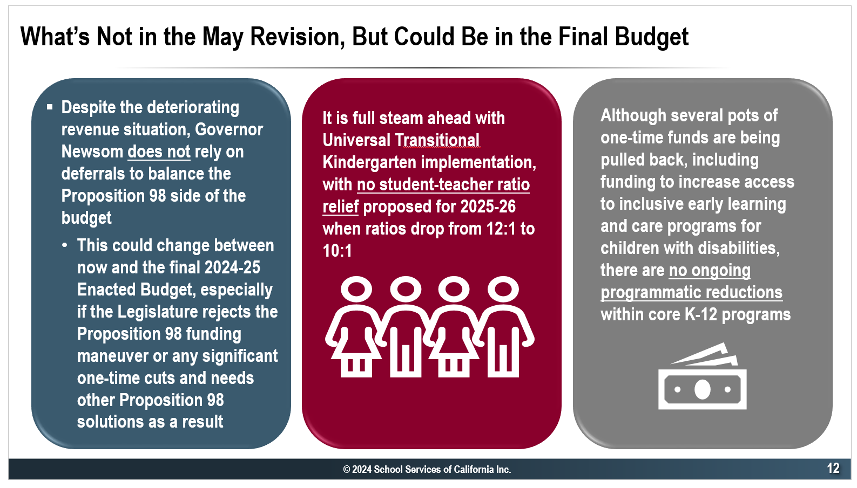
Notes:
The governor and the legislature are working to get the budget finalized by the statutory deadline of June 15. Between now and then, many things could change. If the legislature rejects the Proposition 98 maneuver or any other significant items, they could choose to add deferrals to balance the budget.
We don’t see any relief for TK ratios which are set to drop from 12 to 1 to 10 to 1 in 2025-26. Given the state’s funding constraints, this may be addressed in the final budget.
We also don’t see any ongoing programmatic reductions to K-12 core programs but as the governor and legislature work to balance the budget, this could be on the table.
Likely, when we bring the final budget to you for adoption in June, not all the dust will be settled but our focus will be on presenting a balanced budget based on the information we have.

Slide 14
Revenue Assumptions

Slide 16
Expense Assumptions
Updated Teacher Salary Scale
9.8% Increase in Health Insurance costs
Rent
  BCCS ($152,676)
  M&O costs for MORCS ($138K)
  Prop 39 for High School ($280K)
  LSC ($57K)
MORCS Prop 1D repayment loan ($145K Interest & $180K Principal)
LCS Cost – allocated based on the number of students.

Slide 17
Expense Assumptions
ExED contracts:
  Management and Accounting Services :
    FY24-25 $263,000 – (6% increase)
  CALPADS:
    $17,100 per school ($1000 increase per school from FY22-23)

Slide 18
Central Admin – Summary Budget

Slide 19
BCCS – Summary Budget

Slide 20
MORCS – Summary Budget

Slide 21
BCCHS – Summary Budget

