Slide 1
Youth Policy Institute GEAR UP
Jesse Noonan, Chief Academic Officer Steve Schultz, Chief Financial Officer

Slide 2
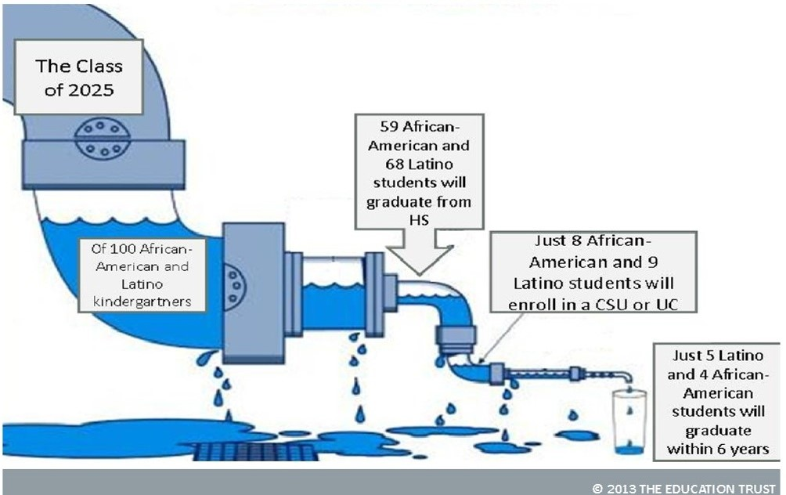
The Need in the San Fernando Valley/ Pacoima
90% Latino population; 94% of targeted students
The six-year graduation rates in four-year universities are lower for Latinos (49%) and African Americans (39%) than Asians (68%) and Whites (61%)
Only 22% of Latinos enrolled in a California community college have completed a certificate or degree, or transferred to a university after six years, compared to 26% of African American and 37% of White students

Slide 3
The Need in the San Fernando Valley/ Pacoima
31% of children living in poverty
Median family income is under $36,000
54% of those 25 years of age or older has less than a high school diploma
86% of students enrolled in target schools are eligible for free and reduced lunch
Average of 45% of 8th graders at cohort schools are enrolled in Algebra 1, compared to 65% in District schools
Average of 40% of cohort students took SAT/ACT, compared to 52% in District schools
Average of 55% of cohort students agree that “I know which A-G courses I need to take to get into college,” compared to 81% of District students
55% of cohort parents agree that “school staff helps me understand how to apply for financial aid, compared to 81% of District parents

Slide 4
What is GEAR UP?
The GEAR UP program (Gaining Early Awareness and Readiness for Undergraduate Programs) is designed to significantly increase the number of low-income students who are prepared to enter and succeed in postsecondary education.
GEAR UP services are provided at high poverty middle and high schools, and through the first year of college.
YPI GEAR UP will serve a two grade cohort totaling 2,700 students, beginning with all current 6th and 7th graders, and following them to Year 1 of college (2014-2021).

Slide 5
GEAR UP Objectives
1) Increase academic performance for postsecondary education
2) Students will be proficient/advanced (at grade level or higher) in core subjects. Grades of B or higher are essential for college readiness
3) Increase regular student attendance in school
4) Increase readiness for high school graduation and college entry without remediation
5) Increase rate of grade level advancement, high school graduation and enrollment in postsecondary education for cohort students
6) Increase cohort student and families’ knowledge of postsecondary education options/ financing

Slide 6
Targeted Schools
Middle Schools | High Schools
Vista Middle School | James Monroe High School
Sepulveda Middle School | Sylmar Biotech Health Academy
San Fernando Institute of Applied Media (SFiAM) | Discovery Charter Preparatory #2
Bert Corona Charter School | YPI Charter High School
Vaughn Next Century Learning Center (MIT) | Vaughn Next Century Learning Center (VISA)

Slide 7
Program Components
College and career counseling
College visits
Career exploration
Financial literacy/ aid information
In-class tutoring
PSAT/SAT/ACT/CAHSEE test prep
Near-peer mentoring
Parent workshops
Summer enrichment opportunities
Scholarships
Case management services

Slide 8
GEAR UP Staffing
GEAR UP Coordinators
College Access Advisors
Academic Specialists
Tutors
Mentor Project Leaders
Community Advocates
Research and Evaluation Manager
Case Managers
Post-Secondary Counselor (2020-2021)
College Services Coordinator (Dual Enrollment Coordination)

Slide 9
Partners and Supporters
UCLA
CSU Northridge
Mission College
Unusual Suspects
Roadtrip Nation
Elite Prep
Junior Achievement of Southern California

Slide 10
Opportunities for Collaboration
Classroom presentations
Afterschool workshops
Student and parent surveys
Instructional Tools
Tutor Management
Referrals for additional support
Field trip attendance
Teacher Professional Development
Administration and Documentation

Slide 11
Contact Information
Nicholas Wu
GEAR UP Manager
nwu@ypiusa.org
818-964-1085

