Slide 1
2023-24 Local Control & Accountability

Slide 2
Charting the Course
Originally introduced by Governor Brown in 2013 with the creation of the Local Control Funding Formula (LCFF), the Local Control & Accountability Plan (LCAP) is meant to serve as a comprehensive plan for LEAs on the use of funds aligned to the Eight State Priorities

Slide 3
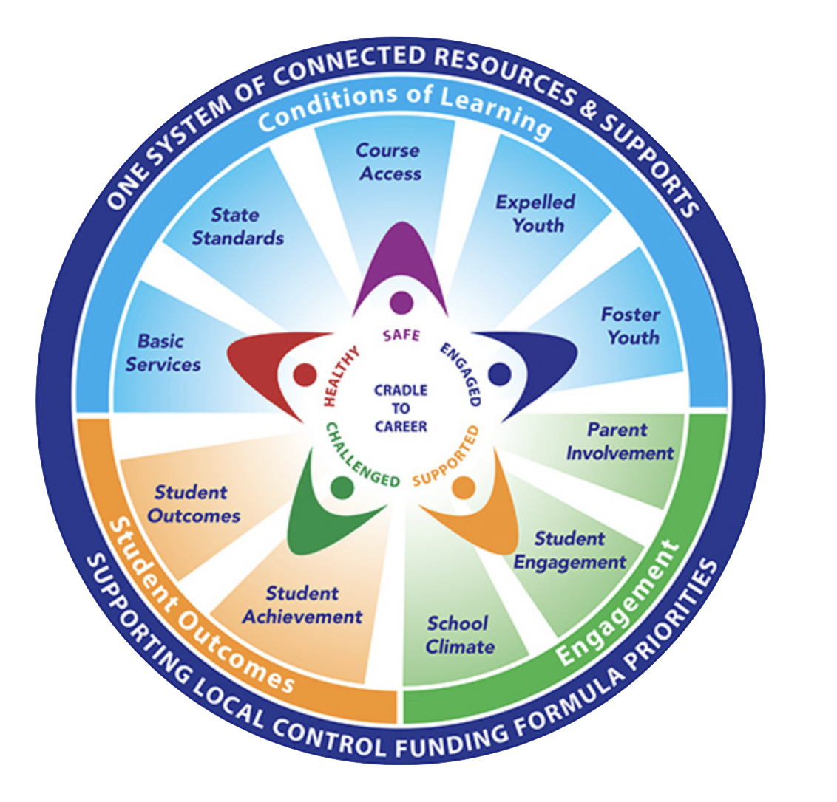
The LCFF Eight Priorities
Conditions of Learning
Basic Services (Priority 1)
State Standards (Priority 2)
Course Access (Priority 7)
Student Outcomes
Student Achievement (Priority 4)
Student Outcomes (Priority 8)
Engagement
Parent Involvement (Priority 3)
Student Engagement (Priority 5)
School Climate (Priority 6)

Slide 4
The Current LCAP Goals (22-23)
Goal 1: Increase Student Achievement
Goal 2: Increase meaningful and purposeful student, teacher, and parent engagement.
Goal 3: Provide an appropriate Basic Condition of Learning Social-emotional and behavioral support with extended classes and enrichment activities for students, and ensure all students are actively engaged and supported through a safe, healthy, and rigorous learning environment. Increase student engagement.

Slide 5
Rebuilding for 2023 and Beyond
In reflecting on the 2022-23 LCAPs developed last year, we determined the need to revamp the plans to address the following:
Strategic consideration of assessment data/response to it
Provide plans for our communities which are more transparent on the manner by which we seek to meet the goals
Provide metrics which align to the eight state priorities which can been actively progress monitored

Slide 6
Goal 1 Conditions of Learning (State Priorities: 1 Basic Services, 2 Implementation of State Standards, 7 Course Access)
Maintain high standards for a safe, nurturing, engaging learning environment where ALL students are supported in attaining high levels of achievement through the use of high-quality curricula and exceptional staff.

Slide 7
Goal 2 Annual Growth & Achievement in English Language Arts (State Priorities: 4 Pupil Achievement, 8 Other Pupil Outcomes)
Increase student achievement in English/Language Arts - Maintain high standards for our community to engage students in high levels of achievement in English/Language Arts through the use of high-quality curricula and local assessments, and ensure the necessary targeted acceleration and supports are delivered in a timely manner to maximize student growth.

Slide 8
Goal 3 Annual Growth & Achievement in Mathematics & Science (State Priorities: Priority 4 Pupil Achievement, Priority 8 Other Pupil Outcomes)
Increase student achievement in Mathematics and Science - Maintain high standards for our community to engage students in high levels of achievement in mathematics through the use of high-quality curricula and local assessments, and ensure the necessary targeted acceleration and supports are delivered in a timely manner to maximize student growth.

Slide 9
Goal 4 Growth & Achievement for English Learners and At-Promise Students (State Priorities: 4 Pupil Achievement, 8 Other Student Outcomes)
Annual growth for English Learners and special student groups - Ensure English learner students are demonstrating annual growth and progress in the mastery of state standards in English, mathematics and science.

Slide 10
Goal 5 School Culture & Climate (State Priorities: 3 Parental Involvement, 5 Student Engagement, 6 School Climate)
Engage students, teachers and parents as partners to strengthen the school climate and increase their understanding of the focus to improve successful secondary outcomes.

Slide 11
MORCS 2023-24 LCAP

Slide 12
Successes
iReady growth of Latino, English learners & Students with Disabilities
Use of ELOP program in building community

Slide 13
Opportunities for Growth/Improvement
Chronic Absenteeism
English Language Arts Indicator - CA Dashboard
Mathematics Indicator – CA Dashboard

Slide 14
BCCS 2023-24 LCAP

Slide 15
Successes
iReady “Stretch Growth” & “Improved Placement” in English and math
English Learner Progress in developing English Proficiency (ELPAC & SBAC)
Suspension Rate Indicator – CA Dashboard
Mathematics Indicator – CA Dashboard

Slide 16
Opportunities for Growth – CA Dashboard
Additional Targeted Support & Improvement (ATSI) identification for Hispanic, English learner, Students with Disabilities & Low-income
Chronic Absenteeism Indicator
English/Language Arts Indicator
Mathematics Indicator

Slide 17
BCCHS 2023-24 LCAP

Slide 18
Successes
Graduation Rate
Suspension Rate
School Climate

Slide 19
Opportunities for Growth – CA Dashboard
English Learner Progress in developing English Proficiency
English/Language Arts Indicator
Mathematics Indicator

