Slide 1
State and Federal Budget Update
March 18, 2021

Slide 2

This budget year has been like no other.
January 2020: 2.29% COLA
May 2020: 7.92% deficit
June 2020: flat funding with significant cash deferrals
3 federal stimulus bills
New state In-Person Instruction & Expanded Learning Opportunities Grants

Slide 3
Assembly Bill 86
Signed into law on March 5, 2021
Provides $2.0 billion for In-Person Instruction Grants and $4.6 billion for Expanded Learning Opportunities Grants.
AB 86 Funding Estimates
 | In-Person Instruction Grant | Expanded Learning Opportunity Grant
BCCS | $120,524 | $253,863
MORCS | $121,374 | $255,652
BCHS | $75,858 | $159,781

Slide 4
AB 86: In-Person Instruction Grants
Must offer in-person instruction to students by April 1 (in accordance with the color tier county is in)
Still eligible for incrementally decreased grant amounts as long as in-person instruction is offered by May 15 (grant is reduced by 1% for each instructional day between 4/1 and 5/15 that the LEA does not provide in-person instruction -- $770/day for VCES; $908/day for VCMS.)
Entire grant is forfeited if 1) the LEA does not offer in-person instruction by May 15 or 2) the LEA does not provide continuous in-person instruction through the remainder of the school year (hybrid model OK).
There is no partial grant amount for serving some but not all of the required students.
Grants is distributed in proportion to an LEA’s share of Local Control Funding Formula
LEAs will receive an in initial allocation in May and a final allocation in August
Grant recipients must report to the state by June 1 on when they reopened for in-person instruction.

Slide 5
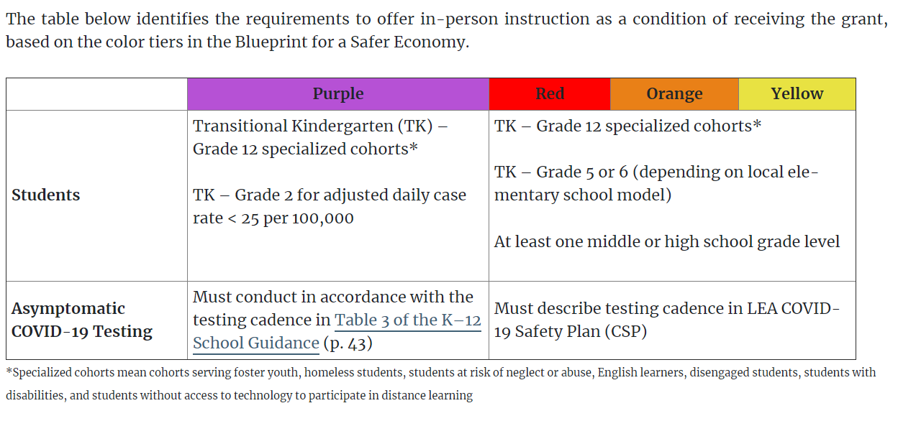
AB 86: In Person Instructional Grants
Source: School Services of California
Note: Purple Tier testing cadence not required for LEAs that are providing in-person instruction by April 1, or have a board adopted plan for in-person instruction by that date and have posted their COVID-19 Safety Plan (CSP).

Slide 6
AB 86: Expanded Learning Opportunity Grants
To be used for various strategies to accelerate learning and address student needs, such as extended learning time, professional development, programs to address social-emotional learning, and access to school meals.
85% of the funds must be used for activities provided in-person, and up to 15% of funds may be used for activities provided remotely.
At least 10% of grant proceeds must be used to employ paraprofessionals (full-time status is prioritized, not required).
If an LEA foregoes receiving the In-Person Instruction Grant, then up to ten percent of the Expanded Learning Opportunity Grant may be used for costs associated with reopening for in-person instruction.
Funds are available to spend though August 31, 2022.
LEAs will be required to adopt a plan by June 1, 2021, detailing the use of the Expanded Learning Opportunity Grant.

Slide 7
Coronavirus Response and Relief Supplemental Appropriations (CRRSA) Act
Approved by Congress in December 2020
Funds a second round of Elementary and Secondary School Emergency Relief (ESSER)
The ESSER II Funds can be used in much the same way as the ESSER Funds under the Coronavirus Aid, Relief, and Economic Security (CARES) Act. (Allowable expenditures available here.)
Funds can be spent through September 30, 2023
 | Preliminary Estimate
BCCS | $431,447
MORCS | $505,152
BCHS | $256,038

Slide 8
American Rescue Plan
$1.9 Trillion stimulus bill earmarks nearly $170 billion for education, including $122.8 billion for a third round of funding into the Elementary and Secondary School Emergency Relief (ESSER) Fund.
ESSER III funds are available to spend through September 30, 2024. (Actual deadline: 9/30/23, but a federal provision grants an additional year past the stated deadline.)
Reopening plan must be published within 30 days of receiving ESSER III. (Existing adopted reopening plan OK as long as LEA allowed for a public comment period and the plan details a “safe return to in-person instruction and continuity of services.” )
20% of ESSER III funds must be reserved for learning loss mitigation measures (e.g. expanded learning programs and summer school)
ESSER III Funding Estimates
 | Set Aside for Learning Loss* | Total ESSER III
BCCS | $188,194 | $940,969
MORCS | $220,343 | $1,101,715
BCHS | $111,682 | $558,409
*Set aside for learning loss represents 20% of Total ESSER III funding and is included in total

Slide 9
Significant $$ requires significant planning
 | BCCS | MORCS | BCHS | Spend By
Coronavirus Relief Fund | $ 386,116 | $ 355,055 | $ 258,188 | 5/31/2021
In-Person Instruction Grant | $ 120,524 | $ 121,374 | $ 75,858 | 8/31/2022
Expanded Learning Grant | $ 253,863 | $ 255,652 | $ 159,781 | 8/31/2022
GEER | $ 33,581 | $ 16,560 | $ 23,921 | 9/30/2022
ESSER I | $ 111,213 | $ 124,055 | $ 60,790 | 9/30/2022
ESSER II | $ 431,447 | $ 505,152 | $ 256,038 | 9/30/2023
ESSER III | $ 940,969 | $ 1,101,715 | $ 558,409 | 9/30/2024
Total | $ 2,277,713 | $ 2,479,563 | $ 1,392,985

Slide 10
Significant $$ requires significant planning.
Funds are one-time in nature but span multiple years
  Traditional one-time expense for one-time revenue rule may not apply but there must be a plan in place to eliminate or reallocate the expense when the funds go away.
Critical to have a plan that
  Considers all of the available $
  Is aligned with the LCAP
  Leverages one-time dollars for on-going benefits
  Communicates the short-term nature of modifications to school’s program
  Maintains fiscal solvency after the funds are gone

