Slide 1
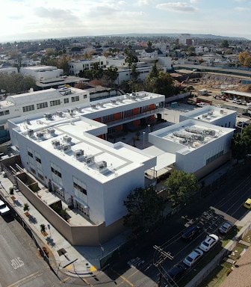


Multifunction Printer Proposal
PREPARED BY:
Joseph Chuan
Branch Manager, Greater Los Angeles
805-200-6865
joseph.chuan@ricoh-usa.com
June 17, 2020

Slide 2

Cover Letter
Dear Yvette,
On behalf of your Ricoh team, thank you for meeting with us to discuss your organization’s challenges and how we can deliver the solutions that will help propel your Charter School forward and position you for success. Based on our conversations, I have prepared a proposal that will assist you in achieving your goals.
Ricoh has transformed the way people live and work with breakthrough technologies and services. Our solutions help you to remove obstacles to sustained growth by optimizing the flow of information and automating antiquated processes to increase productivity.
In addition, our extensive experience in a wide range of industries gives us in-depth knowledge of your unique challenges — and how our services can help overcome them.
We appreciate your time and look forward to helping your organization work smarter.
Sincerely,
Joseph Chuan
Branch Manager, Greater Los Angeles
805-200-6865
joseph.chuan@ricoh-usa.com

Slide 3

Executive Summary
About Ricoh
Current State
Ricoh’s analysis of your current situation revealed:
  Current contract does not have consolidated billing and does not take advantage of economies of scale
  No means to track or measure printing/copying
  Budget shortfall requires a combination of short-term and long-term reductions in fixed and variable costs to retain staff and faculty
For over 80 years, Ricoh has transformed the way people work with breakthrough technologies that help businesses innovate and grow. Our focus has always been to envision what the future will look like so that we can help prepare you for success. Today, that means improving workplaces using innovative technologies & services enabling individuals to work smarter.
Learn more:
ricoh-usa.com/about-us
Goals
  Reduce fixed and variable costs
  Solution to track, measure and manage print easily
  Improve service with guarantees for uptime and productivity
  Utilize a State approved contract vehicle that provides flexibility in case situations arise like non-appropriations
Video: Ricoh is empowering
digital workplaces
Ricoh’s team is always there when we need them. And they understand and respect what we do, so they work diligently to resolve issues quickly.
Oregon based
Non-profit Organization
Proposed Solution
  Our proposed solution will address the current challenges by bringing together our K/12 Charter School expertise to offer–
    A competitive, cost effective solution
    Tools designed to reduce print volumes allowing for tracking, measuring and managing print across the Charter.

Slide 4


Proposal for YPICS
  Work smarter with digital workplace solutions
  The digital shift is transforming the way people work, and businesses need to move fast to stay ahead of the competition and keep customers happy. Ricoh provides digital workplace solutions to more than 1.29 million companies worldwide by helping them improve workplaces with innovative technologies and services that enable people to work smarter. The key to helping you succeed is our evolving services and solutions portfolio. Here are some benefits you can expect from our hardware and services proposal.
Reduce fixed costs
Provide faculty and staff with new technology while containing costs with rich reporting and print controls
Budget and funding allocation made easy by assigning costs for printing, paper and lease
Bridge budget gap to ensure retention of faculty and staff
The integrated solution that Ricoh put together has helped reduce off-site storage and save even more in filing space. It has saved countless hours of clerical effort and contributed to an improved work environment with more productivity and less stress.
Real Estate Investor in Massachusetts
Click here to learn about all of our Services & Solutions

Slide 5
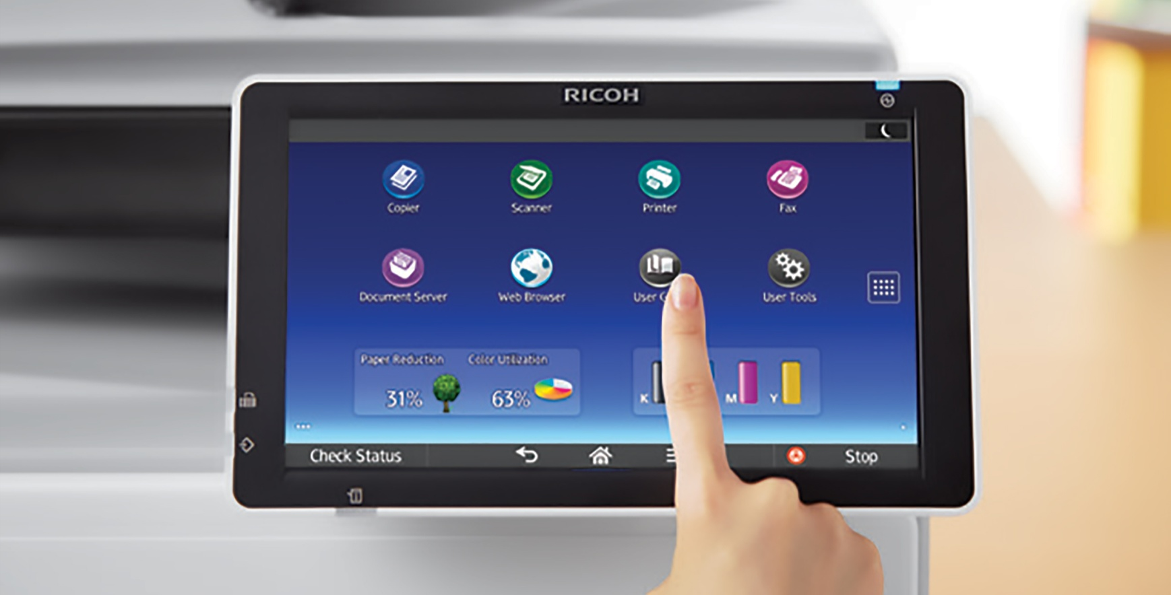
Proposal for YPICS
  Leveraging 80+ years of innovation in office technology
  Ricoh’s industry leading product line is designed to meet the demands of any of our customer’s environments. We offer both workgroup multifunctional printers and printers that work seamlessly with our digital workplace solutions and software to allow our clients to create, share and mange their critical business information and documents. [Customer Name] can look forward to these benefits:
Ability to connect to cloud applications
Lower Total Cost of Ownership (TCO)
Improved print & scan quality
Increased document security options
Reduction in hardware malfunctions, resulting in improved uptime
Ricoh...wants to be our
partner and solve our problems. Ricoh is a straight shooter that has vastly improved our organization’s information management.
Logistics & Transportation Service Provider in Pennsylvania
Click here to learn more about Ricoh’s innovative office technology

Slide 6
Financial Summary
Current Equipment |  | Model / Product | Monthly Payment | Meter | Includes: |  | Avg Monthly Volume | Overage Copies | Cost Per Print | Meter Charges | Avg Monthly Cost
 | 1 | Xerox XC702 MORCS | $887.84 | B&W | 20,000 | Copies/Month | 9,248 | -10,752 | $0.007310 | $0.00 | $1,627.27
 |  |  |  | Color | 4,000 | Copies/Month | 13,825 | 9,825 | $0.075260 | $739.43
 |  |  |  |  | [Labor, Parts, Supplies]
 | 2 | Xerox WC 7845PT MORCS | $348.30 | B&W | 4,000 | Copies/Month | 8,442 | 4,442 | $0.010810 | $48.02 | $989.71
 |  |  |  | Color | 1,000 | Copies/Month | 6,779 | 5,779 | $0.102680 | $593.39
 |  |  |  |  | [Labor, Parts, Supplies]
 | 3 | Xerox XC702 YPI PCHS | $640.21 | B&W | 10,000 | Copies/Month | 12,920 | 2,920 | $0.0000 |  | $1,333.93
 |  |  |  | Color | 1,000 | Copies/Month | 8,639 | 7,639 | $0.0000 | $693.72
 |  |  |  |  | [Labor, Parts, Supplies] |  |  |  | No DATA
 | 4 | Xerox WC 7845PT BCMS | $1,654.51 | B&W | 35,200 | Copies/Month | 1,922 | -12,809 | $0.0000 |  | $3,258.88
 |  |  |  | Color | 6,250 | Copies/Month | 5,031 | 18,344 | $0.08746 | $1,604.37
 |  |  |  |  | [Labor, Parts, Supplies]
 | 5 | Xerox XC702 BCMS | Included w/ #4 | B&W | Incl. | Copies/Month | 17,769 | Incl. |  |  | Incl. with #4
 |  |  |  | Color | with #4 | Copies/Month | 19,563 | #4
 |  |  |  |  | [Labor, Parts, Supplies]
 | 6 | Xerox WC 7845PT HQ (no replacement) | $292.29 | B&W | 4,000 | Copies/Month | 871 | -3,189 | $0.010810 | $0.00 | $626.41
 |  |  |  | Color | 500 | Copies/Month | 3,754 | 3,254 | $0.102680 | $334.12
 |  |  |  |  | [Labor, Parts, Supplies]
 | Total |  | $3,823.15 |  |  |  |  |  |  | $4,013.05 | $7,836.20
Proposed Equipment |  | Model / Product | Monthly Payment | Meter | Includes: |  | Avg Monthly Volume | Overage Copies | Cost Per Print | Meter Charges | Avg Monthly Cost
 | 1 | Ricoh MP C8003 MORCS | $588.76 | B&W | 0 | Copies/Month | 9,248 | 9,248 | $0.0055 | $50.86 | $1,202.30
 |  |  |  | Color | 0 | Copies/Month | 13,825 | 13,825 | $0.0407 | $562.68
 |  |  |  |  | [Labor, Parts, Supplies]
 | 2 | Ricoh IMC4500 MORCS | $324.06 | B&W | 0 | Copies/Month | 8,442 | 8,442 | $0.0055 | $46.43 | $646.40
 |  |  |  | Color | 0 | Copies/Month | 6,779 | 6,779 | $0.0407 | $275.91
 |  |  |  |  | [Labor, Parts, Supplies]
 | 3 | Ricoh MP C8003 YPI PCHS | $583.94 | B&W | 0 | Copies/Month | 12,920 | 12,920 | $0.0055 | $71.06 | $1,006.61
 |  |  |  | Color | 0 | Copies/Month | 8,639 | 8,639 | $0.0407 | $351.61
 |  |  |  |  | [Labor, Parts, Supplies]
 | 4 | Ricoh IM C4500 BCMS | $324.06 | B&W | 0 | Copies/Month | 1,922 | 1,922 | $0.0055 | $10.57 | $539.39
 |  |  |  | Color | 0 | Copies/Month | 5,031 | 5,031 | $0.0407 | $204.76
 |  |  |  |  | [Labor, Parts, Supplies]
 | 5 | Ricoh MP C8003 | $553.01 | B&W | 0 | Copies/Month | 17,769 | 17,769 | $0.0055 | $97.73 | $1,446.95
 |  |  |  | Color | 0 | Copies/Month | 19,563 | 19,563 | $0.0407 | $796.21
 |  |  |  |  | [Labor, Parts, Supplies]
 | Total |  | $2,373.83 |  |  |  |  |  |  | $2,467.82 | $4,841.65

Slide 7
Investment Scenario
Monthly Cost Comparison
 | Current | Proposed
Lease | $3,823.15 | $2,373.83
Maintenance & Supplies | $4,013.05 | $2,467.82
Total | $7,836.20 | $4,841.65
Savings of $2,994.55 per month / $179,673.00 over contract term!
Included in Monthly Fee
New Ricoh MFPs 60-month FMV US Communities Contract | 5 MFPs: (3) MP C8003 & (2) IM C4500 Delivery, setup, installation & Training General maintenance agreement: One click-rate for entire fleet – pay-as-you go with zero committed volume. Print zero-Pay zero Parts, labor, toner and staples included 1-hour call-back on 4-hours onsite US Communities SLAs with guaranteed uptime Stream of Payments‡ check to YPICS in the amount of $22,411.26 Check‡ to YPICS in the amount of $1,790.00 to cover storage and return of Xerox equipment expiring after 8/2020: Contract 010-0042733-001 (2 devices) – Return to vendor 8/2020 Contract 010-0058450-001 (1 device) – Store & return to vendor 9/2021 Contract 010-0058450-002 (1 device) – Store & return to vendor 9/2021 Contract 010-0042736-001 (1 device) – Return to vendor 9/2020 Contract 010-0058450-003 (1 device) – Store & return to vendor 12/2021 5-months deferred lease payment - 2-months of existing lease and 3-months of new Ricoh lease – an immediate upfront savings of $13,687.79. ‡Check to be provide 30-days after delivery and acceptance of new Ricoh equipment.
PaperCut | PaperCut migration 5-years, licensing, maintenance & support Remote install, admin and end-user training Card authentication at the device for secure print release and tracking Rules and cost based rules – quota setting if desired Rich reporting for billback and budget allocation

Slide 8
US Communities
U.S. Communities is a “National Local Government Purchasing Group” that is a nonprofit instrumentality of government formed under the U.S. Code, Title 26, Internal Revenue Code, Section 115. This Master Agreement in conjunction with Public Agency’s governing purchasing laws and ordinances, and can be utilized by all public agencies, except Federal, that have authority to purchase from another public agency’s competitively solicited contract. Eligible participants include: Counties, Cities, Special Districts, Schools, Colleges and Universities and Nonprofits. Nonprofits include, but are not limited to private K-12 and Higher Education, healthcare and legal and financial, such as credit unions.
Our current U.S. Communities contract was bid by the County of Fairfax, VA. It represented over 2,100 devices, services and solutions that were solicited for. The selection committee included the City and County of Denver, City of Kansas City, MO and Fresno Unified School District Ricoh sold an estimated 100,000+ units and over $2.3 Billion through our relationship as a U.S. Communities supplier.
Details, including all contract documentation can be found here:
https://public.omniapartners.com/suppliers/ricoh/overview
Some advantages of utilizing US Communities contract include, but are not limited to:
Guaranteed Service Level agreements
No contract escalations
No charge for delivery, installation and return at end of term.
No charge moves inside of same site
Non-appropriations language
Competitively bid and State approved contract vehicle
Access to vendors that are part of the GPO, like Amazon Business, Home Depot, Cintas, etc.

Slide 9
Hardware Highlights
All Ricoh hardware feature:
Simplified graphical user interface (GUI)
  All Ricoh GUI are the same regardless of speed or class of device – learn to use one Ricoh device, learn to use all Ricoh devices
Capable scanning
  High-speed single-pass duplex scanning of up to 220 images per minute
  Scan to email, folder, FTP
Sharp print resulting from 1200 x 1200 dpi output
Passive and active environmental sustainability
  Energy Star compliant
  EPEAT Gold certification
  Advanced biometric sensor for fast recovery from sleep mode
  Gamification to encourage sustainability practices

Slide 10
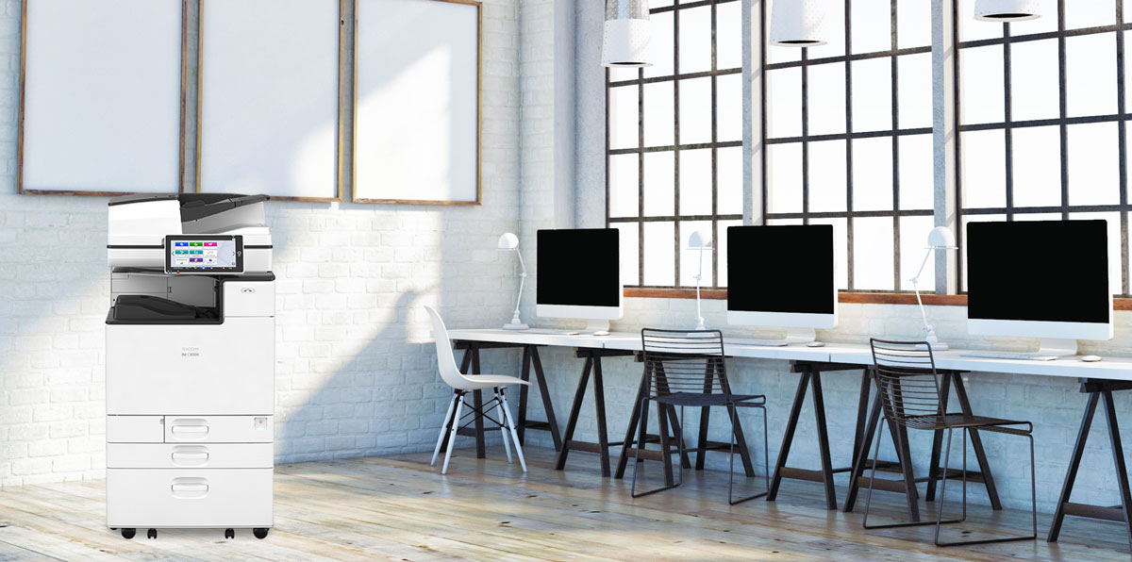

Multifunction (Scanner, Printer, Copier, Fax)
Products included in proposal may differ from product pictured.
Ease into long-lasting productivity
With RICOH Always Current Technology, the capabilities of your device can grow with your business. This platform allows you to install the latest features and interface enhancements as they become available to meet your workplace needs
IM C4500 Highlights
Upgrade your workflows with speed and new technologies
Prints up to 45 ppm, copy, scan, optional fax
1200 x 1200 dpi max print resolution
Paper capacity of up to 4,700 pages
Expand high-speed capabilities with responsive control and convenient apps
Troubleshoot with intelligence
Simplify maintenance with a host of RICOH Intelligent Support capabilities. Our service specialists can remotely access your Ricoh printer to fix issues and minimize downtime. You can also give in-house IT managers the ability to resolve issues over the company network.
The process of working with Ricoh was seamless. Installation and configuration was quick and thorough, and the Ricoh team was very professional.
Retail Store in Greater Los Angeles
Reduce costs and cut energy usage
Our equipment features energy-saving options like Sleep Mode and Quick Start-Up, and resource-saving options like automatic duplex printing — all while maintaining your productivity.
Click here for more information

Slide 11

Multifunction (Scanner, Printer, Copier, Fax)
Products included in proposal may differ from product pictured.
Flick, pinch, and swipe touchscreen*
Our large, intuitive 10.1” Smart Operation Panel puts advanced capabilities at your fingertips. Run single-function apps that streamline your workflows and help guide users through common jobs such as ID Card Scan & Copy and more.
MP C8003 Highlights
Make high-volume color highly productive
Prints up to 80 ppm, copy, scan, fax
1200x4800 dpi max print resolution
Paper capacity up to 8,100 pages
Full-color 10.1" Smart Operation Panel
Device monitoring available
Avoid the hassle of calling in service requests and meter reads, printing usage reports and checking toner levels with the optional RICOH @Remote device monitoring and management system. When equipped, you can expect shortened downtime and improved service.
The process of working with Ricoh was seamless. Installation and configuration was quick and thorough, and the Ricoh team was very professional.
Retail Store in Greater Los Angeles
Reduce costs and cut energy usage
Our equipment features energy-saving options like Sleep Mode and Quick Start-Up, and resource-saving options like automatic duplex printing — all while maintaining your productivity.
Click here for more information
* Not standard on all models. Consult with your Client Executive

Slide 12

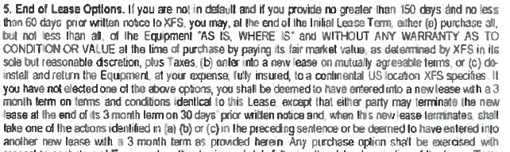
Implementation Plan
Assess
Plan
Integrate
Transition to Steady State
Analyze
Build/
Deploy
Rollout
Close
Next Steps
Step | Timeframe
Letter of Intent | Letter of intent for leases expiring August and September 2020 must be sent the week of 6/22 in order to avoid roll-over 90-day term being added to your lease.
Decision | In order to take advantage of funds that provide the 5-month deferral, new Ricoh contract must be executed by 6/25 to process for end-of-month.
Implementation & Training | Implementation of hardware and software solutions week of August 24th for September 1 contract start date. Hardware and Software training week of September 7th (after Labor Day holiday)

Slide 13


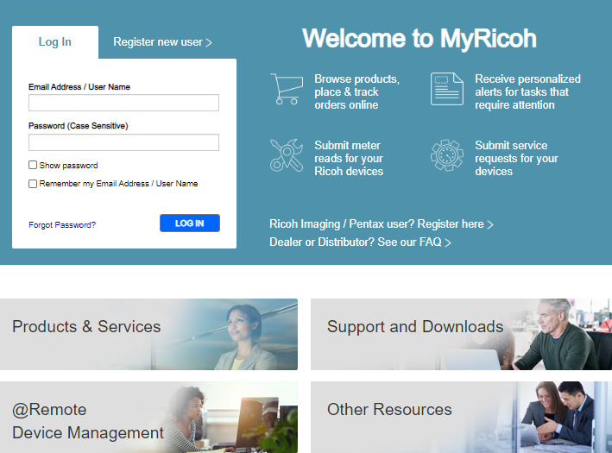

Maximizing Customer Experience with Ricoh
One of the industry’s largest services networks of over 12,000 field based employees
State-of-the-art automated cloud dispatch program brings together the right technician with the right parts and keeps you appraised of status
Support personnel who possess the professional certifications to work effectively in your environment and resolve issues quickly
Ricoh’s Technology Support Services Center provides 24/7 customer support for hardware devices as well as application software that’s part of your solution
  Onsite service
  Self-help global knowledgebase
  Customer help desk
  Dispatch via web
MyRicoh online customer service portal offers a quick and easy way to securely manage your account and do business with us online 24/7, on your schedule, whenever it’s most convenient for you
  View invoices, contract details, and update purchase order numbers for your contracts
  Order supplies, submit meter reads, request and manage service
  Schedule equipment relocations
  Live chat with our support team, access FAQs and our Global knowledge base for product questions
Projectors
Our Technology Services team has received the NorthFace ScoreBoard Award (SM) for customer satisfaction. This award recognizes organizations who not only offer exemplary service to their customers, but who also center their existence on a deep commitment to exceeding customer expectations and is solely based on the Voice Of the Customer satisfaction ratings for our Technology Services function.
Learn more

Slide 14





Security is in Ricoh’s DNA
Ricoh technologies and solutions are designed, manufactured and implemented with security as a core requirement from the start in everything from product design to sales. And, we don’t stop there. Ricoh is addressing our customers’ expanding security concerns through Governance, Risk and Compliance (GRC). These services encompass data lifecycle and risk assessment & management, eDiscovery, end-point and server security, identity access, email security and protections against advanced network threats. It’s in Ricoh’s DNA — informing both our design philosophy and our commitment to work continuously to support our customers with solutions and services as threats evolve.
Device Security Our device security capabilities can help address potentially compromised firmware, hard disk drive, non-volatile memory, open network ports and system of authentication on our multifunctional devices and laser printers. Ricoh has obtained certification for a wide range of products based on Common Criteria (ISO/IEC 15408).
Digitally signed firmware updates DataOverwriteSecurity System (DOSS) and hard drive overwrite services Hard drive encryption | Fax line security IEEE 2600 independent security certification Device user authentication Hard drive disposal and MFP cleansing services
Projectors
Data Security It’s easy to accidentally leak information. Ricoh multifunction printers help protect your data whether you’re printing, copying, scanning or faxing. Ricoh’s data encryption - which uses a RSA BSAFE Crypto encryption module that is FIPS 140-2 validated - helps protect your data both when it is in transit and when it is at rest.
Secured scanning solutions Locked Print Copy data security | Mandatory secured information print Cost accounting and recovery
Network Security Multifunction printers exchange critical information with computers and servers over networks. Ricoh products and technologies offer features that can help protect against unauthorized access via networks. Employed techniques include encryption of network communications and print streams, network user authentication and a host of administrative countermeasures.
Network user authentication Close unused network ports Network encryption | Print stream encryption Device Management Remote fleet reporting and firmware updates

Slide 15
Ricoh’s layered approach
Services
Server
Security
Network
Embedded
applications
Smart
Operation
Panel
Device Security
Security threats are no longer limited to personal computers, servers or networks. Ricoh can help you tackle potential issues caused by vulnerabilities in your devices, the data they process and the networks to which they connect.
Projectors
Device Security
Network (Transport & Data Layers)
ISO 15408 / IEEE 2600 certifications
Ricoh-only Operating System
Hard Disk Encryption
DataOverwriteSecurity System (DOSS)
Digitally signed firmware updates
Leverage & comply with customer’s network security policies & measures
End to end encryption of scan and print files
Smart Operational Panel (User Interface)
Server Security
Ricoh only unique OS
Unnecessary tools and components, tools with known issues are not installed
Linux Kernel and Services are customized
Root access is not available
Leverage & comply with customer’s server security policies & measures
Segregation of administrator and user roles
Embedded Applications
Services
Providing extended features such as authentication, secured print, scan & capture, encryption and workflow
Tested, compatibility certified and digitally signed by Ricoh
Security Optimization Services
ITIL (Information Technology Infrastructure Library) & ISO certified service processes
Security Incident & Response Team
End of Life Disposal Services
Security beyond the device with Information Governance services

Slide 16














Grow your Business with Ricoh
Uphold your competitive edge by leveraging our industry expertise and intellectual property to help you unravel your business challenges through people, processes and technology. With over 80+ years of innovation, our focus has always been to help prepare you for success. The key to helping you succeed in the midst of this ongoing change is our digital workplace solutions.
Managed Print
Enterprise Content Management & Workflow
Business Process Outsourcing
Workplace Productivity
Enterprise Support
Customer Communications Management & Mail
Information Governance & Cyber Security
Cloud & IT
Our recognition that sets us apart
 | 2018 World’s 50 Most Innovative Companies from USA Today
 | Awarded Highest Gold Rating in EcoVadis Global Supplier Survey 4 times in a row
 | Named a Leader in Gartner Magic Quadrant for Managed Print & Content Services worldwide 6 years in a row.
 | 2020 Energy Star Partner of Year
 | 2019 Global Leader in Print and Document Security from IDC MarketScape
 | 2018 Excellence in Partnership Best Veteran Hiring Award from Coalition for Government Procurement

Slide 17
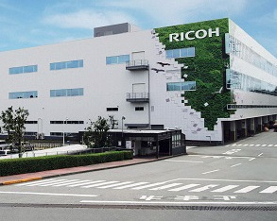

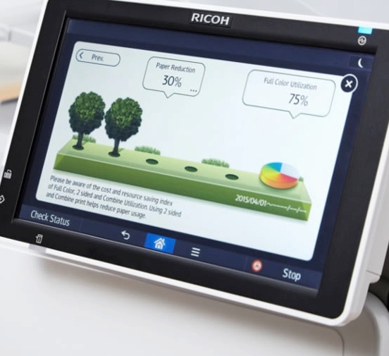
Work toward a sustainable future
Our commitment to environmental conservation has been woven into the DNA of our manufacturing, logistics, product use and final disposal processes. With our sustainable practices, we can help you advance your green initiatives through eco-responsible procurement, recycling programs, paper reduction and output optimization.
All of our manufacturing facilities worldwide are ISO 14001-certified and support sustainable environmental management. We have been an ENERGY STAR® partner for more than 20 years and were designated ENERGY STAR partner of the year for three years in a row.
Learn more: ricoh-usa.com/environment

Slide 18

Ricoh’s Digital Workplace Solutions combine the right services, expertise, and technology to optimize the flow of information, so you can improve employee productivity, better serve your customers, and grow your business.

Slide 19
Ricoh USA, Inc. 300 Eagleview Blvd Ste 200, Exton, PA, 19341 | 1-800-63-RICOH
©2020 Ricoh USA, Inc. All rights reserved. Ricoh® and the Ricoh logo are registered trademarks of Ricoh Company, Ltd. All other trademarks are the property of their respective owners. The content of this document, and the appearance, features and specifications of Ricoh products and services are subject to change from time to time without notice. Products are shown with optional features. While care has been taken to ensure the accuracy of this information, Ricoh makes no representation or warranties about the accuracy, completeness or adequacy of the information contained herein, and shall not be liable for any errors or omissions in these materials. Actual results will vary depending upon use of the products and services, and the conditions and factors affecting performance. The only warranties for Ricoh products and services are as set forth in the express warranty statements accompanying them.

