Slide 1
FY20-21 budget
YPI Charter Schools, Inc

Slide 2
Revenue Assumptions
One time Federal ESSER funding (CARES Act)
BCCS - $135,044
MORCS - $150,638
BCHS - $73,817
LCFF -10% COLA (May revised is -7.92%)
SB740 assumes 0% funding for Other Costs and 20% reduction to Rent Reimbursement
PPP Loan is not included in the budget

Slide 3
Revenue Assumptions
Enrollment / ADA
BCCS – 371 / 356.16 or 96%
MORCS – 350 / 337.75 or 96.5%
High School – 197 / 183.33 or 94.5%
Unduplicated Count
BCCS – 77%
MORCS – 94%
High School – 92%
LAUSD – 85.40%

Slide 4
Expense Assumptions
Salaries
Salaries Freeze
Staff Reduction
Hiring Freeze
STRS 16.15% (decrease from 18.1%)
Health Insurance Costs are estimated to stay the same as FY19-20
Reduction in Field Trips
Reduction in Travel

Slide 5
Expense Assumptions
Rent
BCCS ($10,300 a month)
M&O for MORCS $280K + $60K for Utilities
M&O contract assumes 3 years
Prop 39 for High School ($227K)
Closing of Central Admin building in October
MORCS Prop 1D repayment loan
Indirect Cost – allocated based on the number of students.

Slide 6
Expense Assumptions
ExED contracts:
Management and Accounting Services :
$222,282 – no increase
CALPADS:
$11,500 per school (increase from $8,750 due to increase in complexity of CALPADS reporting)
CASH Flow needs
Bert Corona High School will need to borrow from Bert Corona Middle during the year to support cash flow needs due to the deferrals

Slide 7
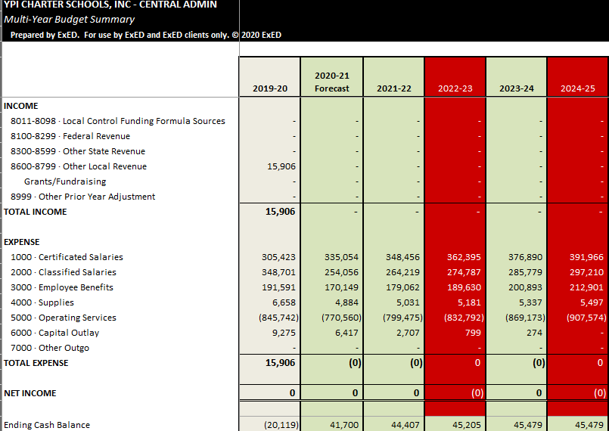
Central Admin – Summary Budget

Slide 8
BCCS – Summary Budget

Slide 9
MORCS– Summary Budget

Slide 10
HS– Summary Budget

