Slide 1
YPICS GEAR UP
March 18, 2019
Board Presentation
Nicholas Wu
GEAR UP Director, YPI

Slide 2
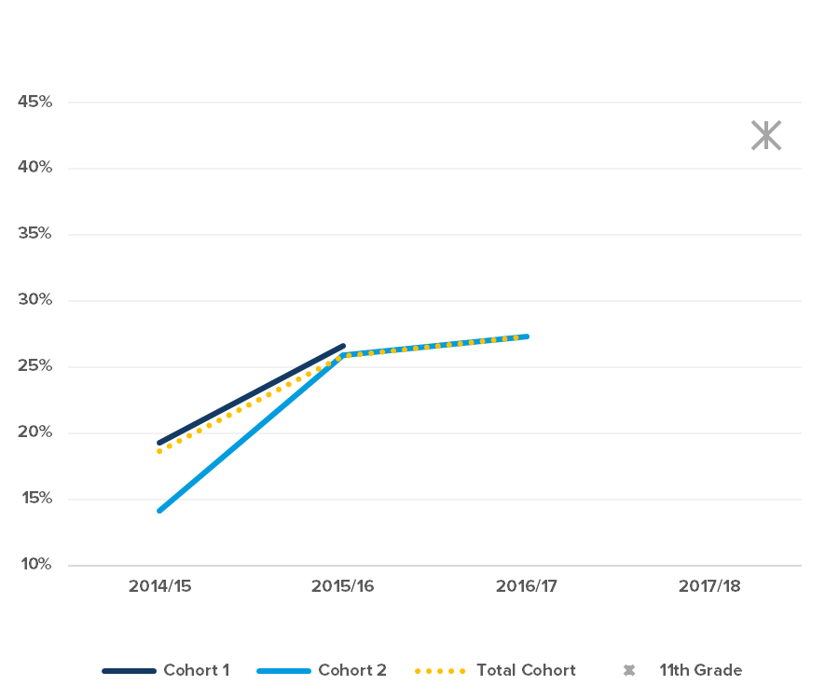
The percentage of students scoring at or above grade level* in Common Core ELA grew by 8 percentage points for Cohort 1 from 2014/15 to 15/16. For Cohort 2, the percentage grew by 12 points from 14/15 to 15/16, and 1 point from 15/16 to 16/17.
Percent Met/Exceeded - ELA
2017/18 11th graders included as a reference point
* Includes test levels Standard Met and Exceeds Standard
GEAR UP Goal: Percent of students scoring at or above grade level in Common Core ELA will increase by 3 points each year.
Notes:
Play around with text and see if there is a prettier way to show increase from 16/17 to 17/18.
Add question and answer options for each year
Add actual grant goal into slide somewhere

Slide 3
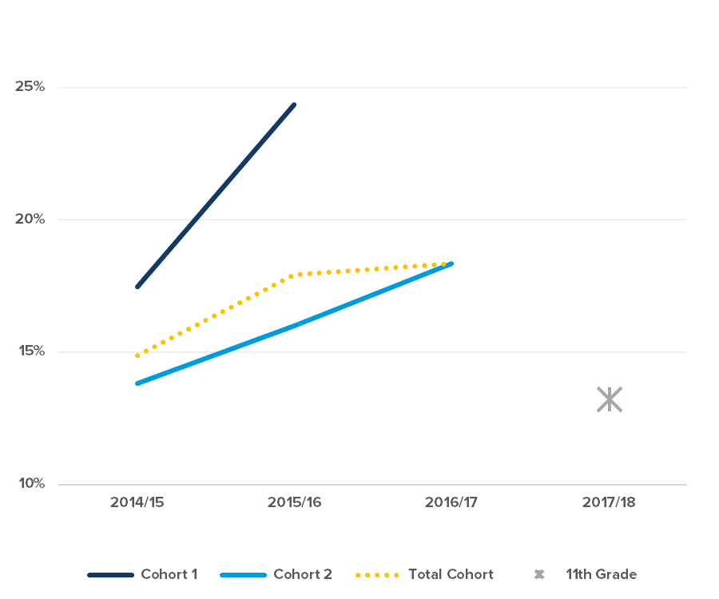
The percentage of students scoring at or above grade level* in Common Core Math grew by 7 percentage points for Cohort 1 from 2014/15 to 15/16. For Cohort 2, the percentage grew by 2 points from 14/15 to 15/16, and 2 points from 15/16 to 16/17.
Percent Met/Exceeded - Math
2017/18 11th graders included as a reference point
* Includes test levels Standard Met and Exceeds Standard
GEAR UP Goal: Percent of students scoring at or above grade level in Common Core Math will increase by 3 points each year.
Notes:
Play around with text and see if there is a prettier way to show increase from 16/17 to 17/18.
Add question and answer options for each year
Add actual grant goal into slide somewhere

Slide 4
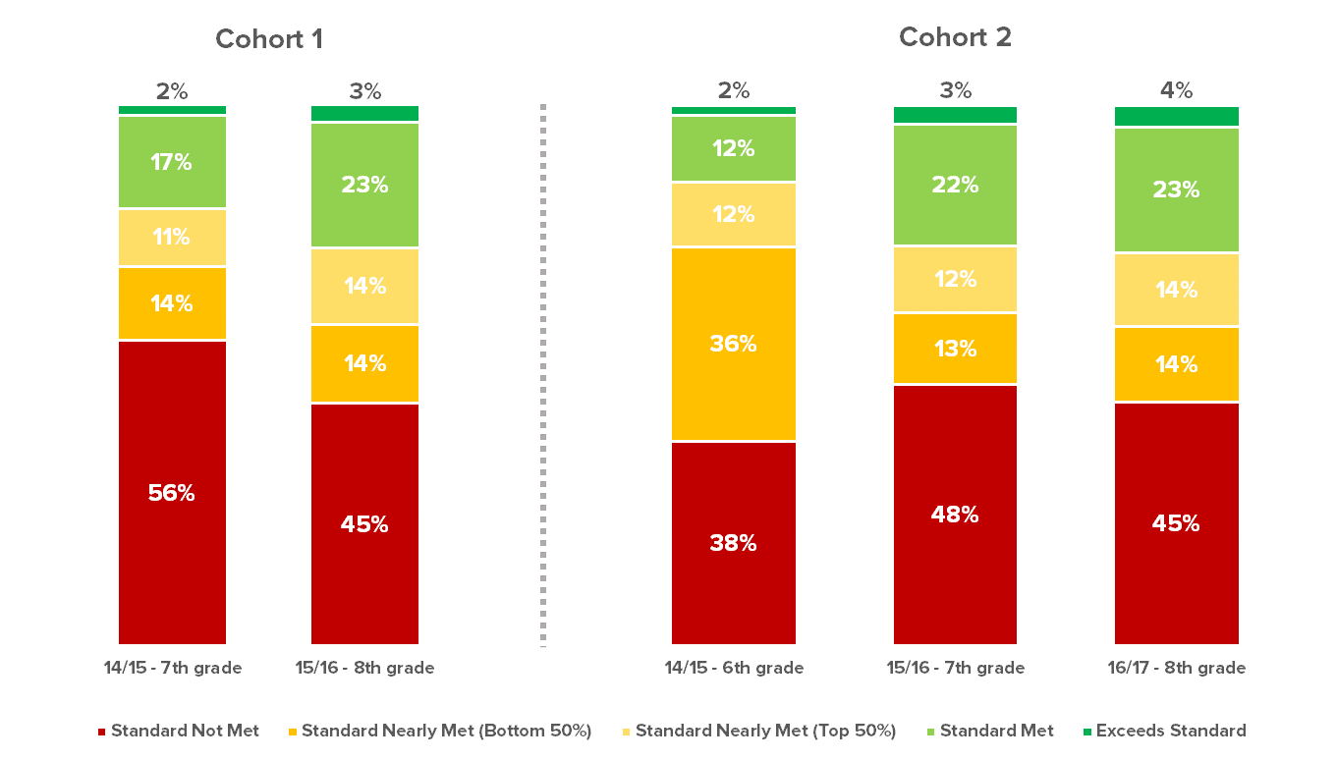
ELA Score Distribution
Key take-aways: Percentage of students meeting the standard increased each year across both cohorts
Cohort 1 saw a significant decrease in percentage of students not meeting the standard

Slide 5
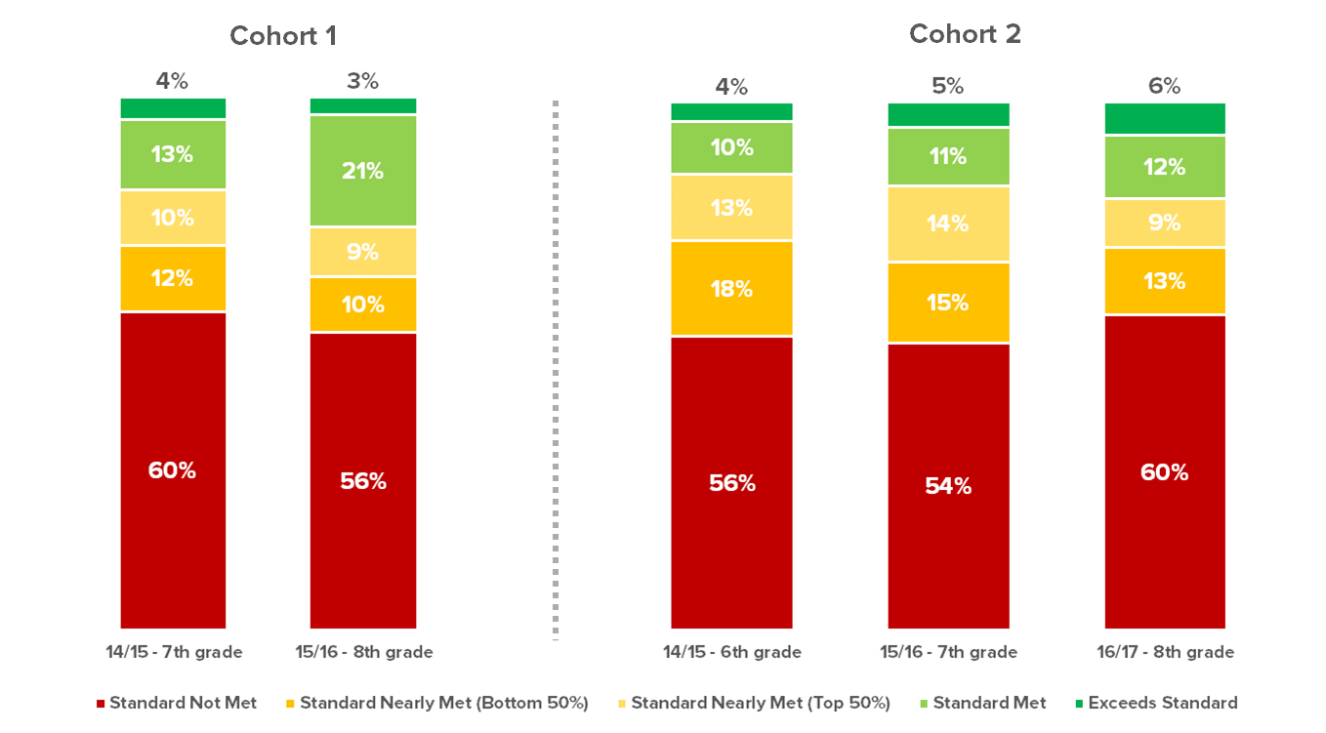
Key take-aways: Percentage of students meeting the standard increased across both cohorts Percentage of students nearly meeting the standard has decreased across both cohorts Cohort 1 saw a decrease in percentage of students not meeting the standard, whereas Cohort 2 saw some fluctuation
Math Score Distribution

Slide 6
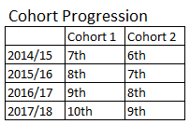
GEAR UP has successfully met its target of 38% of students achieving a 3.0 or better each year the program has been fully implemented.* This is particularly impressive as coursework and grading typically get more challenging as students' progress each grade level.
38%
*The GEAR UP program was not fully staffed until the summer of 2015.

Slide 7
There seems to be a fair amount of fluctuation between the groups of students receiving a 3.0 or better by term. In most cases GPA's decrease in the second semester, the only exception to this pattern is 8th grade for each cohort.
COHORT 1
COHORT 2
8th Grade
9th Grade
10th Grade
7th Grade
8th Grade
9th Grade

Slide 8
Counseling/Advising Impact on GPA
Students that received counseling/advising support had better outcomes than students without this type of support when comparing changes in GPA throughout the school year.
Out of the three types of counseling/advising provided, individual/small group advising seemed to have the greatest impact.
Data represented above is from the 2016/17 academic year
Notes:
Comparisons of participants in any type of counseling to those with no counseling participation showed a statistically significant improvement for ninth graders (t = -3.329, p < .01). Likewise, time spent in counseling overall was significantly positively correlated with change in GPA among ninth graders (r = .159, p < .05)

Slide 9
The percentage of students agreeing* that "I know which A-G courses I need to pass with a 'C' or better to get into college” grew by 63% from 2016/17 to 17/18. Although both cohorts experienced significant increases, the greater gain was seen in Cohort 1.
Students’ Knowledge Around A-G Requirements
Cohort Progression
 | 2016/17 |  | 2017/18
Cohort 1 | 8th | → | 9th
Cohort 2 | 9th | → | 10th
* 2016/17 responses counted towards this question include “Completely true” and “Mostly true”
* 2017/18 responses counted towards this question include “Strongly agree” and “Agree”
Notes:
1) Fill in red sections.
2) Add label to grant goal line
3) Add label under graph with cohort progression
4) Add question and answer options for each questions
Want to add blurb about objective met?

Slide 10
The percentage of parents reporting that school staff had helped them understand which A-G courses were needed for college entry* rose from 52% in 2016/17 to 72% in 2017/18.
Questions asked by year
2016/17: Who from your child’s school has helped you to understand the A-G courses your child is required to complete to get into a University of California (UC) institution? (You may choose more than one option.)
2017/18: Who from your child’s school has helped you understand the A-G courses your child is required to complete to get into a University of California (UC) or California State University (CSU) institution? (You may choose more than one option.)
* All responses other than “no one” counted towards this question
Percentages calculated based on total number of parents who reported receiving any kind of help.
GEAR UP Goal met: Percent of parents who say school staff helps them understand A-G courses their child needs for college entry will rise incrementally each year of services.
Notes:
Play around with text and see if there is a prettier way to show increase from 16/17 to 17/18.
Add question and answer options for each year
Add actual grant goal into slide somewhere

Slide 11
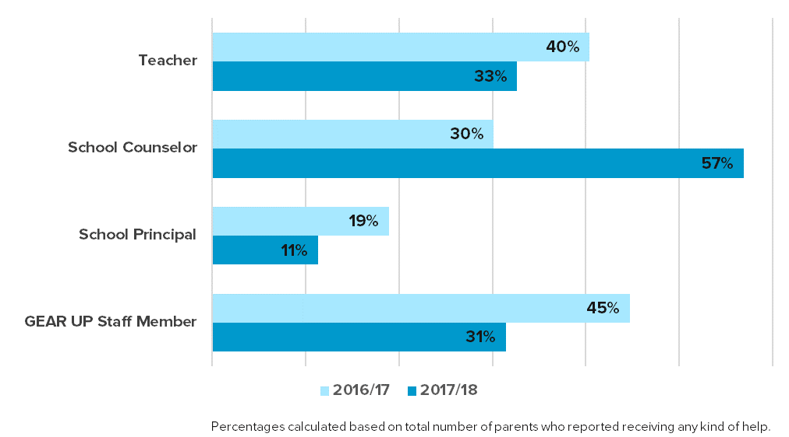
The percentage of parents agreeing* that “school staff helps me understand necessary courses for my child to graduate high school” rose from 62% in 2016/17 to 83% in 2017/18.
Question 3:
Who from your child’s school has helped you understand the necessary courses your child must complete to graduate from high school? (You may choose more than one option.)
* All responses other than “no one” counted as agreeing for this question
GEAR UP Goal met: Percent of parents who agree that “school staff helps me understand necessary courses for my child to graduate high school” will rise incrementally each year of services.

Slide 12
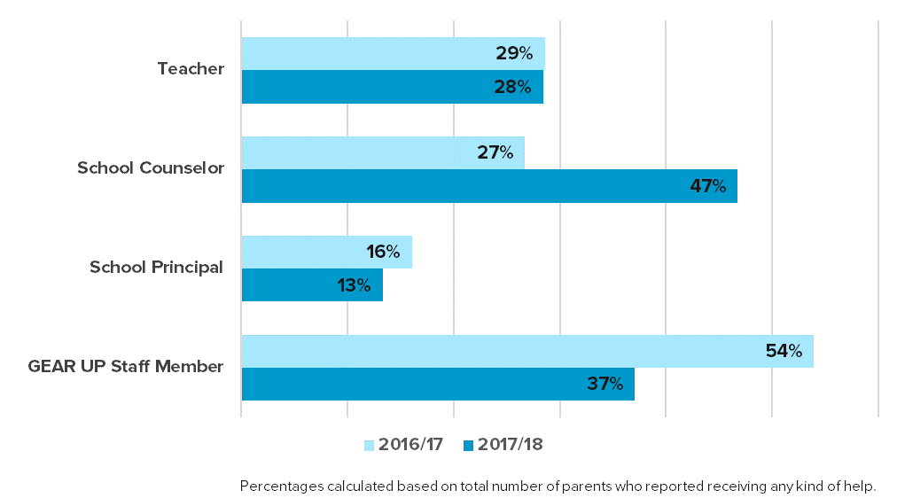
The percentage of parents reporting that school staff had helped them understand which A-G courses were needed for college entry* rose from 52% in 2016/17 to 73% in 2017/18.
Question 4:
2016/17: Who from your child’s school has helped you to understand the A-G courses your child is required to complete to get into a University of California (UC) institution? (You may choose more than one option.)
2017/18: Who from your child’s school has helped you to understand the A-G courses your child is required to complete to get into a University of California (UC) or California State University (CSU) institution? (You may choose more than one option.)
* All responses other than “no one” counted towards this question
GEAR UP Goal met: Percent of parents who say school staff helps them understand A-G courses their child needs for college entry will rise incrementally each year of services.

Slide 13
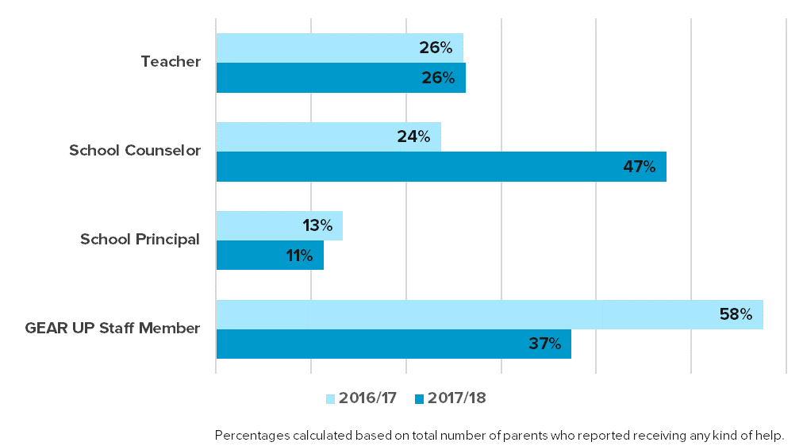
The percentage of parents agreeing* that “school staff helps me understand how to assist my child in applying for college” rose from 50% in 2016/17 to 67% in 2017/18.
Question 5:
Who from your child’s school has helped you understand how to assist your child in applying for college? (You may choose more than one option.)
* All responses other than “no one” counted as agreeing for this question
GEAR UP Goal met: Percent of parents who agree that “school staff helps me understand how to assist my child in applying for college” will rise incrementally each year of services.

Slide 14
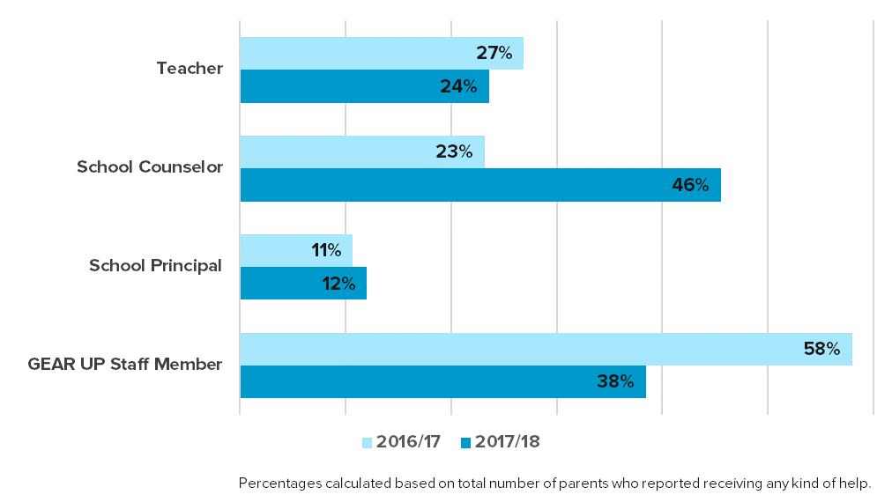
The percentage of parents agreeing* that “school staff helps me understand how to apply for financial aid” rose from 46% in 2016/17 to 61% in 2017/18.
Question 6:
Who from your child’s school has spoken to you about the availability of financial aid? (You may choose more than one option.)
* All responses other than “no one” counted as agreeing for this question
GEAR UP Goal: 90% of students and parents will agree with this statement by Year 6: “School staff helps me understand how to apply for financial aid.”

Slide 15
Upcoming Events
Annual Performance Report due April 15
3 Overnight College Trips planned for Spring Break
3 PSAT/SAT Test Prep programs implemented earlier this semester; 1 more planned leading up to June test date
Secured 8 student spots to attend the Youth Leadership Summit at this summer’s GEAR UP Annual Conference (July 14-17)
UCLA Peer Leaders program, TBD in Summer

