Slide 1
Executive
Director
Report
December 2022

Slide 2
Table of contents
01
02
Enrollment
Enrichment
03
04
News
Achievement
You can describe the topic of the section here
You can describe the topic of the section here
You can describe the topic of the section here
You can describe the topic of the section here

Slide 3
Enrollment

Slide 4
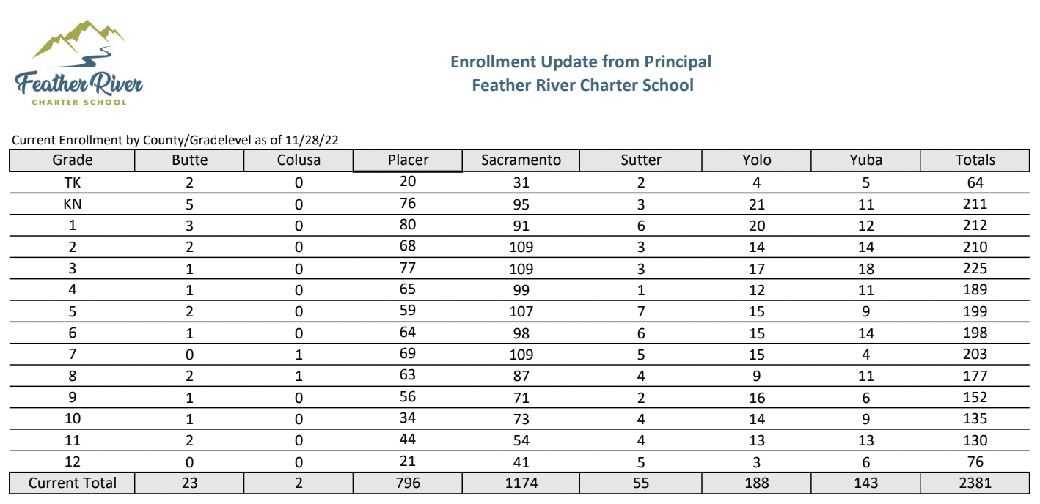

Slide 5
Enrichment

Slide 6
Ordering
December 1 Funds Drop
Orders have been on a 3 day turn around
Amazon Punchout
Sequoia Grove staff will be off for Winter Break and no orders will be processed during that time.
Amazon Punchout will not be available starting December 19th through the Winter Break
Coming Next Year: New Punchout Vendors!
BookShark
Office Depot
Staples

Slide 7
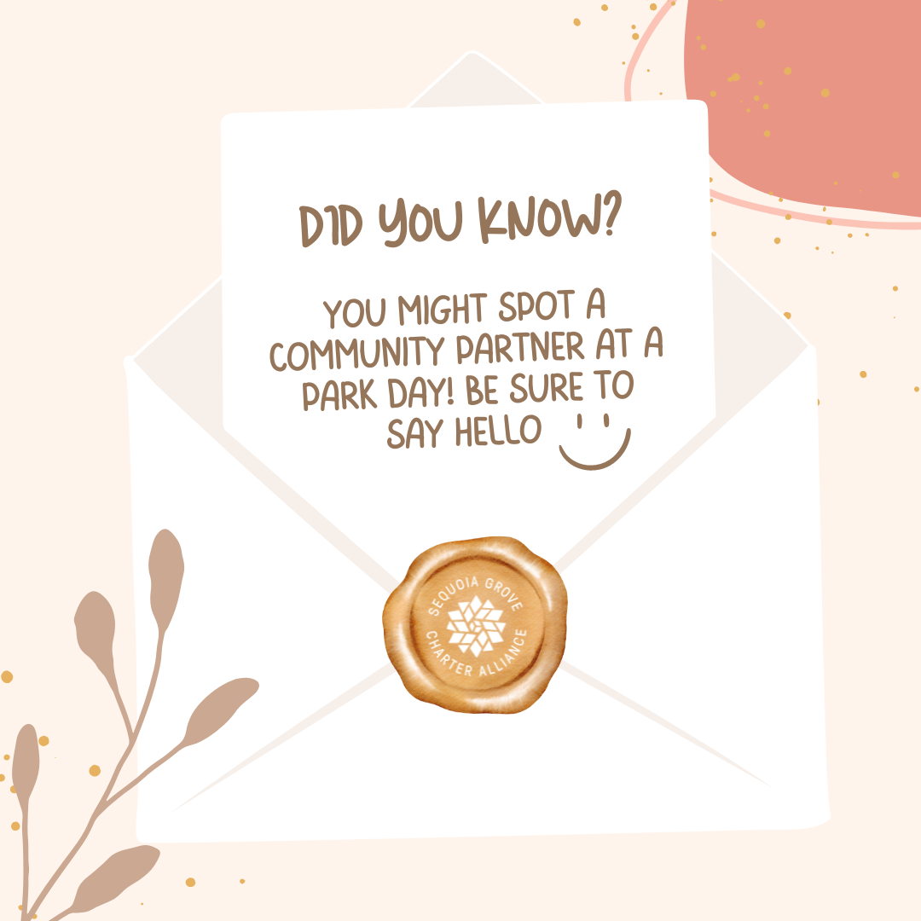
Community Partners
CSO Community Partner team is working on ways to increase support for our valued community partners!

Slide 8
Lending Library
Mobile lending library park days in Fair Oaks, Roseville, Rocklin, Elk Grove, Auburn, Folsom, Sutter Creek, Chico
Library Park days will start including crafts and activities in January
Now two vans with fresh wraps!

Slide 9
News

Slide 10
New High School Counselor
Due to our increased number of high school students, we have added another counselor to better serve our families. Welcome Rachel!

Slide 11
New SST Specialist
Our new SST specialist has hit the ground running. In the short time she has been with us she has scheduled over 40 SSTs to support our struggling students. Welcome Stephanie!

Slide 12
January Professional Development

Slide 13
Diversity, Inclusion & Growth
Book Club
Coffee & Conversations
Event
6 week staff book club- “A Place to Belong” by Amber O’Neal Johnston
15 staff members attend regularly
Virtual Coffee & Conversation for parents on how to create a diverse and inclusive home library.
Slidedeck will be available on the DIG Homeschool Helper page.
Resources for Universal Human Rights Month (December) on the DIG Homeschool Helper page
Native American Heritage month- Lauren Garcia, provided a school wide zoom event about how Indegnious People are still present today and the positive impact they are having on the environment with their sustainable practices.
50 students, parents, and staff were in attendance.

Slide 14
Achievement

Slide 15
Classes
Our amazing intervention teachers are providing
Tier 1, 2, and 3 live instructional support to many students
Over 150 seats filled during the school year thus far

Slide 16
Student Support
What Parents Like
“The homework/things to practice and the space to allow him to practice with a teacher and not just mom saying it.”
“Communication from the instructor and the amount of knowledge that was shared”
“They were very engaging. [My student] very much enjoyed the class”
“Teacher and layout of instruction and reputation”
“I think the overall structure was great and included good review and games to retain concepts learned”

Slide 17
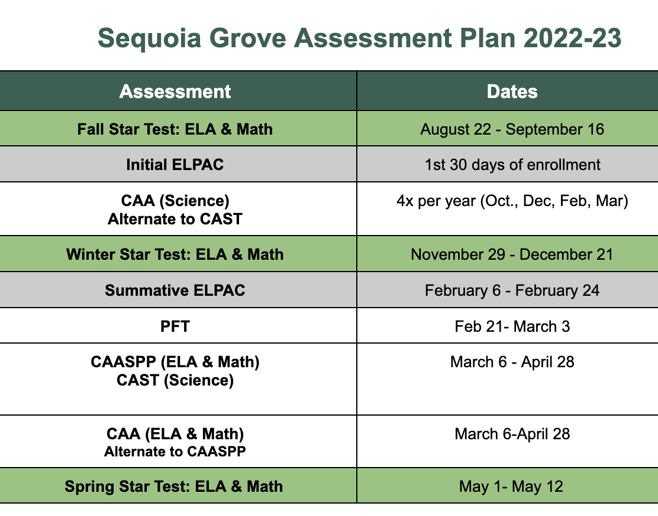
Assessment Resource Site for Parents Available!

Slide 18
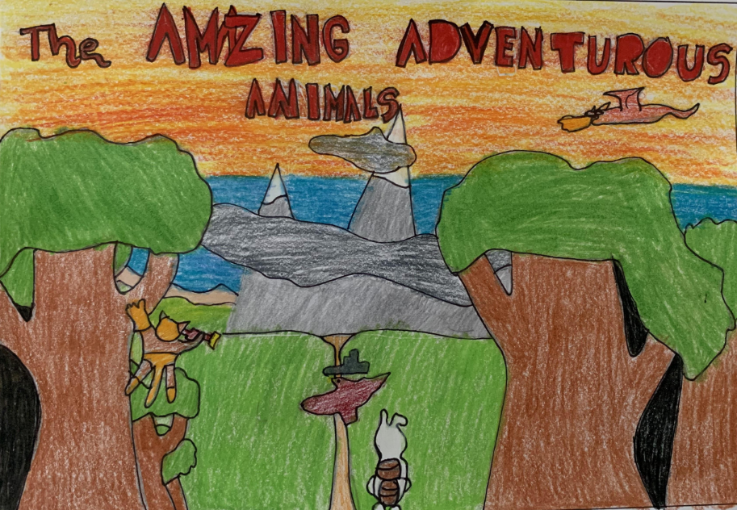
Adventure Academy
Digital Newsroom class started our first-ever SGCA Student Newspaper! Click here to enjoy reading articles for students, by students!
You Can Be an Author class wrote and published a book that parents were able to purchase. This book will also be available for viewing in the new year.
We hosted several ADVA field trips to enhance our classes. Our Session 2 field trips included Sac Underground, Sierra College Natural History Museum and Planetarium and Sprouts.

Slide 19
Thank You
Your commitment and dedication to our school is greatly appreciated.

