Slide 1


MSA-1 New High School Project
September,2018

Slide 2
MSA-1 New High School Project
New High School Classroom Building
New building has twenty classrooms, plus admin space, plus rooftop basketball court. New building will hold high school, existing building will hold middle school.

Slide 3
MSA-1 New High School Project
New High School Classroom Building
Administration
Subcontracts being written – all early packages done – finishes 50% complete
Cost reporting system and control systems defined and loaded – first payment made - second pay application in August
Pending changes – first Change Order to Board September – about half planned expense items – balance well within contingency budget
There are no administrative issues at this time.

Slide 4
MSA-1 New High School Project
New High School Classroom Building
Design
Technical submittal process continues – all early packages and structural packages approved – 5 open submittals - turnaround times remain good
Requests for Information – 66 submitted/11 outstanding – turnaround time is good
Revising rooftop assembly based on independent consultant review – now exploring pricing (expensive!) before making final recommendation.
There are no design issues at this time.

Slide 5
MSA-1 New High School Project
New High School Classroom Building
Permits and Inspection
Building Permits
  all current building permits pulled (excavation, building, engineering, electrical, mechanical)
  deferred approvals/permits outstanding for fire sprinklers and alarms (normal and in process) – to be submitted in August
Inspection
  All required inspections to date current and passed - all inspectors and contractor collaborating well
  Underground work mostly done – shifting to framing and structural phase
There are no permit or inspection issues at this time.

Slide 6
MSA-1 New High School Project
New High School Classroom Building
Construction
Slab on grade and underground utilities complete – CMU walls complete
Now shifting to wood framing of walls and floors – will soon start to look like a building
There are no construction issues at this time.

Slide 7
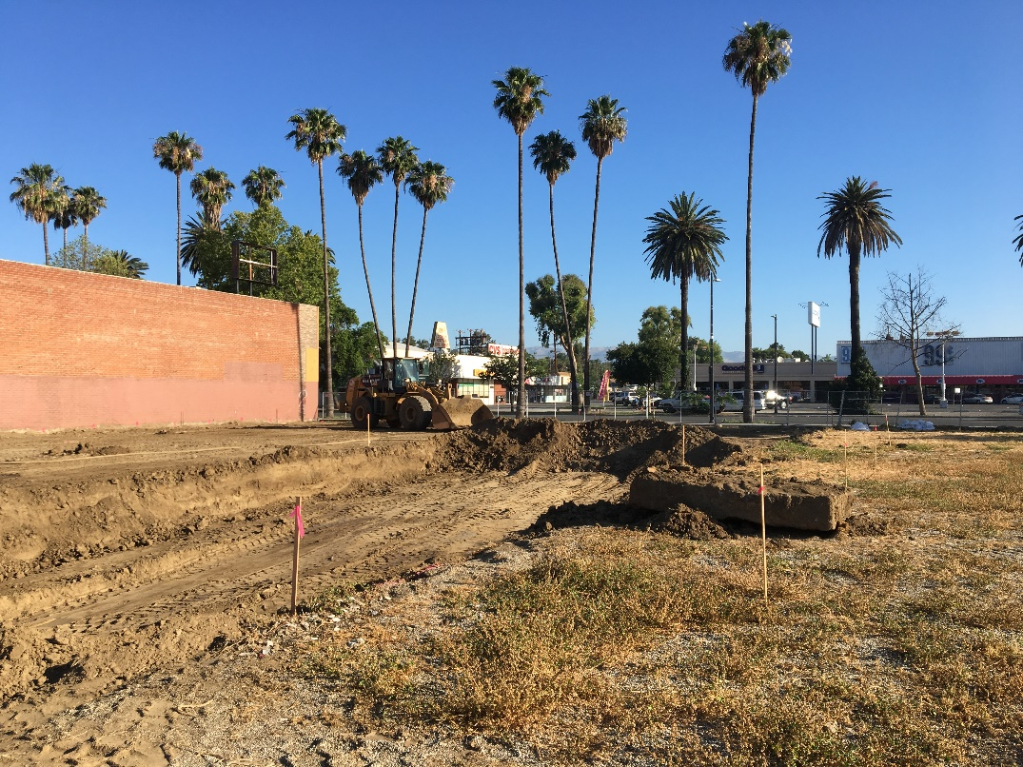
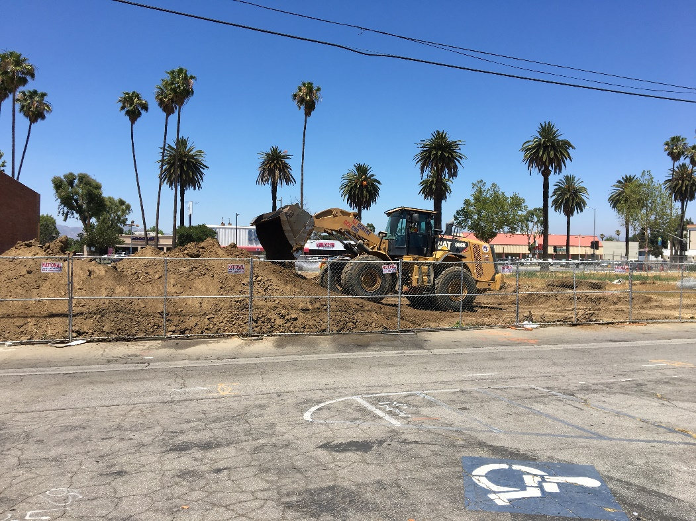
Excavation was completed in July…
The top 4 feet of soil was removed
and re-compacted… work inspected and complete

Slide 8
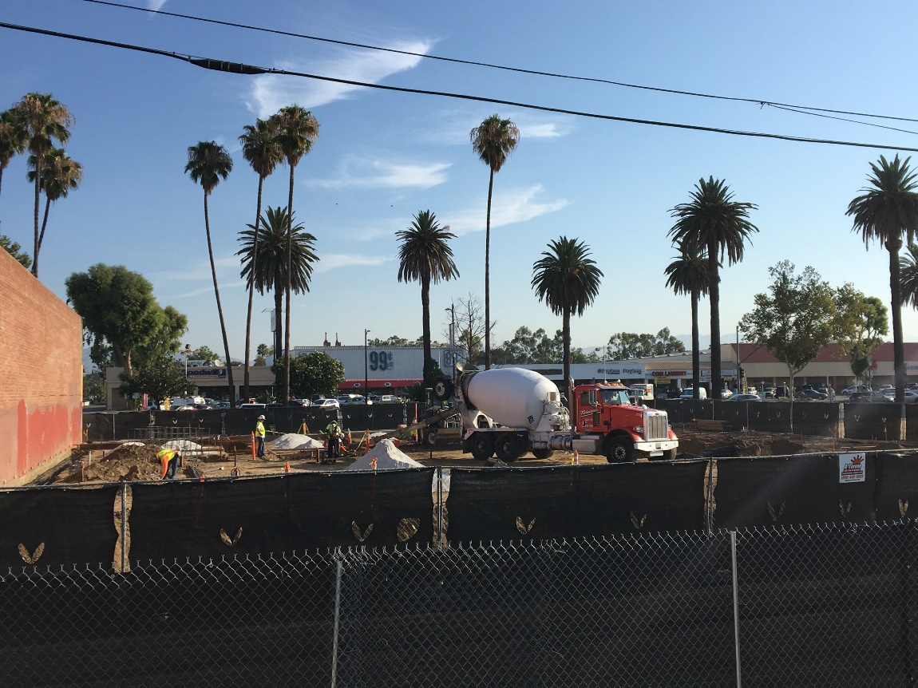
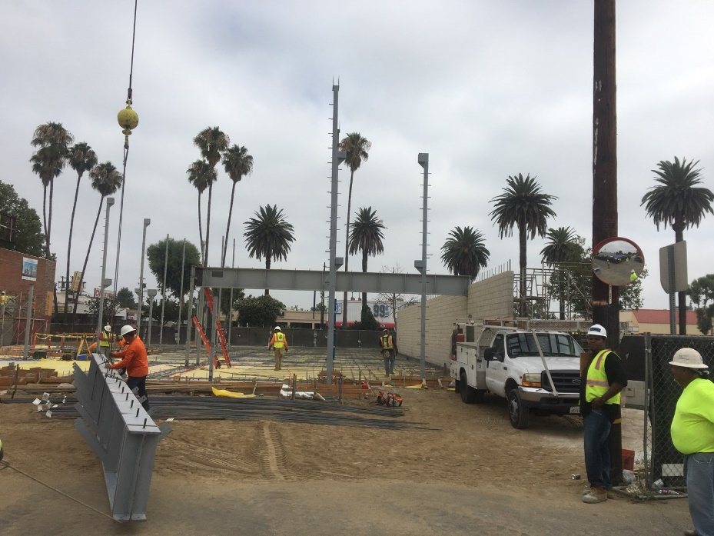
Next came underground utilities, footings and first structural steel…

Slide 9
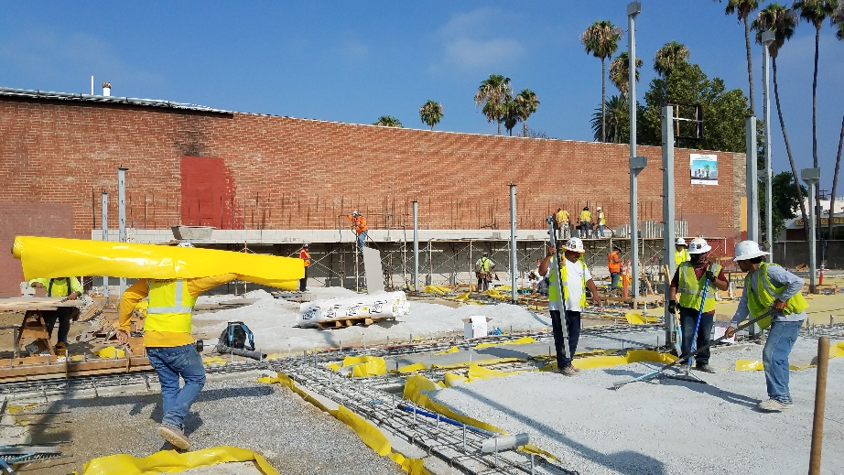
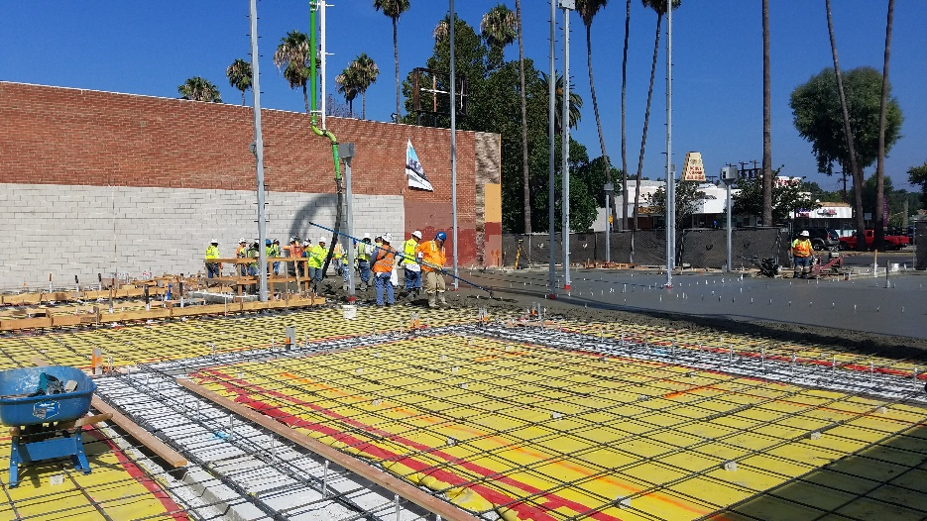
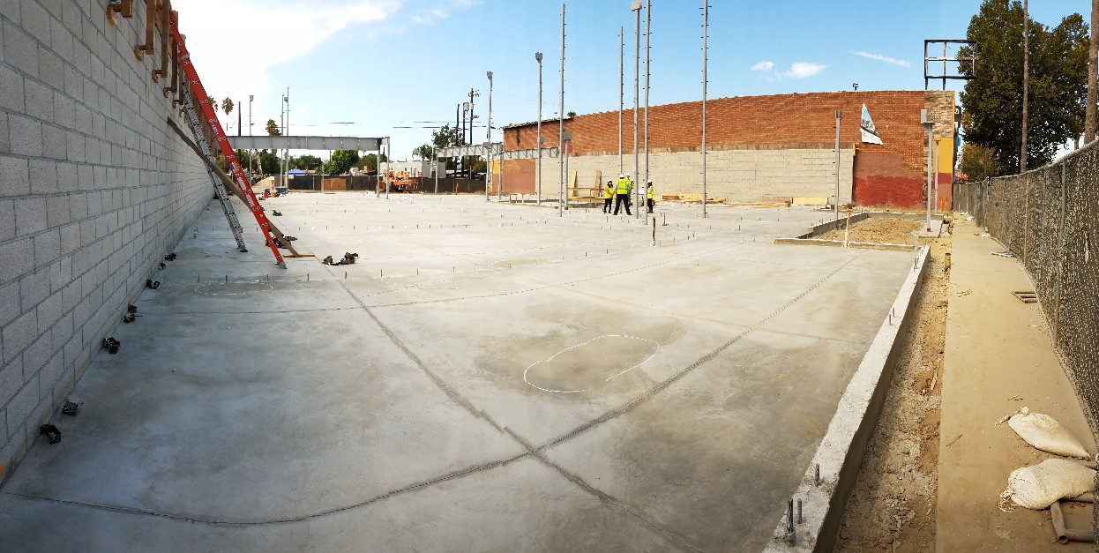
Slab on grade is prepped, placed and done…

Slide 10
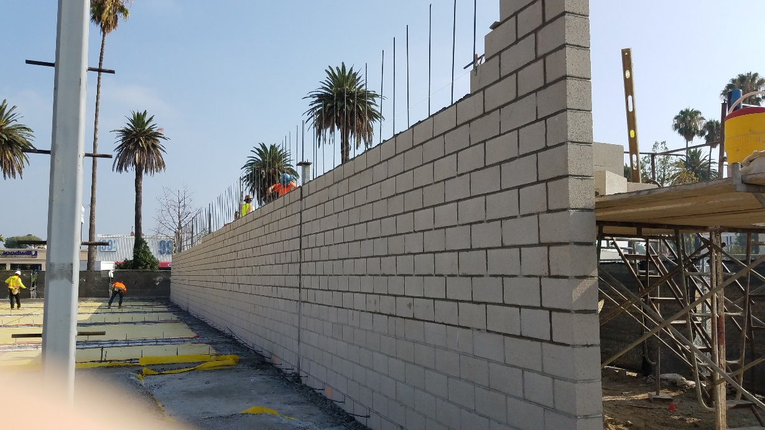
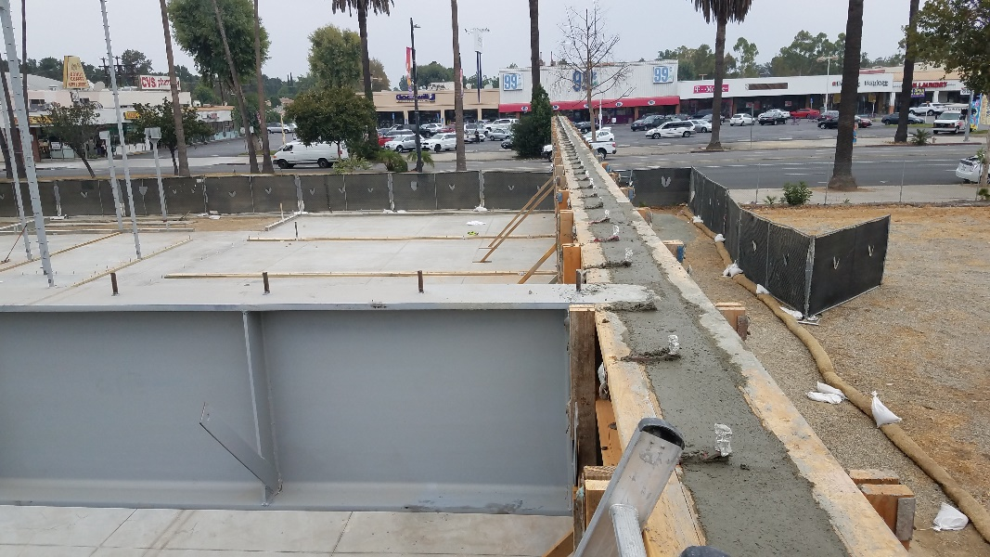
CMU exterior walls and bond beam are complete.
No surprises – completing CMU walls define building exterior on two sides – completing these walls releases the entire building for wood framing.

Slide 11
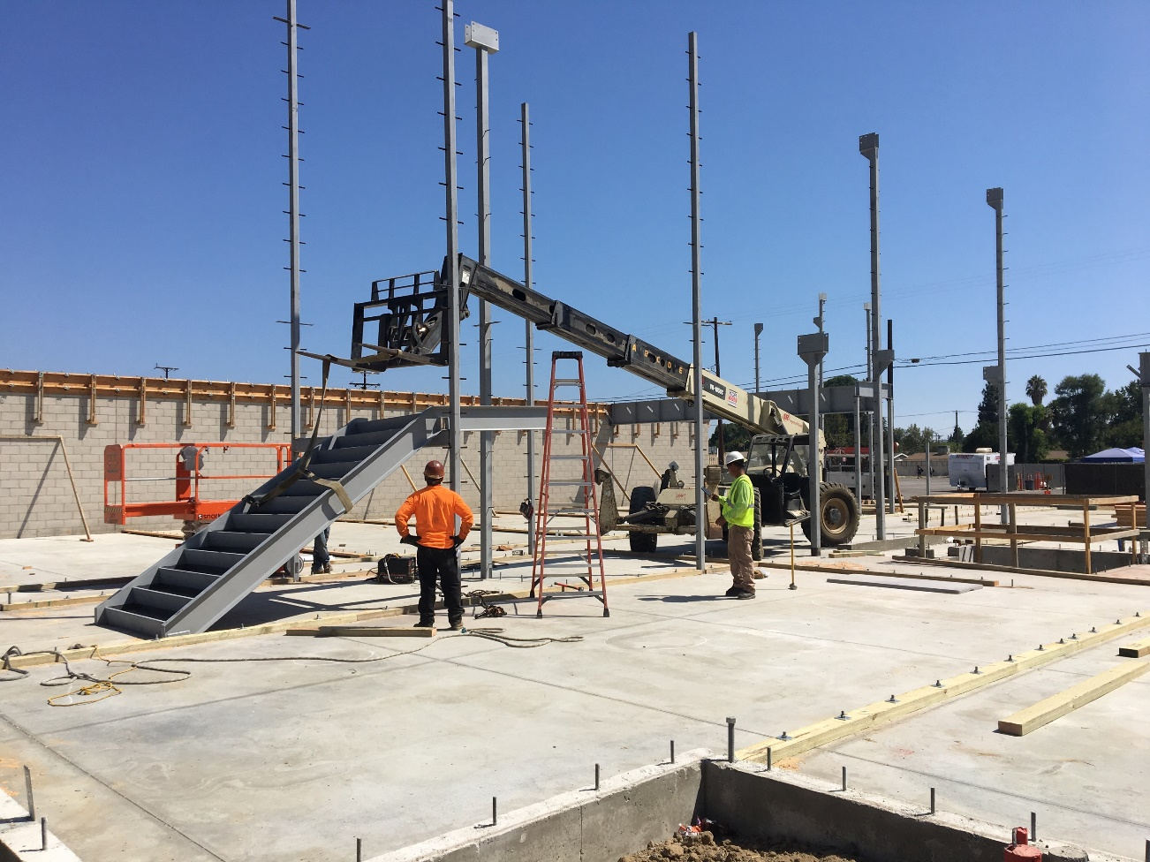
And up we go…stairs first, then framing…
Treated wood has arrived on site. Plates are going down on the slab on grade. First floor walls will follow this month.

Slide 12
MSA-1 New High School Project
New High School Classroom Building
Schedule
Contract Schedule – 330 days from full NTP
Detailed CPM schedule was submitted and approved
Schedule is not overly aggressive or overly conservative, looks practical
Completion of slab on grade and underground work removes biggest schedule risk – allows work area to expand greatly
All work elements are on time.
There are no schedule issues at this time. The building will be ready for a spring move-in.

Slide 13
MSA-1 New High School Project
New High School Classroom Building
Budget and Cost
Contract awarded with GMAX of $7,392,479
Little to No Risk - majority of subcontractors now under fixed price contracts.
No Risk – subcontractor buyout is complete – no longer a risk
Low Risk –materials escalation –majority of materials now under fixed price contracts and price locked
Changes – short list of pending changes, some were anticipated at time of contract and were budgeted – balance from budgeted contingency
There are no budget or cost issues at this time. Project on track to finish under budget.

Slide 14
MSA-1 New High School Project
New High School Classroom Building
Oltmans Summary
Oltmans is well underway.
Everything remains on track.
Work on site is ramping up fast.
There are no significant issues.

