Slide 1


MSA-1 New High School Project
July, 2018

Slide 2
MSA-1 New High School Project
Scope of Work
New High School Classroom Building
Existing Middle School Classroom Building
Solar Shade Shelter
Master Planning
Site Development

Slide 3
MSA-1 New High School Project
New High School Classroom Building
New building has twenty classrooms, plus admin space, plus rooftop basketball court. New building will hold high school, existing building will hold middle school.

Slide 4
MSA-1 New High School Project
New High School Classroom Building
Contract Status
General construction contract awarded to Oltmans Construction Company on May 14th.
Limited NTP issued May 15th, and Oltmans immediately began work
Full contract start date 6/11/18
Contract documents are finalized
  There are no contract issues at this time.

Slide 5
MSA-1 New High School Project
New High School Classroom Building
Administration
VE effort done, design changed to accept changes
Subcontractor and supplier buyout complete
Contractor contingency has increased by $100k
Subcontracts being written – all early packages done – finishes remaining
Cost reporting system and control systems defined and loaded – first pay application in July
Pending changes – approx. $170k, half planned, half new – well within budgeted amount – first change order to Board in August
There are no administrative issues at this time.

Slide 6
MSA-1 New High School Project
New High School Classroom Building
Design
Technical submittal process well underway – all early packages and structural packages approved – turnaround times good
Requests for Information – 27 submitted/6 outstanding – turnaround times good
Completing independent consultant review of rooftop assembly structure – 2nd opinion – will generate some design changes and improvements
There are no administrative issues at this time.

Slide 7
MSA-1 New High School Project
New High School Classroom Building
Permits and Inspection
Building Permits
  all current building permits pulled (excavation, building, engineering, electrical, mechanical)
  deferred approvals/permits outstanding for elevators, fire sprinklers and alarms (normal and in process)
City Inspection
  Kickoff meetings held, fully mobilized
  All inspections to date passed
MSA Inspection
  Consultants on board and mobilized
  Overall QA/QC plan being developed
  All inspections to date passed
  Beginning commissioning coordination
There are no permit or inspection issues at this time.

Slide 8
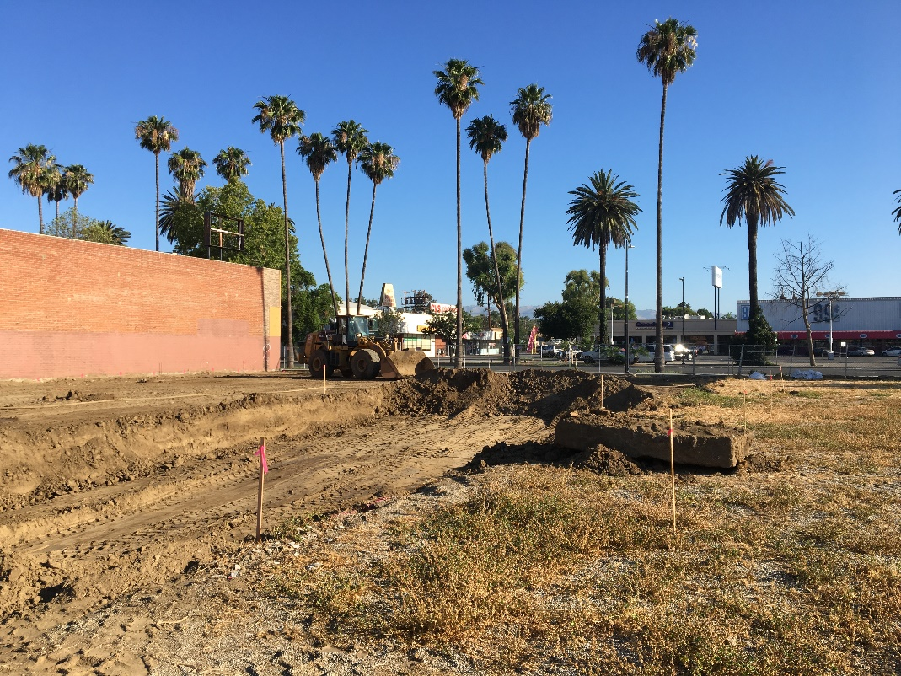
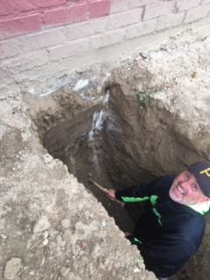
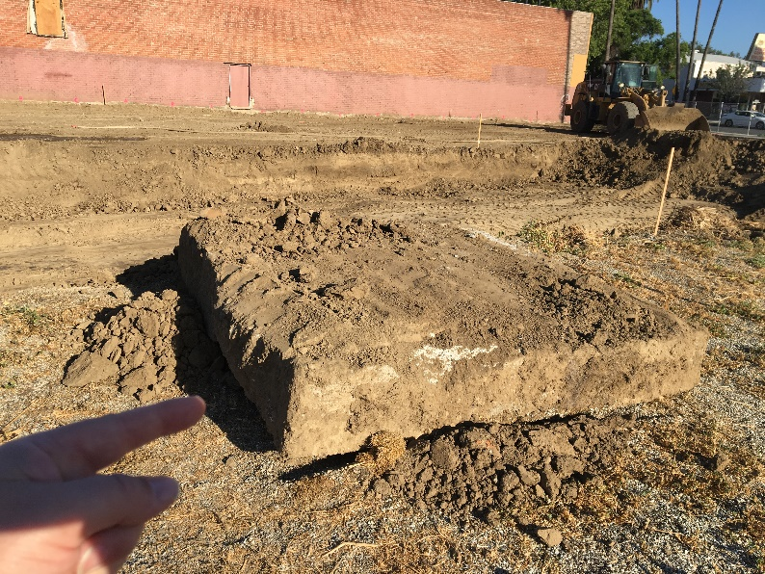
Excavation has begun…
The top 4 feet of soil gets removed
and re-compacted…
Depth has been confirmed…
A few surprises were uncovered…
Situation normal and moving forward.

Slide 9
MSA-1 New High School Project
New High School Classroom Building
Construction
Oltmans general conditions
  Mobilized and most support in place
  Adding security features at site and storage areas
  String of security issues are alarming, being managed
Mass excavation and recompaction – first major construction activity – supports the building – done.
Underground utilities – electrical, civil and plumbing that goes under footings – will be done this week.
Footing concrete – begins next week
There are no construction issues at this time.

Slide 10
MSA-1 New High School Project
New High School Classroom Building
Schedule
Contract Schedule – 330 days from full NTP
Schedule start date is June 11, 2018
Detailed CPM schedule submitted and in complaince
Schedule is not overly aggressive or overly conservative, looks practical
Advanced buy-out of materials and equipment underway to protect price and schedule
There are no schedule issues at this time.

Slide 11
MSA-1 New High School Project
New High School Classroom Building
Budget and Cost
Contract awarded with GMAX of $7,392,479
Majority of subcontractors now under fixed price contracts.
Risk – completing buyout/contracting of subcontractors and suppliers within estimate – well underway and under budget
Risk –materials escalation – now have successfully placed majority of materials under fixed price contracts and pursuing early delivery to lock price – well underway and working
Changes – Shifting 2 large items from MSA to Oltmans - only minor changes to date – all planned and within budget
Shifting Oltmans cost elements to maximize CSFIG cost recovery – will be higher CSFIG revenue than anticipated in approved budget
There are no budget or cost issues at this time.

Slide 12
MSA-1 New High School Project
New High School Classroom Building
Oltmans Summary
Oltmans is fully launched.
Everything remains on track.
Work on site has begun, and will now go fast.

Slide 13
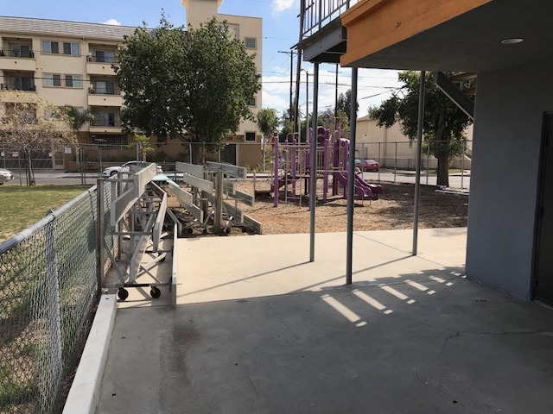
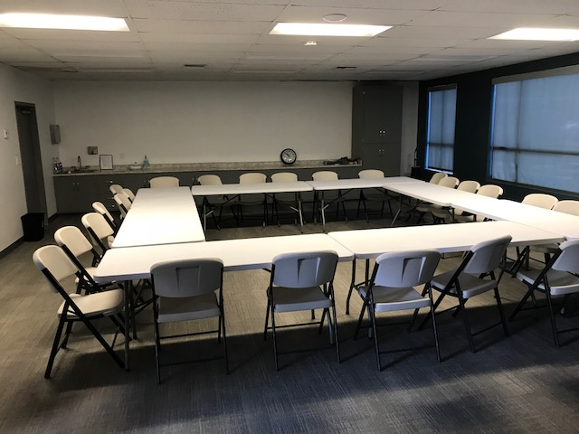
MSA-1 New High School Project
New High School Classroom Building
Interim Capacity
MSA-1 growing from 450 students to 900 students
Admitted +100 more students 2018-19
Located additional interim space Bible Fellowship campus – now leased
6 classrooms, admin space, athletic field, 10 minute walk from MSA-1
Potential long-term relationship, expand MSA-1 to add elementary grades

Slide 14
The Bible Fellowship Campus
Will take some work to get ready
Lease finalized
Need to take possession and organize classrooms
Used furniture donation fulfills majority of need
Staff being organized to address separate campus
LACOE formal approvals required (informal approval already received)
There are no issues at this time with TBBF campus

Slide 15
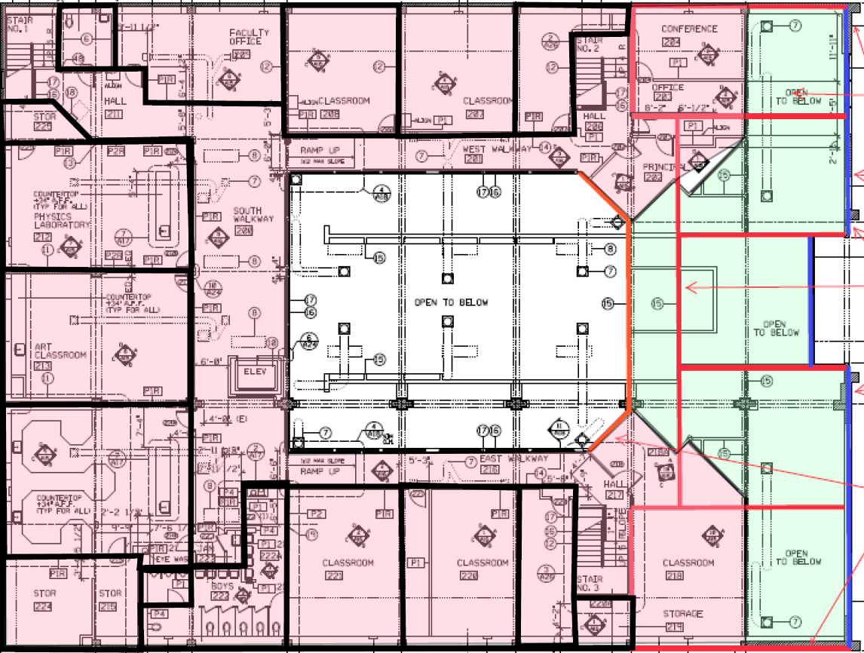
MSA-1 New High School Project
Existing Middle School Classroom Building
SCOPE
Seismic Upgrades – floor and roof connections to walls
Expand 2nd floor – gain 4 classrooms, improve circulation
Prop 39 Improvements – LED lighting, modern HVAC
General Renovation - facelift

Slide 16
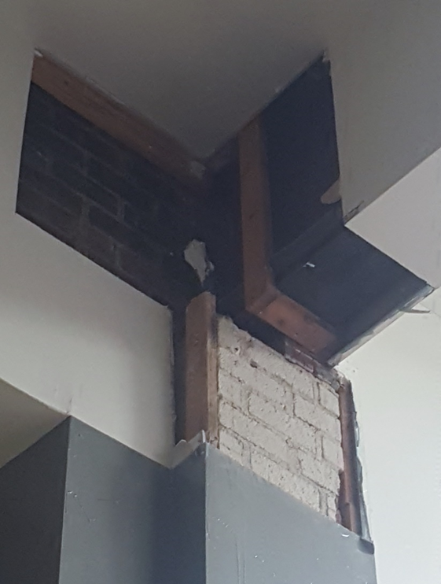
MSA-1 New High School Project
Existing Middle School Classroom Building
SEISMIC ISSUES
Structural Investigation – 1st phase complete, draft ASCE report prepared, findings:
Very weak or non-existing connections between roof and floor and exterior walls
In an earthquake, walls move and roof and second floor can collapse
Creates serious risk of loss of life in an earthquake
Risk of serious earthquake is high (San Andreas 99% within 26 years)
Issue should be recognized and plan adopted

Slide 17
MSA-1 New High School Project
Existing Middle School Classroom Building
SEISMIC ISSUES
Third round of seismic investigation completed. Proposed 2nd floor expansion/seismic renovation remains practical and cost-effective
Will complete structural design – summer 2018
Permit process then bidding and award – fall 2018/winter 2019
May be able to begin seismic retrofits while building occupied – less disruptive than alternatives
May have to defer Sherman Way side of building until new HS building complete, and able to vacate Sherman Way side of MS building – Spring 2019
We are pushing forward with seismic renovation ASAP. There have been no surprises in the third round of investigation.

Slide 18
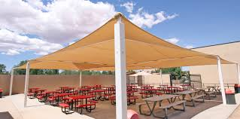
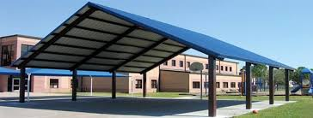
MSA-1 New High School Project
Solar Shade Shelter
Initial goal – cover outdoor dining area only and provide power to MS Building
Now – much larger, outdoor dining and basketball court power to both buildings

Slide 19
MSA-1 New High School Project
Existing Middle School Classroom Building
Mechanical and Electrical Renovation
Current HVAC system failing and cannot be replaced in kind (wrong equipment, bad installation, illegal refrigerant)
Mechanical engineer on board and proceeding with HVAC replacement design
Goal to have D/B procurement package ASAP
Goal to make package CSGIG and Prop 39 eligible
We are pushing forward with this work as quickly as possible. System is barely supporting school right now. This is urgent work!

Slide 20
MSA-1 New High School Project
Solar Shade Shelter
Original concept was for energy savings to cover cost of structure and shade shelter to self-finance
Project is technically feasible, but not economically feasible
Cummings contract being terminated
Now exploring non-solar alternatives – will wait to work with City project
Project is not viable economically – have to explore alternate methods of providing outdoor covered space.

Slide 21
MSA-1 New High School Project
Master Planning
Initial goal to support zone change
Current goal – zone change and Ice Rink partnership

Slide 22
MSA-1 New High School Project
Master Planning
MSA needs outdoor dining, recreation and parking - fits on site, but tight, little room for future gymnasium
Ice Rink does not fit on City parcels – City needs more space for support spaces (lockers)
Sharing parcels allows combined parking, shared support space, maybe gymnasium, and leaves more space for outdoor recreation – both sides benefit
Initial meeting with City very positive. Cannot do substantive discussion until land transfer completed this summer.
No change. This concept still looks viable. We ae waiting on the City land transfer…

Slide 23
MSA-1 New High School Project
Site Development
Placeholder site development plan was permitted and included in Oltmans scope
Oltmans scope will be modified based on Master Planning + City negotiations
  could be pulled if Ice Rink progresses
  If no Ice Rink, will require minimal refinement
Now putting solar on hold – allow more flexibility in Ice Rink negotiations
Final decision not required until 2019, leaves room to fully explore Ice Rink potential.
No change. We have the time and flexibility to work this deal.

Slide 24
MSA-1 New High School Project
Overall Budget
New High School Building – Adopted Budget $11,355,997
  Budget adequate, no changes since adoption
  Buyout proceeding, no issues, on budget
  Small changes to date will come from contingency
  Value Engineering almost done, has increased contingency
  Forecast remains to meet budget
  Attempting to recover additional CSFIG funds, reduces interschool loan size
Prop 39 projects – Placeholder Budget $250,000
  Must keep scope within budget
  Materials costs increasing rapidly
  Prioritize HVAC over lighting to ensure adequate funds
Existing Building – Placeholder Budget $700,000
  Must complete seismic investigation to define scope
  Seismic scope will drive budget
  Available funds inadequate, cannot do estimate without design concept
Solar Shade Shelter – Placeholder Budget $-0-
  On hold, looking for alternative plan
  No change – project remains on approvd budget.

