Slide 1
Magnolia Science Academy, Santa Ana, CA
Gymnasium Project

Slide 2
Overview
Project Summary
Project Schedule Update
Project Documentation
Financial Report
Progress Photos

Slide 3
Project Summary
Project is approximately 22% complete
Project Submittals are 97% complete
Procurement of structural steel in process
Project construction meetings on going, Tuesdays at 9:00 am
Contractor’s payment application #04 has been reviewed

Slide 4
Project Schedule Update
Schedule Milestones
Construction Completion date: August 15,2018
Presently the project is on schedule
Contractor’s has submitted March 2018 update construction schedule
Upcoming Construction Activities
Erection of Exterior and Interior Masonry Wall on going
Construction Impacts to the General Campus and Local Community
No impacts to school activities are anticipated during the next 30 days

Slide 5
Project Documentation
Submittals
As of February 28, 2018, 83 submittal packages have been issued by the contractor.
The Architect has approved 52 submittal packages.
The Architect has returned 10 submittal package to be revised and resubmitted.
21 submittals either have been closed or are currently with the Architect for review
RFI’s
As of February 28, 2018, 66 RFI’s have been issued by the contractor
7 remain open with none of those being critical

Slide 6
Project Documentation
Architect’s Supplemental Instruction
ASI #1 Add Alternate (RC Construction currently putting together a cost proposal)
Rubberized Gym Flooring
ASI #2 Deductive Alternates (RC Construction Currently Putting together a cost proposal)
Removal of glazing at east gym wall and replacing CMU block
Eliminate graffiti coating on exterior gym walls
Modify concrete floor finishes
Remove lockers
Remove carpet tile

Slide 7
PCO #02 | Contractor to provide and install power for fire alams |  |  |  | RFI #34 | Negotiations | 01/30/18 | $ 3,826.00 | $ 3,055.47 | $ 770.53 | $ 3,440.25 | 0 | Cost to be drawn from project contingency
PCO #03 | Contractor to provide and install power for water heater |  |  |  | RFI #29 | Negotiations | 01/30/18 | $ 1,311.00 | $ 852.82 | $ 458.18 | $ 1,096.33 | 0 | Cost to be drawn from project contingency
4 | Potential Cost Associated w/Fire Sprinkler Riser |  |  |  | N/A | Pending |  | $ 7,000.00 |  |  |  |  | ROM, COR not submitted by RC
5 | Power to raise & lower basketball back boards |  |  |  | NA | Pending |  | $ 14,000.00 |  |  |  |  | Cost is only ROM from GC
Financial Report
Change Order
Change Order Log
Non-Compensatory Time Extension: 94 Days
Potential Change Order Log
Contingency Draw Downs- Final Agreed to Cost
 | Contractor total | Gafcon Total | Agreed Amount
PCO #02 Provide Power to Fire Alarm System-Submitted | $ 3,826.25 | $ 3,055.47 | $ 3,440.25
PCO #03 Provide Power to Water Heater- Submitted | $ 1,311.00 | $ 852.82 | $ 1,096.33
Modifications to Fire Sprinkler Riser- Pending | $ 7,000.00
Power to raise & Lower Basketball Back Boards-Pending | $ 14,000.00
Contingency Starting Balance | $ 112,544.89
PCO #02 Provide Power to Fire Alarm | $ 3,440.25
PCO #03 Provide Power to Water Heater | $ 1,096.33
Contingency Balance as of Febraury 28,2018 | $ 108,008.31

Slide 8
Financial Report

Slide 9
Financial Report
Project Contract and Billings to Date
RC Construction Services Base Contract | $ 3,864,041.36
Invoice as of January 28,2018 (Pay Apps No. 01-No. 03) | $ 541,431.07
Remaining Balance as of January 31,2018 | $ 3,322,610.29
Berliner Architects Total Contracts Amounts | $ 219,090.00
Invoice as of January 28,2018 | $ 34,334.29
Remaining Balance as of January 31,2018 | $ 184,755.71
Gafcon Total Contract Amounts | $ 184,619.00
Invoice as of Janaury 31,2018 | $ 126,364.10
Remaining Balance as of January 31,2018 | $ 58,254.90
Inland Inspection Services Contract Amount | $ 114,075.00
Invoiced as of January 28,2018 | $ 32,448.00
Remaining Balance as of January 31,2018 | $ 81,627.00
River City Testing Contract Amount | $ 52,882.00
Invoiced as of January 28,2018 | $ 3,162.25
Remaining Balance as of January 31,2018 | $ 49,719.75

Slide 10
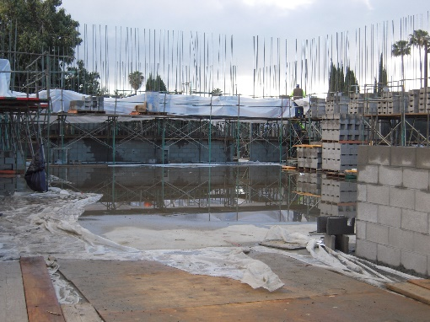
Progress Photos

Slide 11
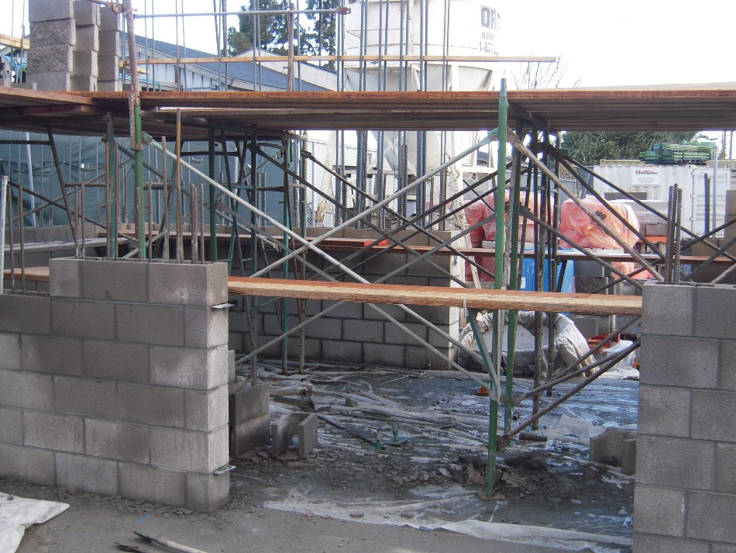
Progress Photos

Slide 12
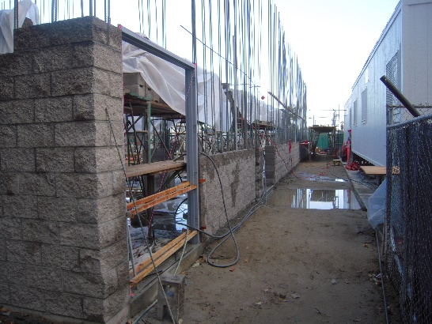
Progress Photos

Slide 13
Board Q&A

