Slide 1
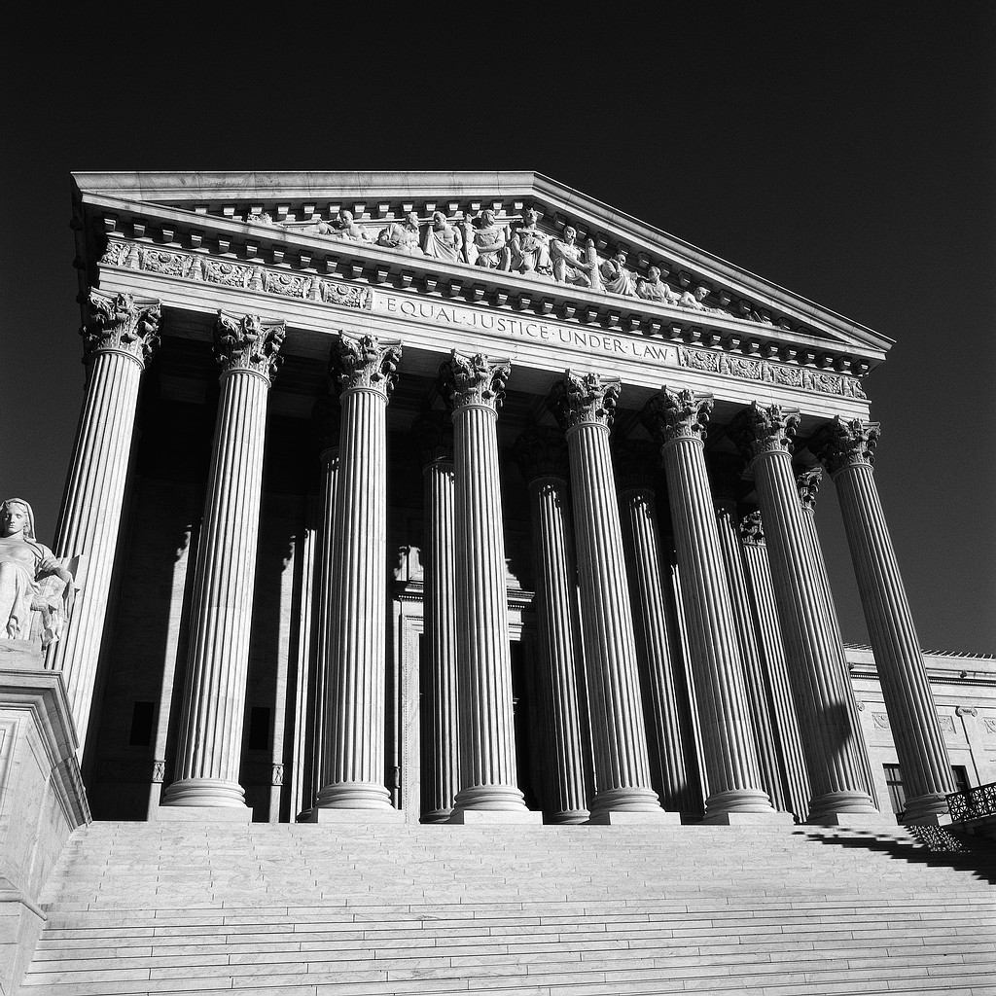
CALIFORNIA OPEN MEETING LAW:
THE RALPH M. BROWN ACT
Presentation By:
Brian L. Holman, Esq.
Musick, Peeler & Garrett LLP

Slide 2
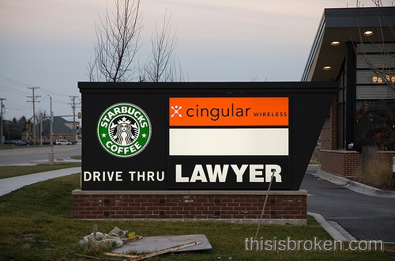

Slide 3

PURPOSE AND SCOPE; BASIC AUTHORITIES
[CA Gov. Code § 54950 et seq.]
  Actions of public boards and agencies shall be taken openly, and their deliberations conducted openly; and
  The People of the State do not yield their sovereignty to public agencies, and the People insist on remaining informed so that they may retain control over the agencies they have created.

Slide 4

PURPOSE AND SCOPE; BASIC AUTHORITIES
[CA Gov. Code § 54950 et seq.] (Cont.)
The Brown Act is intended to ensure the public’s right to attend public agency meetings to facilitate public participation in all phases of local government decision-making, and to curb misuse of the democratic process by secret legislation of public bodies.
Exception: Closed sessions (construed narrowly).

Slide 5

“MEETINGS”
Meetings of a legislative body are subject to the Brown Act.
A. Scope:
Any congregation of a majority of members of a legislative body at the same time and location to hear, discuss, deliberate or take any action.
“Deliberations”
Collective acquisition and exchange of facts preliminary to the ultimate outcome.
C. “Action Taken”
Collective decision; collective commitment or promise to make a positive or negative decision; actual vote.

Slide 6
What’s a Meeting?
Definition: gathering of majority of members to hear or discuss any item of school business or potential business.
Three types of meetings
  Regular: Regularly scheduled board meetings. School must set time, place for regular meeting in by-laws or by resolutions.
  Special: Meetings called by the chair or by agreement of a majority of board
  Emergency: Meetings to deal with emergencies

Slide 7
Collective Briefings
Collective briefings are not permitted. Any briefings involving a majority of directors must be open to the public and satisfy the Brown Act’s notice and agenda requirements
The Board cannot meet to discuss school business outside of a meeting without complying with agenda and notice requirements

Slide 8
Exceptions to Meetings
Subject to some ground rules, the following occasions are not meetings:
Individual contacts or conversations
Conferences and similar gatherings, open to the public
Open and publicized meeting organized by a person or organization other than the local agency
Open and noticed meeting of: (a) another body of the same local agency; or (b) a legislative body of another local agency.
Purely social or ceremonial occasions.

Slide 9
Exceptions to Meetings
Rule of Thumb:
With all of the exceptions, Directors must not talk about school business at social/ceremonial/other event.
The only time school business may be discussed is in a meeting properly noticed and on the agenda

Slide 10
Special Meetings
Requirements for Special Meetings:
  Written notice to each Director
  Noticed posted 24 hours prior to the meeting and at a site freely accessible to public
  Cannot consider business not posted on notice
  Special meeting must allow for public comment

Slide 11
Emergency Meetings
Used for emergency– definition: crippling activity, work stoppage, or other activity which severely impairs public health, safety or both [54956.5(a)(1)]
Generally, emergency meetings do not include closed sessions (54956.5)
Anyone requesting notice of meeting must be called one hour before meeting
If phones are not working, notice requirement is waived

Slide 12
Reach of the Brown Act
Act applies to:
Standing Committees: committee that has continuing jurisdiction over a topic [54952(b)] i.e., budget committee
Advisory Committees that include a majority of board
Advisory Committees that are Standing Committees regardless of the number of directors

Slide 13
Reach of the Brown Act
Exception:
Brown Act does not apply to an ad hoc advisory committee that is made up of less than a majority of directors and that does not have continuing jurisdiction over its subject matter.

Slide 14

“MEETINGS”
  Prohibition
    Serial Meetings ARE NOT ALLOWED
      Def: Majority of directors communicated about an issue and developed a collective concurrence
    Using a series of communications of any kind, e.g. emails, phone
    Exception
      Staff Communications.
      Note: Staff may not communicate to board members the comments or position of any other board member(s).

Slide 15
Types of Serial Meetings
Daisy Chain Meeting
  Ex: Director Jose calls Director May to discuss School business. May calls Director Ming and Ming calls Director Amad. A majority have spoken and came to a collective concurrence.
Hub and Spoke Meeting
  Ex: Ex. Dir. Calls Director Jose to discuss new grant. E.D. then calls Director May and then Director Amad to discuss same and telling Directors what each other Director has said.

Slide 16
Limit on Unilateral Communications
An employee may have separate communications outside of a meeting with directors to answer questions or provide information; person may not tell other Board members of the communication or position of Board member

Slide 17

Meeting Agendas
Meetings of Board of Directors must have posted a proper agenda.

Slide 18

NOTICE AND AGENDA REQUIREMENTS
A. Regular Meetings
1. Time and Place
2. Agenda – Brief General Description of Items
3. Exceptions to Agenda Rule
a. Need to Take Immediate Action
b. “Emergency” or “Dire Emergency”
4. Public Testimony [“Public Forum”]

Slide 19
NOTICE AND AGENDA REQUIREMENTS
Posting requirements: Post at least 72 hours before regular meeting in location freely accessible to the members of public
Content requirements: Contain a brief general description of each item of business to be transacted or discussed at meeting, including items to be discussed in closed session.

Slide 20
NOTICE AND AGENDA REQUIREMENTS
D. Closed Sessions - Three Essential “Notice” and “Agenda” Requirements
1. Briefly described on the agenda [“Safe Harbor” formats].
2. Before adjourning into closed session, the items to be discussed in closed session are to be orally announced.
3. The Board may be required to report actions taken in the closed session.

Slide 21
PERMISSIBLE CLOSED SESSIONS
Authorized Closed Sessions
Personnel
Employee appointment or employment
Evaluation of performance
Discipline/dismissal
Complaints against employee

Slide 22
PERMISSIBLE CLOSED SESSIONS
Pending litigation
Existing litigation
Threatened litigation
Potential litigation
* Attorney general opined that lawyer must be present during closed session

Slide 23
Location of Meetings
Meetings must be held within School boundaries
Hawaii most likely not a good place to hold a meeting
Meeting may not be held in a facility that discriminates based on race, religion, color, or inaccessible to disabled or where public may not attend without making payment/purchase

Slide 24
Location of Meetings
Some exceptions:
  To comply with judicial order or law
  To inspect real property
  Participating in multi-agency meeting
  If no facility within school boundaries, can meet in closest facility or at the principal office of the school if the office is located outside of school boundaries

Slide 25
Permissible Close Sessions
Real estate negotiations:
  To discuss with negotiator the purchase, sale, exchange or lease of real property
  Before going into close session, identify the negotiator and describe the property and name the parties with whom the school is negotiating

Slide 26
Minutes of Close Session
School may designate a clerk to take notes and enter them in a minute book
Minute book is not public and is exempt from disclosure under the Public Records Act

Slide 27

Use of Teleconference
Requirements for phoning in:
  Votes taken must be by roll-call
  Post agenda at all tele-conference locations
  Each tele-conference location on agenda
  Tele-conference location accessible by public
  Quorum participating in district boundaries
  Provide for public comment at each location

Slide 28

ENFORCEMENT/REMEDIES
  Criminal Penalties
  Misdemeanor
Civil Remedies
Injunction, action void past acts
Award of attorneys fees

Slide 29


