Slide 1
Complying With California Conflict of Interest Laws
Presented by: Jerry W. Simmons, Esq. jsimmons@mycharterlaw.com
1

Slide 2
Goals for Session
This is a primer; non-exhaustive overview.
Charter petition, bylaws, Memorandum of Understanding with your authorizer(s), and school policies might obligate you even more stringent rules and higher standards than minimum requirements set by statute.
Limit disruptions and prevent civil or criminal liability for Board members in most common conflict of interest scenarios.
Disclaimers
Real problems are fact specific & complex. Consult legal counsel.
You should only speak to legal counsel about compliance issues to ensure the attorney-client privilege applies. Emails to staff are discoverable.
Only highlighting most common compliance issues.
Federal conflict of interest law is not covered in this presentation.
2

Slide 3
Why You Should Care About Conflict Law Compliance
Potential criminal penalties
Potential fines
Potential charter revocation
Loss of good reputation
Potential loss of Foundation support and funding
Distractions and public controversy
Can lead to loss of accreditation
3

Slide 4
Understanding Conflict of Interest Laws
4

Slide 5
Conflicts of Interest
Broad Definition
A conflict of interest arises when an individual who has a private financial interest in the outcome of a corporate contract or a public decision, participates in the decision-making process or influences or attempts to influence others making the contract or decision.
In short, a conflict of interest is a clash between an individual’s duty to his or her office and his or her personal interests.
5

Slide 6
Conflicts of Interest
Trend has been toward more legislation and investigations related to conflicts of interest.
Landscape is shifting toward strict compliance and avoiding the appearance of impropriety.
Many new charter schools are avoiding having either their employees or owners and employees of their vendors and landlords on their boards.
6

Slide 7
Conflicts of Interest
7

Slide 8
Financial Interests
Common Types of Financial Interests
Ownership or investment in business entity
Investment in real property
Source of income
Position in business entity (e.g., director, officer, partner, trustee, employee, management)
Source of gifts
Effect on personal finances
* Financial interests of immediate family members of Board members and employees typically are covered.
8

Slide 9
Hoops to Jump Through
What happens if a Board member or employee has a conflict of interest in a decision (such as a proposed transaction or contract)?
Disclose the interest.
Employees disclose in writing to supervisor
CEO and Board members disclose to Board and ensure it is noted in the minutes
Abstain from any vote or discussion before or during the meeting and do not participate in the matter (leave the room).
Determine whether the remaining members of the Charter School Board can enter into the transaction or contract under all of the laws and regulations we will talk about today. Must be able to jump through six hoops that we will talk about today. Consult with attorneys because minor facts of each case can change legal advice.
9

Slide 10
Hoops to Jump Through
Government Code Section
1090
Political
Reform Act
Corporations Code
Regulations
Common Law
10

Slide 11
Hoop #1: Government Code Section 1090
11

Slide 12
Hoop #1: Government Code Section 1090
Elements
Public official (officer, board member, or employee)
Making a public contract (for sale or purchase)
A financial interest
Applicability to Charter Schools Is Debated But You Have Agreed to Comply
Text of Statute
Governors’ Vetos
AG Opinion Requested
Current District Attorney Prosecution Ongoing
Positions Taken by School District Attorneys
12

Slide 13
Hoop #1: Government Code Section 1090
What you need to know about Section 1090
If board member has financial interest, the entire board is prohibited from entering into the contract; even if it is with the best vendor at the best price and the interested board member abstains. (Unless an exception applies.)
Making a public contract is defined very broadly! Applies to earliest discussions, planning, solicitation for bids, etc., not just vote.
Check your Charter, MOUs, Bylaws, COI Code, COI Policies (if any) for statements regarding commitment to comply with Section 1090 or District policies regarding ethics and/or conflicts.
13

Slide 14
Hoop #2: Political Reform Act
DECISIONS
14

Slide 15
Hoop #2: Political Reform Act
Elements
Public officials (officers, board members, employees)
Participating in or attempting to influence a governmental decision
Public official has qualifying financial interest (e.g., (a) investment in business entity $2k; (b) real property investment $2k; (c) income of $500 or more;(d) business position in entity; (e) gift of $460 or more) *Includes spouse and children
Financial interest is material
See regulations
15

Slide 16
COI Code & Form 700
Conflict of Interest Code
States who must file the Form 700
Assigns disclosure categories
Form 700
Statement of Economic Interests
When it must be filed:
Assuming or reappointment to office or position (within 30 days)
Once annually (by April 1st)
Leaving office or position (within 30 days)
Penalties for failure to file:
Criminal charges by Atty General or District Atty for deliberate failure to file
Civil or administrative action by FPPC or private citizen
16

Slide 17
Hoop #3: Corporations Code
Nonprofit Boards
17

Slide 18
Hoop #3: Corporations Code
Board Composition (Corp. Code § 5227)
No more than 49% of the persons serving on the Board of any nonprofit may be “interested persons”.
Any person currently being compensated by the corporation for services rendered to it within the previous 12 months, whether as a full- or part-time employee, independent contractor, or otherwise, excluding any reasonable compensation paid to a director as director; or
Any brother, sister, ancestor, descendant, spouse, brother-in-law, sister-in-law, son-in-law, daughter-in-law, mother-in-law, or father-in-law of any such person.
Be careful to monitor compliance when Board vacancies occur.
18

Slide 19
Hoop #3: Corporations Code
Self-Dealing Transactions (Corp. Code § 5233)
Director (i.e. Board member) must not have material financial interest in any contract or transaction unless:
Fully disclosed/noted in the minutes;
Transaction approved by directors without interested director’s involvement (leaves room);
Charter school could not obtain a better agreement with reasonable effort; and
Transaction is in the best interest of charter school and is fair and reasonable at the time.
Recommended to make findings in resolution form.
*Must synthesize these requirements with PRA & Section 1090
19

Slide 20
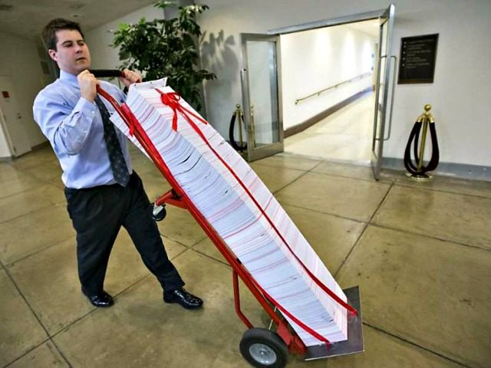
Hoop #4: Regulations
Regulations
20

Slide 21
Hoop #4: Regulations
For charter schools accepting lease reimbursement funds from the State of California, special conflict of interest rules apply. See Title 4, California Code of Regulations Section 10170.14.
IRS presumes that executive compensation is reasonable if approved in advance by the Board, without participation by interested persons, provided that the Board obtained and relied upon comparability data and adequately documented the basis for determining the reasonableness of the compensation. (IRS Reg. § 53.4958-6(a).) For IRS purposes, the definition of “interested persons” is broader than other laws. “Interested” for the purpose of approving an executive’s compensation includes employees working for/under any person whose salary is at issue. (IRS Reg. § 53.4958-6(c)(1)(iii).)
21

Slide 22
Hoop #5: Common Law on Conflicts of Interest
Prohibition Against Conflicts of Interest
Public official engaging in transaction or influencing decision
Creating an appearance of impropriety (financial interest not necessarily required)
Doctrine of Incompatible Offices
Public official holding two public offices
simultaneously
Offices are incompatible with each other
(creating divided loyalties); overlapping jurisdictions
22

Slide 23
QUESTIONS AND RESPONSES
THANKS FOR ATTENDING TODAY!

