Slide 1
CCRPI
The GLOBE Academy

Slide 2
About
https://youtu.be/wjFO0AKwvis

Slide 3
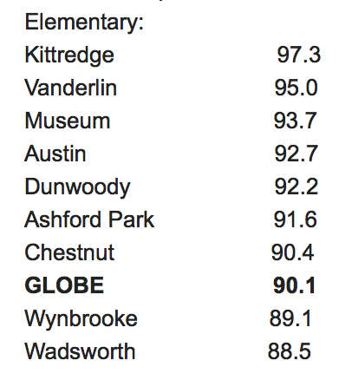
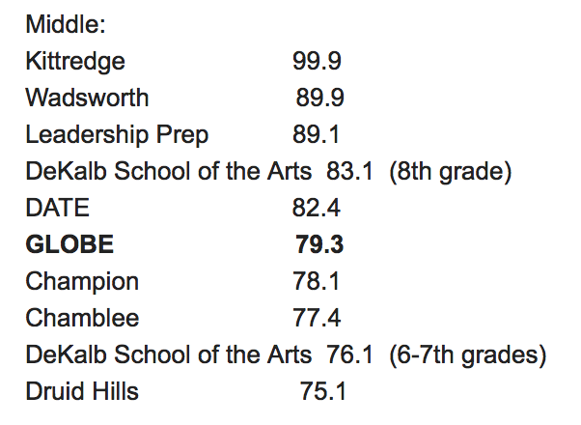
How do we rank in DeKalb

Slide 4
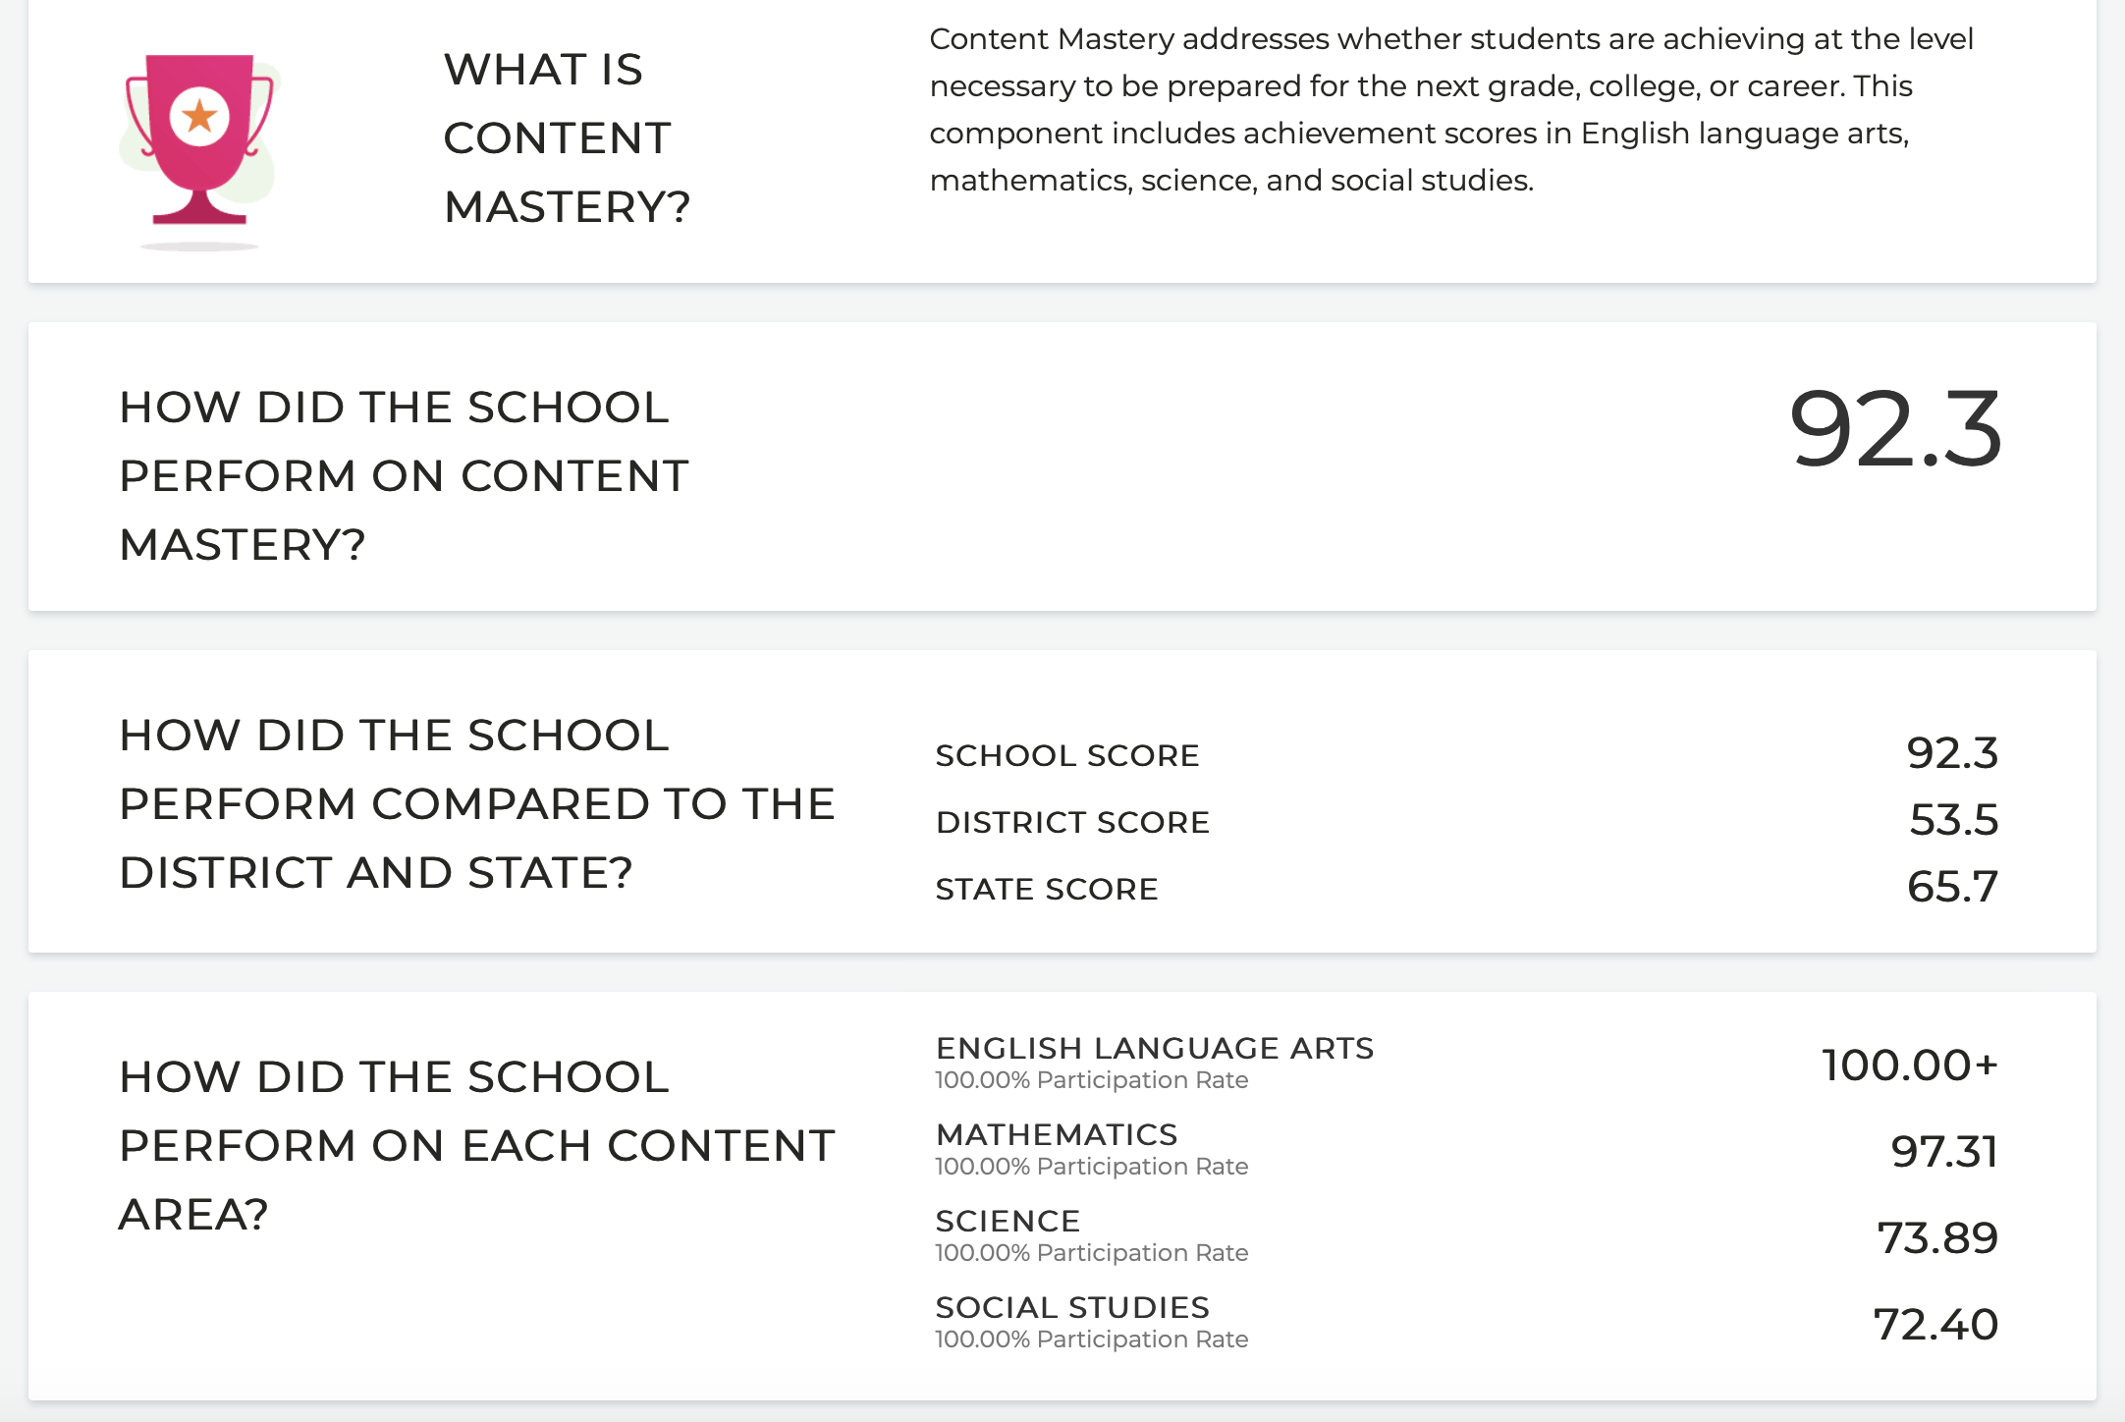
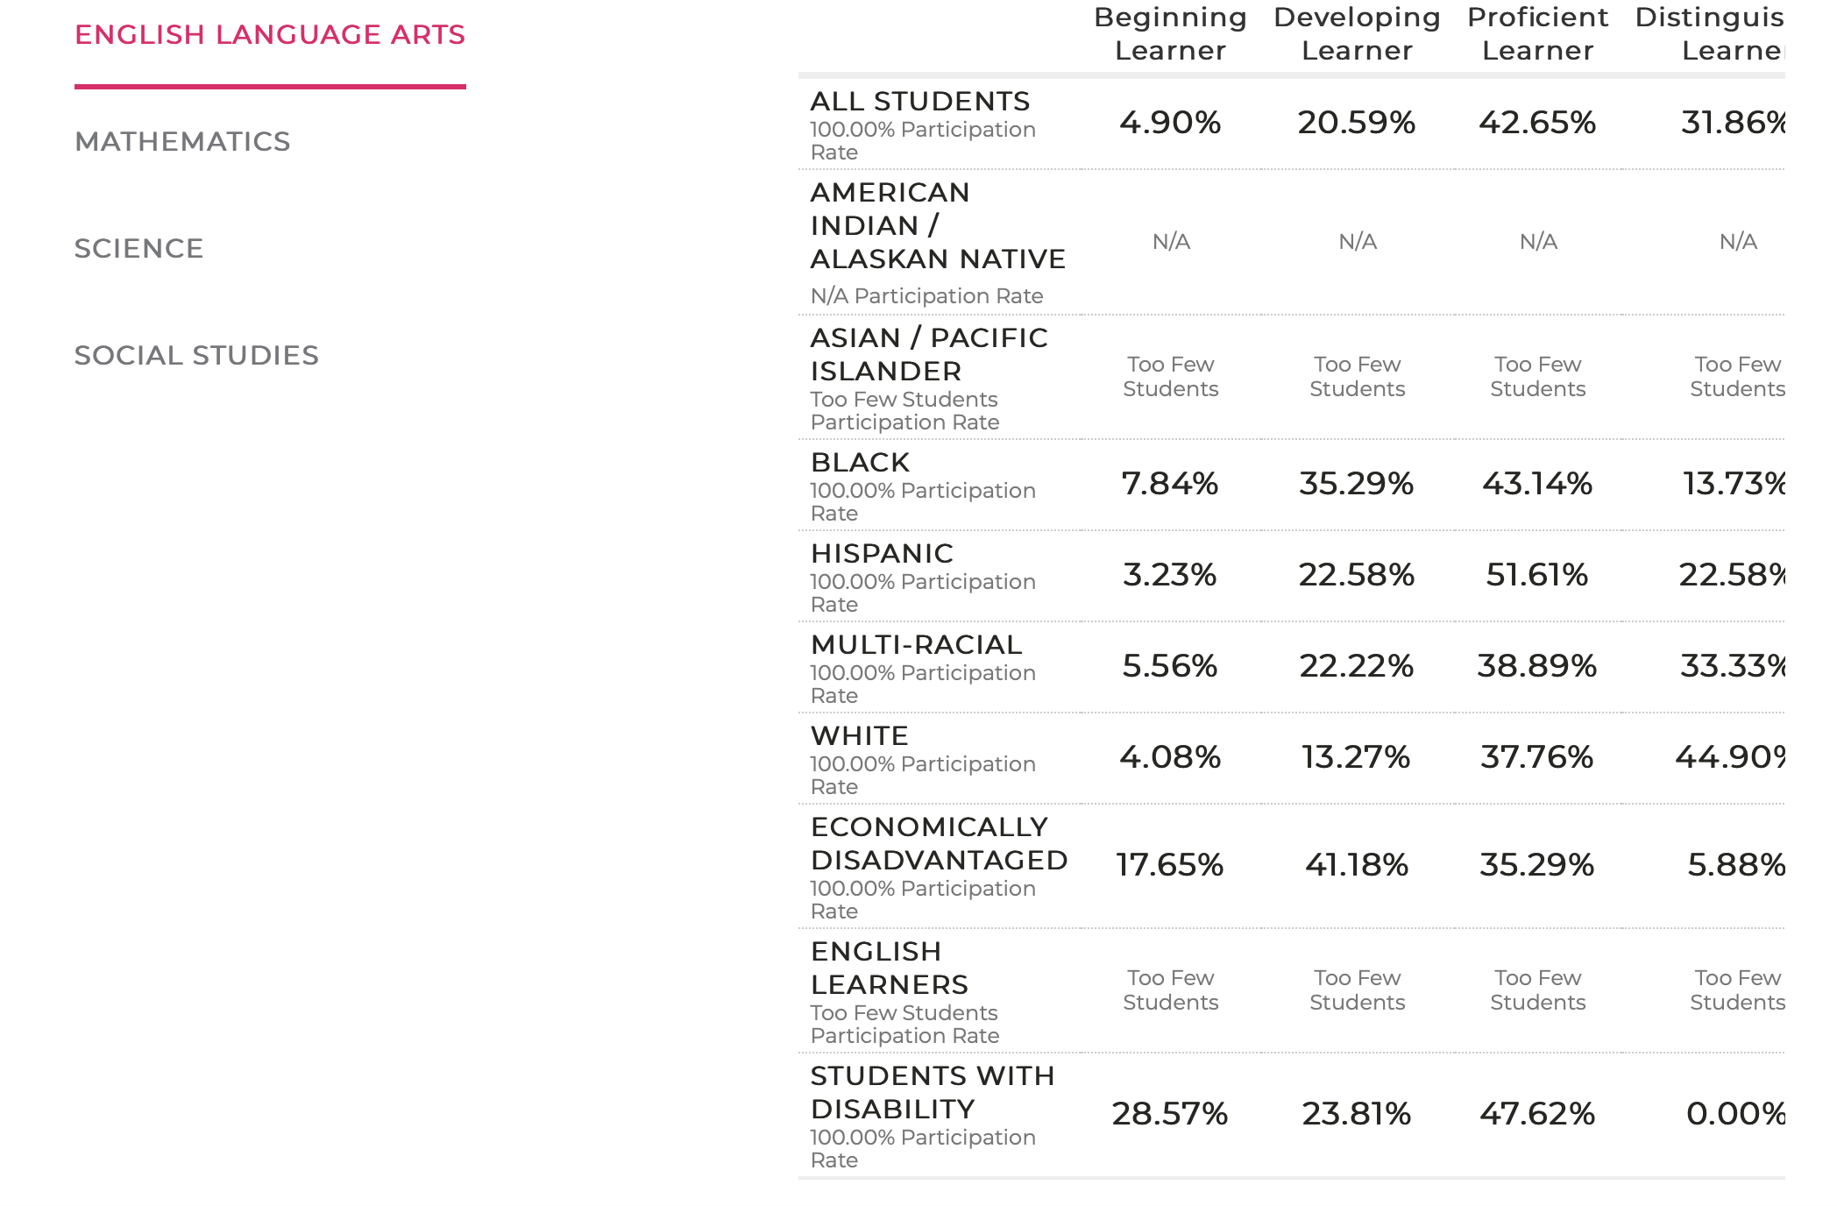
Our Elementary Scores

Slide 5
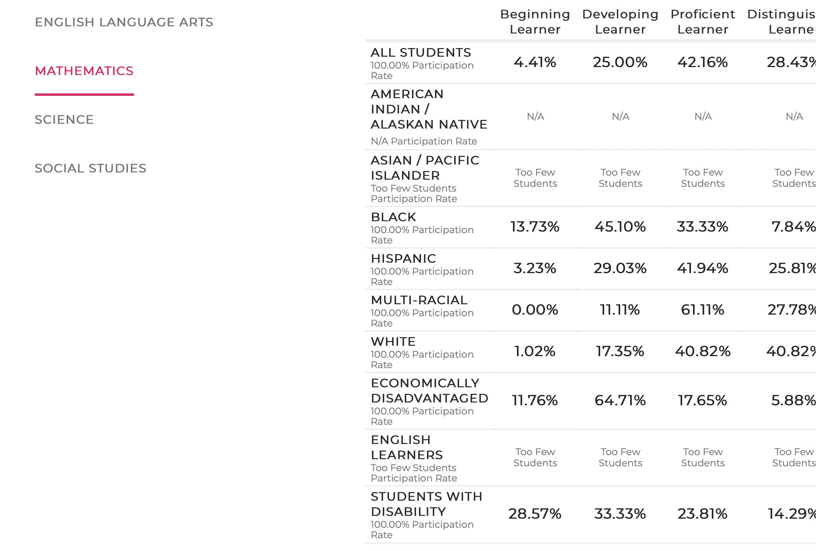

Slide 6
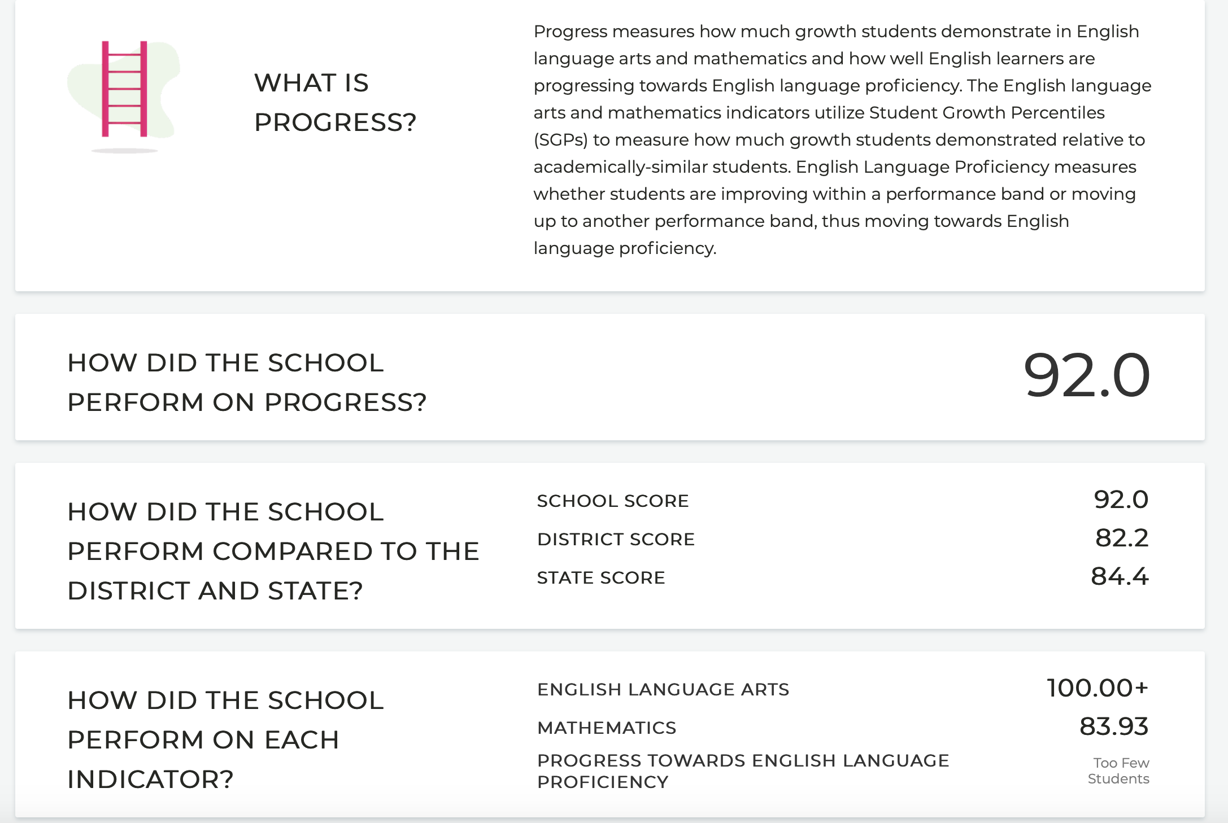

Slide 7
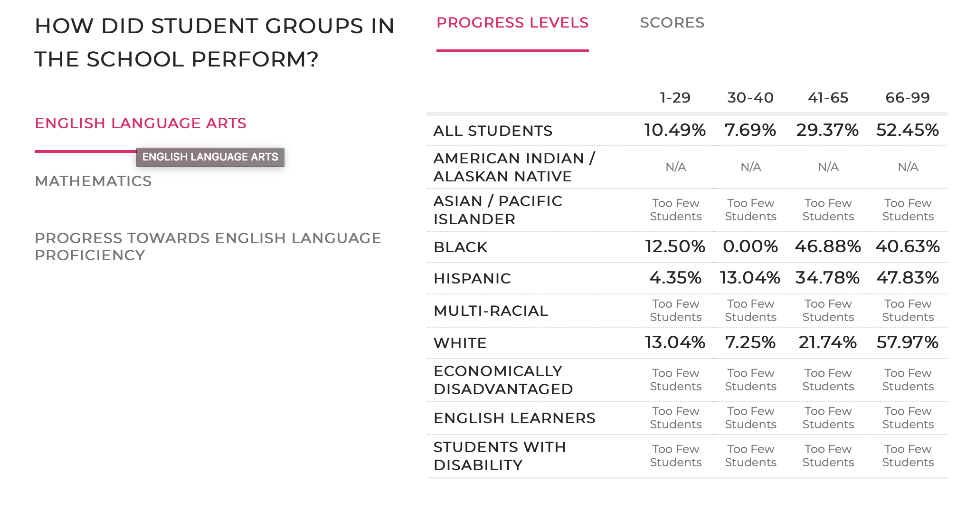
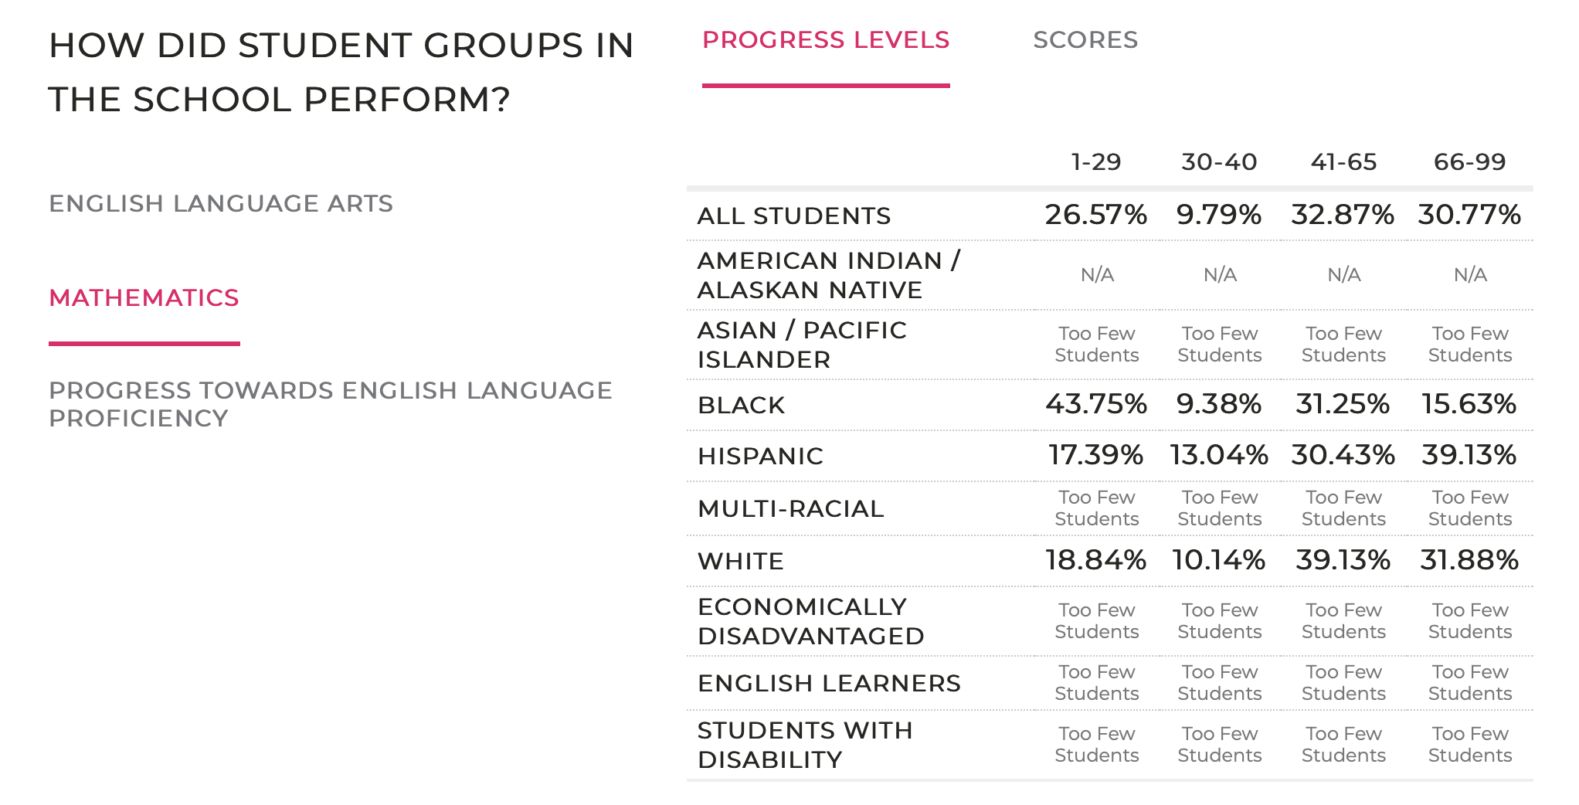

Slide 8
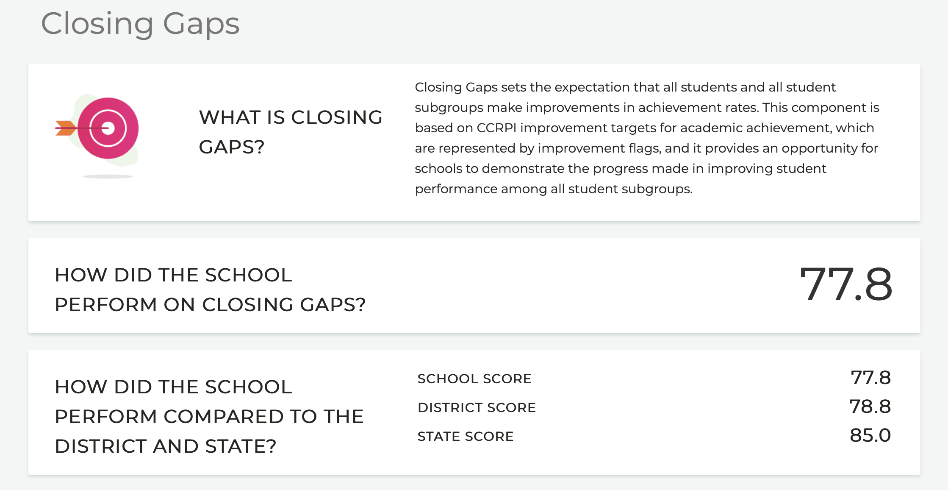

Slide 9
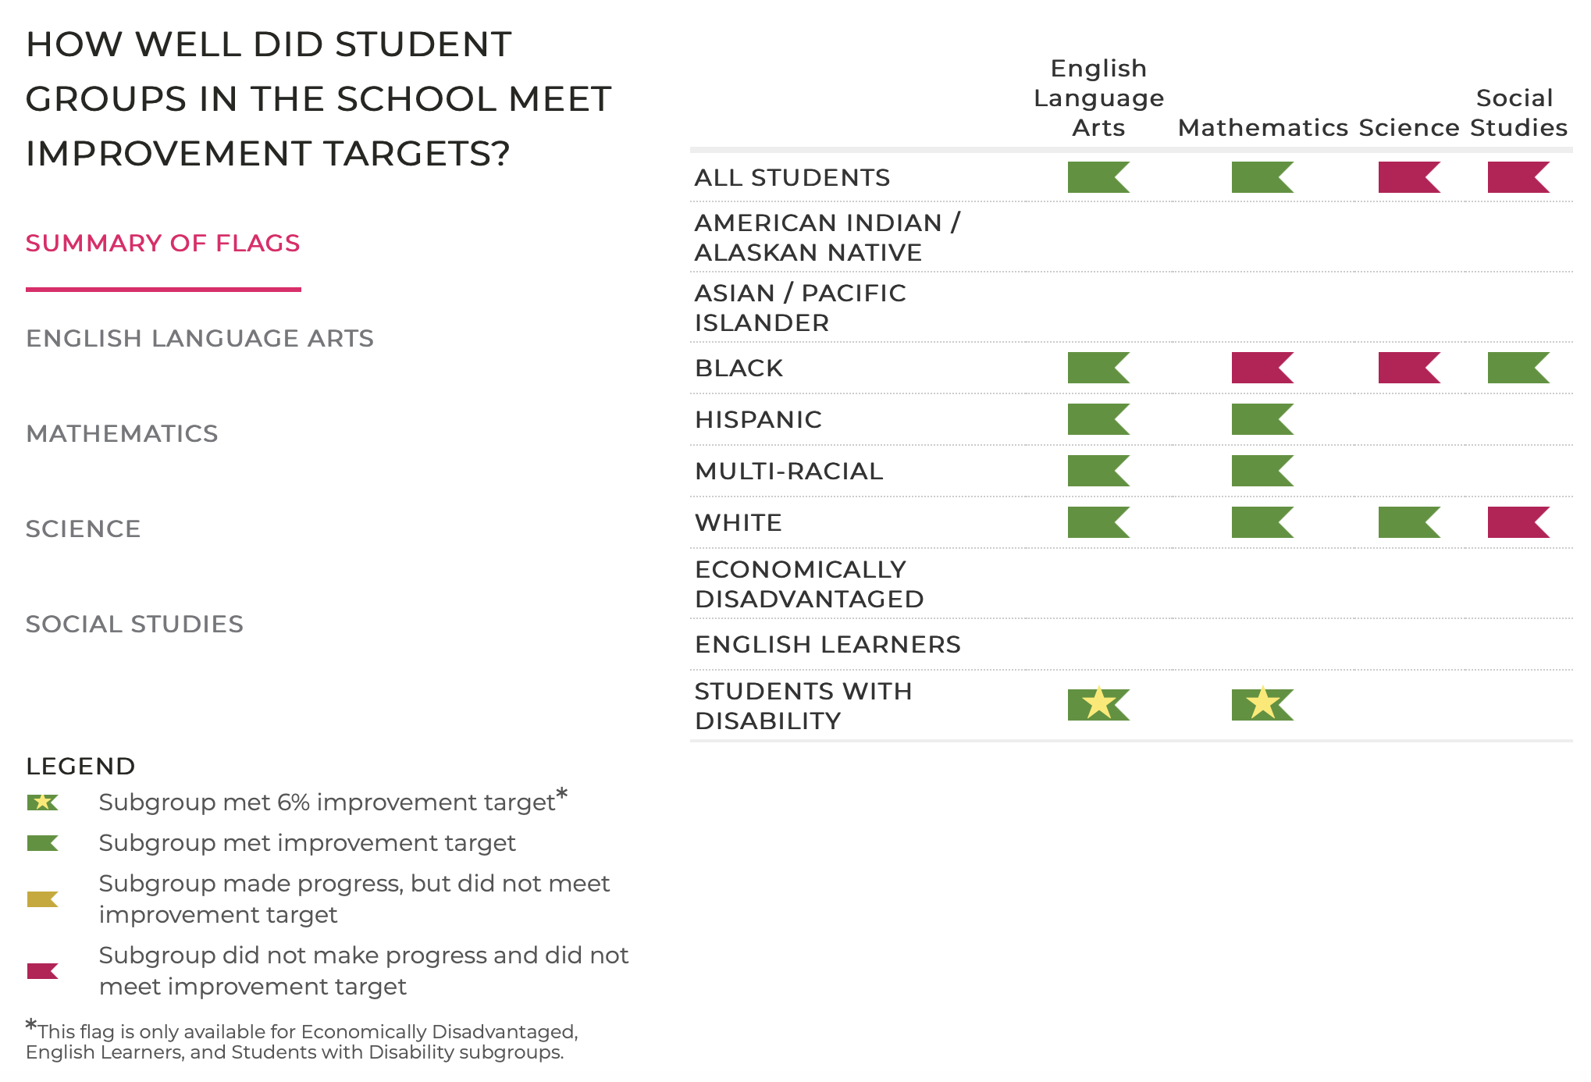

Slide 10
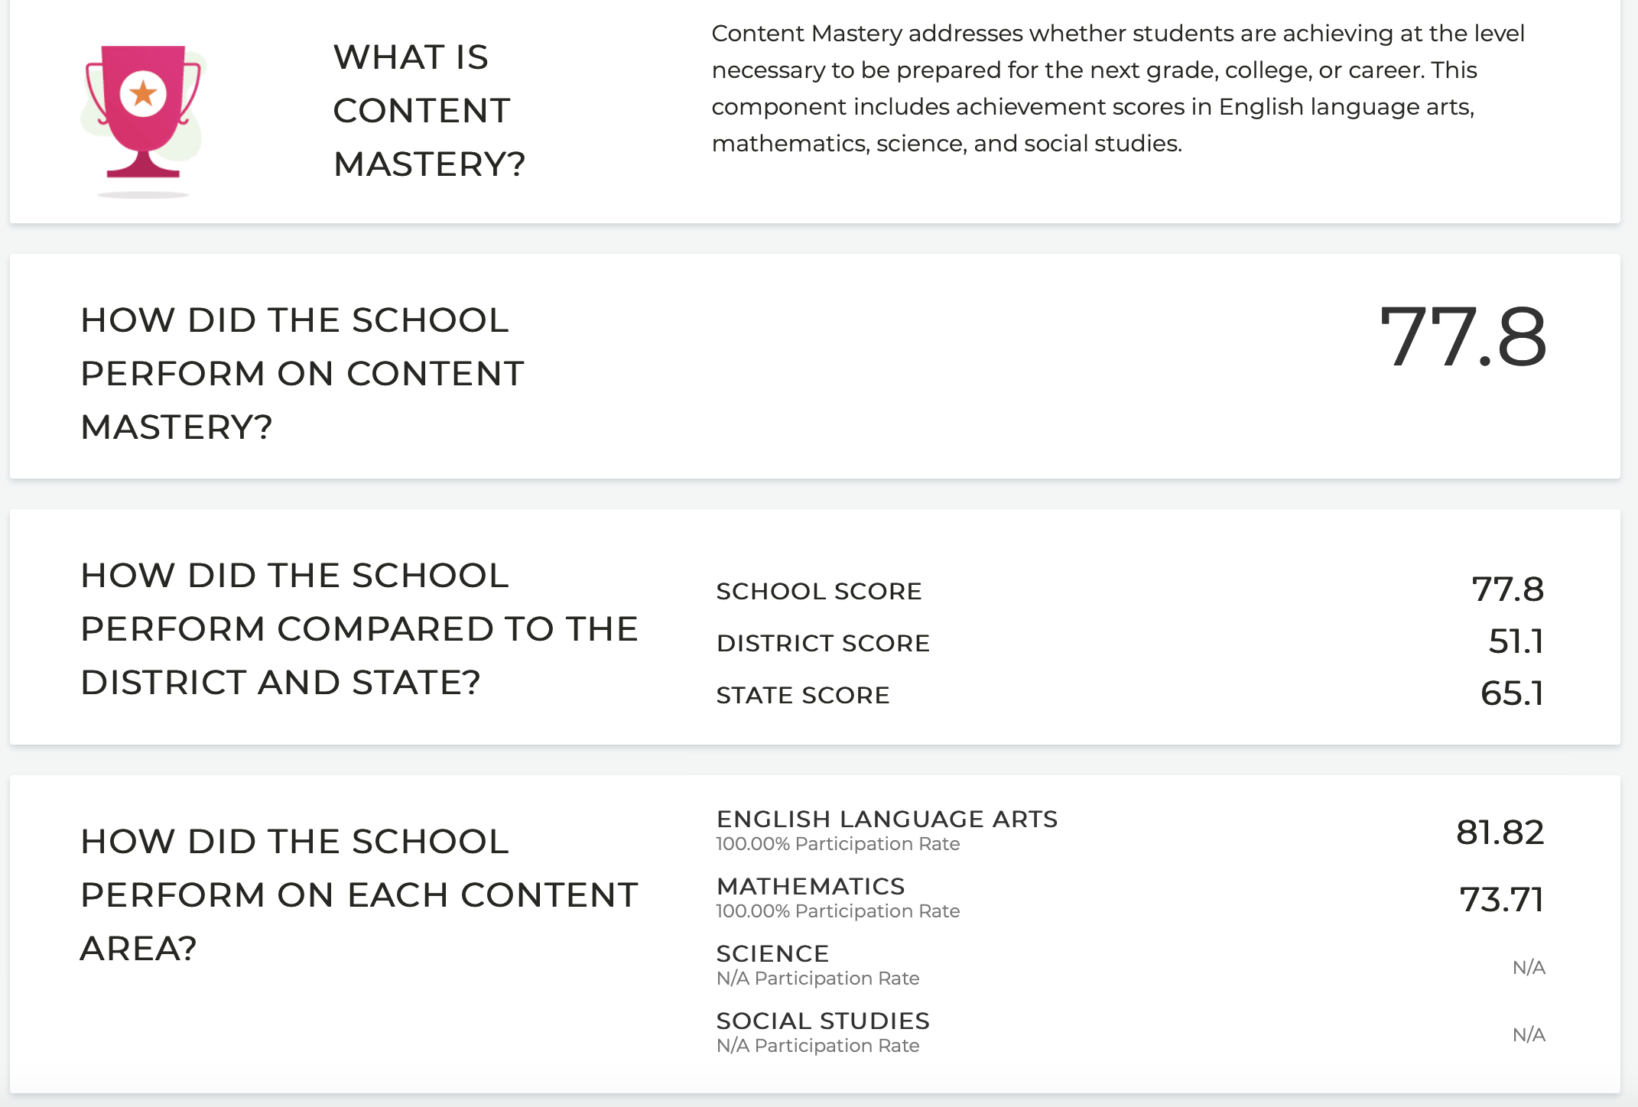

Slide 11
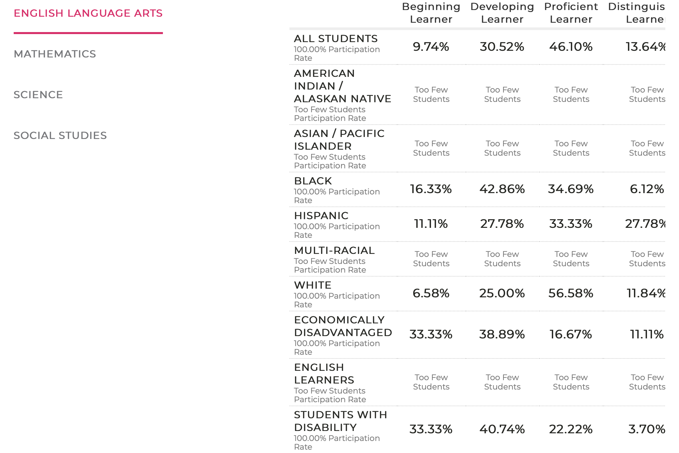
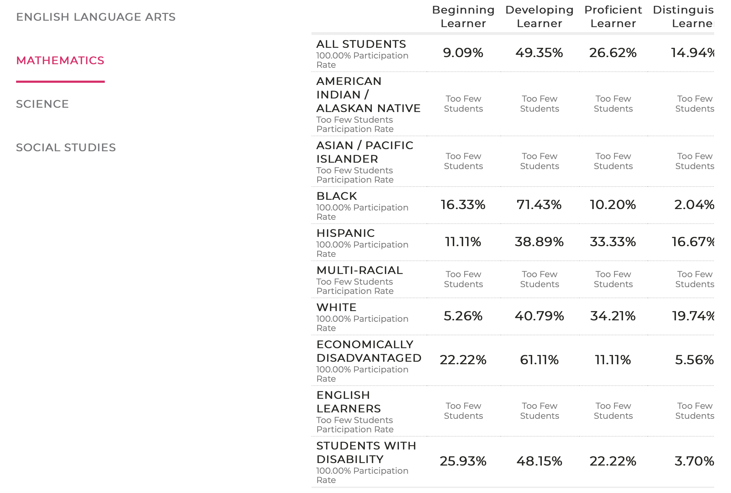

Slide 12
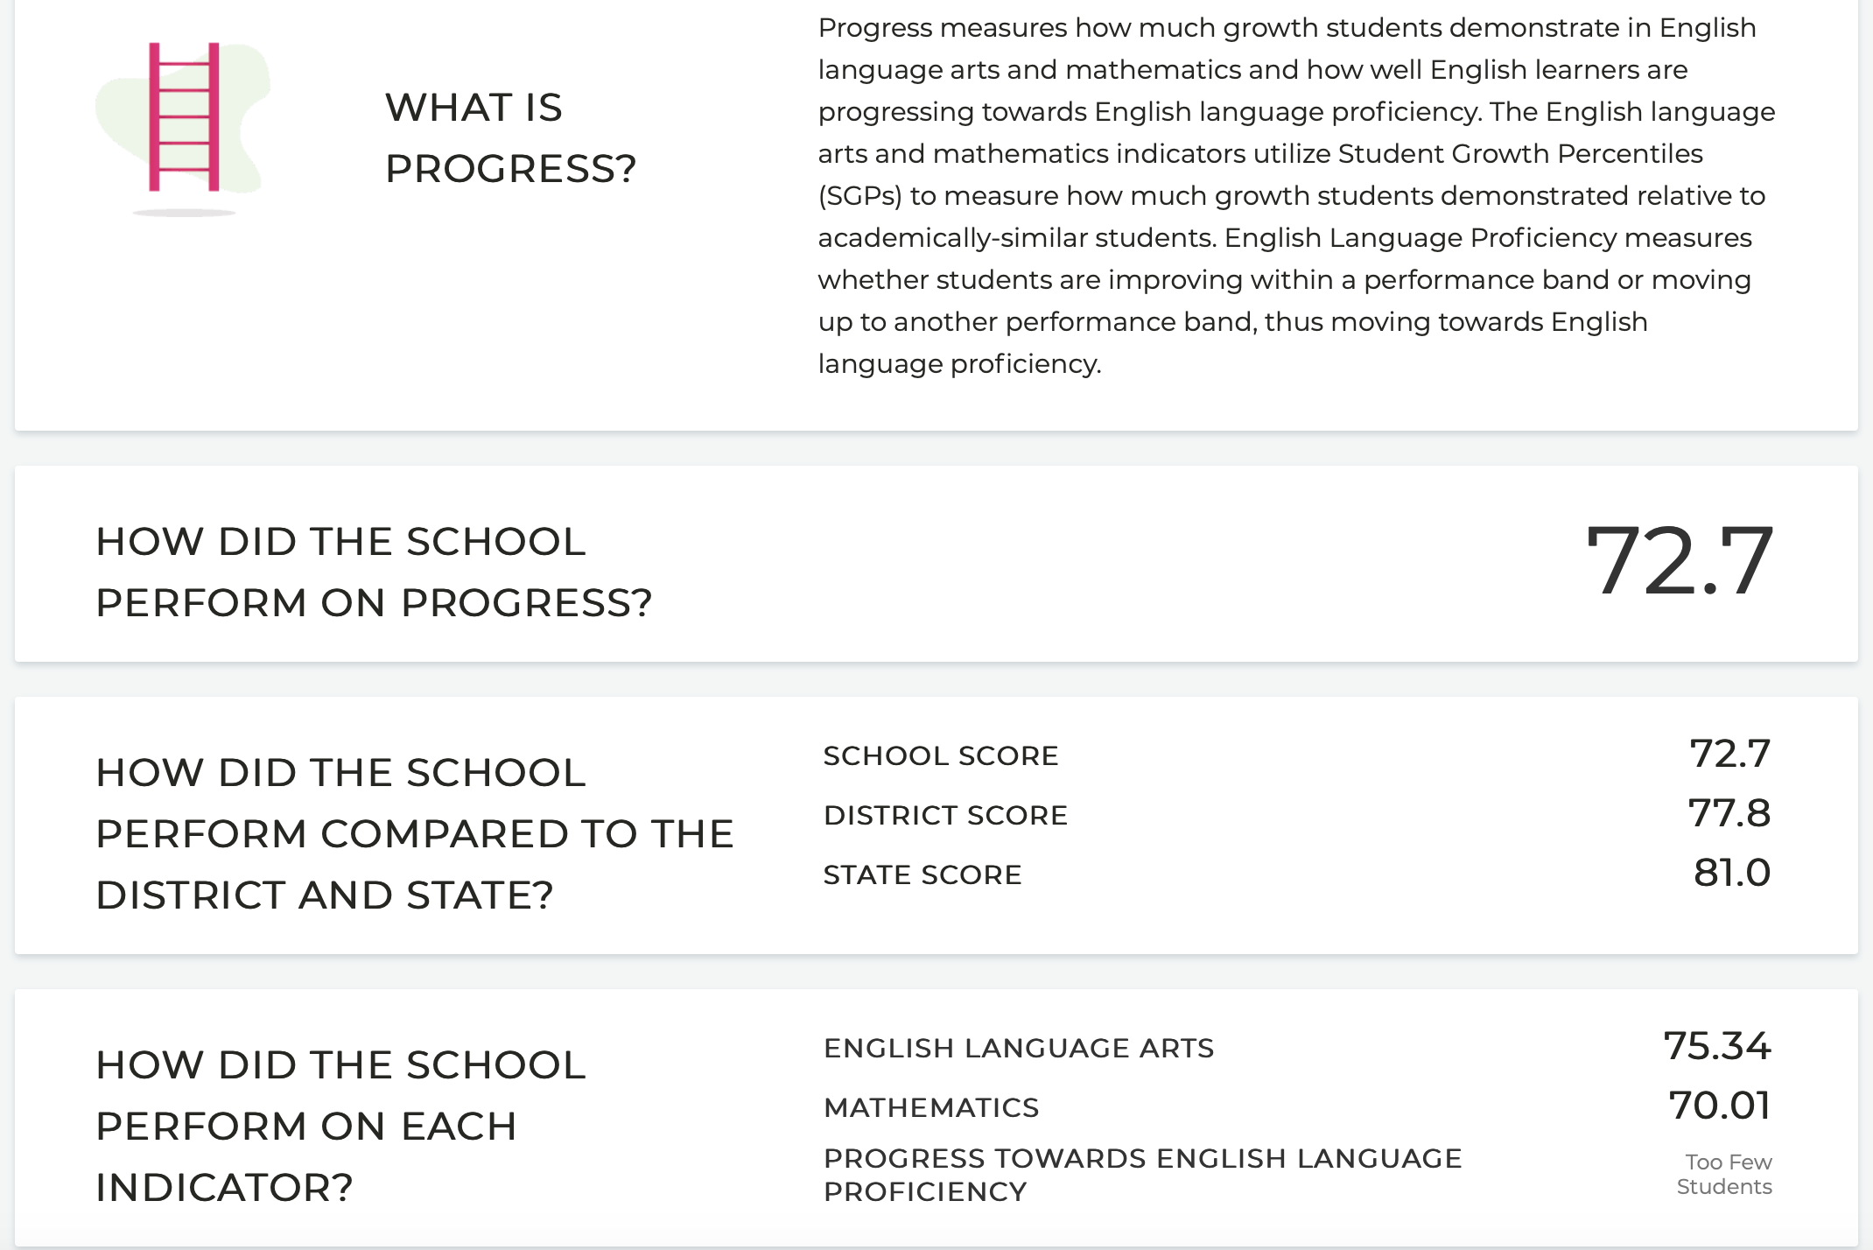

Slide 13
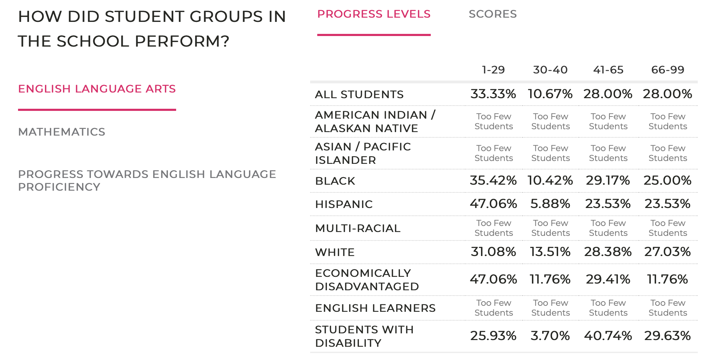

Slide 14
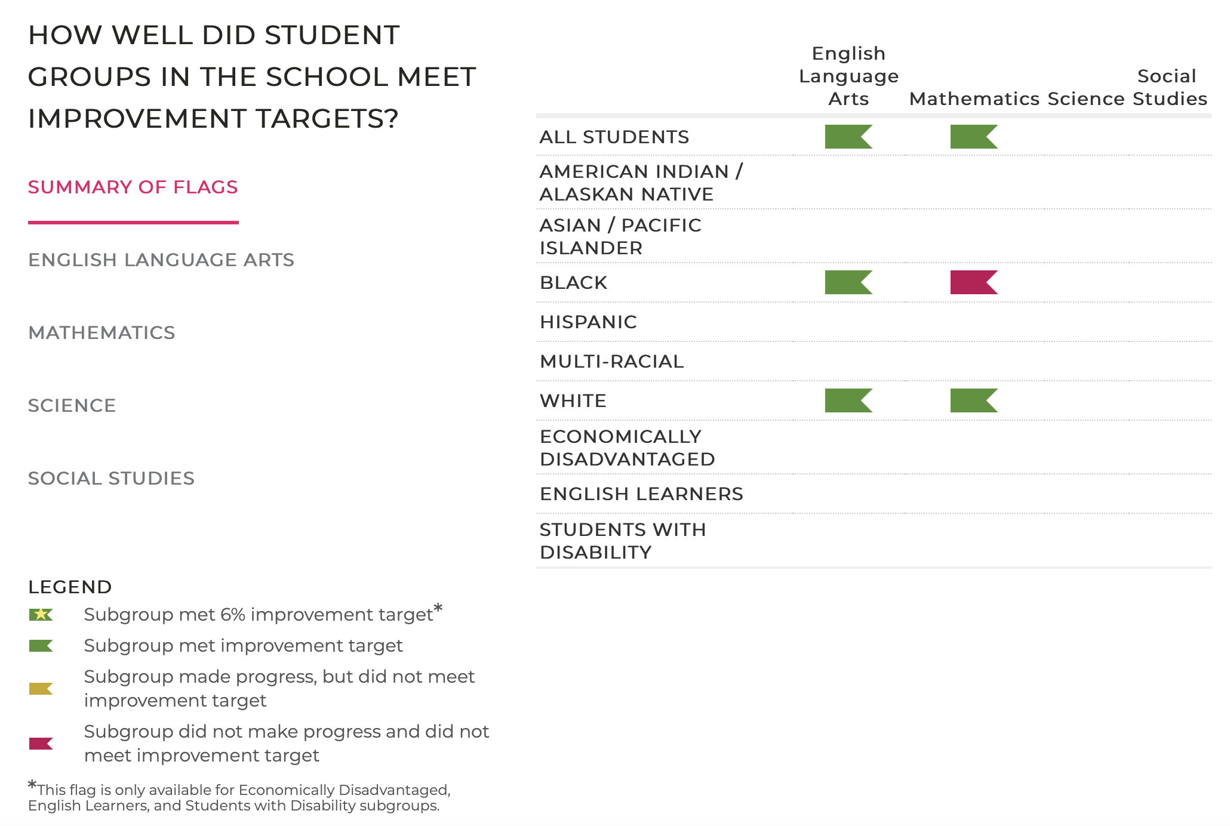

Slide 15
How are we looking at this data?
We will be looking at this data as a whole school. Where do we see trends? In what areas do we need to address in closing the gaps?
Equity audit is looking at this data to include in their report.
Strategic Planning committee will take this data to help guide our goals for our school and students.

Slide 16
What does this mean for our students?

Slide 17
Overall
Our overall scores look good. We now have the data to dig deep and create goals for all of our students. We want to not only outperform overall school scores, but we want to outperform subgroup targets. We want to close our gaps.

