Slide 1
Board Update December 7, 2020
Notes:
Katie

Slide 2
2020-2024 Strategic Plan
Community, Respect, Empathy, Sustainability, Trust
1.1 Implement 5-year staffing plan
1.2 Clarify roles and responsibilities
1.3 Implement communication strategy
1.4 Implement perf. mgmt. system for
teachers and staff
1.5 Strengthen teacher recruitment,
hiring and onboarding
1.6 Codify org operations, processes, and procedures
1.7 Implement cont. improvement
system
2.1 Design and implement a master plan for lower campus facilities
2.2 Design and implement a master plan for upper campus facilities
2.3 Create the conditions for
excellent facilities management
School Facilities
Secure long-term use of K-8 facilities and execute facility improvements to enable deep learning and play
Organizational Development
Create an optimal school staffing and operating model with a pipeline of outstanding, qualified teachers
Core Instruction
Implement best in-class K-8 global learning curriculum and immersion model to accelerate student learning, advance global citizenship and close achievement gaps
3.1 Develop best-in-class academic, immersion and global citizenship model and curriculum
3.2 Define and align on a common
vision for excellent teaching
3.3 Implement a comprehensive
professional development strategy
3.4 Support students to develop into
global citizens
Diversity, Equity, Inclusion
4.1 Create Diversity, Equity and Inclusion vision and goals
4.2 Strengthen and build capacity to
execute student behavior plan
4.3 Implement “strong start” school
culture plan
4.4 Develop staff Diversity, Equity and Inclusion competencies
Develop a school-wide Diversity, Equity & Inclusion vision and align all aspects of the school to this vision
MISSION: The GLOBE Academy fosters Global Learning Opportunities through Balanced Education for children of all backgrounds. With a focus on dual-language immersion,
an experiential-learning model and a constructivist approach, GLOBE inspires students to be high-performing lifelong learners equipped to make a positive impact in the word.
Notes:
Katie
This was the plan that decided to work on with 4 main initiatives which was then broken down into initiatives under the main ones. These should be complete at the end of 5 years.

Slide 3
Strategic Initiatives Progress Update
Organizational Development
Developed 5-year staffing plan
Developed and implemented first phase of communications strategy
Developed revised teacher hiring toolkit
Developed continuous improvement Metrics Dashboard
Core Instruction
Developed a common vision for teaching excellence (in-person and virtual)
Developed a teacher professional development and talent management framework
School Facilities
Designed lower campus facilities master plan
Designed upper campus facilities master plan
Launched revised facilities management plan
Diversity, Equity, Inclusion
Initiated staff DEI trainings with Conscious Roots
Notes:
Katie

Slide 4
Initiative prioritization process for SY21-22
Prioritized Initiatives
Ensuring the safety for all students and staff
Communicating with families to inform re-opening
Meeting academic and social-emotional needs of all students
Providing Diversity, Equity and inclusion training for all staff
Delivering effective virtual instruction
Initiatives on Pause
Long-term organizational development (e.g., job descriptions for all positions, standardizing teacher on-boarding)
Broad changes to immersion model, curriculum design, and enrichment
Non-essential facilities improvements
Notes:
Katie

Slide 5
Implementation Roadmap
Year 3
SY2020-21
Year 4
SY2021-22
Year 5
SY2022-23
 | 1.Organizational Development (Ryan, Christi, Denise, Amy) | Semester 1 1.3 - Expand communication strategy to drive inclusion and consistency Semester 2 1.1 - Create and communicate staffing vision, year-by-year org chart and budget implications 1.5 - Design recruitment strategy, hiring process and certification requirements 1.6 - Design school dashboard of KPIs for all functions & data review process 1.7 - Design and implement continuous improvement school review cycle | Semester 1 1.5 - Implement recruitment strategy, hiring process and certification requirements 1.6 - Streamline and codify organizational processes and procedures (HR, hiring, student data, etc.) 1.6 - Implement school dashboard of KPIs for all functions & data review process Semester 2 1.7 - Expand continuous improvement school review cycle to include annual school strategic planning cycle | Semester 1 1.2 - Design clear job descriptions, management relationships and roles and responsibilities for all positions (Teachers/TAs/Etc.) 1.5 - Implement standardized teacher on-boarding process 1.6 - Refine organizational processes and procedures Semester 2 1.4 - Design performance management system with staff 1.7 - Continue to expand continuous improvement school review cycle
 | 2. School Facilities (Megan, Jerry) | 2.1 - Develop long-term facility plan; complete master plan for lower campus and implement prioritized renovations 2.2 - Complete master plan for upper campus; implement planned renovations to upper campus 2.3 - Establish regular facility and audit procedures | 2.1 - Finalize long-term facility plan; 2.3 - Establish regular facility and audit procedures | 2.2 - Implement planned renovations to upper campus and lower campus
 | 3. Core Instruction (Katie, Judy, Sabrina, Cutia) | Semester 1 3.1 - Define profile of a graduate; Launch taskforce to research global learning curriculum and K-8 immersion model 3.2 - Define vision for excellent teaching with teachers and staff Semester 2 3.1 - Develop implementation plan for global learning curriculum and K-8 immersion model 3.2 - Calibrate on vision for excellent virtual/hybrid teaching 3.3 - Design comprehensive professional development system aligned to vision for excellent teaching | 3.2 - Continue to calibrate on vision for excellent instruction 3.3 - Launch redesigned Professional Learning Community (PLC) model and coaching | 3.1 - Implement global curriculum and K-8 immersion model (in phases) 3.4 - Launch capstone experiences and sister schools
 | 4. Diversity, Equity & Inclusion (Monique, Fatimah, Zakia) | 4.1 - Design DEI vision statement 4.3 - Design “strong start” school culture plan 4.4 - Develop staff DEI competencies | 4.1 - Calibrate on DEI vision statement 4.4 - Continue to develop staff DEI competencies | 4.3 - Implement “strong start” school culture plan 4.2 - Implement student behavior vision and plan 4.4 - Continue to develop staff DEI competencies
Notes:
Christie (to the end)

Slide 6
Spotlight: Calibration on Teaching Excellence
Notes:
Q&A

Slide 7
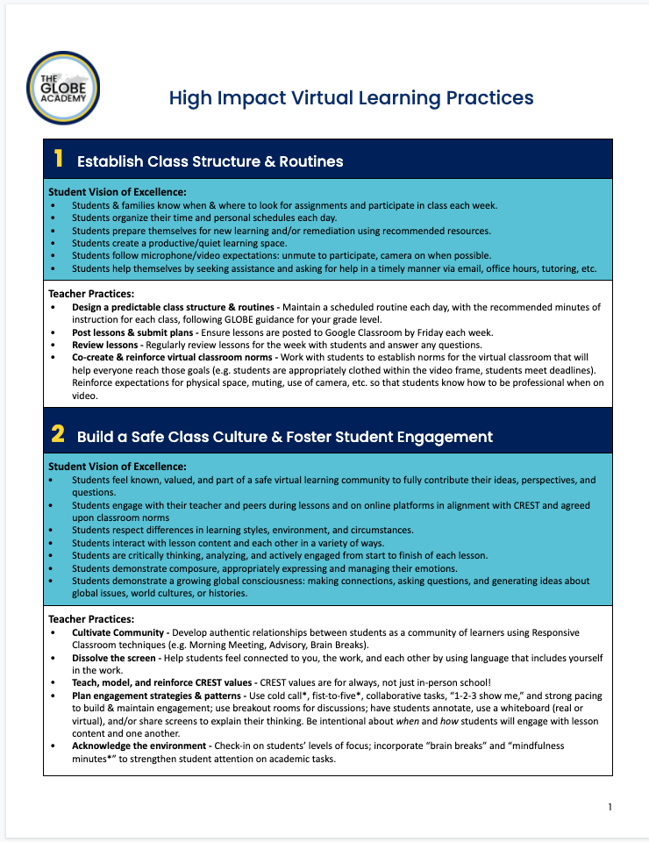
Spotlight: Virtual Learning Vision of Excellence
Technology (Devices, LMS, Zoom, etc.)
Professional Development (Pre-Planning, Calibration, Coaching,PLCCs, etc.)
Virtual Learning
Clear Expectations (Students, Staff, Families)
Shared Vision for Excellence
High Impact Virtual Learning Practices
Notes:
Q&A

Slide 8
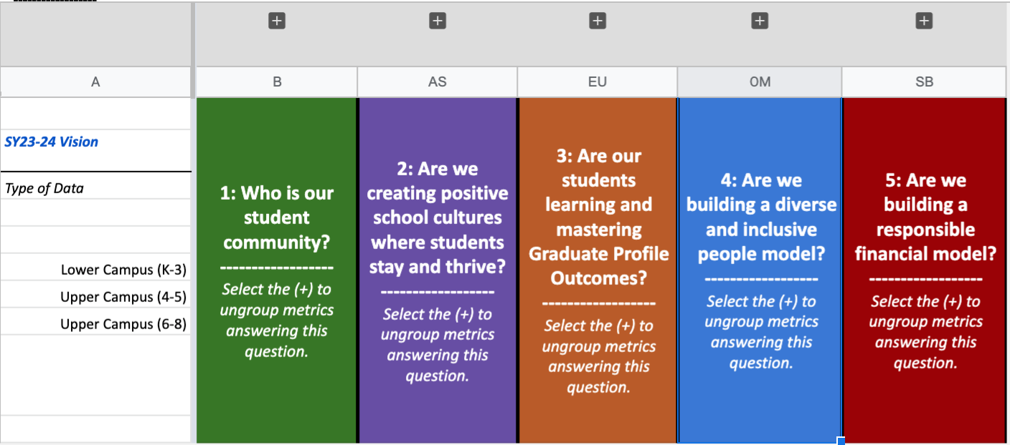
Spotlight: GLOBE’s Metrics Tracker
Draft Dashboard
Notes:
Christi: make equity connection

Slide 9
Spotlight: Teacher Development Framework
Draft Dashboard
Notes:
Q&A

Slide 10
Appendix
Notes:
Q&A

