Slide 1
ACADEMIC COMMITTEE
June 2020 Board Meeting Report Drew Reynolds, PhD, MSW, MEd Committee Chair

Slide 2
Racial and Ethnic Differences in Discipline and Attendance at GLOBE Academy
Data from Governor’s Office on Student Achievement K-12 Student Discipline Dashboard
https://public.gosa.ga.gov/noauth/extensions/DisciplineDASHV1/DisciplineDASHV1.html#

Slide 3
CONTEXT: SCHOOL-TO-PRISION-PIPELINE
﻿The school-to-prison pipeline (STPP) refers to a path from the education system to the juvenile or adult criminal justice system.
Student involved in school discipline
Student experiences higher consequences
Discipline interferes with schooling
Student involved with criminal justice system
GOAL: To prevent students from over involvement in discipline system and reduce the likelihood that discipline will interfere with a student’s success in school and beyond.

Slide 4
CONTEXT: DISCIPLINE AT GLOBE
Responsive Classroom – focus on relationships
Positive approach to discipline that promotes teaching students to be good choice makers.
Helps children develop the intrinsic decision-making skills that will keep them safe, happy, and successful in their life endeavors.

Slide 5
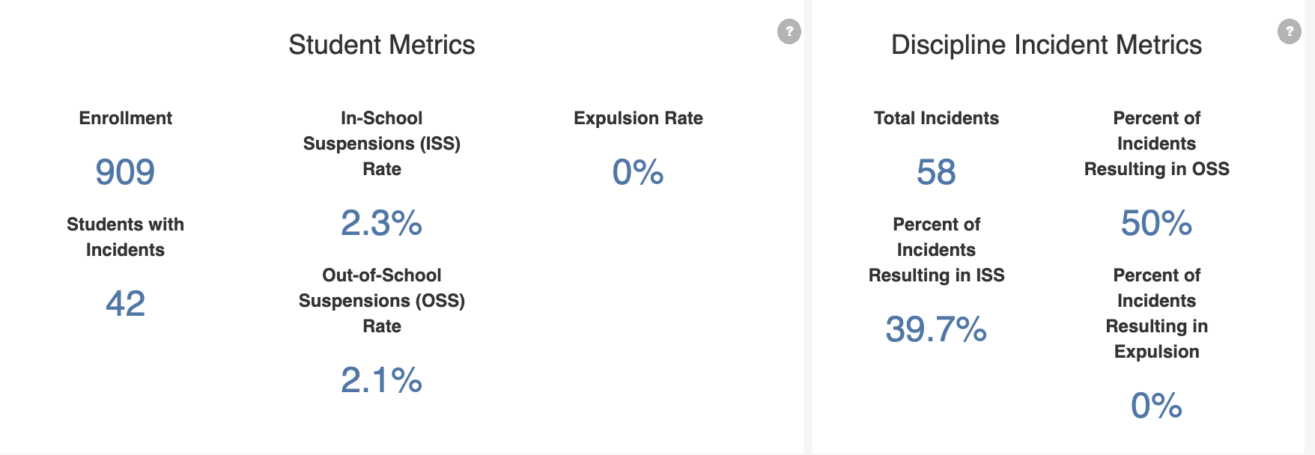
2019 DISCIPLINE DATA

Slide 6
2019 DISCIPLINE BY RACE/ETHNICITY
KEY POINT:
Black students are disciplined at higher rate relative to their % of the student population.

Slide 7
DISCIPLINE BY RACE/ETHNICITY & YEAR

Slide 8
ATTENDANCE RACE/ETHNICITY & YEAR

Slide 9
Anticipating the “Covid-19 Slide” at GLOBE Academy
Projections on changes in student achievement as a result of lost school time due to Covid-19
https://www.nwea.org/content/uploads/2020/05/Collaborative-Brief_Covid19-Slide-APR20.pdf

Slide 10
COVID-19 SLIDE
“Projections suggest major academic impacts from COVID closures for students, especially in mathematics.”

Slide 11
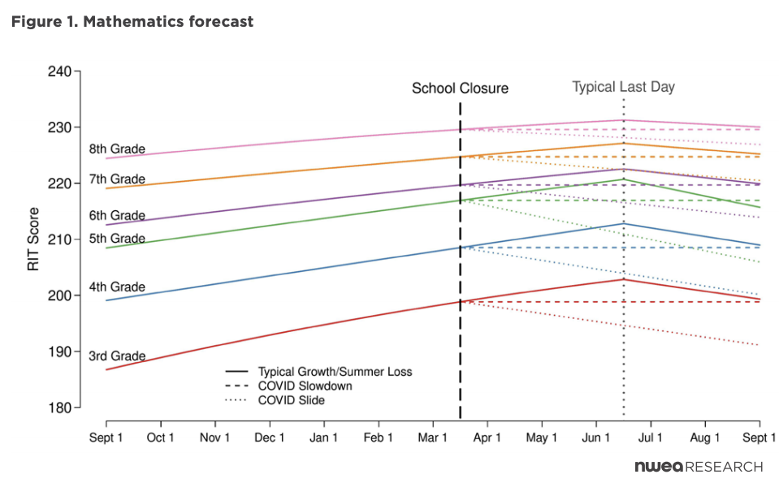
KEY POINT:
We should expect students to have higher summer learning loss

Slide 12
RECOMMENDATIONS
Policymakers, educators, families, and communities should further their work to provide support, especially in mathematics, to students while school is disrupted.
GLOBE: Provide teacher professional development in distancing learning and supporting student social/emotional needs -> Eureka Math
To guide curriculum and instruction to support students, educators will need data.
GLOBE: Prioritize MAP testing in Fall, hope for in-person
Researchers, policymakers, and schools should work together to understand potential policies and practices for recovery
GLOBE: Identify what has worked and what needs improvement from Spring 2020

Slide 13
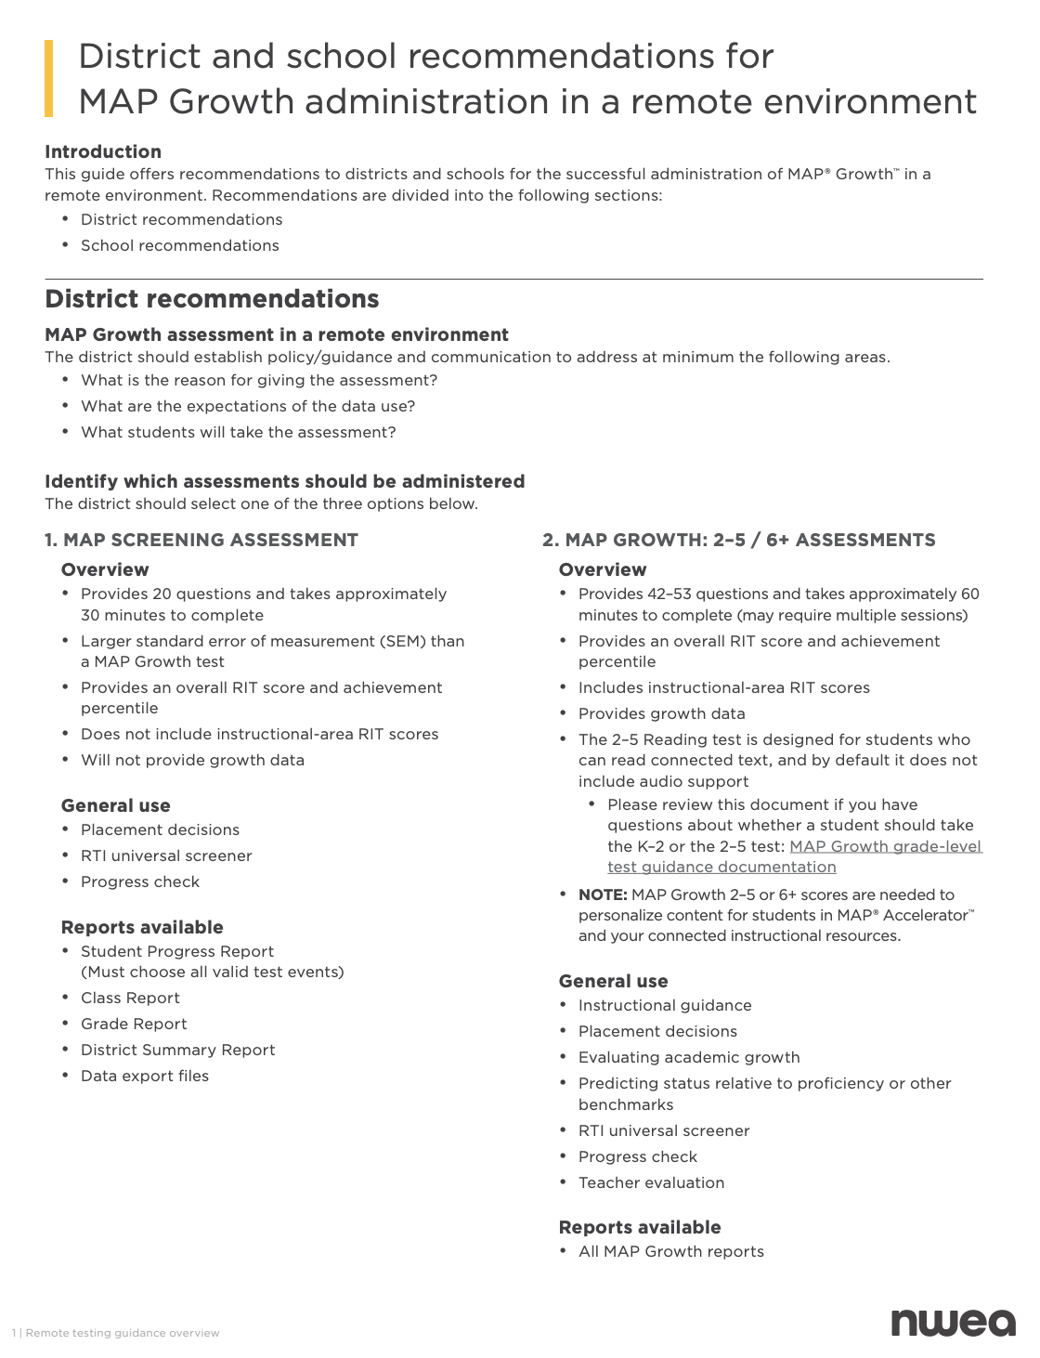
NWEA Guidance on Remote Testing

