Slide 1
The Globe Academy – Finance Committee - Agenda
Item | Purpose
Upper Campus Loan Refinancing | Vote
Financial Policies Amendment – Staff and Travel Expenses | Vote
Financial Statements – FY2020 | FYI
FY2021 Budget Timeline | FYI

Slide 2
The Globe Academy – Finance Committee – Upper Campus Refinancing
CenterState is offering us a better loan option than the current one for the Upper Campus Building and we would like to get approval for the board to refinance up to 4.5M
New Loan would be fixed rate (~4.22% APR) for 20 years instead of 4.49% for the next 4 years and variable rate (Prime + 0.5% = Currently 5.25%) for the next 20 years—we would save approximately $850K in interest expense for the life of the loan.
The Bank has asked us for the following language to appear in the BOD minutes:
“A motion was made by ____________________ and seconded by ______________________ to approve up to $4,500,000 loan by CenterState Bank for the refinancing of the Upper Campus building. “

Slide 3
The Globe Academy – Finance Committee – Staff & Travel Expenses Amendment
Here is the original language from XV.STAFF AND TRAVEL EXPENSES that we are looking to amend. We would also like the amend all reference to HOS in the Financial Policies be changed to ED (Executive Director)
Original Text | Proposal (Changes highlighted)
All out-of-town travel shall be approved by the Head of School in advance. All staff shall submit travel reimbursement forms by which they request reimbursement. Travel reimbursement forms shall document employee name, travel dates, destination, business purpose, and detail business costs such as tolls, parking, mileage and meals. All receipts and substantive documentation must be attached to the travel reimbursement form. Submitted travel reimbursement forms shall be reviewed by the Business Manager for: (a) accuracy of computations; (b) completeness of required receipts; and (c) adherence to established guidelines. Inaccurate or incomplete information shall be discussed with the submitting staff member, and any necessary additional information shall be requested by and provided to the Business Manager prior to reimbursement. Staff shall be compensated within 10 business days of submission of a complete and accurate reimbursement form to the Business Manager. Reimbursement requests submitted by the Business Manager shall be reviewed and approved for payment by CFO; requests submitted by the CFO and HOS shall be reviewed and approved for payment by an Officer (Chair, Vice Chair or Treasurer). | All expenditure requests shall be approved by the Executive Director in advance. All travel for the Executive Director shall be approved in advance by the Board Chair or their board designee. All staff shall submit travel reimbursement forms by which they request reimbursement whether the expense is paid out-of-pocket or with an organizational debit card or other payment method. Travel reimbursement forms shall document employee name, travel dates, destination, business purpose, and detail business costs such as tolls, parking, mileage and meals. All receipts and substantive documentation must be attached to the travel reimbursement form. Submitted travel reimbursement forms shall be reviewed by the Business Manager for: (a) accuracy of computations; (b) completeness of required receipts; and (c) adherence to established guidelines. Inaccurate or incomplete information shall be discussed with the submitting staff member, and any necessary additional information shall be requested by and provided to the Business Manager prior to reimbursement. Staff shall be compensated within 10 business days of submission of a complete and accurate reimbursement form to the Business Manager. All expenditure authorization and reimbursement requests submitted by the Business Manager shall be reviewed and approved for payment by CFO; requests submitted by the CFO and HOS shall be reviewed and approved for payment by the ED; requests submitted by the ED shall be reviewed and approved for payment by an Officer (Chair, Vice Chair or Treasurer) of the Board.

Slide 4
The Globe Academy – Finance Committee – Financial Statements
 | Globe Academy Financial Statement FY 2020
 | (Figures in '000s unless otherwise stated)
 |  |  |  |  |  | Previous | Current |  | Budget | Current - Budget
 |  |  |  |  |  | YTD | YTD | Y/Y | YTD | Δ | %
 |  | Revenues |  |  |  | $6,413 | $7,737 | 21% | $7,159 | $578 | 8%
 |  | Expenses |  |  |  | $5,739 | $6,700 | 17% | $6,236 | -$487 | -8%
 |  |  | Instruction |  |  | $3,453 | $4,001 | 16% | $4,025 | $25 | 1%
 |  |  | Pupil Services |  |  | $211 | $256 | 22% | $275 | $18 | 7%
 |  |  | Training and Improvement |  |  | $105 | $131 | 24% | $109 | -$22 | -20%
 |  |  | General Adminstration |  |  | $155 | $277 | 79% | $168 | -$109 | -65%
 |  |  | School Administration |  |  | $572 | $656 | 15% | $707 | $51 | 7%
 |  |  | Support Services-Business |  |  | $162 | $176 | 9% | $171 | -$5 | -3%
 |  |  | Maint & Oper-Plant Services |  |  | $607 | $661 | 9% | $322 | -$339 | -105%
 |  |  | Fundraising Activities |  |  | $12 | $16 | 37% | $9 | -$7 | -72%
 |  |  | School Nutrition Program |  |  | $46 | $94 | 103% | $51 | -$43 | -84%
 |  |  | ASP Operations |  |  | $325 | $343 | 5% | $250 | -$93 | -37%
 |  |  | Debt Services |  |  | $91 | $90 | -2% | $149 | $59 | 40%
 |  | Total Other Income |  |  |  | $2 | $16 | 901% | $0 | $16 | 0%
 |  | Total Other Expenses |  |  |  | $0 | $0 | -100% | $0 | $0 | 0%
 |  | Net Income |  |  |  | $676 | $1,053 | 56% | $923 | $130 | 14%

Slide 5
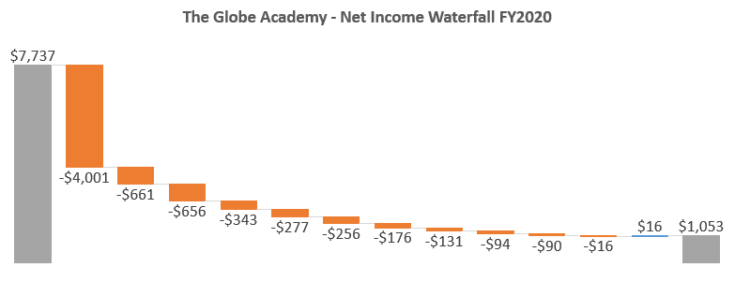
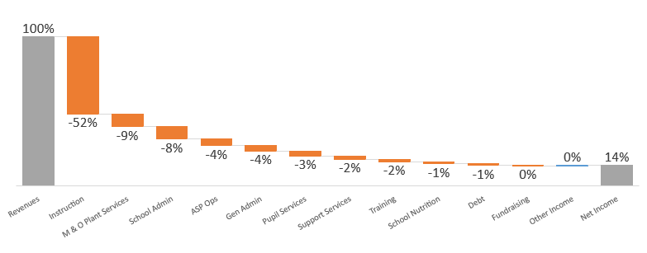
The Globe Academy – Finance Committee – Financial Statements

Slide 6
The Globe Academy – Finance Committee – FY2021 Budget Timeline
We would have the preliminary budget for approval by the April BOD’s meeting
Public Budget meeting between April’s and May’s meetings
Final Budget by the May BOD’s meeting
 | Week
 | 2/2/2020 | 2/9/2020 | 2/16/2020 | 2/23/2020 | 3/1/2020 | 3/8/2020 | 3/15/2020 | 3/22/2020 | 3/29/2020 | 4/5/2020 | 4/12/2020 | 4/19/2020 | 4/26/2020 | 5/3/2020 | 5/10/2020 | 5/17/2020 | 5/24/2020
 | 2/8/2020 | 2/15/2020 | 2/22/2020 | 2/29/2020 | 3/7/2020 | 3/14/2020 | 3/21/2020 | 3/28/2020 | 4/4/2020 | 4/11/2020 | 4/18/2020 | 4/25/2020 | 5/2/2020 | 5/9/2020 | 5/16/2020 | 5/23/2020 | 5/30/2020
Estimate of Projected Cost
Estimate of Projected Revenue
Addition / Substraction of projects
Preliminary Discussion with the Financial Committee
Preliminary Budget presented to Board
Public Meeting to Discuss Budget and make changes
Final Budget Approval

