Slide 1
GLOBE Label FrancÉducation
Sandra A. Daniel
Language Coordinator
March 30, 2020

Slide 2
Agenda
What is the French Label?
Requirements
Benefits and Awards

Slide 3
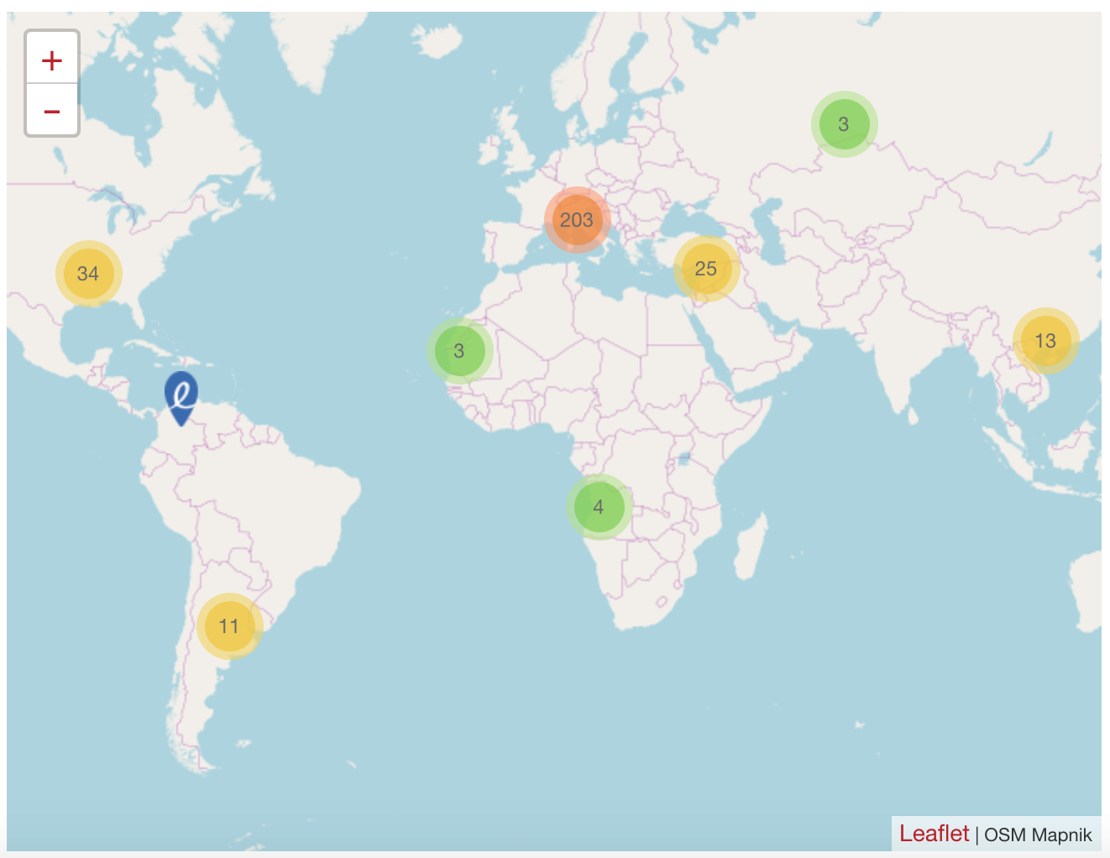
Launched in 2012 "LabelFrancÉducation" seal is granted to schools promoting French language and culture as part of their specific curriculum.
"LabelFrancÉducation" recognizes public or private schools that offer students enhanced French instruction in language and content.
"LabelFrancÉducation" promotes outstanding education in French among students and parents.
"LabelFrancÉducation" is granted by the French Ministry of Foreign Affairs, French Ministries of Foreign Affairs and Education, the Agency for French Education Abroad, the French institute, and Mission Laïque Française.
395 schools from all over the world have received the "LabelFrancÉducation" seal.

Slide 4
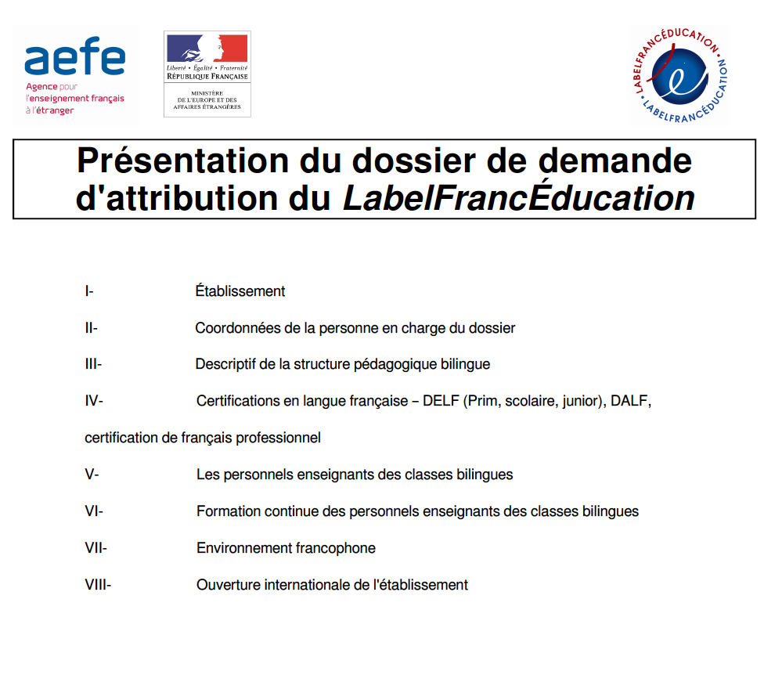
Requirements
Notes:
-Enhanced instruction in French and content, Content instruction must equate to 20% of weekly teaching schedule
-Evidence of highly educated, specialized French language teachers
-Have a strong PD program/trainer specific to Language – sharing with community DLI in a day, participation in GADII
-Students must be evaluated by STAMP or DELF-DALF
-French teachers with at least a Master’s degree
-Prove that you provide a French-speaking environment (educational resources, school partnerships, events, celebrations, training)
-Renew every 3 years

Slide 5
Benefits and Awards
International recognition for outstanding French education
French Ministry of Education database
Access to French academic resources for teaching, partnership for recruitment of high-quality French teachers and assistants, and cultural events

