Slide 1
Georgia Milestones: Movement Across the Bands
Comparative Data Across Race and Subgroups

Slide 2
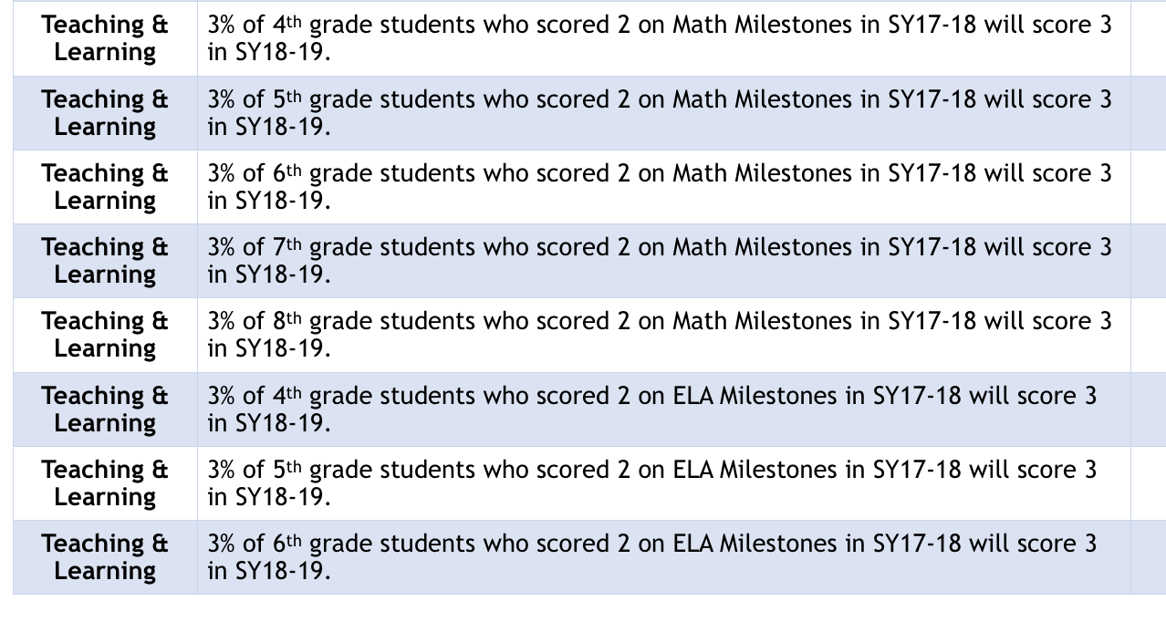
Teaching and learning targets

Slide 3
GLOBE Demographics
School Year | Total Enrollment | Male % | Female % | Econo DisAd % | Asian % | Black % | Hispanic % | Amer. Indian % | Multiracial % | White % | SWD %
2017-18 | 783 | 50 | 50 | 11.24% | 4.0% | 28.0% | 12.0% | <1 | 9.0% | 48.0% | ~10%
2018-19 | 903 | 49 | 51 | 12.85% | 4.0% | 26.0% | 10.30% | <1 | 8.0% | 48.0% | 11%

Slide 4
Comparing the numbers Across Grade LEvels

Slide 5
Comparing the numbers Across Grade LEvels

Slide 6
Comparing Numbers Across Race

Slide 7
Comparing Numbers Across Race

Slide 8
Comparing Numbers Across Subgroups

Slide 9
Comparing Numbers Across Subgroups

Slide 10
Comparing Numbers Across Subgroups

Slide 11
Plan of Action
Collaborate with the Academic Committee to set SMART teaching and learning targets
Continue to identify ways to close the achievement gaps
MAP Growth and Projection Data
Pre/Post Test Assessments
Fountas and Pinnell
Keep a pulse on newly enrolled 2nd through 5th graders

