Slide 1
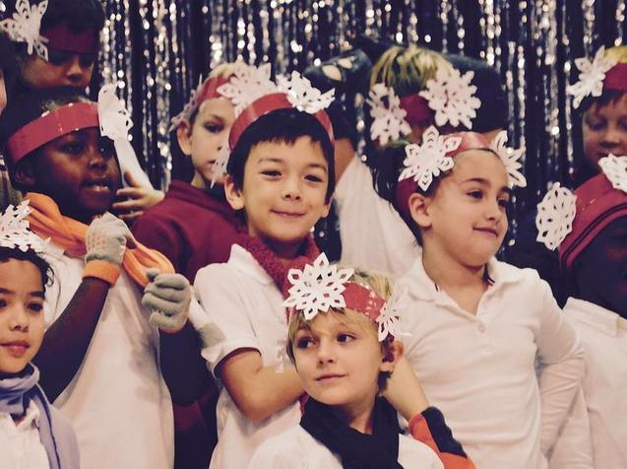
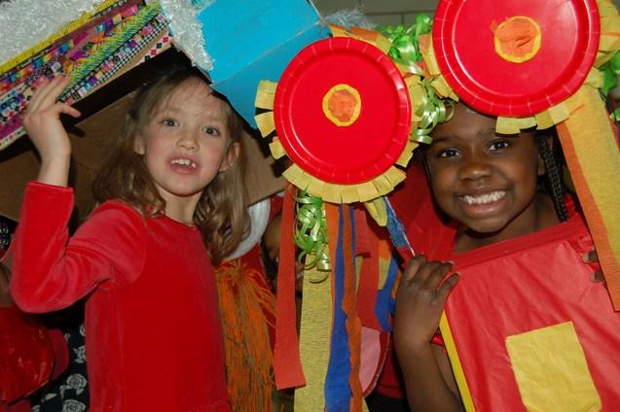
2020-2025 Strategic Plan June 2020

Slide 2
What will be different for GLOBE students, staff and families if we implement this 5-year plan?

Slide 3
What will the student experience look like in 5 years?
Global Citizenship
Academic Equity
Students learn about global issues, acquire skills to view, analyze, and shape these issues, and develop competencies to navigate and thrive in a quickly changing and increasingly complex world.
Students are challenged with rigorous and relevant content; academic achievement gaps are consistently tracked and closed
School Culture
Global Experiences
Classrooms are consistently joyful, inclusive and well-managed places to learn; students’ unique backgrounds, interests and cultures are an integral component of the learning experience
Students grapple with rich global capstone experiences, engage deeply with sister language schools and are consistently exposed to diverse global learning experiences
Facilities
Language Immersion
Students master a second language as a result of GLOBE’s implementation of a best-in-class language immersion model; implementation of integrated curriculum and instruction is led by highly-qualified teachers in every classroom
Students learn in modernized, joyful and highly functional schools that reflect GLOBE’s values and diversity

Slide 4
What will the staff experience look like in 5 years?
Staffing
Teacher Resources
Staff are positioned for success due to optimized staffing models, clear job descriptions and well-articulated responsibilities and goals to clarify the vision for excellent performance
Teachers have a full-suite of curriculum that are consistently vetted, integrated and refined by teams of GLOBE staff to ensure rigor, relevance and alignment; facilities support student learning
Performance Management
Teacher Development
All staff work within clear management lines, receiving the on-going support, feedback and professional development needed to thrive in their roles
Teachers receive frequent, content-specific coaching from content experts and participate in structured peer learning communities to unpack curriculum, analyze data and hone their practice
Hiring
New staff are hired from a deep, carefully cultivated hiring pool and participate in a rigorous screening process creating a high bar for joining the GLOBE team; on-boarding helps all staff get off to a “strong start”
Staff Culture
Teacher Support
Teachers are at their best at GLOBE as a result of a culture that is distinctly purposeful, joyful and collaborative; the school’s culture promotes teacher-leadership, staff empowerment and ownership over all aspects of the school
Teachers feel highly supported to implement the Responsive Classroom model and actualize GLOBE’s Diversity, Equity and Inclusion vision statement; teachers report feeling heard, supported and well informed of school events and progress

Slide 5
What will the family experience look like in 5 years?
Communication
Engagement
Families receive consistent communication from teachers and leaders on their child’s progress, school events and opportunities to engage more deeply; communications meet the needs and communication preferences of all families and have a consistent look and feel
Families are on-boarded to GLOBE through a holistic and welcoming process that supports deep understanding of GLOBE’s model and shared ownership for GLOBE’s success; families and students have multiple shared experiences that support student learning and GLOBE’s mission

Slide 6
2020-2025 Strategic Plan

Slide 7
The Globe Academy 2020 – 2025 Strategic Plan
Community, Respect, Empathy, Sustainability, Trust
1.1 Implement 5-year staffing plan
1.2 Clarify roles and responsibilities
1.3 Implement communication strategy
1.4 Implement perf. mgmt. system for
teachers and staff
1.5 Strengthen teacher recruitment,
hiring and onboarding
1.6 Codify org operations, processes, and procedures
1.7 Implement cont. improvement
system
2.1 Design and implement a master plan for lower campus facilities
2.2 Design and implement a master plan for upper campus facilities
2.3 Create the conditions for
excellent facilities management
School Facilities
Secure long-term use of K-8 facilities and execute facility improvements to enable deep learning and play
Organizational Development
Create an optimal school staffing and operating model with a pipeline of outstanding, qualified teachers
Core Instruction
Implement best in-class K-8 global learning curriculum and immersion model to accelerate student learning, advance global citizenship and close achievement gaps
3.1 Develop best-in-class academic, immersion and global citizenship model and curriculum
3.2 Define and align on a common
vision for excellent teaching
3.3 Implement a comprehensive
professional development strategy
3.4 Support students to develop into
global citizens
Diversity, Equity, Inclusion
4.1 Create Diversity, Equity and Inclusion vision and goals
4.2 Strengthen and build capacity to
execute student behavior plan
4.3 Implement “strong start” school
culture plan
4.4 Develop staff Diversity, Equity and Inclusion competencies
Develop a school-wide Diversity, Equity & Inclusion vision and align all aspects of the school to this vision
MISSION: The GLOBE Academy fosters Global Learning Opportunities through Balanced Education for children of all backgrounds. With a focus on dual-language immersion,
an experiential-learning model and a constructivist approach, GLOBE inspires students to be high-performing lifelong learners equipped to make a positive impact in the word.

Slide 8
Implementation Roadmap
Year 0
SY2018-19
Year 1
SY2019-20
Year 2*
SY2020-21
 | 1.Organizational Development (Ryan, Christi, Denise, Amy) | 1.2- Design clear job descriptions for priority positions 1.3 - Address immediate communication gaps w/staff and parents 1.6 - Design school dashboard of KPIs for all functions & data review process | Semester 1 1.1 - Create staffing vision, year-by-year org chart and budget implications 1.2 - Design clear job descriptions, management relationships and roles and responsibilities for all positions 1.3 - Expand communication strategy to drive inclusion and consistency Semester 2 1.5 - Design and implement recruitment strategy, hiring process and certification requirements; strengthen onboarding process 1.6 - Streamline and codify organizational processes and procedures (HRIS, hiring, student data, etc.) 1.7 - Design and implement continuous improvement school review cycle | Semester 1 1.4 - Design performance management system for staff 1.5 - Implement standardized teacher on-boarding process 1.6 - Refine organizational processes and procedures Semester 2 1.4 - Implement performance management system with staff 1.7 - Expand continuous improvement school review cycle to include annual school strategic planning cycle
 | 2. School Facilities (TBD, Megan, Jerry) | 2.1 - Plan for lower campus location | 2.1 - Develop long-term facility plan; complete master plan for lower campus and implement prioritized renovations 2.2 - Complete master plan for upper campus; implement planned renovations to upper campus 2.3 - Establish regular facility and audit procedures | 2.1 - Continue to implement master plan for lower campus 2.2 - Continue to implement master plan for upper campus
 | 3. Core Instruction (Katie, Judy, Sabrina, LC Leader) | 3.1 - Fully adopt phonics program for English in K-2; Common Math curriculum for K-5 and 6-8; Full implementation of Readers and Writers workshop | Semester 1 3.1 - Define profile of a graduate; Launch taskforce to research global learning curriculum and K-8 immersion model 3.2 - Define vision for excellent teaching with teachers and staff Semester 2 3.1 - Develop implementation plan for global learning curriculum and K-8 immersion model 3.2 -Calibrate on vision for excellent teaching 3.3 - Design comprehensive professional development system aligned to vision for excellent teaching 3.4 - Launch capstone experiences and sister schools | 3.1 - Implement global curriculum and K-8 immersion model (in phases) 3.3 - Launch redesigned PLC model and coaching 3.4 - Align academic systems, learning/enrichment opportunities to graduate profile
 | 4. Diversity, Equity & Inclusion (Monique, Fatimah, Zakia) | 4.2 - Hold responsive classroom trainings and incorporate updating student behavior plan | 4.1 - Design DEI vision statement 4.2 - Implement student behavior vision and plan 4.3 - Design “strong start” school culture plan 4.4 - Develop staff DEI competencies | 4.3 - Implement “strong start” school culture plan 4.4 - Continue to develop staff DEI competencies
* Years 3-5 - Implement Annual Planning Cycle to develop annual goals, priorities and action plans

Slide 9
Implementation Plans

Slide 10
1.1 - Implement a 5-year staffing plan
Initiative Overview
Objectives: | Create long-term staffing vision, with aligned year-by-year org chart and budget implications
Impact Goals: | % of teachers SA/A they are satisfied with the overall quality of their job % staff SA/A they receive coaching that improves teaching/professional practice |  |  | Key Deliverables: | Year-by-year organizational charts, denoting current and new roles Budget implications for projected staffing changes Documented rationale to support communicating changes to GLOBE stakeholders
Key Activities: | Activity |  |  |  |  |  |  | Timing |  |  | Staff Owners
 | Identify multi-year goals and strategic initiatives for each functional area (Facilities, Academics, Talent, Administration, Etc.) and develop 5-year staffing vision |  |  |  |  |  |  | 9/19 |  |  | Christi
 | Identify prioritized staffing needs by functional area |  |  |  |  |  |  | 9/19 |  |  | Christi
 | Collect and analyze org charts and job descriptions from similar schools (ANCS, ICS, etc.) |  |  |  |  |  |  | 10/19 |  |  | Christi
 | Design year-by-year org charts |  |  |  |  |  |  | 11/19 |  |  | Christi
 | Develop budget implications |  |  |  |  |  |  | 12/19 |  |  | Denise
 | Document rationale and communication strategy for org chart changes |  |  |  |  |  |  | 12/19 |  |  | Comm. Director
 | Develop strategy for forecasting leadership vacancies and developing leadership pipelines |  |  |  |  |  |  | 12/19 |  |  | Christi/Amy/Denise
Resources: | External Partner |  |  |  | Planning Team
 | Yes - Gather comparable org charts, assess current state, propose recommendations to staff and board |  |  |  | Ryan, Christi, Denise, Amy

Slide 11
1.2 - Clarify roles & responsibilities
Initiative Overview
Objectives: | Design clear job descriptions, management relationships and roles and responsibilities for all positions
Impact Goals: | % staff SA/A roles and responsibilities are clearly defined at GLOBE % parents SA/A decision-making at GLOBE is transparent % staff SA/A decision-making at GLOBE is transparent % of teachers SA/A they are satisfied with the overall quality of their job |  |  | Key Deliverables: | Updated job descriptions (outlining outcomes, key roles and responsibilities) for all staff members at GLOBE Org chart with clear managerial relationships Pictorial representation of responsibility shifts (e.g., Head of School today vs new, board today vs. new, etc.) Posters, 1-pagers and website updates to help communicate roles and responsibilities to all stakeholders
Key Activities: | Activity |  |  |  |  |  |  | Timing |  |  | Owners
 | Identify admin roles and new roles to prioritize for increased clarity |  |  |  |  |  |  | 7/19 |  |  | Christi
 | Design revised job descriptions outlining job outcomes, key roles and responsibilities for key positions |  |  |  |  |  |  | 7/19 |  |  | Amy/Denise
 | Design revised job descriptions outlining job outcomes, key roles and responsibilities for all positions |  |  |  |  |  |  | 10/19 |  |  | Denise/Patti
 | Design org chart that shows clear managerial relationships |  |  |  |  |  |  | 10/19 |  |  | Christi/Denise
 | Develop pictorial representations of responsibility shifts (including board) |  |  |  |  |  |  | 11/19 |  |  | Christi/Denise
 | Share draft job descriptions and shifts with staff and stakeholders for input |  |  |  |  |  |  | 11/19 |  |  | Christi/Amy/Denise
 | Design communication materials (posters, 1-pagers and website updates) to drive clarity |  |  |  |  |  |  | 12/19 |  |  | Comm. Director
Resources: | External Partner |  |  |  | Planning Team
 | Yes- Facilitate summer off-site working session to clarify roles and responsibilities and prepare for communication with staff in August; Facilitate admin and board team to develop clear roles & responsibility matrix, job descriptions, roles/responsibilities, management lines for all positions; Create clear visuals (door signs, 1-pagers, infographics, etc.) to communicate roles & responsibilities to staff, parents and stakeholders |  |  |  | Ryan, Christi, Denise and Amy

Slide 12
1.3 - Implement communication strategy
Initiative Overview
Objectives: | Design inclusive and comprehensive communication strategy and plan for all stakeholders Ensure teachers, staff, board and families systematically receive relevant, timely, and easily-accessible information
Impact Goals: | % parents SA/A decision-making at GLOBE is transparent % of teachers SA/A they are satisfied with the overall quality of their job % parents SA/A GLOBE communicates clearly about school’s goals and priorities % staff SA/A there is efficient, clear communication between administrators and teachers at GLOBE % staff SA/A decision-making at GLOBE is transparent |  |  | Key Deliverables: | Clearly defined communication strategy (methods, frequency, content) for each stakeholder group (teachers, families, board) with implementation outlined over two years Parent orientation/onboarding (DLI model, scheduling, opps/challenges of GLOBE’s model, grading system, communication expectations on progress, etc.) Communication brand guidelines establishing consistent look and feel for all GLOBE communications Communication calendar to highlight relevant priorities throughout the year
Key Activities: | Activity |  |  |  |  |  |  | Timing |  |  | Owners
 | Audit current communications to each stakeholder group |  |  |  |  |  |  | 7/19 |  |  | Christi/Comms
 | Address immediate/prioritized communication gaps |  |  |  |  |  |  | 7/19 |  |  | Christi/Comms
 | Identify best-in-class communication methods, frequency and content to each stakeholder group |  |  |  |  |  |  | 9/19 |  |  | Christi/Comms
 | Design branding and templates for each communication method (e.g., staff newsletter, board presentations, etc.) and establish communication calendar |  |  |  |  |  |  | 10/19 |  |  | Christi/Comms
 | Collect feedback from stakeholders on updated communications and revise as needed |  |  |  |  |  |  | 10/19 |  |  | Christi/Comms
 | Train staff on communication best practices (e.g., simple, jargon-free, etc.) |  |  |  |  |  |  | 11/19 |  |  | Christi/Comms
 | Ensure systems and staff capacity are in place to ensure strong on-going communication |  |  |  |  |  |  | 12/19 |  |  | Christi/Comms
Resources: | External Partner |  |  |  | Planning Team
 | Yes- Facilitate summer off-site working session to address immediate communication gaps; facilitate admin team to develop long-term communication plan |  |  |  | Ryan, Christi, Amy and Communications Manager

Slide 13
1.4 - Implement performance management system for teachers and staff
Initiative Overview
Objectives: | Design a performance management system aligned to GLOBE’s unique values and academic model that supports teacher and staff growth and accountability
Impact Goals: | % of teachers SA/A they are satisfied with the overall quality of their job % staff SA/A they are given the tools they need to perform according to the performance management system. % staff SA/A that their evaluation is fair and informative for future development. |  |  | Key Deliverables: | Performance management system and tools aligned to GLOBE’s unique values, academic model (3.1), vision for excellent teaching (3.2) and staff expectations (1.2) with implementation outlined in two phases Annual performance management calendar establishing cycle of expectation setting/calibration for all teachers, goal setting, mid-year and end of year evaluations (aligned to TKES cycle)
Key Activities: | Activity |  |  |  |  |  |  | Timing |  |  | Owners
 | Refine administrative staff performance management cycle, aligned to staff expectations (1.2) |  |  |  |  |  |  | 9/20 |  |  | Christi
 | Complete defining vision for excellent teaching (3.2) |  |  |  |  |  |  | 1/20 |  |  | HoS
 | Review examples of teacher and leader performance management systems and select design that aligns with GLOBE’s goals |  |  |  |  |  |  | 10/20 |  |  | Christi
 | Design performance management system in partnership with teachers, staff and community |  |  |  |  |  |  | 11/20 |  |  | Christi
 | Design annual performance management calendar |  |  |  |  |  |  | 11/20 |  |  | Christi
 | Train leaders and teachers in performance management system goals and processes |  |  |  |  |  |  | 12/20 |  |  | Christi & HoS
 | Launch teacher and leader performance management system |  |  |  |  |  |  | 1/21 |  |  | Christi & HoS
Resources: | External Partner |  |  |  | Planning Team
 | Yes- Facilitate design and implementation of performance management system |  |  |  | Ryan, Christi, Denise and Amy

Slide 14
1.5 - Strengthen teacher recruitment, hiring, and onboarding
Initiative Overview
Objectives: | Design and implement recruitment strategy, hiring process and certification requirements that attracts high-quality, diverse staff members Design onboarding process for key staff roles
Impact Goals: | % staff SA/A at GLOBE we hire and retain a highly qualified staff % of staff that SA/A that we recruit teachers/staff of diverse backgrounds % staff SA/A that we hire teachers/staff of diverse backgrounds |  |  | Key Deliverables: | Recruitment strategy aligned to GLOBE’s diversity vision (4.1) and charter renewal goals Hiring process aligned to GLOBE’s diversity vision (4.1), charter goals, and vision for excellent teaching (3.2) Onboarding toolkit aligned to staff expectations (1.2), academic model (3.1), and vision for excellent teaching (3.2)
Key Activities: | Activity |  |  |  |  |  |  | Timing |  |  | Owners
 | Research DLI teacher recruitment best practices by reaching out to HR leaders in DLI districts and schools; develop beliefs and policies for teacher certification |  |  |  |  |  |  | 10/19 |  |  | Christi & Sandra
 | Create recruitment strategy with clear timelines and owners |  |  |  |  |  |  | 10/19 |  |  | Christi, L’ship Team
 | Implement recruitment strategy |  |  |  |  |  |  | 1/20 |  |  | Patti
 | Research best practices in teacher hiring (identifying key competencies, mitigating bias) |  |  |  |  |  |  | 1/20 |  |  | Christi, L’ship Team
 | Design a hiring process including owners and participants for each step of the process (resume review, initial interview, candidate communication, etc.) |  |  |  |  |  |  | 2/20 |  |  | Christi, Denise
 | Identify knowledge, skills, and experiences all teachers should have within their first week, month, and semester at GLOBE |  |  |  |  |  |  | 4/20 |  |  | HoS, Coaches
 | Design an onboarding process/toolkit aligned to knowledge, skills, and experiences teachers need to be successful at GLOBE |  |  |  |  |  |  | 4/20 |  |  | HoS, Coaches
Resources: | External Partner |  |  |  | Planning Team
 | Yes - Bring forth recruitment best practices and facilitate design of recruitment and hiring system |  |  |  | Ryan, Christi, Denise and Amy

Slide 15
1.6 - Codify organizational operations, processes, and procedures
Initiative Overview
Objectives: | Streamline and codify organizational processes and procedures Develop SOPs (standard operating procedures) outlining all major operations, processes, and procedures
Impact Goals: | % staff SA/A that the day to day processes are clear to staff % staff SA/A that systems are in place that adequately track data necessary based on key performance indicators (KPIs) |  |  | Key Deliverables: | SOPs for all major operations, processes, and procedures
Key Activities: | Activity |  |  |  |  |  |  | Timing |  |  | Owners
 | Identify most impactful/most often repeated operations, processes, and procedures |  |  |  |  |  |  | 1/20 |  |  | Christi, Denise
 | Gather existing documentation/codification of operations, processes, and procedures |  |  |  |  |  |  | 2/20 |  |  | Christi,Denise
 | Design document management system for organizing SOPs |  |  |  |  |  |  | 3/20 |  |  | Christi,Denise
 | Communicate to all stakeholders: how to access SOPs, timeline on which they’ll be developed |  |  |  |  |  |  | 4/20 |  |  | Christi, Denise
Resources: | External Partner |  |  |  | Planning Team
 | No (NorthStar to share best practices for GLOBE staff to use as a guide) |  |  |  | Ryan, Christi, Denise and Amy

Slide 16
1.7 - Implement continuous improvement system
Initiative Overview
Objectives: | Design and implement continuous improvement school review cycle and annual planning cycle Establish the data systems and review process to regularly track and respond to key performance indicators
Impact Goals: | % staff SA/A leaders at GLOBE seek out teacher feedback and use it to drive improvement |  |  | Key Deliverables: | School dashboard of key performance indicators aligned to essential questions (e.g., are our students learning and progressing academically? Who are our students? Are we on track to implement our 5-year strategic initiatives? etc.) and strategic goals Data collection processes to ensure timely data available for all key stakeholders (teachers, staff, board, families) Implement data collection and review process
Key Activities: | Activity |  |  |  |  |  |  | Timing |  |  | Owners
 | Design school data dashboard that comprehensively tracks key performance indicators |  |  |  |  |  |  | 1/20 |  |  | Christi, Zakia
 | Implement data dashboard (embed into recurring staff meetings, board meetings, staff check-ins, performance management systems, coaching cycles, etc.) |  |  |  |  |  |  | 2/20 |  |  | Christi, Zakia
 | Audit existing data systems and identify gaps in systems and processes to populate dashboard |  |  |  |  |  |  | 2/20 |  |  | Christi, Zakia
 | Develop multi-year plan to improve underlying data systems to ensure easy and accurate availability of data |  |  |  |  |  |  | 3/20 |  |  | Christi, Zakia
 | Design annual school cycle for reflecting on progress against strategic plan, action planning for the upcoming quarter/year |  |  |  |  |  |  | 4/20 |  |  | Christi
Resources: | External Partner |  |  |  | Planning Team
 | Yes- Facilitate a team of admin and teachers to design a school data dashboard and develop data systems required to regularly populate the dashboard; Develop an annual cycle to review, analyze and respond to data |  |  |  | Ryan, Christi, Amy

Slide 17
2.1 - Design and implement a plan for lower campus facilities
Initiative Overview
Objectives: | Develop long-term plan for lower campus Complete master plan for lower campus and implement prioritized renovations
Impact Goals: | % staff and parents SA/A GLOBE’s lower campus is a good physical space in which to teach and learn Every teacher has their own teaching space; every student has a seat Parking for every staff member |  |  | Key Deliverables: | Deed for lower campus and plan for extended lease and payback Completed master plan for lower campus renovations including consideration for interim plans Multi-year implementation plan for lower campus Implementation underway
Key Activities: | Activity |  |  |  |  |  |  | Timing |  |  | Owners
 | Negotiate plan to acquire lower campus with DeKalb |  |  |  |  |  |  | 5/19 |  |  | Jerry
 | Secure board approval for extended lease and “payback” plan from DeKalb for any improvements if lower campus is NOT purchased |  |  |  |  |  |  | 8/19 |  |  | Christi
 | Hire architect to design master facilities plan |  |  |  |  |  |  | 6/19 |  |  | Jerry
 | Hold community meetings to get input for master facilities plan |  |  |  |  |  |  | 8/19 |  |  | Jerry
 | Finalize master facilities plan with community input |  |  |  |  |  |  | 10/19 |  |  | Jerry
 | Develop multi-year implementation plan for implementing master facilities plan |  |  |  |  |  |  | 11/19 |  |  | Jerry
 | Develop and execute capital campaign to raise required funding for each phase |  |  |  |  |  |  | 1/20 |  |  | Christi
 | Revisit which grades on which campus, transportation, etc. |  |  |  |  |  |  | 3/20 |  |  | Jerry
 | Develop communication plan to keep stakeholders up to date on facilities improvement plan |  |  |  |  |  |  | 4/20 |  |  | Jerry
Resources: | External Partner |  |  |  | Planning Team
 | Yes - Master Plan Designer |  |  |  | Juan, Megan, Jerry

Slide 18
2.2 - Improve upper campus facilities
Initiative Overview
Objectives: | Complete master plan for upper campus; implement planned renovations to upper campus
Impact Goals: | % students, staff and parents SA/A GLOBE’s upper campus is a good physical space in which to teach and learn Every teacher has their own teaching space, every student has a seat (achieve metrics per student:teacher ratio) Parking for every staff member |  |  | Key Deliverables: | Completed master plan for upper campus renovations including consideration for interim plans (based on changing student enrollment) Multi-year implementation plan for upper campus Implementation underway
Key Activities: | Activity |  |  |  |  |  |  | Timing |  |  | Owners
 | Finalize master facilities plan with community input (field, security fence, gym, etc.) |  |  |  |  |  |  | 10/19 |  |  | Jerry
 | Develop multi-year implementation plan for implementing master facilities plan |  |  |  |  |  |  | 11/19 |  |  | Jerry
 | Develop and execute capital campaign to raise required funding for each phase |  |  |  |  |  |  | 1/20 |  |  | Christi
 | Develop communication plan to keep stakeholders up to date on facilities improvement plan |  |  |  |  |  |  | 4/20 |  |  | Jerry
Resources: | External Partner |  |  |  | Planning Team
 | Yes - Master Plan Designer |  |  |  | Juan, Megan, Jerry

Slide 19
2.3 - Create the conditions for excellent facilities management
Initiative Overview
Objectives: | Establish regular facility and audit procedures
Impact Goals: | % staff SA/A at GLOBE day-to-day operations run smoothly |  |  | Key Deliverables: | Job description, goals, and performance management tools for Director of Facilities Facility and audit procedures
Key Activities: | Activity |  |  |  |  |  |  | Timing |  |  | Owners
 | Re-write RFP procurement policy to allow greater staff flexibility |  |  |  |  |  |  | 9/19 |  |  | Denise
 | Identify board facilities committee lead and clarify board’s role in facilities management |  |  |  |  |  |  | 10/19 |  |  | Sharon
 | Hire and effectively on-board (context building, skill building in project mgmt software, etc.) Director of Operations |  |  |  |  |  |  | 11/19 |  |  | Christi
 | Determine reporting relationships and management structure for Director of Operations |  |  |  |  |  |  | 12/19 |  |  | Christi
 | Develop performance management system and goals for Director of Operations |  |  |  |  |  |  | 12/19 |  |  | Christi
 | Design regular facilities audit, maintenance and improvement procedures |  |  |  |  |  |  | 12/19 |  |  | Jerry
Resources: | External Partner |  |  |  | Planning Team
 | No |  |  |  | Juan, Megan, Jerry

Slide 20
3.1 - Develop best-in-class academic, immersion and global citizenship model and curriculum
Initiative Overview
Objectives: | Define profile of a graduate Launch task force to develop global learning curriculum and K-8 immersion model to match profile
Impact Goals: | CCRPI scores “beat the odds” CCRPI scores higher than the district and state CCRPI-ELA & Math (% proficient + distinguished) % parents satisfied with child’s education STAMPS % staff SA/A have access to resources and time to deliver excellent instruction |  |  | Key Deliverables: | Profile of a GLOBE graduate outlining knowledge, skills and habits developed through their K-8 learning experience Best-in-class academic model for K-8 DLI immersion and Global Learning (clarifying goals, assessments, master schedule, curriculum, instructional methods, etc.) Curriculum map, unit plans and lesson plans that integrate all components of GLOBE’s academic model (includes recommended texts, curricular resources, pacing guides, etc.)
Key Activities: | Activity |  |  |  |  |  |  | Timing |  |  | Owners
 | Fully adopt phonics program for English in K-2; Common Math curriculum for K-5 and 6-8; Full implementation of Readers and Writers workshop |  |  |  |  |  |  | 8/19 |  |  | HoS
 | Lead a team of teachers, staff and stakeholders through a process to define the profile (knowledge, skill and habits) of a GLOBE graduate |  |  |  |  |  |  | 10/19 |  |  | HoS
 | Convene academic guiding team to research and assess multiple Academic, DLI immersion and Global Citizenship models; develop multi-year implementation plan |  |  |  |  |  |  | 11/19 |  |  | HoS
 | Develop an integrated Academic model for stakeholder review and input |  |  |  |  |  |  | 3/20 |  |  | HoS
 | Launch UbD curriculum design process to develop integrated curriculum, assessments, pacing guides and curricular resources (Phase 1 for Q1 of SY20-21, Phase 2 for Q2 of SY20-21, etc.) |  |  |  |  |  |  | 4/20 |  |  | HoS
 | Implement revised model and curricular resources in phases |  |  |  |  |  |  | 8/20 |  |  | HoS
Resources: | External Partner |  |  |  | Planning Team
 | Yes - Support guiding team through defining graduate profile, researching school immersion/Global Learning models and facilitating UbD curriculum design process |  |  |  | Judy, Sabrina, Sharon, Katie

Slide 21
3.2 - Define and calibrate on excellent teaching
Initiative Overview
Objectives: | Define and calibrate on vision for excellent teaching with teachers and staff
Impact Goals: | CCRPI scores “beat the odds” CCRPI scores higher than the district and state CCRPI-ELA & Math (% proficient + distinguished) % parents satisfied with child’s education STAMPS % staff SA/A teachers operate with shared vision for what excellent instruction looks like |  |  | Key Deliverables: | Observation and self-reflection framework that casts a vision for excellent teaching at GLOBE (What should the workshop model at its best look like? What does excellent DLI and Global Learning look like at its best when it is integrated into the curriculum?) Process and tools (video footage, calibration protocols) for calibrating staff on vision of excellence
Key Activities: | Activity |  |  |  |  |  |  | Timing |  |  | Owners
 | Review examples of observation frameworks and select design that aligns with GLOBE’s goals |  |  |  |  |  |  | 9/19 |  |  | HoS
 | Design observation framework in partnership with teachers, staff and community |  |  |  |  |  |  | 10/19 |  |  | HoS
 | Collect footage of GLOBE teachers demonstrating behaviors in framework |  |  |  |  |  |  | 11/19 |  |  | HoS
 | Schedule and hold calibration exercises with teachers (train on vision of excellence, watch footage, discuss alignment with vision of excellence) via staff meetings and PLCs |  |  |  |  |  |  | 1/20-4/20 |  |  | HoS
Resources: | External Partner |  |  |  | Planning Team
 | Yes - Facilitate design of Vision for Excellence and create calibration process |  |  |  | Judy, Sabrina, Sharon, Katie

Slide 22
3.3 - Implement a comprehensive professional development strategy
Initiative Overview
Objectives: | Design comprehensive professional development system aligned to vision for excellent teaching; launch coaching model
Impact Goals: | CCRPI scores “beat the odds” CCRPI scores higher than the district and state CCRPI-ELA & Math (% proficient + distinguished) % parents satisfied with child’s education STAMPS % of staff SA/A receive coaching that improves teaching practice % of staff SA/A PD is relevant, well-facilitated, actionable |  |  | Key Deliverables: | Create a holistic, ongoing teacher professional development system that integrates unit/lesson planning, teacher coaching, data-reviews, PLCs and school-wide professional development Develop training, tools and resources to support each component of the professional development system (e.g., instructional coaching tools, PLC protocols for data analysis, lesson planning/practice, etc.) Launch Instructional Coaching Model (2nd semester SY19-20) and PLC model (1st semester SY20-21)
Key Activities: | Activity |  |  |  |  |  |  | Timing |  |  | Owners
 | Review examples of professional development systems and select system that aligns with GLOBE’s goals (Responsive Classroom, Engage NY, Vision for Excellent Teaching, DEI, Readers and Writers Workshop, etc.) |  |  |  |  |  |  | 1/20 |  |  | HoS, Coaches
 | Design professional development system in partnership with teachers and staff that results in deepening teacher content knowledge, strengthens instructional practices, supports curricular implementation and ensures teachers receive consistent feedback from content experts |  |  |  |  |  |  | 2/20 |  |  | HoS, Coaches
 | Create PD calendar for weekly staff meetings, PLC meetings and coaching |  |  |  |  |  |  | 3/20 |  |  | HoS, Coaches
 | Develop implementation plans and orientation materials to launch PD cycle in SY20-21 |  |  |  |  |  |  | 4/20 |  |  | HoS, Coaches
 | Launch comprehensive PD model (coaching + PLCs + data-driven instruction) |  |  |  |  |  |  | 8/20 |  |  | HoS, Coaches
Resources: | External Partner |  |  |  | Planning Team
 | Yes - Design a comprehensive professional development system; Design tools (PLC protocols, coaching protocols, etc.) to support the professional development system |  |  |  | Judy, Sabrina, Sharon, Katie

Slide 23
3.4 - Support students to develop into Global Citizens
Initiative Overview
Objectives: | Launch capstone experiences and sister schools Integrate Global Learning and experiences throughout K-8 experience, supporting students to understand the wider world and their place in it Support students to take an active role in their community and work with others to make our planet more equal, fair and sustainable
Impact Goals: | STAMPS % parents SA/A student is becoming more globally minded % staff SA/A teachers at GLOBE cultivate a global view |  |  | Key Deliverables: | Launch of capstone experiences and sister schools Profile of a GLOBE student Set of K-8 Global learning experiences to cultivate development of global citizenship Integration of Global Citizenship into K-8 curriculum
Key Activities: | Activity |  |  |  |  |  |  | Timing |  |  | Owners
 | Launch capstone experiences for GLOBE students |  |  |  |  |  |  | 8/19 |  |  | Sandra
 | Identify and launch sister-schools program |  |  |  |  |  |  | 12/19 |  |  | Sandra
 | Convene taskforce to study Global Learning school concepts, curriculum and learning experiences (see 3.1) |  |  |  |  |  |  | 11/19 |  |  | Leadership Team
 | Launch expanded sequence of Global Learning experiences and integrated K-8 curriculum |  |  |  |  |  |  | 8/20 |  |  | Leadership Team
Resources: | External Partner |  |  |  | Planning Team
 | Yes - Support guiding team through researching school immersion/Global Learning models and facilitating UbD curriculum design process |  |  |  | Judy, Sabrina, Sharon, Katie

Slide 24
4.1 - Create DEI vision and goals
Initiative Overview
Objectives: | Develop shared vision and goals to advance Diversity, Equity and Inclusion at GLOBE
Impact Goals: | >20% GLOBE students qualify for FRL % staff SA/A all students regardless of background receive instruction and support to meet potential % of total attrition made up of students who qualify for FRL |  |  | Key Deliverables: | School-wide DEI vision DEI goals (behavior, academics, access, hiring, etc.) over 5 years DEI data collection and reflection plan (aligned to 1.6)
Key Activities: | Activity |  |  |  |  |  |  | Timing |  |  | Owners
 | Identify external facilitator to lead DEI vision and 3-year plan development process |  |  |  |  |  |  | 9/19 |  |  | Christi
 | Identify data-systems required to monitor progress towards DEI goals |  |  |  |  |  |  | 12/19 |  |  | Christi
 | Develop annual process for gathering, analyzing and reflecting on DEI vision and goals (1.6) |  |  |  |  |  |  | 12/19 |  |  | Christi
 | Create action plans to support progress towards DEI goals |  |  |  |  |  |  | 3/20 |  |  | Christi
Resources: | External Partner |  |  |  | Planning Team
 | Yes - DEI Facilitator to create DEI vision and 3-year plan |  |  |  | Monique, Fatimah, Zakia

Slide 25
4.2 - Strengthen and build capacity to implement student behavior plan
Initiative Overview
Objectives: | Hold Responsive Classroom trainings and incorporate updating student behavior plan Address and close gaps in current student behavior plan Build teacher and administrator capacity to effectively and equitably implement behavior plan
Impact Goals: | % parents and staff SA/A school rules are consistently and fairly enforced |  |  | Key Deliverables: | Updated student behavior plan Staff PD scope and sequence to on-board and continuously build capacity to implement student behavior plan
Key Activities: | Activity |  |  |  |  |  |  | Timing |  |  | Owners
 | Hold Responsive Classroom trainings for teachers and leaders (summer + November + March) |  |  |  |  |  |  | Jul 29/30th |  |  | Christi
 | Convene teachers and staff to review and identify gaps/challenges with current student behavior plan |  |  |  |  |  |  | August 30th |  |  | HoS
 | Revise student behavior plan as needed |  |  |  |  |  |  | August 30th |  |  | HoS
 | Integrate behavior plan expectations into vision for teaching excellence (3.2) |  |  |  |  |  |  | 11/19 |  |  | Assistant HoS
 | Design admin and teacher PD scope and sequence to build capacity to implement plan |  |  |  |  |  |  | 12/19 |  |  | Leadership Team
 | Ensure clarity of roles and responsibilities for implementing plan (aligned to 1.2) |  |  |  |  |  |  | 12/19 |  |  | Fatimah
 | Execute teacher and admin on-boarding training for updated plan |  |  |  |  |  |  | 2/20 |  |  | Christi
 | Execute on-going teacher coaching and PD on behavior plan (aligned to 3.3) |  |  |  |  |  |  | 4/20 |  |  | HoS
 | Collect feedback from teachers to iterate on behavior plan |  |  |  |  |  |  | 4/20 |  |  | Assistant HoS
Resources: | External Partner |  |  |  | Planning Team
 | Yes - Responsive Classroom Trainer |  |  |  | Monique, Fatimah, Zakia

Slide 26
4.3 - Implement “strong start” school culture process
Initiative Overview
Objectives: | Implement “strong start” school culture plan Ensure GLOBE Academy establishes a strong and positive school and classroom culture within the first 6 weeks
Impact Goals: | GA DoE climate rating of 4+ stars |  |  | Key Deliverables: | Strong start observation and coaching plan Strong start data collection and reflection plan
Key Activities: | Activity |  |  |  |  |  |  | Timing |  |  | Owners
 | Identify 3-5 observable indicators for strong classroom culture (aligned to 3.2) |  |  |  |  |  |  | 2/20 |  |  | HoS & Coaches
 | Develop “strong start” observation rubric and coaching plan aligned to 3-5 indicators |  |  |  |  |  |  | 3/20 |  |  | HoS & Coaches
 | Develop plan to consistently observe and provide teachers with feedback and support over the first 6-weeks to ensure all classrooms progress towards demonstrating indicators |  |  |  |  |  |  | 4/20 |  |  | HoS & Coaches
 | Develop a weekly data-collection and reflection process to analyze strong start data and refine coaching/support strategies as needed |  |  |  |  |  |  | 4/20 |  |  | HoS & Coaches
 | Identify teacher training needs aligned to classroom culture indicators and arrange for teachers to participate in needed PD |  |  |  |  |  |  | 4/20 |  |  | HoS & Coaches
 | Train teachers and leaders in strong start plan |  |  |  |  |  |  | 6/20 |  |  | HoS & Coaches
 | Launch strong start school culture plan |  |  |  |  |  |  | 8/20 |  |  | HoS & Coaches
Resources: | External Partner |  |  |  | Planning Team
 | Yes - Facilitate a team of admin and teachers to design a “strong start” school culture plan and monitoring systems aligned to GLOBE’s vision of excellence; Design tools (monitoring tools, rubrics, coaching plans, etc.) to track and coach teachers towards school culture plan |  |  |  | Monique, Fatimah, Zakia

Slide 27
4.4 - Develop staff DEI competencies
Initiative Overview
Objectives: | Identify and cultivate the staff DEI competencies and mindsets required to effectively realize GLOBE’s DEI vision
Impact Goals: | % staff SA/A all students regardless of background receive instruction and support to meet potential % parents and staff SA/A GLOBE provides resources, support, and training needed to work with students with special needs. |  |  | Key Deliverables: | DEI competencies (aligned/integrated into 3.2) DEI development plan (aligned to 3.3) Implementation of DEI development plan
Key Activities: | Activity |  |  |  |  |  |  | Timing |  |  | Owners
 | Identify external facilitator to support identifying staff DEI mindsets and competencies required to realize GLOBE’s DEI vision |  |  |  |  |  |  | 9/19 |  |  | Christi
 | Integrate competencies and mindsets into GLOBE’s vision for teacher excellence (3.2) |  |  |  |  |  |  | 11/19 |  |  | Christi
 | Design a development plan to develop competencies and mindsets (aligned to 3.3) |  |  |  |  |  |  | 12/19 |  |  | Christi
 | Implement development plan |  |  |  |  |  |  | 1/20 |  |  | Leadership Team
Resources: | External Partner |  |  |  | Planning Team
 | Yes - DEI facilitator/trainer |  |  |  | Monique, Fatimah, Zakia

Slide 28
Budget Implications

Slide 29
Organizational Development: Budget Implications
Initiative Name | Budget Line Item | Estimated Cost
1.1 - Implement 5-year staffing plan | Consulting Support - Gather comparable org charts, assess current state, propose recommendations to staff and board | $1,400
1.2 - Clarify roles & responsibilities | Consulting Support - Facilitate summer off-site to clarify roles and responsibilities for prioritized roles; Facilitate admin and board team to develop clear roles & responsibility matrix, job descriptions, roles/responsibilities, management lines; Create clear visuals (door signs, 1-pagers, infographics, etc.) to communicate roles & responsibilities to staff, parents and stakeholders | $3,300
1.3 - Implement communication strategy | Consulting Support - Facilitate summer off-site working session to address immediate communication gaps; Facilitate admin team to develop clear long-term communication strategy and implementation plan | $1,500
1.4 - Design and implement performance management system | Consulting Support - Facilitate design and implementation of performance management system | $12,500
1.5 - Strengthen teacher recruitment, hiring & onboarding | Consulting Support - Bring forth recruitment best practices and facilitate design of recruitment and hiring system | $8,500
1.6 - Codify org operations, processes and procedures | None <NorthStar to share best practices for org operations> | $0
1.7 - Implement continuous improvement system | Consulting Support - Facilitate a team of admin and teachers to design a school data dashboard and develop data systems required to regularly populate the dashboard; Develop an annual cycle to review, analyze and respond to data | $3,500

Slide 30
School Facilities: Budget Implications
Initiative Name | Budget Line Item | Estimated Cost
2.1 - Acquire and implement a master plan for lower campus facilities | Master Plan Designer | In SY19-20 Budget
2.2 - Implement a master plan for upper campus facilities | Master Plan Designer | In SY19-20 Budget
2.3 - Create the conditions for excellent facilities management | None | $0

Slide 31
Core Instruction: Budget Implications
Initiative Name | Budget Line Item | Estimated Cost
3.1 - Develop best-in-class academic, immersion and global citizenship model and curriculum | Consulting Support - UbD Curriculum Facilitator - $20,000 Travel costs to visit best-in-class K-8 Immersion Schools - $3,500 Teacher stipends to support design of curriculum - $18,000 (18 teachers x $1,000) | $41,500
3.2 - Define and align on a common vision for excellent teaching | Consultant Support - facilitate design of Vision for Excellence and create calibration process | $16,500
3.3 - Implement a comprehensive professional development strategy | Consultant Support - design a comprehensive professional development system; Design tools (PLC protocols, coaching protocols, etc.) to support the professional development system | $14,500
3.4 - Support students to develop into global citizens | None | $0

Slide 32
Diversity, Equity & Inclusion: Budget Implications
Initiative Name | Budget Line Item | Estimated Cost
4.1 - Create DEI vision and goals | Consultant Support - DEI Facilitator to create DEI vision and 3-year plan | $15,000
4.2 - Strengthen and build capacity to execute student behavior plan | Consultant Support - Responsive Classroom Trainer | In SY19-20 Budget
4.3 - Implement “strong start” school culture plan | Consultant Support - Facilitate a team of admin and teachers to design a “strong start” school culture plan and monitoring systems aligned to GLOBE’s vision of excellence; Design tools (monitoring tools, rubrics, coaching plans, etc.) to track and coach teachers towards school culture plan | $14,500
4.4 - Develop staff DEI competencies | Consultant Support - DEI facilitator/trainer | $22,000

Slide 33
Overall Project Management: Budget Implications
Initiative Name | Budget Line Item | Estimated Cost
SY19-20 Strategic Plan Project Management Support | Develop strategic initiatives dashboard and process to monitor all strategic initiatives Facilitate monthly 90-minute meeting of initiative leaders to ensure initiatives are “on track” 30-minute 1x1 check-in calls with initiative leaders prior to each meeting Develop strategic initiative update materials (PowerPoint slides) for board, parents, and staff | $7,200

Slide 34
Monitoring Dashboards

Slide 35
Organizational Development: Monitoring Dashboard Last updated: 7/1/2019
Initiative Name | Status | Owner | Progress Update | Open questions/Next steps
1.1 - Implement 5-year staffing plan |  |  |  | Questions: Next Step:
1.2 - Clarify roles & responsibilities |  |  |  | Questions: Next Step:
1.3 - Implement communication strategy |  |  |  | Questions: Next Step:
1.4 - Implement perf. Mgmt. system |  |  |  | Questions: Next Step:
1.5 - Strengthen teacher recruitment, hiring & onboarding |  |  |  | Questions: Next Step:
1.6 - Codify org operations, processes and procedures |  |  |  | Questions: Next Step:
1.7 - Implement continuous improvement system |  |  |  | Questions: Next Step:

Slide 36
School Facilities: Monitoring Dashboard Last updated: 7/1/2019
Initiative Name | Status | Owner | Progress Update | Open questions/Next steps
2.1 - Acquire and implement a master plan for lower campus facilities |  |  |  | Questions: Next Step:
2.2 - Implement a master plan for upper campus facilities |  |  |  | Questions: Next Step:
2.3 - Create the conditions for excellent facilities management |  |  |  | Questions: Next Step:

Slide 37
Core Instruction: Monitoring Dashboard Last updated: 7/1/2019
Initiative Name | Status | Owner | Progress Update | Open questions/Next steps
3.1 - Develop best-in-class academic, immersion and global citizenship model and curriculum |  |  |  | Questions: Next Step:
3.2 - Define and align on a common vision for excellent teaching |  |  |  | Questions: Next Step:
3.3 - Implement a comprehensive professional development strategy |  |  |  | Questions: Next Step:
3.4 - Support students to develop into global citizens |  |  |  | Questions: Next Step:

Slide 38
Diversity, Equity & Inclusion: Monitoring Dashboard Last updated: 7/1/2019
Initiative Name | Status | Owner | Progress Update | Open questions/Next steps
4.1 - Create DEI vision and goals |  |  |  | Questions: Next Step:
4.2 - Strengthen and build capacity to execute student behavior plan |  |  |  | Questions: Next Step:
4.3 - Implement “strong start” school culture plan |  |  |  | Questions: Next Step:
4.4 - Develop staff DEI competencies |  |  |  | Questions: Next Step:

Slide 39
Recommended best practices for strategic initiatives

Slide 40
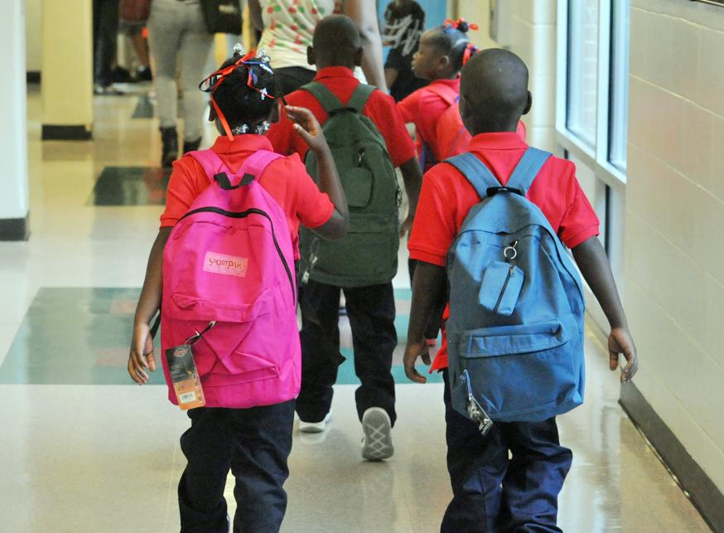
Proposed theory of action for developing a shared vision for excellent instruction
If GLOBEs Teachers, Leaders and staff...
Then Teachers, Leaders and GLOBE staff…
And then Our students…
…collaboratively develop a definition for instructional excellence that UNIQUELY DESCRIBES what excellent teaching looks like in GLOBE classrooms
…will have a COMMON BAR for excellence to inform teacher coaching and development
…will have a COMMON LANGUAGE to facilitate stronger collaboration within schools
…will have SHARED EXPECTATIONS to drive continued student growth
Will grow

Slide 41
There are 6 key stages for creating a shared vision for excellent instruction
October 2019
1
2
Review and provide feedback on first draft of Vision of Instructional Excellence. Broaden stakeholder engagement.
November 2019
3
Finalize Vision of Instructional Excellence. Develop plan to calibrate and align staff on Vision
September 2019
Review multiple frameworks and select framework that aligns with school priorities
January-May 2019
4
Launch teacher and staff calibration on Vision; incorporate Vision into coaching process
December 2019
5
6
Develop coaching systems and calibration process aligned to Vision
SY 20-21+
Continue calibration; integrate Vision into all Talent & Academic Systems (onboarding, hiring, PLCs, evaluations, etc.); build video libraries

Slide 42
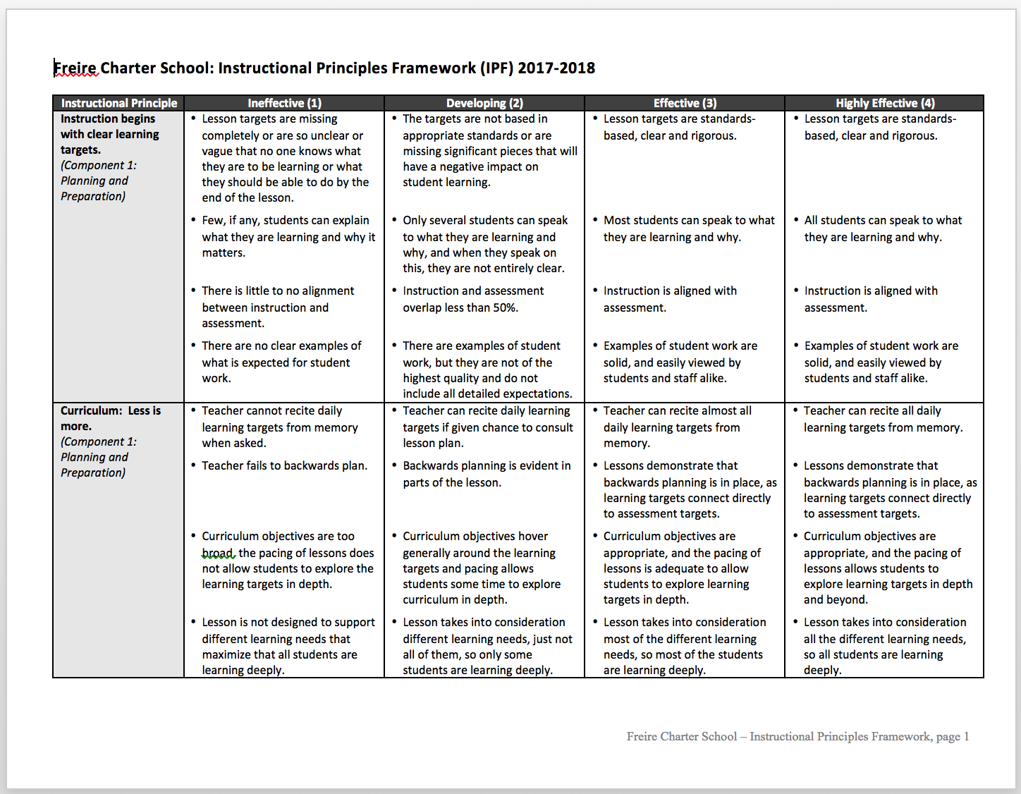
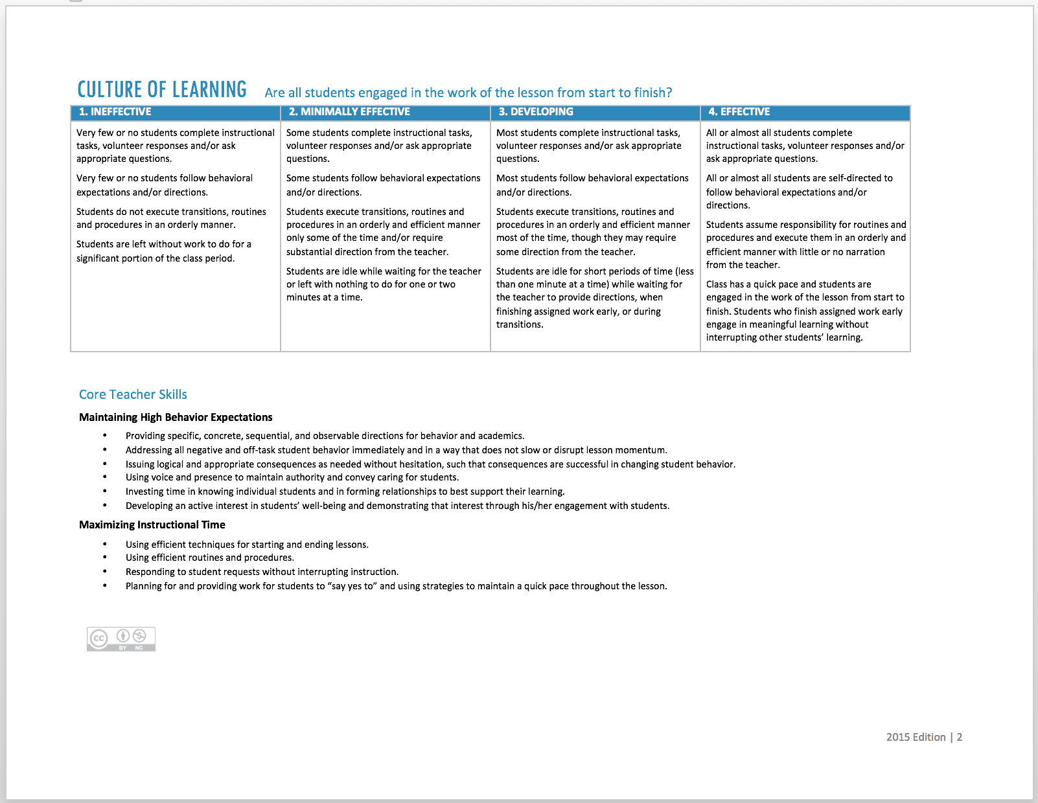
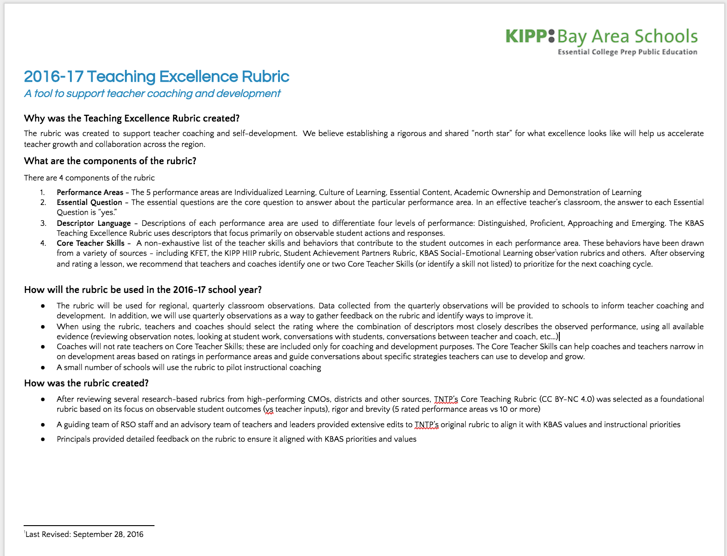
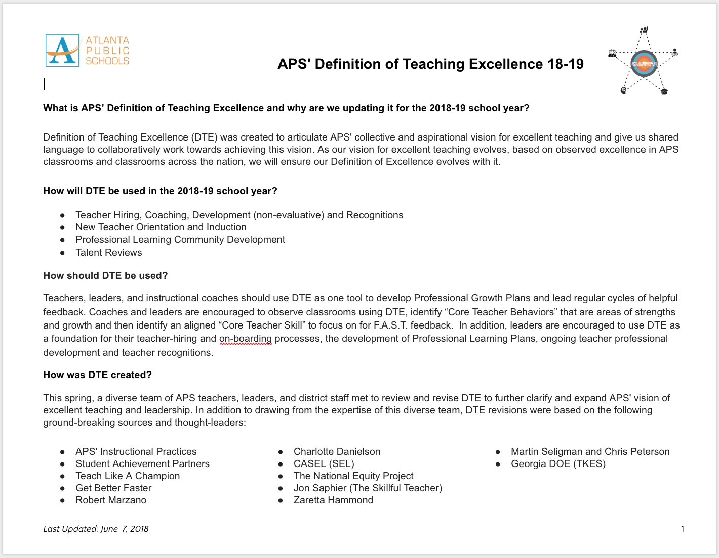
Examples of Instructional Excellence Frameworks
Freire Instructional Principles
Deeper Learning
TNTP Core Rubric
KIPP Bay Area
Atlanta Public Schools
Achievement First
DCPS Video Library

Slide 43
A Vision For Interconnected Teacher Professional Development
1
2
3
4
5
Strong Curricular Resources. Strong starting points for teachers to focus time on internalizing, customizing and mastering vs creating
Content-focused teams. Structured teams of teachers in similar content areas, led by a content-expert and guided by clear protocols.
Strategic Feedback. Regular cycles of observations and content-specific feedback from teacher-leaders or leaders
Aligned school-wide PD. Interactive, strategic school or grade/content specific PDs that address data-driven teacher needs
Data-driven instruction. Regularly scheduled times for teachers to reflect on actionable student data, facilitated by content-experts
FOUNDATION: School Leadership Teams (Principals, APs, Coaches, teacher-leaders) that meet regularly to analyze student data and teacher needs and integrate professional learning
Notes:
When you get under the hood of some of the highest performing urban schools nationally, you start to see some very similar patterns emerging on how professional development for teachers can be interconnected in a way that drives real student learning
Five components:
1) Strong curricular resources - you’ve heard that throughout the day. Strong, researched-based, vetted, curriculum and aligned assessments to serve as a starting point for teachers. Provides teachers with time internalize vs create.
If that’s our vision, let’s step back for a second and ground ourselves in our reality, through the eyes of a teacher.

Slide 44
Professional development theory of action
If GLOBE teachers and leaders...
Then Teachers will...
And then Our students will …
Strategically design and interconnect professional development systems (coaching, PLCs, data-driven instruction, etc.)
Have well-structured, content-specific collaboration time, coaching and professional development
...systematically improve and increase their impact...
...maximize their impact on student growth and feel successful in their work...
Develop the knowledge, skills and habits they need to be successful.

Slide 45
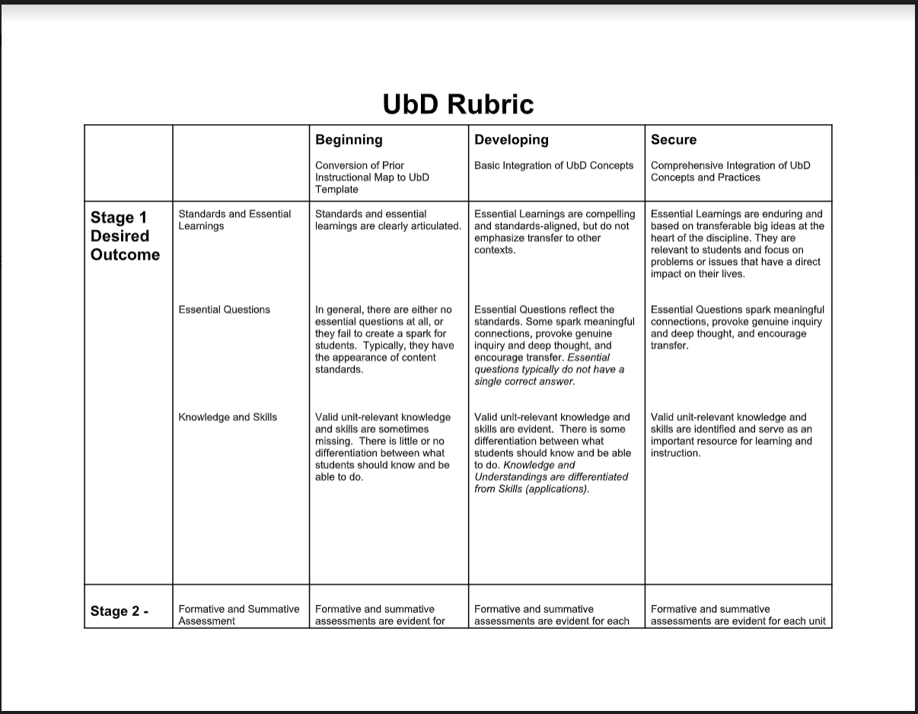
UbD curriculum design process

Slide 46
Organizational processes and procedures
Link to KIPP DC and KIPP Atlanta

Slide 47
2020-2025 Strategic Plan
MISSION: The GLOBE Academy fosters Global Learning Opportunities through Balanced Education for children of all backgrounds. With a focus on dual-language immersion, an experiential-learning model and a constructivist approach, GLOBE inspires students to be high-performing lifelong learners equipped to make a positive impact in the word.
ORGANIZATIONAL DEVELOPMENT
SCHOOL FACILITIES
CORE INSTRUCTION
DIVERSITY, EQUITY, INCLUSION
Create an optimal school staffing and operating model with a pipeline of outstanding, qualified teachers
1.1 - Implement 5-year staffing plan
1.2 - Clarify roles and responsibilities
1.3 - Implement communication strategy
1.4 - Implement perf. mgmt. system for teachers and staff
1.5 - Strengthen teacher recruitment, hiring and onboarding
1.6 Codify org operations, processes, and procedures
1.7 - Implement continuous Improvement system
Secure long-term use of K-8 facilities and execute facility improvements to enable deep learning and play
2.1 - Design and implement a master plan for lower campus facilities
2.2 - Design and implement a master plan for upper campus facilities
2.3 - Create the conditions for excellent facilities management
Implement best in-class K-8 global learning curriculum and immersion model to accelerate student learning, advance global citizenship and close achievement gaps
3.1 - Develop best-in-class academic, immersion and global citizenship model and curriculum
3.2 - Define and align on a common vision for excellent teaching
3.3 - Implement a comprehensive professional development strategy
3.4 - Support students to develop into global citizens
Develop a school-wide Diversity, Equity and Inclusion vision and align all aspects of the school to this vision
4.1 - Create Diversity, Equity and Inclusion vision and goals
4.2 - Strengthen and build capacity to execute student behavior plan
4.3 - Implement “strong start” school culture plan
4.4 - Develop staff Diversity, Equity and Inclusion competencies
GLOBE’S CORE VALUES: Community Respect Empathy Sustainability Trust
Notes:
1.1 - Includes facilities staff members
1.2 - Includes staff and board r&r
1.6 - Includes tracking equity gaps
3.1 & 3.2 - Includes culturally relevant curriculum

