Slide 1
Network NWEA Growth
_August 2023 – May 2024_

Slide 2
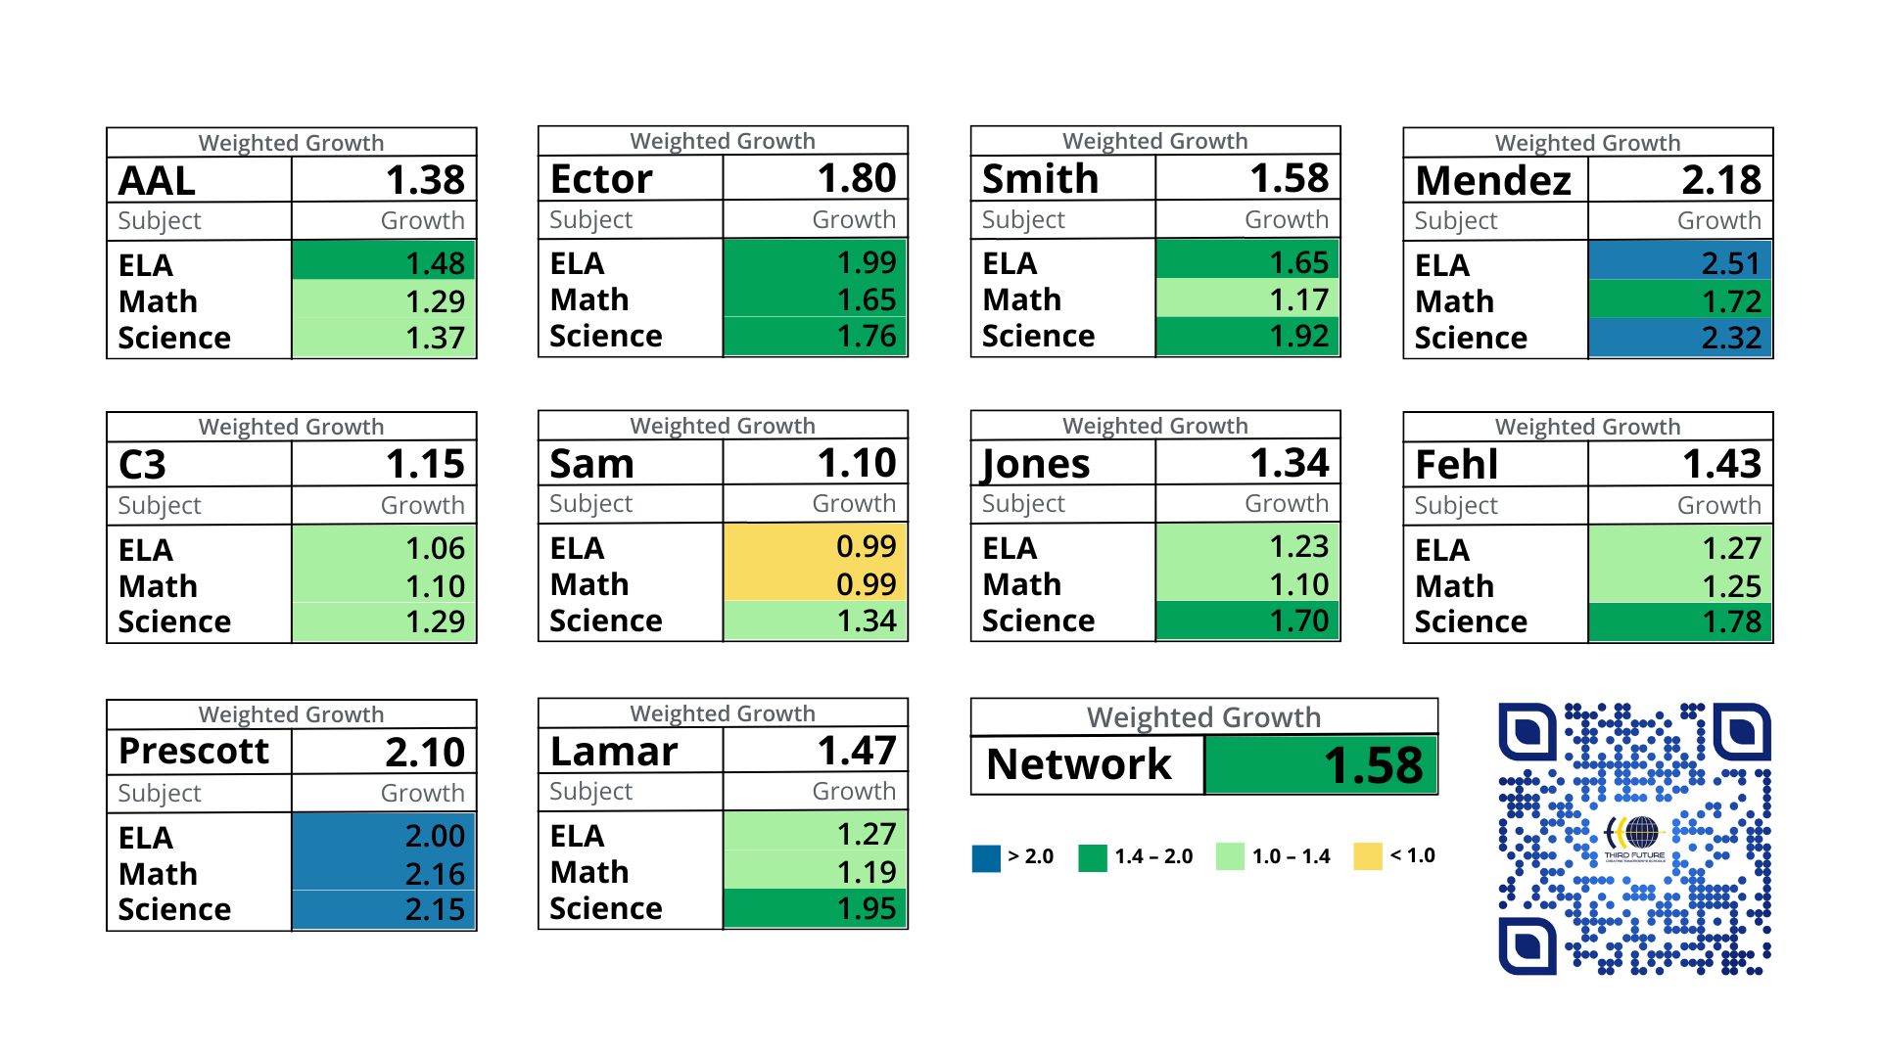
2024 EOY NWEA Growth: Grades 2-8
Updated 8 June 2024

Slide 3
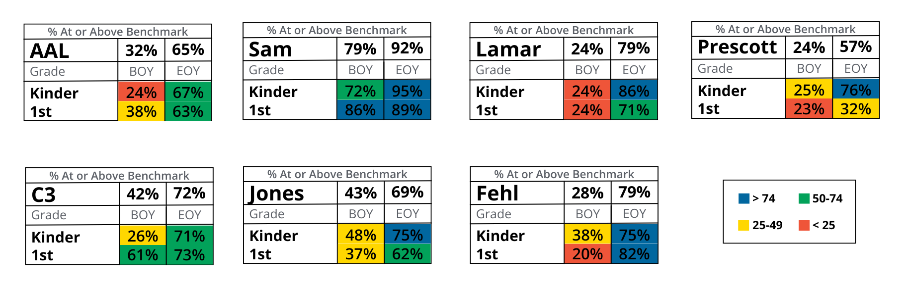
2024 EOY DIBELS Growth: Grades 2-8

Slide 4
2024 EOY NWEA Growth: Grades 2-8

Slide 5
2024 EOY NWEA Growth: Grades 2-8

Slide 6
2024 EOY NWEA Growth: Grades 2-8

Slide 7
2024 EOY NWEA Growth: Grades 2-6

Slide 8
2024 EOY NWEA Growth: Grades 2-6

Slide 9
2024 EOY NWEA Growth: Grades 6-8

Slide 10
2024 EOY NWEA Growth: Grades 7-8

Slide 11
2024 EOY NWEA Growth: Grades 6-8

Slide 12
2024 EOY NWEA Growth: Grades 2-5

Slide 13
2024 EOY NWEA Growth: Grades 2-5

Slide 14
2024 EOY NWEA Growth: Grades 2-8

