Slide 1



Teacher evaluation, compensation, and support
COLORADO Schools, 16 Dec 2020

Slide 2
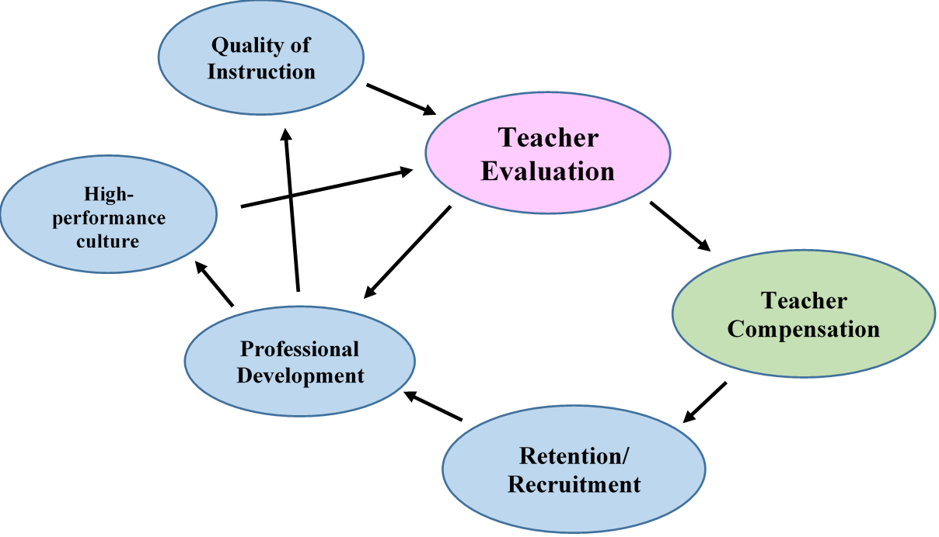
Teacher evaluations should be an integral part of any school system – aligned with professional development, compensation, continuous improvement, recruitment and retention, and the development of a high-performance culture.

Slide 3

Principles of an effective evaluation sytem
Includes student achievement results
Focused on results
Includes individual accountability
Must be fair, accurate, and rigorous

Slide 4

Principles of an effective evaluation sytem
Equally rigorous for all grades and disciplines
Must be standardized across the Network
Aligned with the compensation plan
Aligned with professional development
Allow for revisions over time

Slide 5
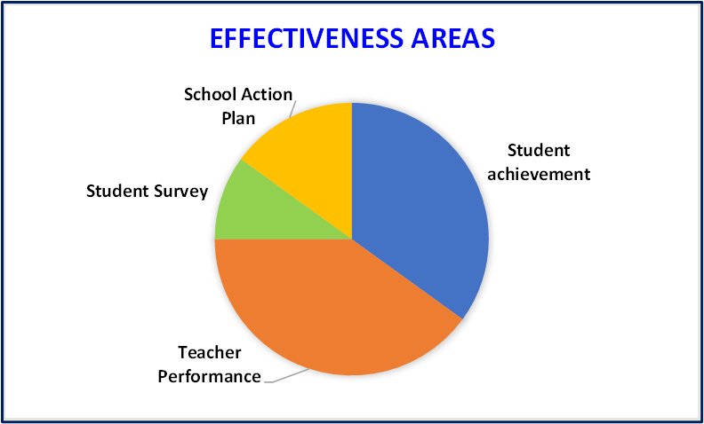

Slide 8
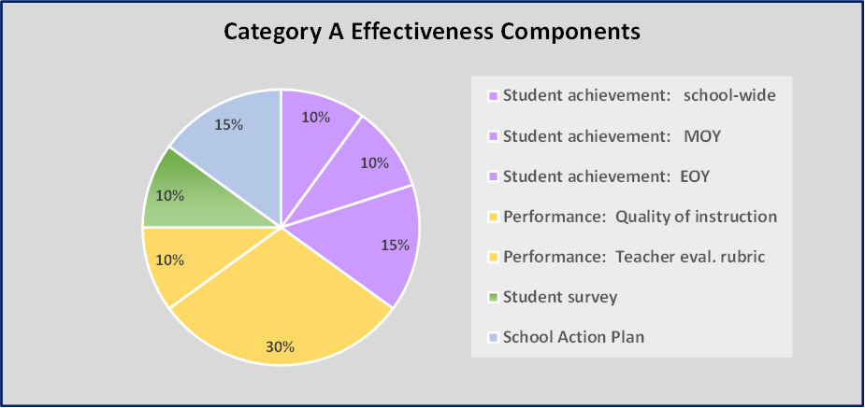

Slide 9
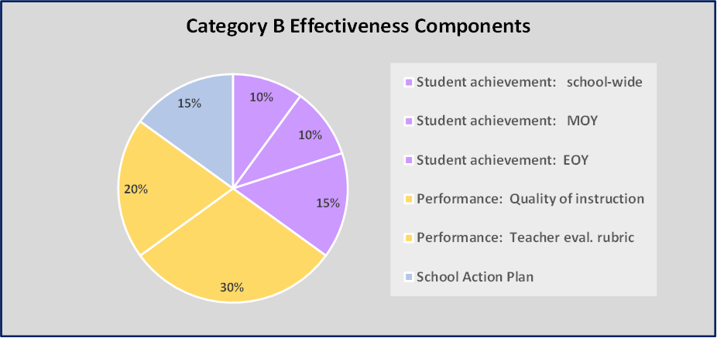

Slide 10
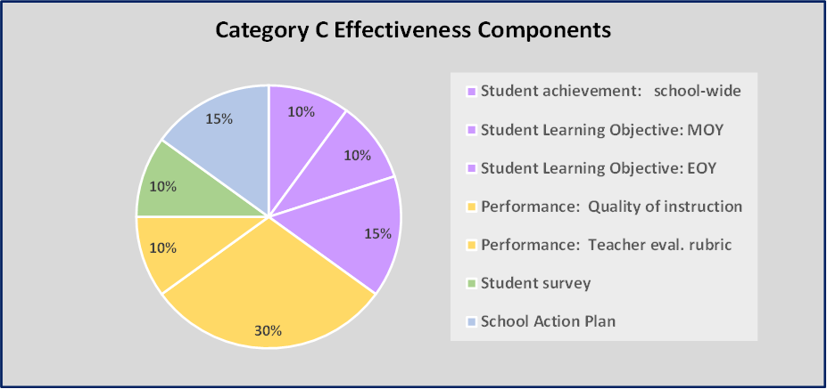

Slide 11
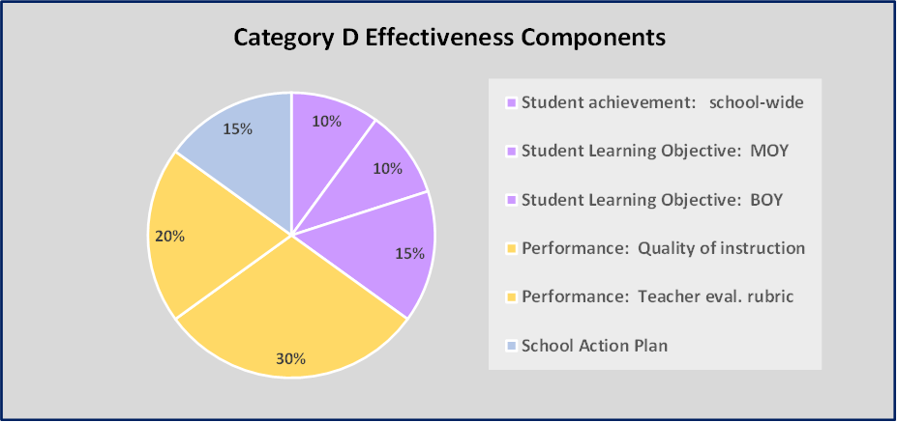

Slide 12
A teacher may earn up to 100 points. The scores from each effectiveness component are added to get the teacher evaluation rating (a score out of 100 points). The scores equate to the following seven effectiveness levels.

Slide 13
School-wide student achievement (10 pts.)

Slide 14
Student achievement EOY (15 pts.)

Slide 15
Quality of Instruction (30 pts.)
The teacher receives up to 10 points for each of 8 spot observations.
The evaluator then adds up to 20 more points based on the day-to-day coaching and general, informal observations conducted throughout the year.
Quality of Instruction Points = (Total score x 30) ÷ 100

Slide 16
Distinguished teachers
Distinguished

Slide 17

Distinguished teachers

Slide 18

Certification of school leaders
Attend and complete specific training
Observe instruction and calibrate
Certification assessment
Calibration monitoring

Slide 19
The target distribution
The method of linking cut-points to a “target distribution” is an elegant solution to the problem of ensuring equal rigor across the system.

Slide 20
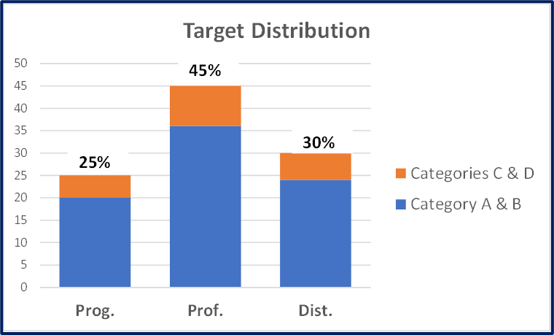
Target distribution
School in its first or second year of operation:
School in its third or higher year of operation:

Slide 21
Cut point adjustment
The network may adjust the initial cut-points after each evaluation cycle. Cut-point adjustment is necessary to ensure that not only are the assessments across grades and disciplines similarly rigorous, but they are also correlated with the state and national assessments. Cut-point adjustment will also ensure that no evaluation component is “too easy” or “too hard” relative to the other factors of effective teaching. This process is key to making the entire evaluation system more fair, accurate, and valid.

Slide 22

compensation

Slide 23
compensation
No organization can maximize its effectiveness if what it values is disconnected from how it compensates its employees.

Slide 24
The incentive

Slide 25

Professional development

Slide 26

We are keenly aware that high accountability without a high level of support only breeds a climate of fear. Thus, the teachers at our schools will receive a lot of support and professional development that is directly tied to the evaluation rating.

Slide 27

Professional development and coaching
On-the-job coaching every day
Spot observations
  At least once a month
17 scheduled professional development or teacher work days
Additional support from teacher leaders and instructional coaches

Slide 28
Professional development topics
The why; vision and mission
The quality of instruction and Third Future Ready characteristics
Creating a high-performance culture
Teacher evaluation and compensation
Curriculum alignment
The LSAE model

Slide 29
Professional development topics
One classroom – three locations
Model instruction practice
School Action Plan
PLC’s and use of data
Team building
Leadership density
Continuous improvement of the quality of instruction

