Slide 1
Curriculum Adoption
Wesley International Academy

Slide 2
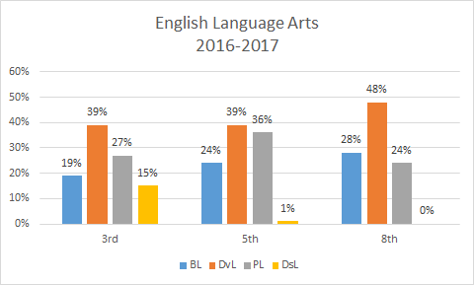
The Story Behind the Numbers
Notes:
Two reasons why our numbers may have looked better:
CRCT was easier
With expansion of MYP, teachers became more specialized in a certain grade level. Whereas in the past, some teachers may have taught across grade levels allowing for cohesion of language as students progressed through MYP.

Slide 3
The Need For Integrated Curriculum:
Strategies for Improving Academic Performance

Slide 4
Vertical Alignment
Allows for teachers to access content across grade-levels
Aids in teaching conceptual underpinnings, not facts.
Embraces IB’s transdisciplinary approach to making connections across the curriculum

Slide 5
Common Practices
Allows for lessons across disciplines are structured through similar instructional models, incorporating the following:
Gradual release
Modeling vocabulary
Guided instruction
Independent practice
Increasing rigor through DOK
Common language

Slide 6
Streamlining
RTI Data Collection
Benchmarks
Grade Reporting
Lesson Planning

Slide 7
Why Pearson?

Slide 8
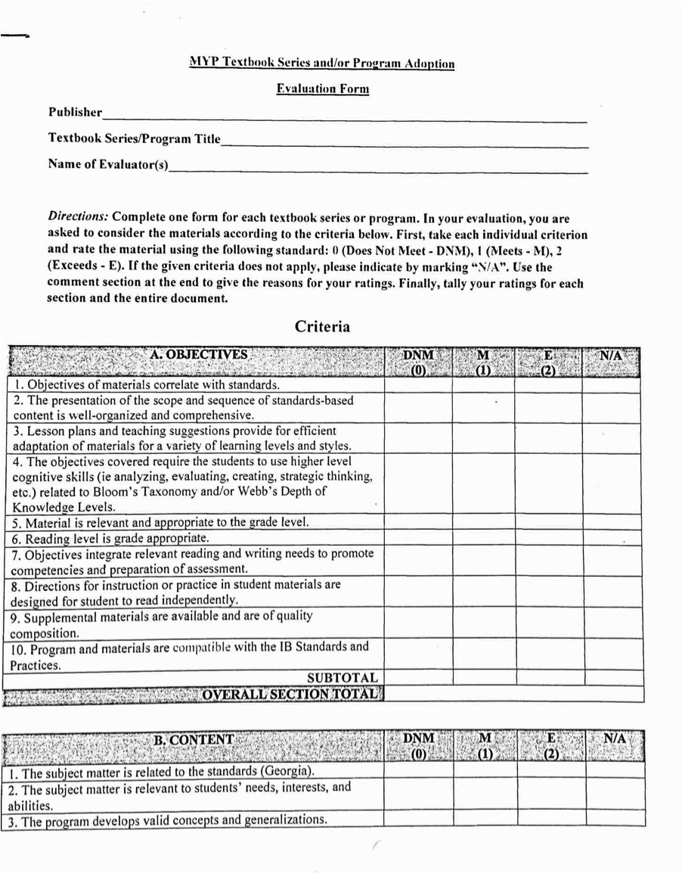
How Did Pearson Compare?
The Curriculum Team reviewed textbook materials from Houghton Mifflin, McGraw-Hill, and Pearson utilizing an Evaluation Form based on the following criteria:
Objectives
Content
Assessment
Organization
Other (Infrastructure, Purchasing Costs, Consumables)

Slide 9
How Did Pearson Compare?
Rating Summary
 | Objectives | Content | Assessment | Organization | Other | Total Points:
Pearson: Envision Math | 14/20 | 18/36 | 11/14 | 8/10 | 4/8 | 55
Houghton Mifflin: Go Math! | 11/20 | 16/36 | 7/14 | 5/10 | 2/8 | 41
McGraw-Hill: Glencoe Math | 4/20 | 9/36 | 0/14 | 5/10 | 4/8 | 22

Slide 10
How Did Pearson Compare?
Rating Summary
 | Objectives | Content | Assessment | Organization | Other | Total Points:
Pearson: My Perspectives | 20/20 | 34/36 | 11/14 | 10/10 | 4/8 | 79
Houghton Mifflin: Collections | 13/20 | 18/36 | 7/14 | 2/10 | 1/8 | 41
McGraw-Hill | 7/20 | 18/36 | 5/14 | 4/10 | 1/8 | 35

Slide 11
Math
Integrating Real-World Application through 3-Act Math Tasks
Mid-Topic Checkpoints and Performance Tasks
Math XL and Virtual Nerd
Aligned to Georgia K-8 Math Scope and Sequence

Slide 12
ELA
PYP K-5: Reading Street
Differentiated Lessons with Level Readers
Emphasizes cloze reading
Computer Scoring Writing Task
Performance Based Assessments
Aligned with GSE
Aligned DOK Levels & Text Complexity
MYP 6-8: MyPerspectives
Unit Plans of Study
Computer Scoring Writing Tasks aligned with the six traits of writing
Performance Based Assessments
Aligned with GSE 6-8 ELA Scope and Sequence

Slide 13
Science
Inquiry based, but scaffolded
Lab kits
Literacy focus
IB alignment
Crosscutting concepts
Patterns, cause and effect, etc.

Slide 14
Social Studies
Grades K-5 (Georgia Experience)
Literacy focus
Explicit vocabulary instruction
GSE Alignment
IB Alignment
Grades 6-8
Project based
Literacy focus
IB Alignment

Slide 15
Demo of Pearson Tools

