Slide 1
Academics Report
April 2024

Slide 2
IHSNO Enrollment
Enroll ment | Mar 2023 | Apr 2023 |  | Mar 2024 | Apr 2024
9th | 104 | 98 |  | 123 | 123
10th | 121 | 122 |  | 106 | 103
11th | 74 | 73 |  | 97 | 100
12th | 80 | 80 |  | 78 | 78
Total | 379 | 373 |  | 404 | 404
This month’s data shows the comparison between last year’s enrollment and the current year during the same months. Last year’s enrollment for the month of March was 379. This year’s enrollment for March was 404, a gain of 25 enrollees for the month of March 2024. Last year’s enrollment for the month of April 2023 was 373. This year’s enrollment for April 2024 is 404, a gain of 31 enrollees for the month of April 2024.

Slide 3
International Baccalaureate
MYP Mid-Consultancy Visit
Critical milestone assessment on April 15-16
Overall successful, on track for Fall 2024 authorization
Areas for further action identified:
Integrating learner profile attributes
Systematic approaches to learning (ATL) skills
Using global contexts for inquiry-based learning
IBDP Internal Assessments
April 20th deadline met with 91% submission rate
22 candidates across subjects and core elements
Career-related Programme (CP)
CP application opened
IB Coordinator presented to Board for initial support
IB Film Festival
DP Film students showcased at Prytania Theater
Well-attended by families, students, faculty

Slide 4
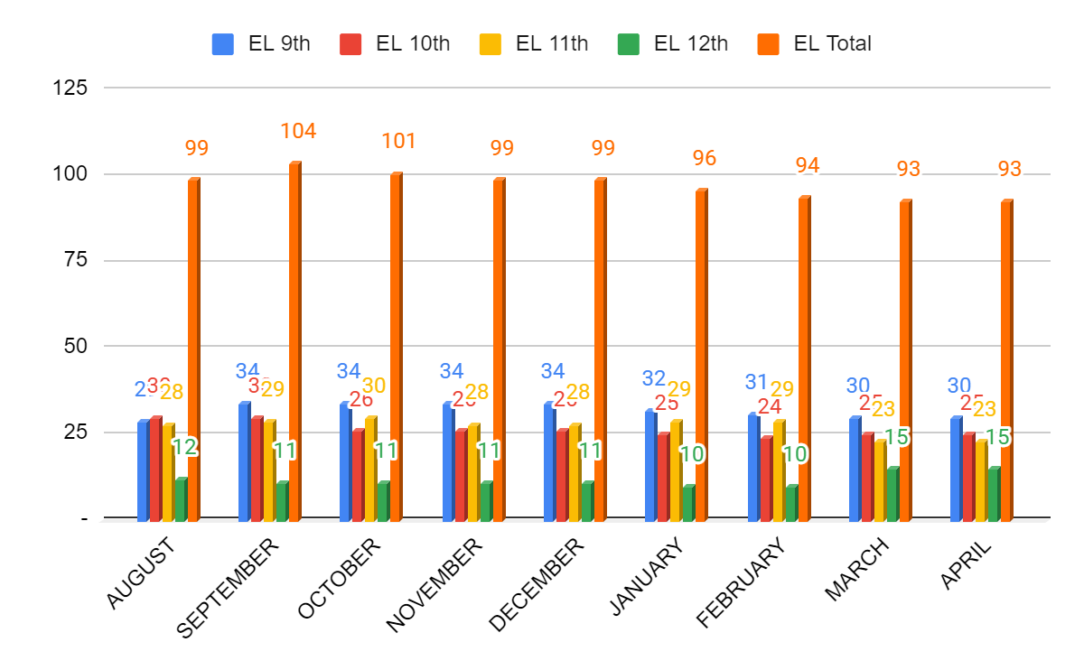
ESL- Month to Month Comparison
No new enrollments or dropped ML students between March and April.

Slide 5
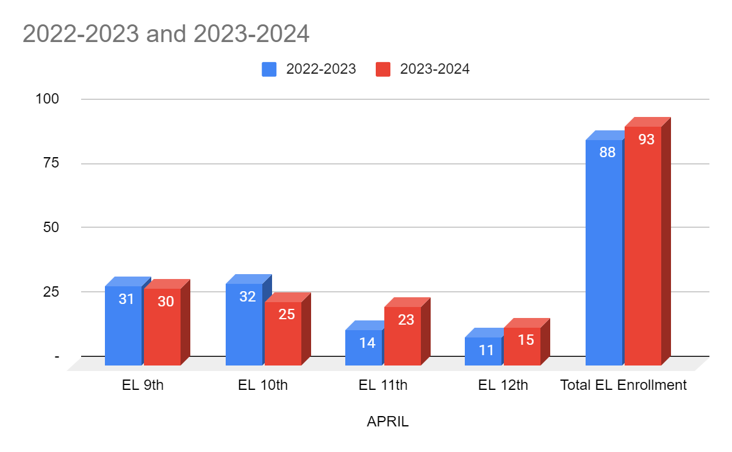
ESL- Year to Year Comparison
The data shows that we need to work to retain students from 9th to 10th grade. ML retention between 9th and 10th grade is a challenge due to overage students that enroll in the United States for the first time and do not have foreign transcript credits. Many of these students qualify as SIFE.

Slide 6
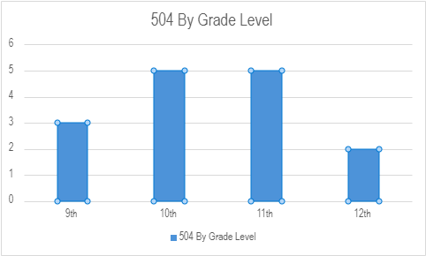
Special Education- 504 Data
Current year to date data shows a total of 15 students enrolled in the program.
9th grade- three
10th grade- five
11th grade- five
12th grade- two
BOY total 14
MOY total 13
CYTD total 15

Slide 7
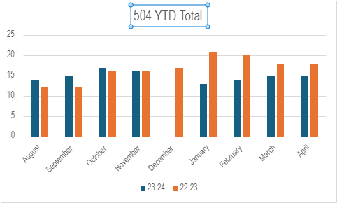
Special Ed- 504 YTD Comparison
Month to Month comparison for total enrollment count
Enrollment seemed to spike in October and Decline in January 2024

Slide 8
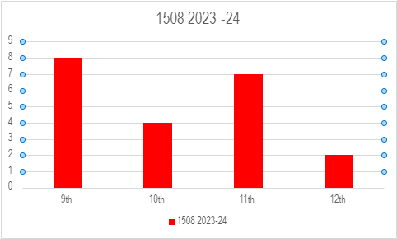
Special Education- 1508 Data
Current year to date data shows a total of 21 students enrolled in the program.
9th grade- eight
10th grade- four
11th grade- seven
12th grade- two
BOY total 19
MOY total 23
CYTD total 21

Slide 9
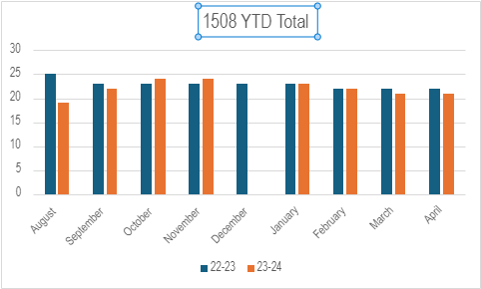
Special Ed- 1508 YTD Comparison
Month to Month comparison for total enrollment count
Enrollment seemed to stay steady

Slide 10
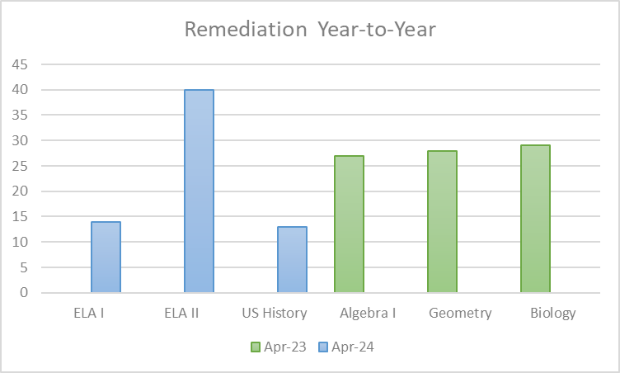
Remediation - Year to Year
17 less students were identified as needing remediation this year (67) versus last year (84) total students served
More students across grade levels & subjects needed math/sci remediation
Students have responded well to the blended intervention model being used this year
Consistency in the remediation staff has allowed them to build rapport and earn the student’s trust

Slide 11
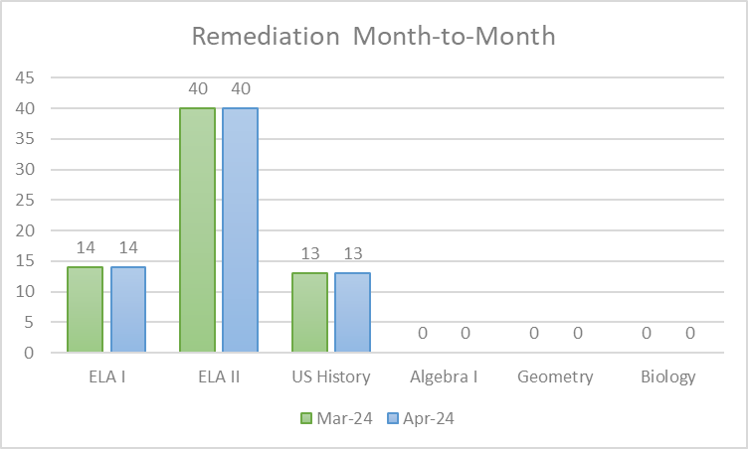
Remediation - Month to Month
Literally no change
No more evaluations to determine if a student can exit remediation occur after spring break since it’s too close to the end of the school year
7 days of class between spring break and LEAP testing was used to check-in with all assigned students 1 more time before testing

Slide 12
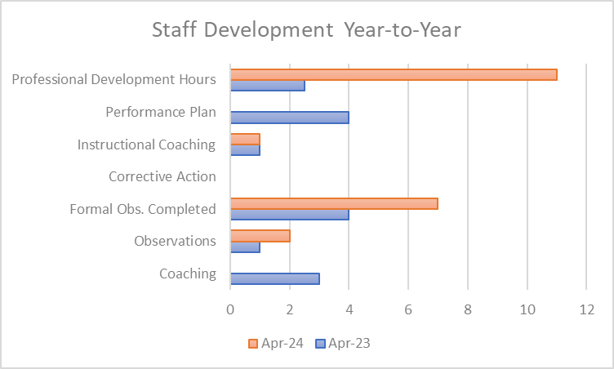
Staff Development - Year to Year
Formal observation counts are higher this year due to delays caused mostly by the building move and staff absenteeism
The 4 asynchronous learning days (Jazz Fest ) allowed additional PD hours to be offered
Drastic improvement in staff discipline; last year 7 documented accounts to 0 this year
PE and Spanish vacancies were filled

Slide 13
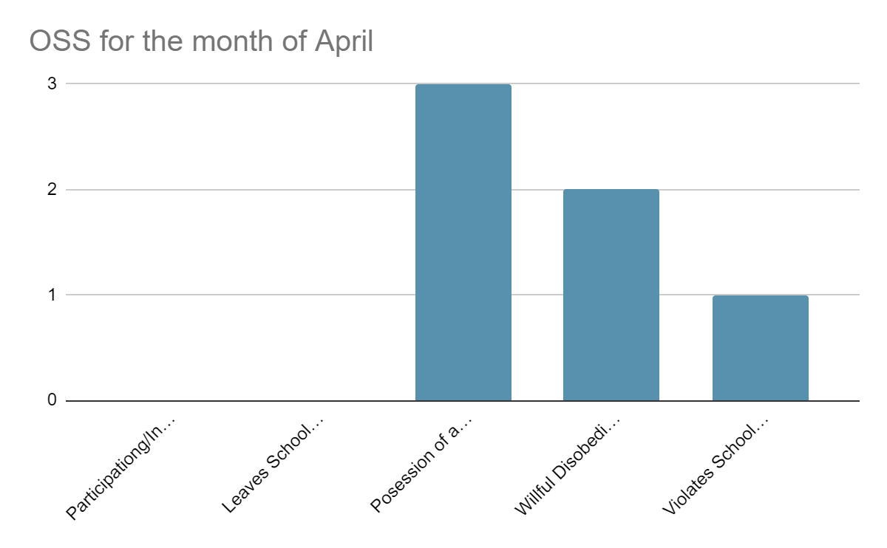
Culture - OSS
This month's OSS infractions were low in comparison to previous months . The issue with the Brown sisters was an one off incident that was the result of civil interactions that came to head here at the school. The vaping incident took place on the bus and would have been prevented if an aid to the driver would be provided. The culture department does its best to address these issues through mediations, but it may be beneficial to look into finding programs where licensed therapists come in to provide sessions for students as a means to cope with the issues students are facing outside of the school. Furthermore, it would also provide students with the means to choose alternative ways of handling situations. 60% of the students who were placed on OSS are African American and 40% are Hispanic/Latino descent

Slide 14
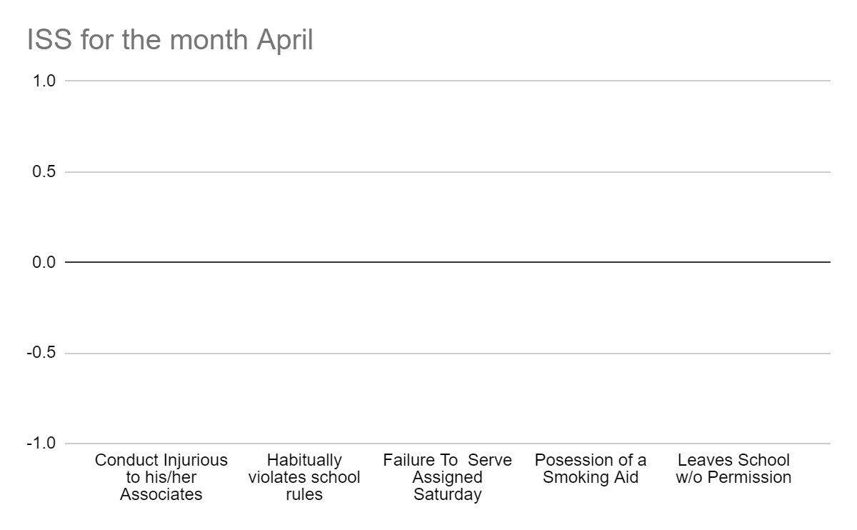
Culture - ISS
There were no ISS infractions for the month of April due to SPring Break, LEAP testing and asynchronous days for Jazz Fest.

Slide 15
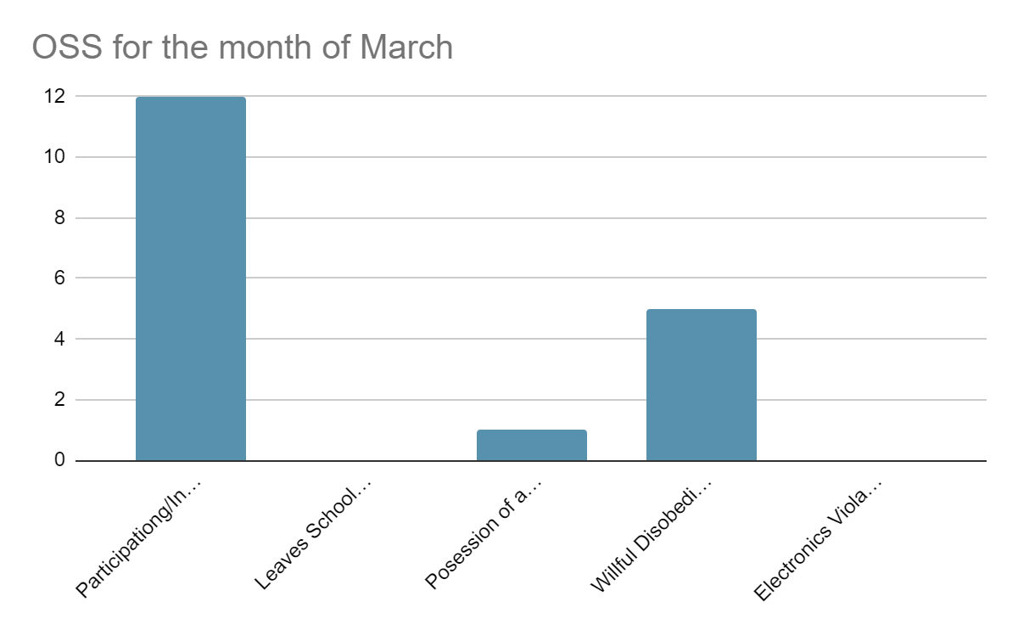
Culture - Month to Month Comparison for OSS
The decline in OSS infractions were due to the limited time students were actually on campus.

Slide 16
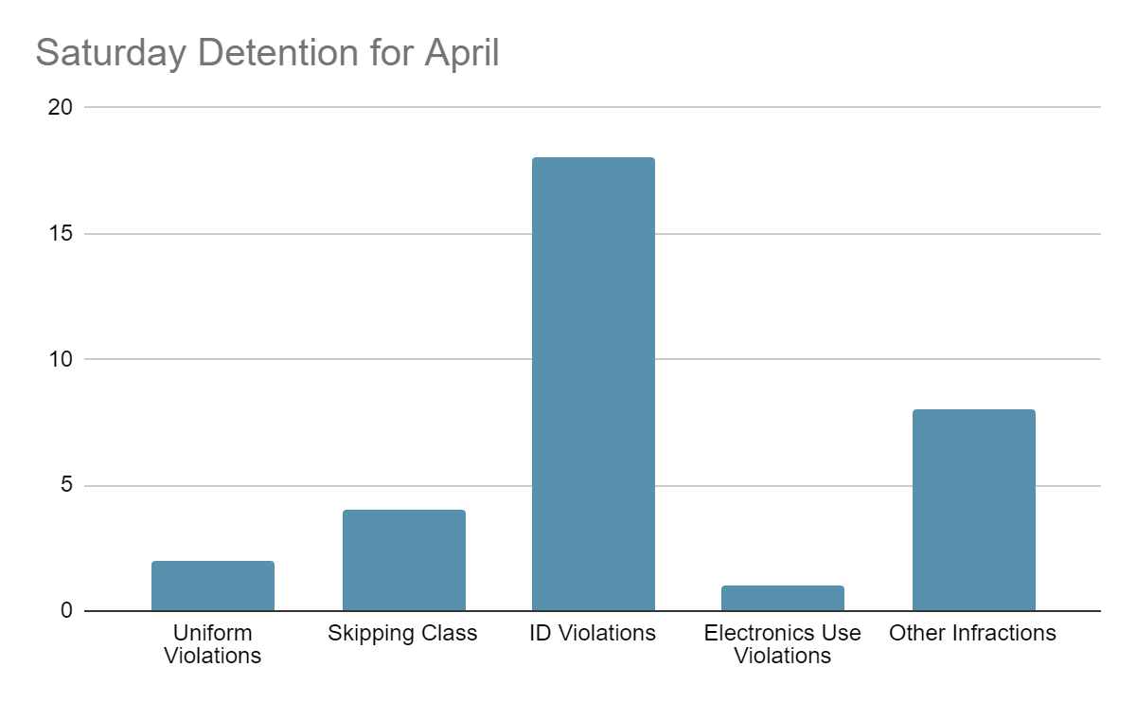
Culture Saturday Detention
Culture has done a great job at identifying the students, but have fallen short with consistent teacher participation in enforcement of the rules. Teachers and administrators would need to redirect and/or issue consequences for non-compliance. Majority of these detentions are when culture conducts walk-throughs during class time. Culture has spoken with administrators about holding teachers and staff accountable on several occasions, however nothing has been done. 73% of these students are African American and 27% are Hispanic

Slide 17
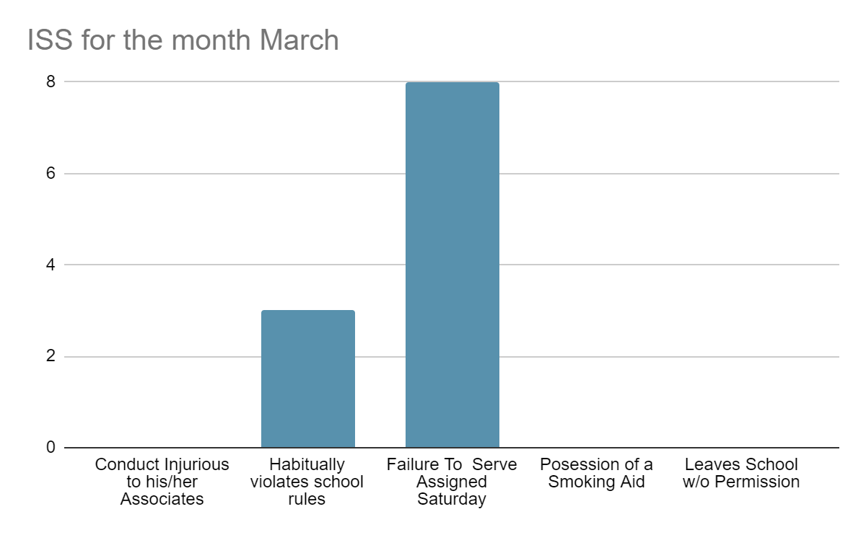
Culture - Month to Month Comparison for ISS
The decline in OSS infractions were due to the limited time students were actually on campus.

Slide 18
Social Work (Attendance)
Data is provided at a 90% threshold.
Students’ attendance continues to be a challenge and a clear plan should be communicated strongly to students and families.
Seat recovery options should be established and enforced from start to finish without additional options unless absolutely necessary.

Slide 19
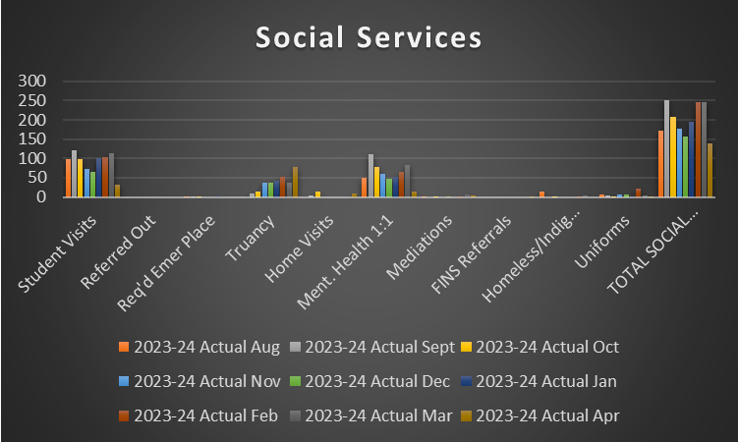
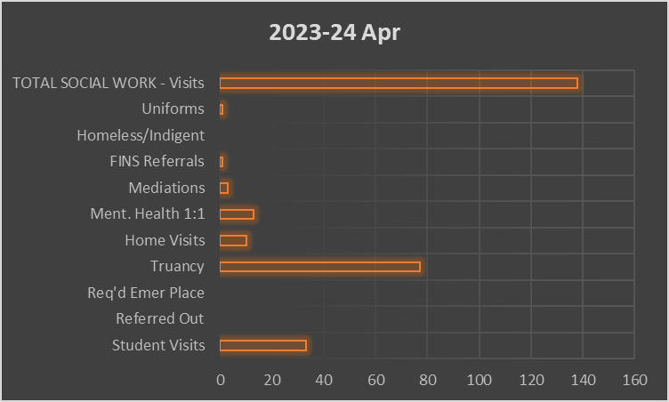
Social Work (Services)
Student visits decreased as a result of time off for spring break and leap testing
Leap seat recovery was a provided opportunity for students to recover missed seat time.
Social work facilitated mediations that were more disciplinarian -based rather than mental health based.
Note: Opportunities for all support staff to build a social emotional competence skill set is advised in effort to effectively serve our present student population.

Slide 20
CTE Pathways

