Slide 1
Academics Report
January 2024

Slide 2
IHSNO Enrollment
Enroll ment | Dec 2022 | Jan 2023 |  | Dec 2023 | Jan 2024
9th | 100 | 101 |  | 126 | 125
10th | 128 | 123 |  | 106 | 106
11th | 78 | 75 |  | 103 | 106
12th | 81 | 81 |  | 74 | 71
Total | 387 | 380 |  | 409 | 408
This month’s data shows the comparison between last year’s enrollment and the current year during the same months. Last year’s enrollment for the month of December was 387. This year’s enrollment for December was 409, a gain of 22 enrollees for the month of December 2023. Last year’s enrollment for the month of January 2023 was 380. This year’s enrollment for January is 408, a gain of 28 enrollees for the month of January 2024. From August 2023 to January 2024, there is a loss of one (1) student (383 to 408).

Slide 3
International Baccalaureate
-IB enrollments stayed the same with 39 total IB Diploma candidates in 11th and 12th grade
-Total enrollments for IBDP course option and diploma students at 143 students
-IB Coordinator and Reimagine Grant Coordinator participated in learning visits around the New Orleans area implementing their programs with Reimagine funding, providing insight and networking opportunities

Slide 4
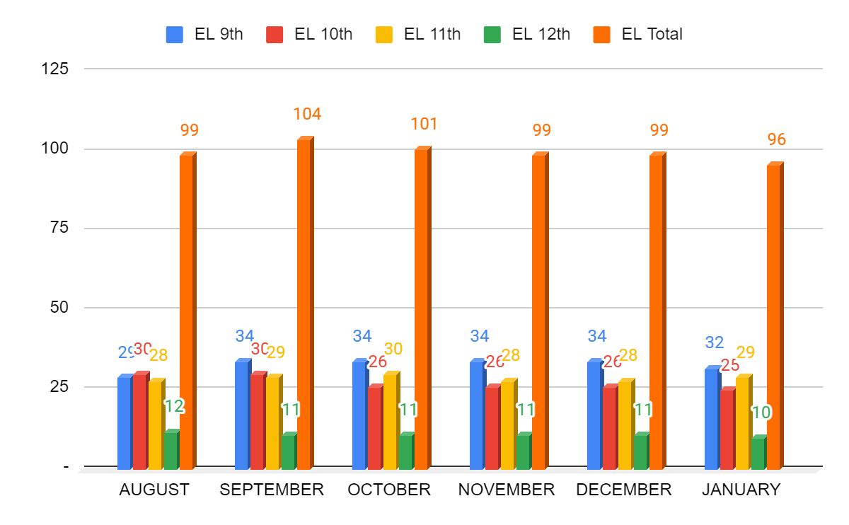
ESL- Month to Month Comparison
9th- two students transferred out, one out of state one to an immigrant support program
10th- one new arriver, two students transferred to new school (one with multiple weeks absent)
11th- one student demoted from 12th to 11th due to DOF status
12th- note 11th, no other changes

Slide 5
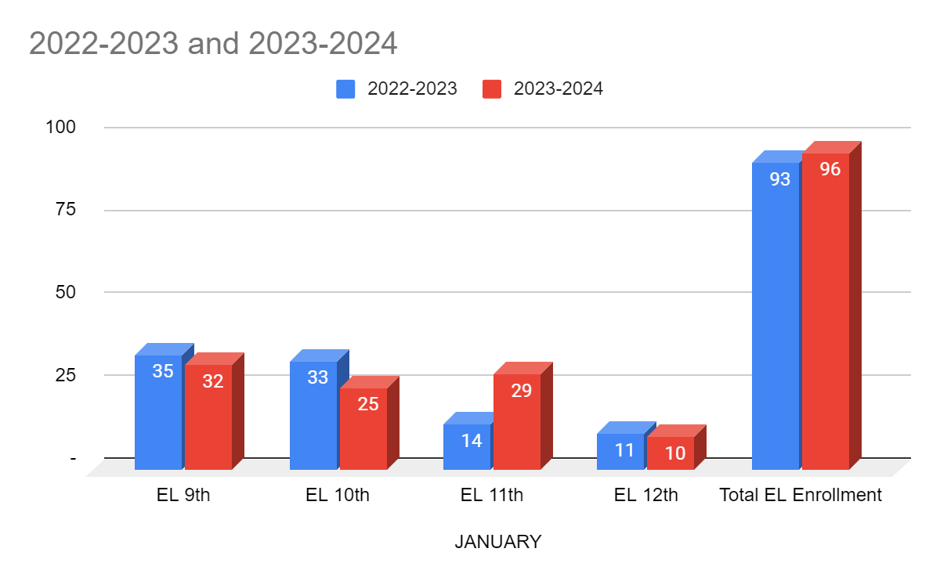
ESL- Year to Year Comparison
9th grade students have stayed steady around 30.
In 10th grade, we have decreased and need to work on 9th to 10th grade retention.
11th grade retention has been great, we just need to carry them through graduation.
Several 12th graders are in danger of non graduation for grades, attendance and LEAP but we are monitoring it closely.

Slide 6
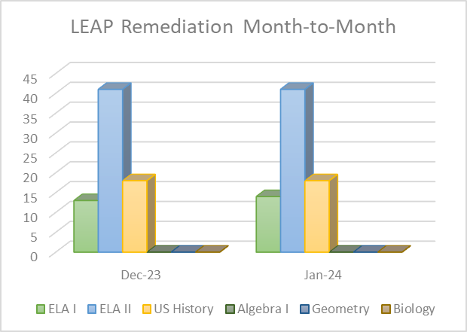
Remediation - Month to Month
The total amount of students receiving intervention support stayed the same.
Benchmark assessments were given to all students receiving intervention to determine growth after using the interventions.

Slide 7
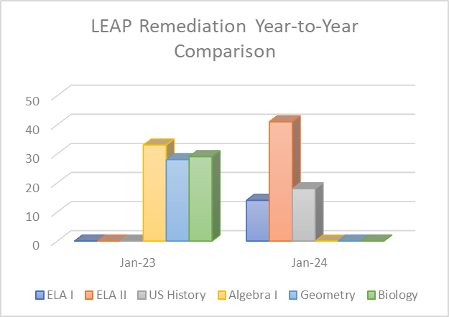
Remediation - Year to Year
Last year the ELA/SS remediation specialist left at the end of 1st semester and was replaced with a Math/Science remediation specialist
Benchmark assessments were given to all students receiving intervention to determine growth after using the interventions.

Slide 8
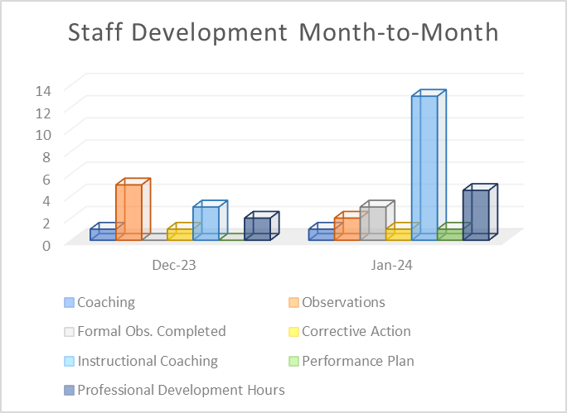
Staff Development - Month to Month
Since last month the amount of instructional coaching sessions have increased as teachers struggled with adjusting to the new building, and its instructional tech, and the instructional coach is making sure to assist all of the new teachers will understanding their formal evaluation cycle

Slide 9
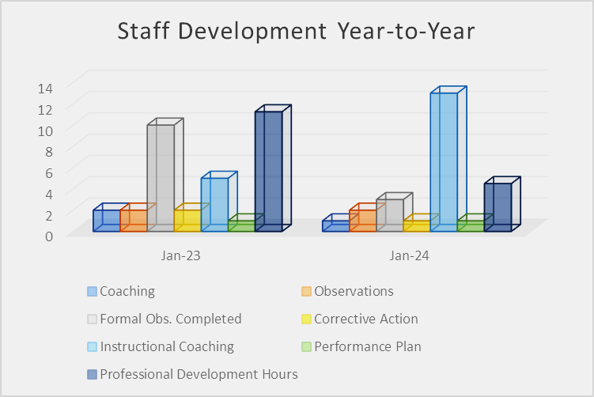
Staff Development - Year to Year
The formal teacher evaluation cycle has progressed slower this last year due to staffing issues and the move to the new building
This month the entire staff received 4.5 hours of PD
8 staff members attended a total of 29.5 additionally PD hours

Slide 10
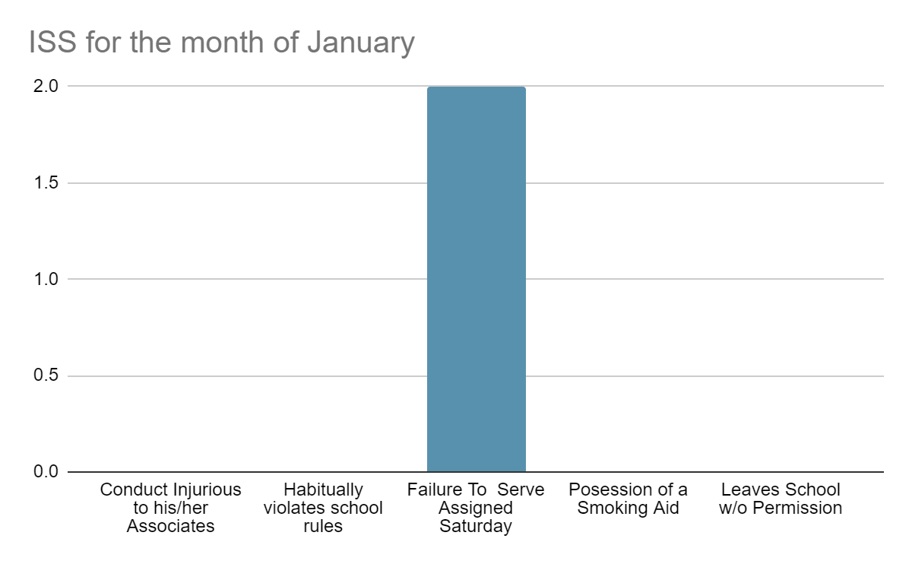
Culture - ISS
The students we had for ISS were the result of failure to come to Saturday detention. Most of the students work on Saturday or can’t get transportation to attend.

Slide 11
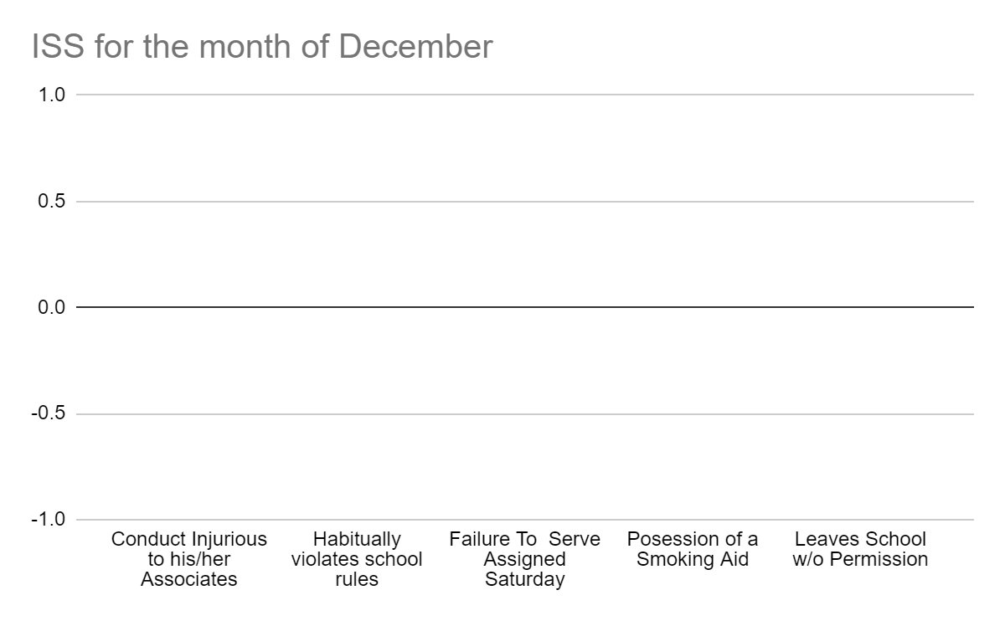
Culture - Month to Month Comparison for ISS

Slide 12
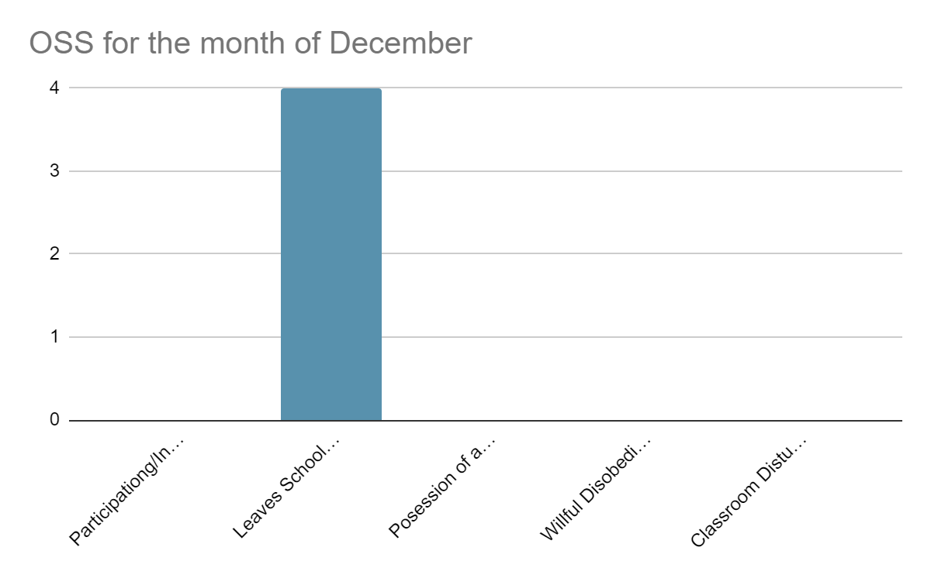
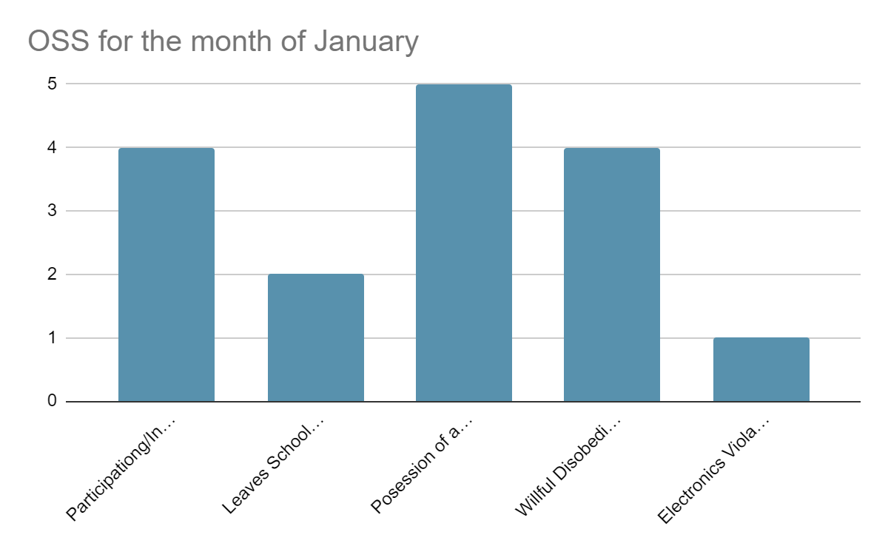
Culture - Month to Month Comparison for OSS
There were 14 OSS this month, 40 % due to vaping, 14%, for willful disobedience, 28 % for instigating or participating in fights and 18% for leaving school without permission. It has been observed that all the incidents that the altercations were the result of civil interactions between students outside of the school that manifested themselves at the school.

Slide 13
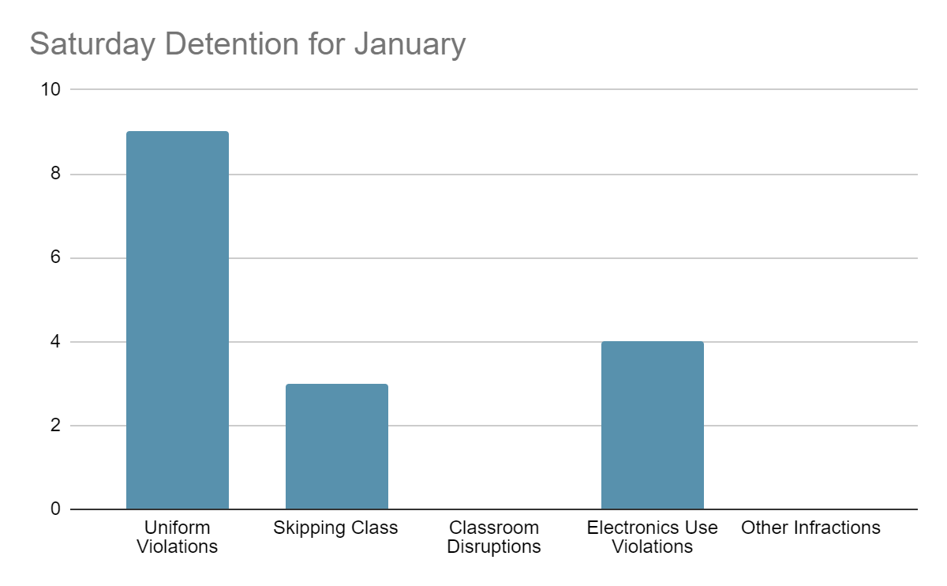
Culture Saturday Detention
There is an increase in detentions due to uniform violations which align with the increase on uniform checks during bag checked and reinstating the expectations during assemblies. IDs are the main cause of uniform violations.

Slide 14
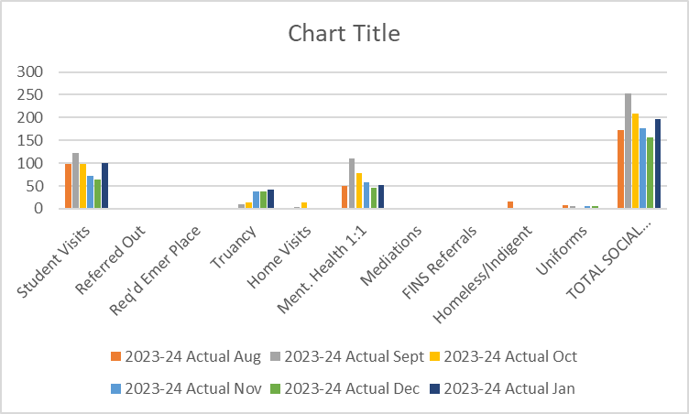
Social Work

Slide 15
Social Work
There are currently 44 students with chronic absenteeism. All social services numbers are provided in the 23-24 dashboard.
Alternative opportunities (e.g., online seat recovery option) are needed to support students with seat recovery.
The seat recovery monthly numbers are as follows: September ‘23=14, October ‘23=24, November ’23=0, December ‘23=3, and January ‘24=165. The increase in January is a result of the attendance assemblies held mid January.
We are working to provide more options to students for seat recovery. However, a 24-25 plan is highly suggested and follow through is crucial to student success.

