Slide 1
Academics Report
December 2023

Slide 2
IHSNO Enrollment
Enrollment | Nov 2022 | Dec 2022 |  | Nov 2023 | Dec 2023
9th | 101 | 100 |  | 124 | 126
10th | 128 | 128 |  | 105 | 106
11th | 77 | 78 |  | 101 | 103
12th | 81 | 81 |  | 73 | 74
Total | 387 | 387 |  | 403 | 409
This month’s data shows the comparison between last year’s enrollment and the current year during the same months. Last year’s enrollment for the month of November was 387. This year’s enrollment for November was 403, a gain of 16 enrollees for the month of November 2023. Last year’s enrollment for the month of December was 387. This year’s enrollment for December is 409, a gain of 22 enrollees for the month of December 2023. From August 2023 to December 2023, there is a gain of 26 students (383 to 409).

Slide 3
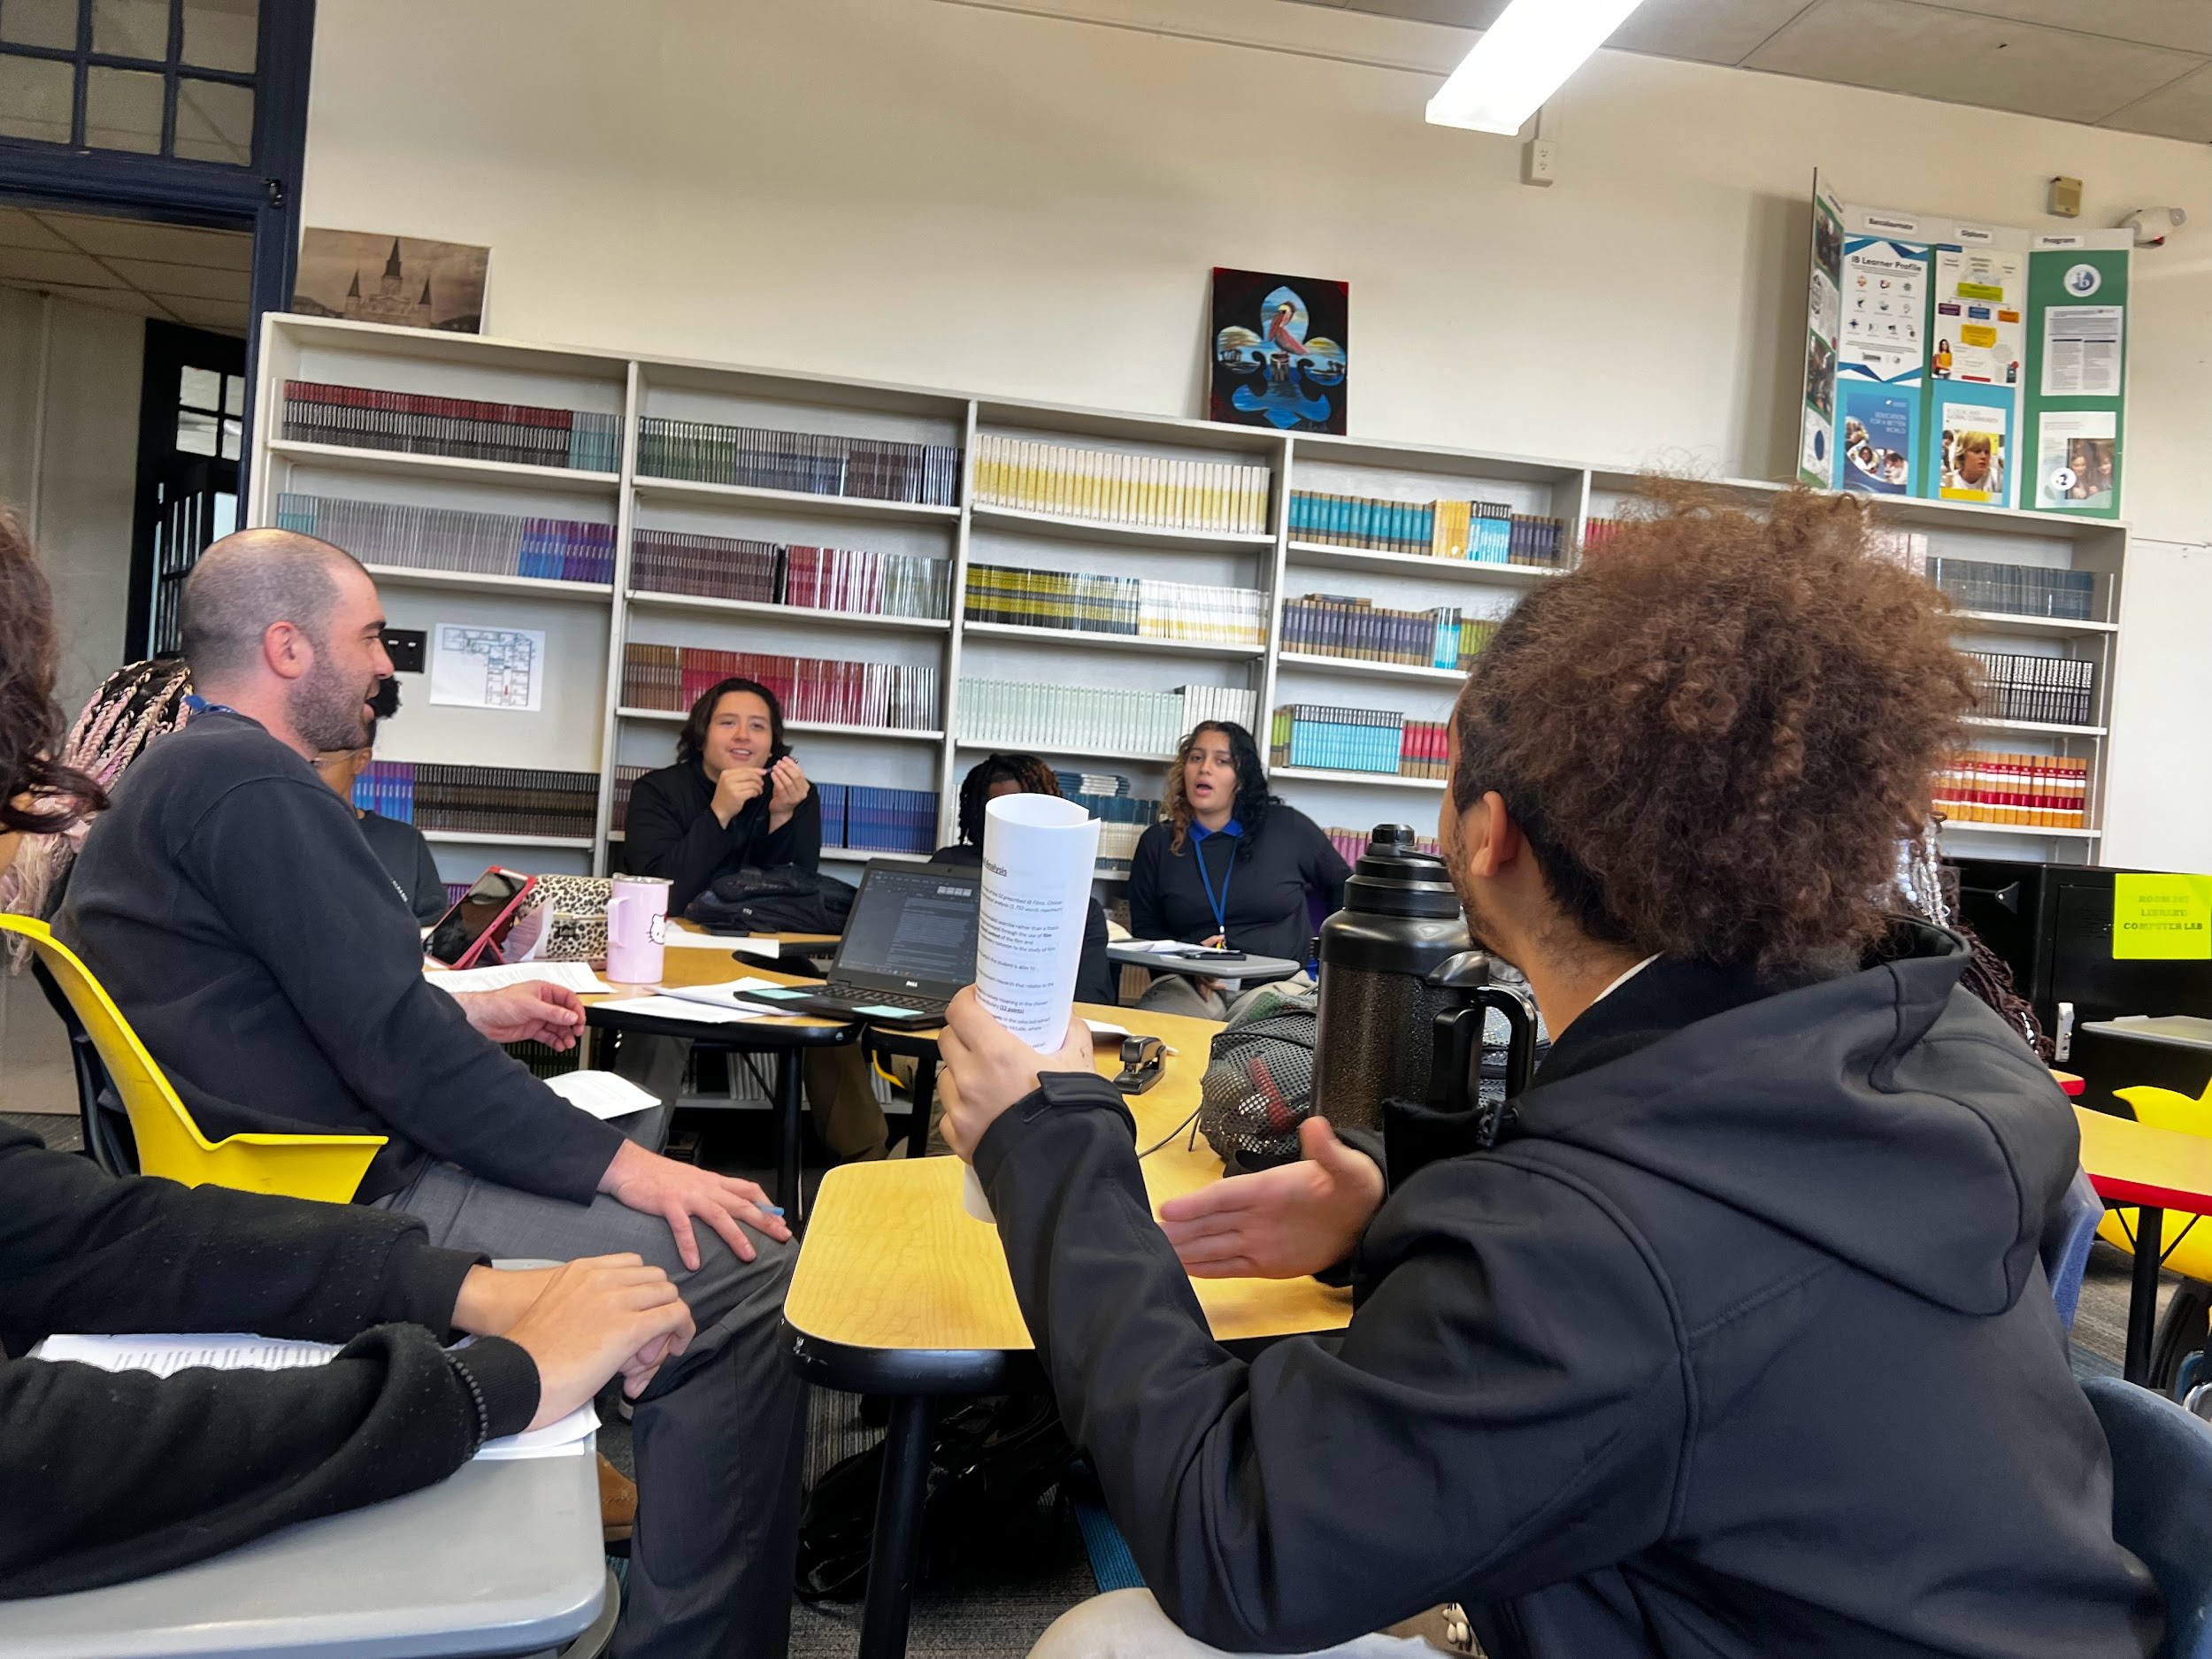
International Baccalaureate
-May 2024 Candidates Registered by the November 15th deadline. 22 seniors registered. 14 Diploma candidates and 8 course option certificate candidates.
-LDOE Quarterly report for the Reimagine Grant be submitted
New Library research and writing space

Slide 4
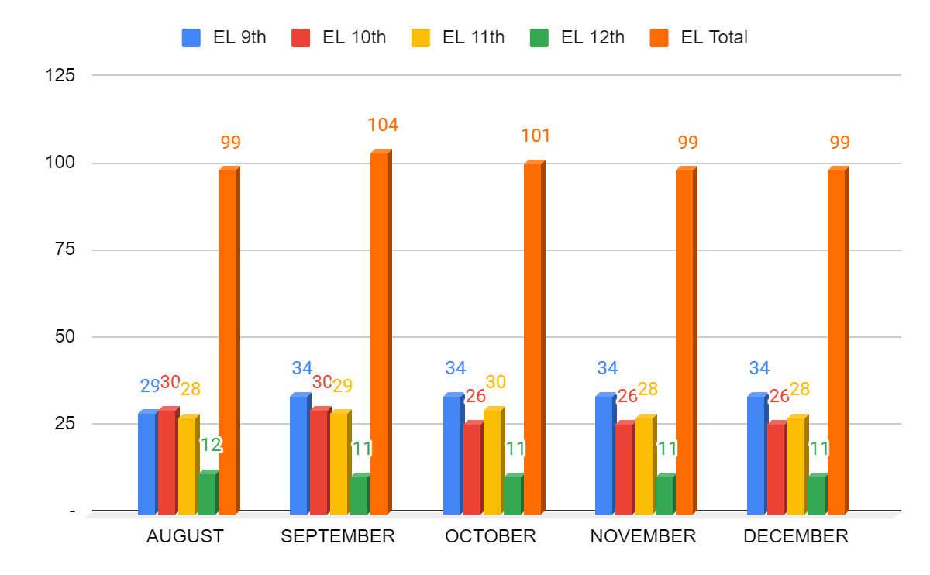
EL- Month to Month Comparison
EL enrollment remained the same between November and December with no new enrollments nor transfers/drops. There are several student retained to 11th that will be eligible for graduation (some barring LEAP results). There are also a few students that have been “no shows” for over 15 days but are not yet 18 years old.

Slide 5
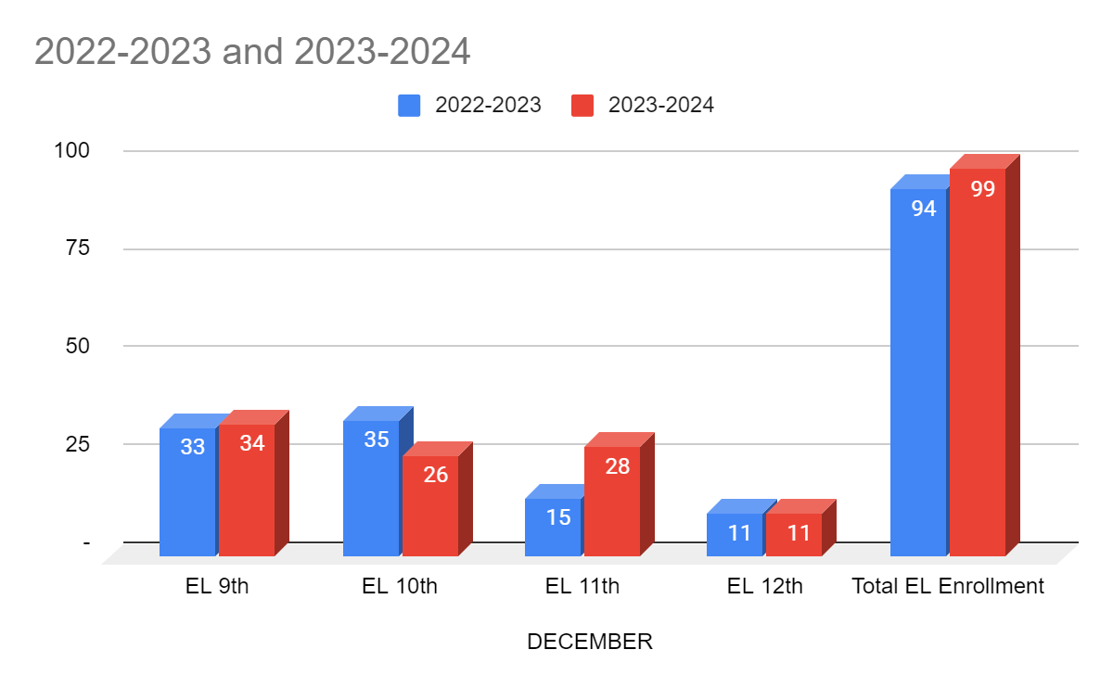
EL- Year to Year Comparison
Semester 1’s year to year trends show that we will remain around 30 students in each grade level. The Senior cohort will be our last small cohort if enrollment remains similar to this year’s Semester 1 EL enrollment.

Slide 6
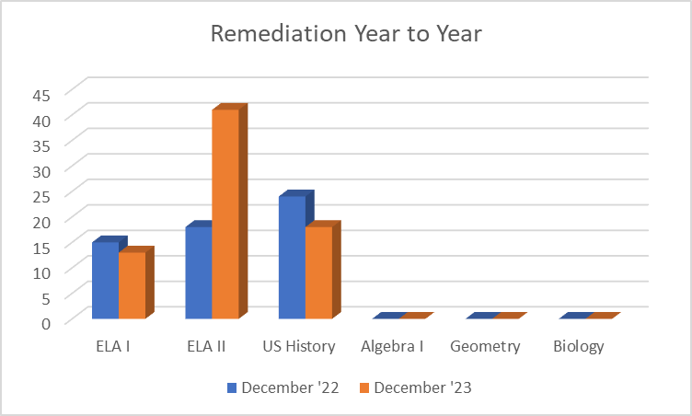
Remediation - Year to Year
There is a high demand for remediation support in English II this year; which it has trended to need more support out of the ELA subject tests. US History has seen a decrease in the need for remediation support this year.

Slide 7
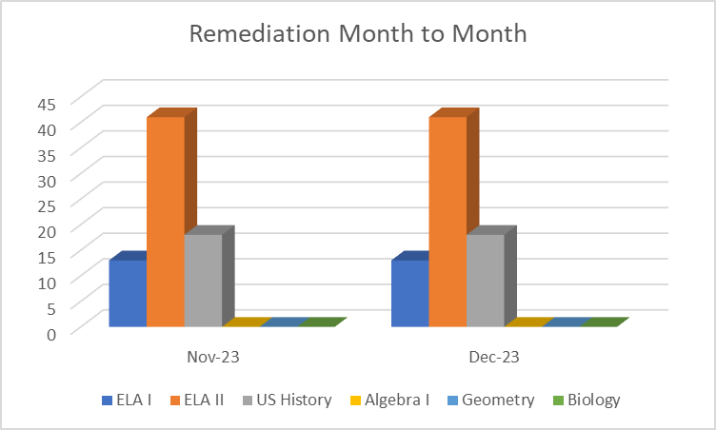
Remediation - Month to Month
No change in the amount of students served from November to December. Students will be assessed in January to measure the impact of the interventions provided throughout the semester.

Slide 8
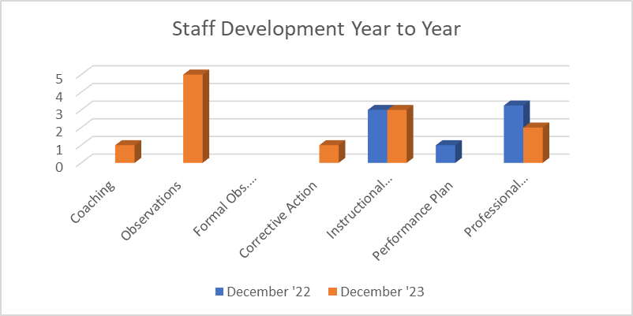
Staff Development - Year to Year
This year more observations were conducted, which could explain the need for coaching/corrective actions simply due to be more aware of what is going on in classrooms. There was a reduction in PD hours due to the building move.

Slide 9
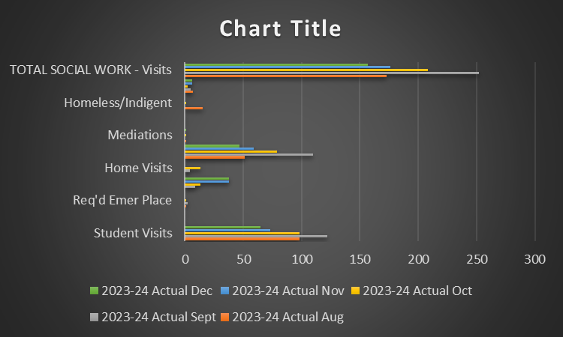
Social Work

Slide 10
Social Work
Attendance continues to be a challenge with the student population specific to cultural and environmental factors (e.g., financial hardship, homelessness, parenting, etc.). As a result, truancy remains a concern.
Providing resources both internally and externally are slightly increasing, As students approach graduation they seek information regarding resources to help them maintain their basic needs.
Uniform assistance is crucial if students will continue to be held to the expectation of being in uniform daily.

