Slide 1
Academics Report
February 2023

Slide 2
IHSNO Enrollment
Enrollment | Jan 2022 | Feb 2022 |  | Jan 2023 | Feb 2023
9th | 148 | 144 |  | 101 | 103
10th | 81 | 81 |  | 123 | 119
11th | 79 | 78 |  | 75 | 74
12th | 81 | 81 |  | 81 | 80
Total | 389 | 384 |  | 380 | 376
This month’s data shows the comparison between last year’s enrollment and the current year during the same months. Last year’s enrollment for the month of January was 389. This year’s enrollment for January is 380, a loss of nine (9) enrollees for the month of January 2023. Last year’s enrollment for the month of February was 384. This year’s enrollment for February is 376, a loss of eight (8) enrollees for the month of February 2023.

Slide 3
International Baccalaureate
Middle Years Programme (MYP) Candidacy Status Granted
Diploma Programme (DP) 5 year evaluation Self-Study and Programme Development Plan Submitted
Preparation for M23 examination session in full swing with Extended Essay, TOK Essay and HL essay due March 15th for seniors

Slide 4
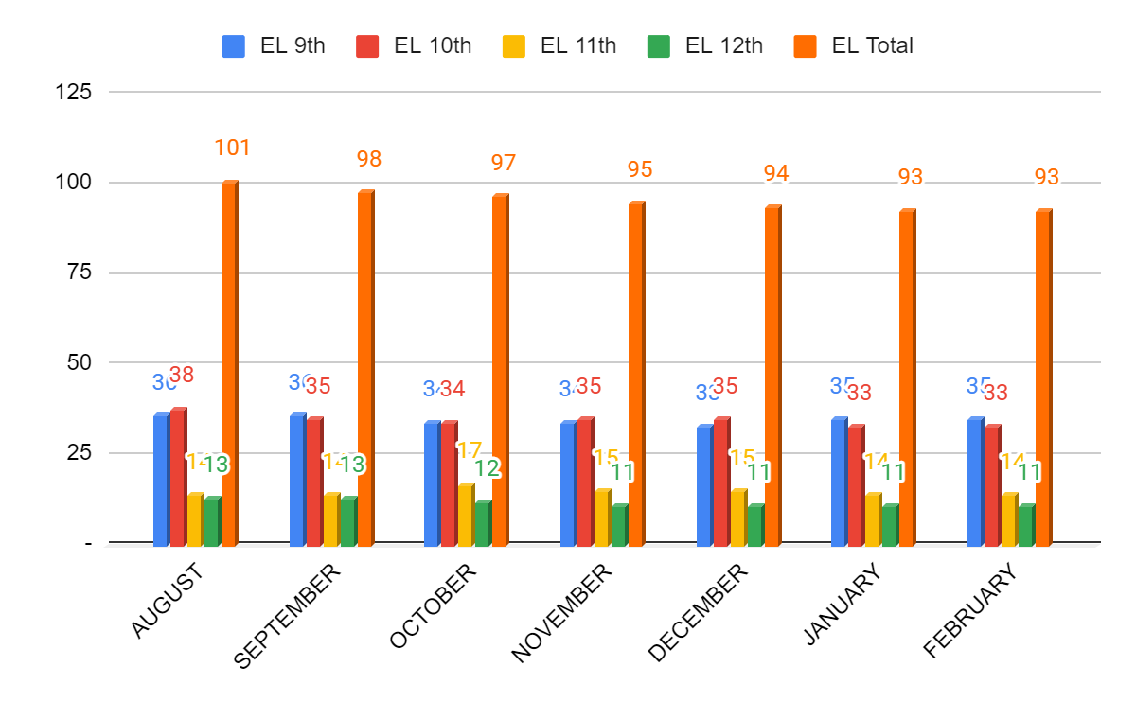
ESL- Month to Month Comparison
Numbers have been very steady throughout the month of February.
9th- one student dropped due to 15 consecutive absences, one new arriver
That’s it!

Slide 5
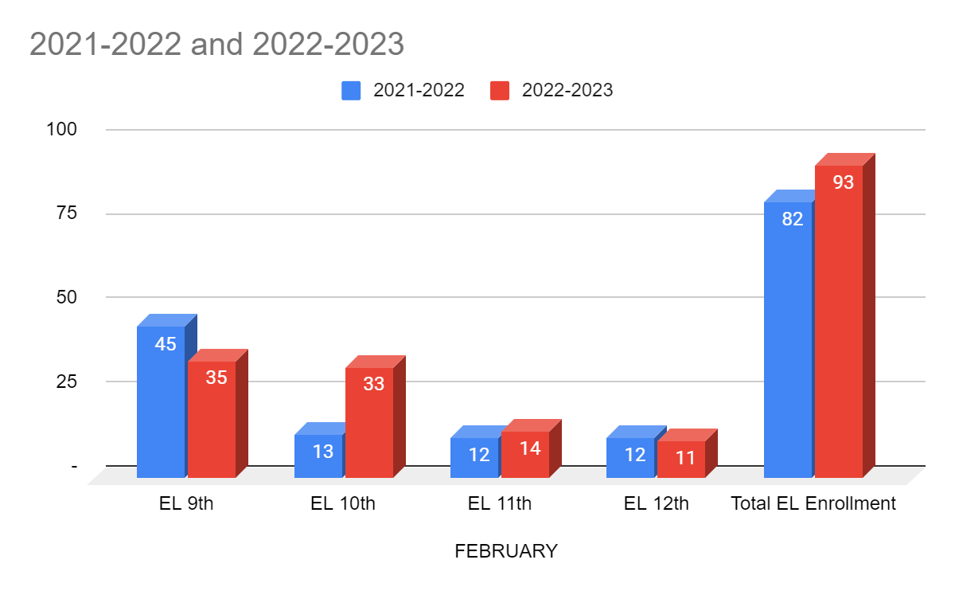
ESL- Year to Year Comparison
Our 9th and 10th grade cohorts remain large, but steady. The goal will be to retain these students to graduation. Our 10th and 11th grade cohorts remain small, but also steady. Several students have dropped from these cohorts since 9th grade, which increases the importance of improving our 9th and 10th grade EL retention to graduation.

Slide 6
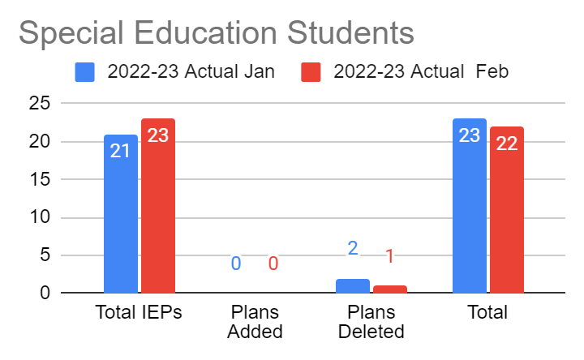
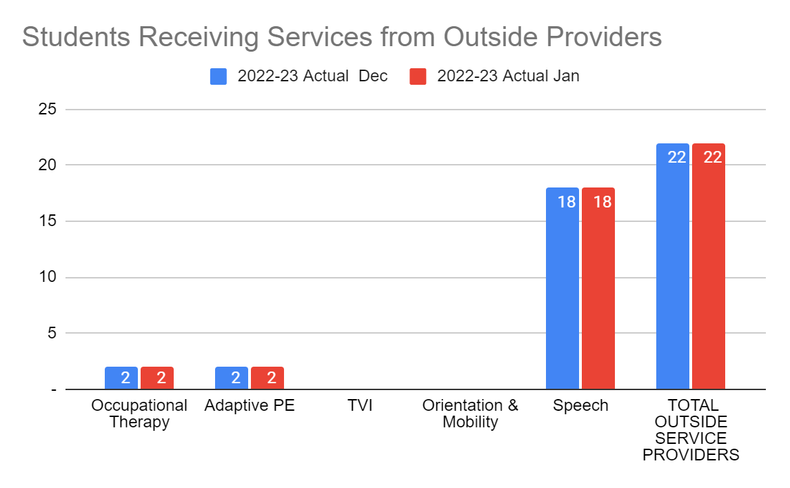
Special Education
For the month of February we closed jurisdiction for one student who transferred to another school, services were also closed, leaving us at 22 IEP students.

Slide 7
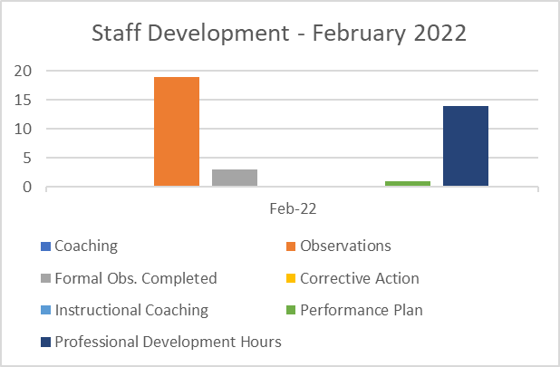
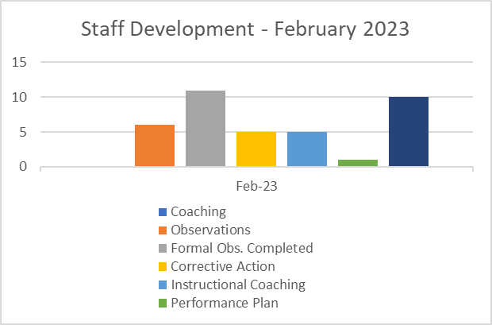
Staff Development
The first round of the formal observation cycle wrapped up in February, accounting for this year’s increased formal observations and the decrease in classroom observations. More coaching has been given to support the staff in developing their teacher practice.

Slide 8
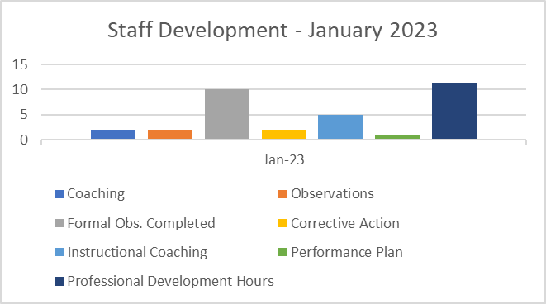
Staff Development Month to Month
The month to month comparison shows consistency in the amount of formal observations conducted and the instructional coaching offered to teachers.

Slide 9
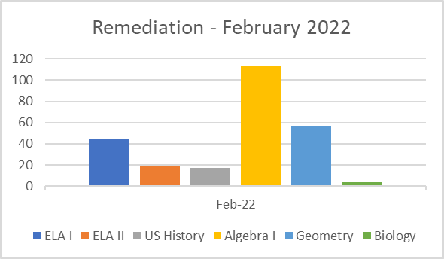
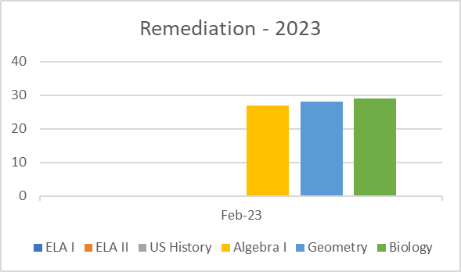
Remediation
There was a definite increase is students receiving remediation in Biology this year. The number of Algebra I and Geometry students have decreased sharply this year. There are long-term subs in place in both classrooms; affecting the accuracy of identifying students. The lack of support in ELA/SS is due to that position remaining vacant.
No significant change was noted in the month to month comparison of January 2023 and February 2023. The Algebra count was reduced by 6.

Slide 11
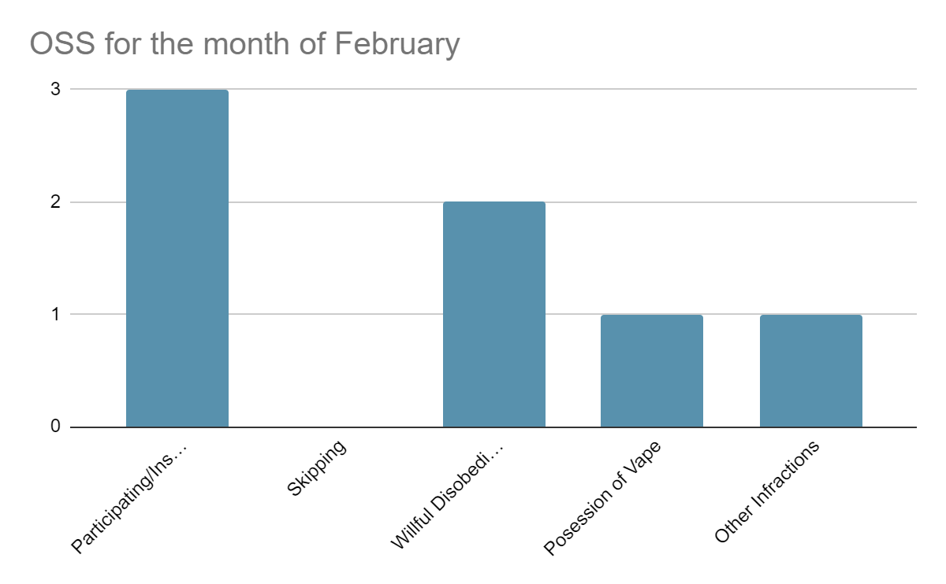
Culture
For the month of February for OSS, there has been seven incidents total. Overall we’re doing well with keeping OSS numbers low.

Slide 12
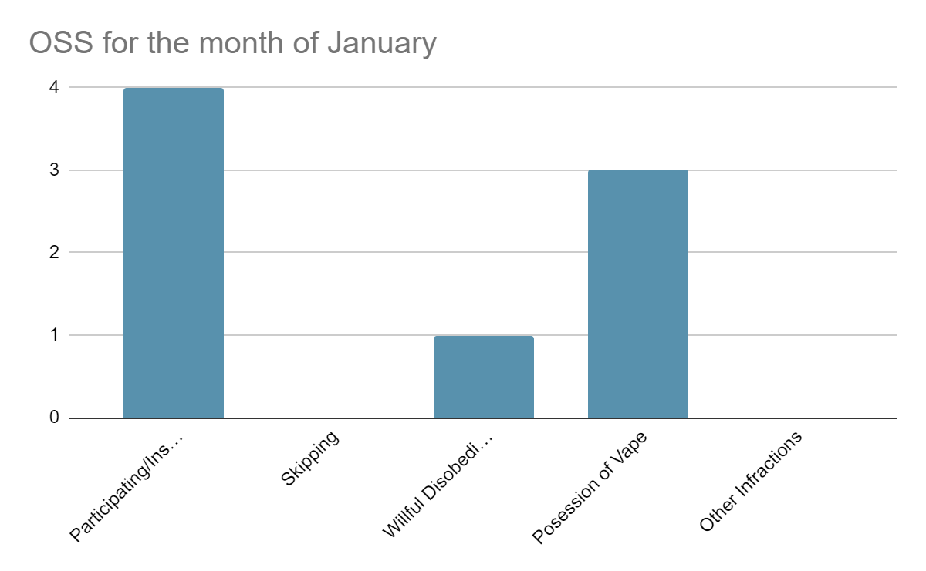
Culture - Month to Month Comparison for OSS
In comparison of January’s report of OSS, there has been an increase of 1% of students having shown Willful Disobedience. However, there has been about a 2% decrease in students being found in possession of a vape and a 1% decrease of students participating or instigating a fight .

Slide 13
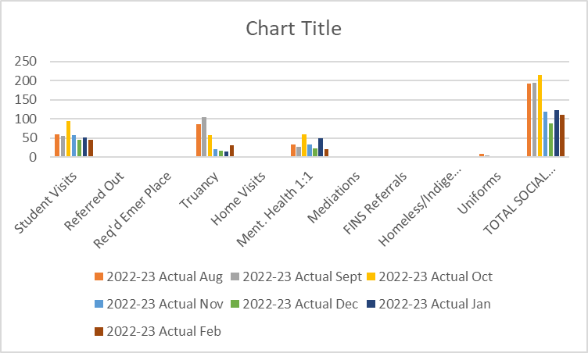
Social Work
Student visits remain steady currently.
Truancy has increased as a result of attendance plans and conferences scheduling.
Uniform assistance is increasing and is not limited to mckinney vento students.
Social services are better distributed among the student population due to the addition of a social worker.

Slide 14
Counseling -Dual Enrollment
Students in grades 9th-12th will are enrolled in college courses for Spring 2023. The online platform has proven to be a great success for our students. The dual enrollment partnership is with Southern University of New Orleans and Operation Spark.
New Orleans Career Center recruiter has conducted (5) information sessions with students in grades 10th-11th for the upcoming school year.

Slide 15
CTE PATHWAYS- SPRING/UPCOMING SY
The career pathways that we will implement this semester is Costmetology with New Beginning Beauty College.
We are working on the implementation of an approved CTE program for the upcoming school year.

Slide 16
Counseling- Assessment
The new platform for ACT WorkKeys will be administered at International High School. The number of registrants is sixty-eight students. We are planning to successfully launch ACT WorkKeys Test on March 8, 2023.
Testers have completed two official practice test for ACT WorkKeys Test. Testers are familiar with the platform, toolkit, and to successfully complete each test sessions.
Test results will be available the next day for the WorkKeys test.

