Slide 1
Academics Report
December 2022

Slide 2
IHSNO Enrollment
Enrollment | Nov 2021 | Dec 2021 |  | Nov 2022 | Dec 2022
9th | 150 | 147 |  | 101 | 100
10th | 87 | 84 |  | 128 | 128
11th | 70 | 73 |  | 77 | 78
12th | 80 | 80 |  | 81 | 81
Total | 387 | 384 |  | 387 | 387
This month’s data shows the comparison between last year’s enrollment and the current year during the same months. Last year’s enrollment for the month of November was 387. This year’s enrollment for November was 387, enrollment remained the same for the month of November. Last year’s enrollment for the month of December was 384. This year’s enrollment for December is 387, a gain of three (3) enrollees.

Slide 3
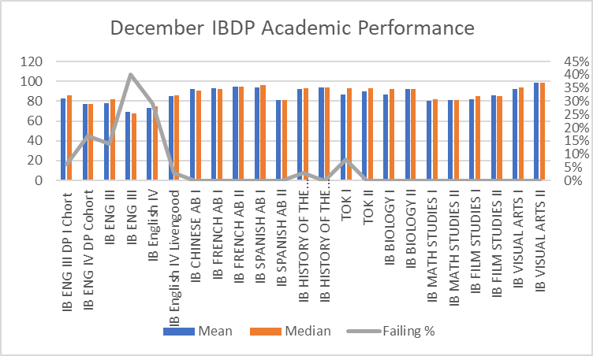
International Baccalaureate
All 30 items needed for IBDP 5-year evaluation were accepted and meet IB Expectations
Next, a self-study of the programme will take place with a March 1 deadline for submission but surveys and other feedback will be needed before then to compete final step of 5-year evaluation

Slide 4
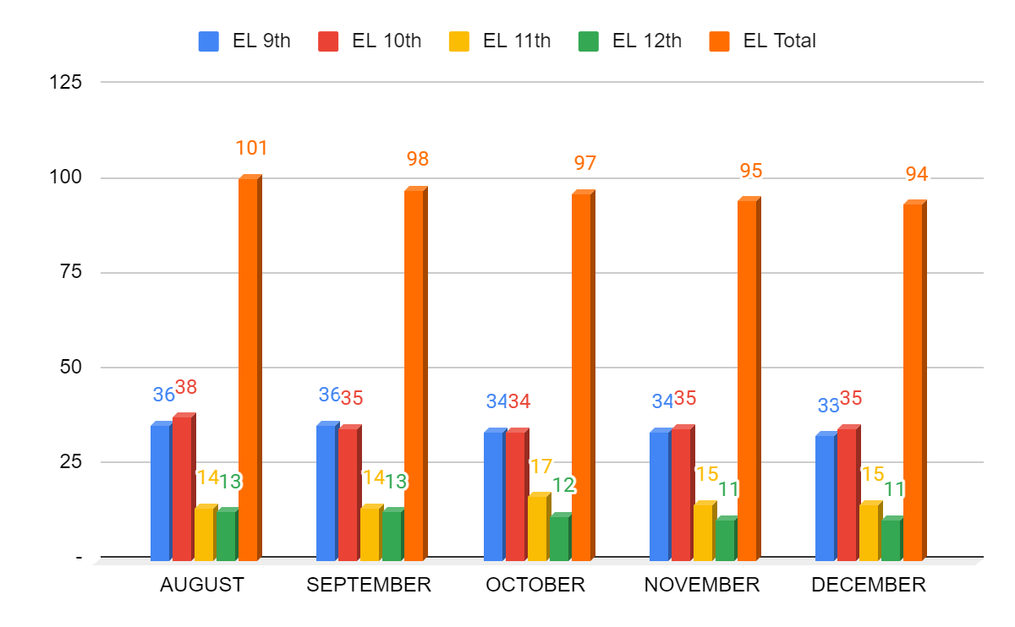
ESL- Month to Month Comparison
9th- one 9th grader has officially transferred out. Three 9th graders have quit attending school since November. Those students have been referred to the front office and social worker.
10th- no changes; however, one student has quit attending since November. Student has been referred to social worker.
11th- no changes; however, one student has quit attending since October due to extenuating circumstances. Name has been referred to 504 Coordinator. Another student has not attended since October and was referred to social workder and front office in Q1 and Q2.
12th- no changes. Based on S1 grades, one student is currently ineligible to graduate. Based on Fall LEAP retesting, the same student and three additional students are currently ineligible for graduation.

Slide 5
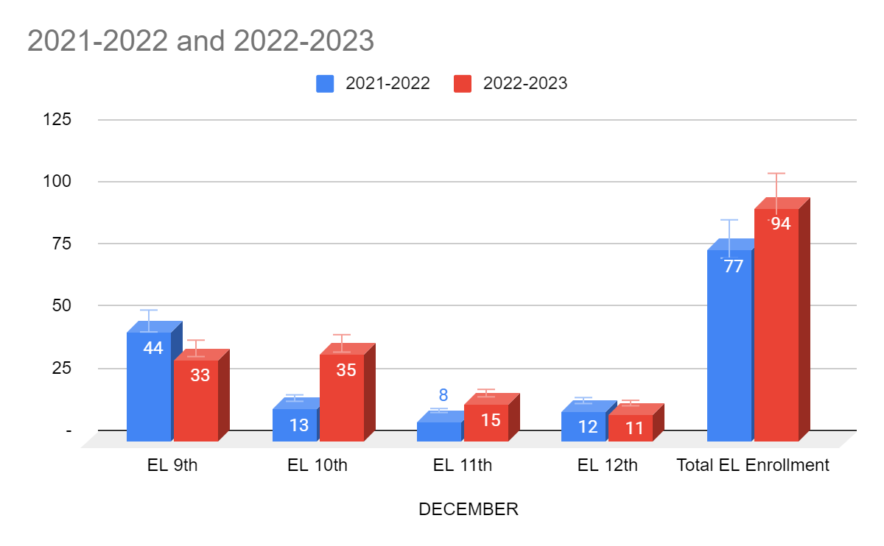
ESL- Year to Year Comparison
9th- our 9th grade cohort is smaller than the 21-22 school year, but remains high on average. Students are transferring out, but fewer students are enrolling late in the school year compared with previous years.
10th- This cohort remains our largest cohort in history. We are retaining the majority of students in this cohort and they continue to meet high expectations.
11th- The majority of the 11th grade cohort is made up of students that began at IHSNO in 9th grade. The other part of this cohort are students that arrived to the country with foreign transcripts that made them eligible for 11th grade placement. One other student will be promoted from 9th to 11th based on her foreign transcript.
12th- The 12th grade cohort remains around 10 students. Our most recent priority with these students is LEAP remediation so that we can reach our goal of 100% graduation.

Slide 6
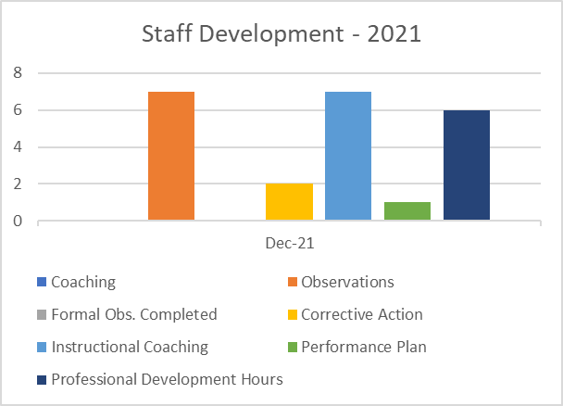
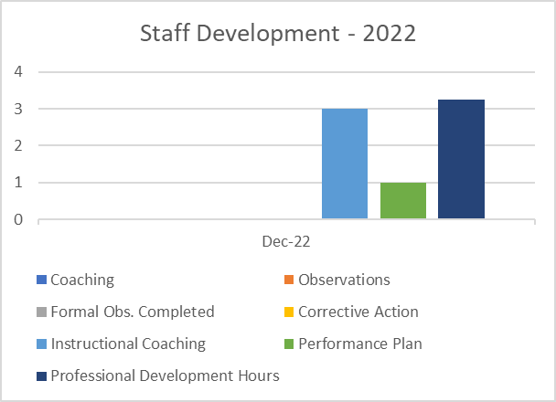
Staff Development
There were 50% less hours of professional development in December 2022.
Corrective actions decreased to 0 in December 2022.

Slide 7
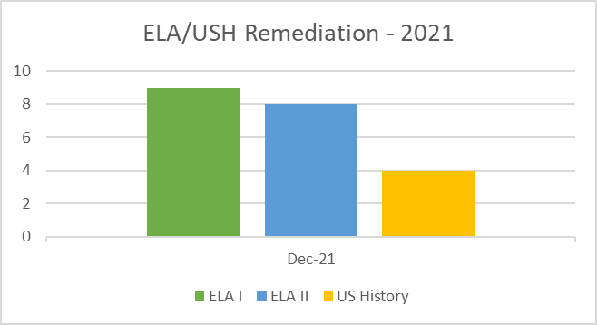
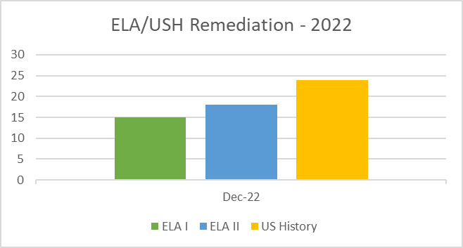
Remediation
Larger number of students received remediation in December 2022, than in 2021. The amount of students receiving ELA I and II remediation doubled in 2022. The largest increase was in US History with nearly 8x more students.

Slide 8
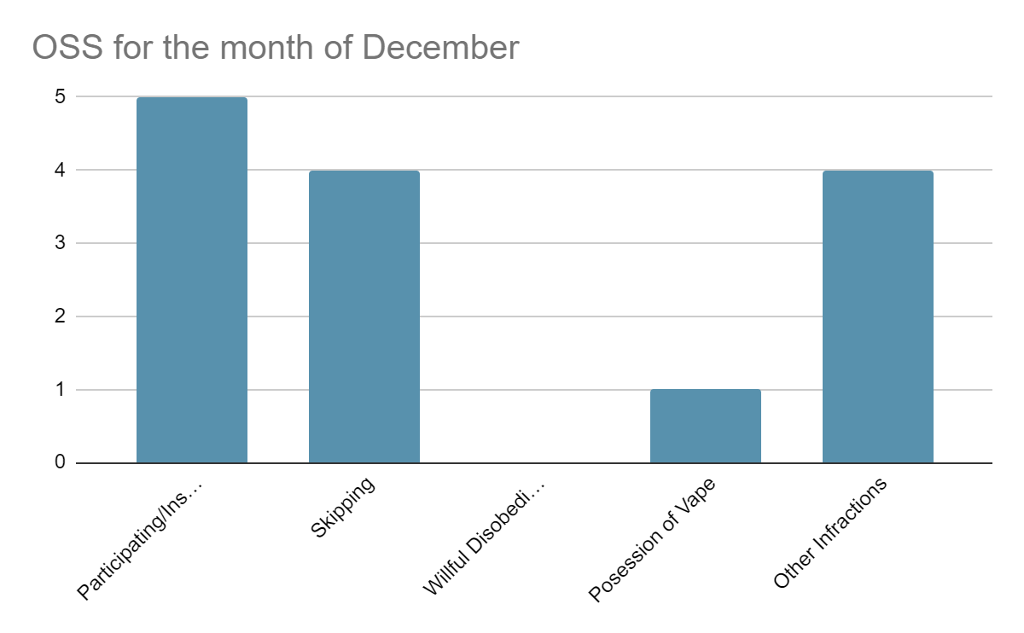
Culture
For the month of December for OSS, there has been a decrease of students participating in a fight, as well as a decrease of students receiving OSS for Skipping. There has also been a decrease of students receiving OSS for Possession of Vape and other Infractions.

Slide 9
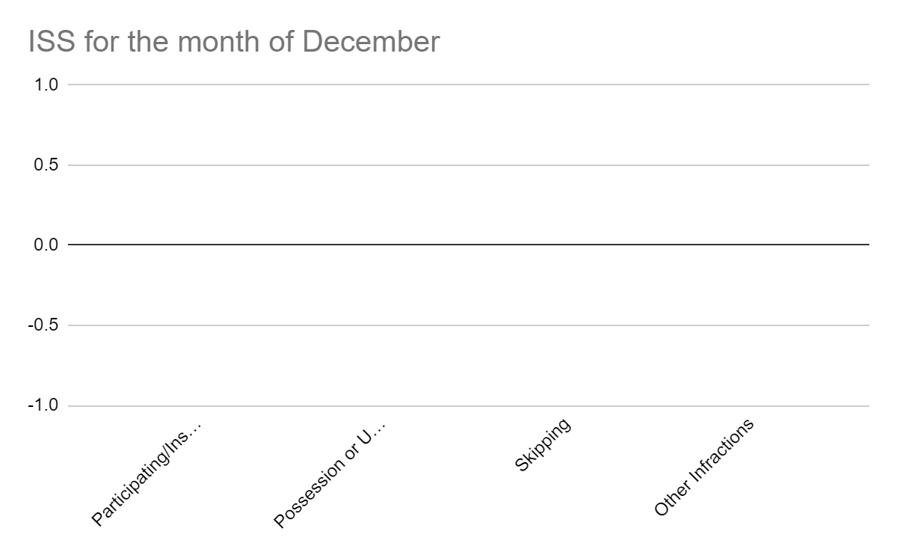
Culture
For the month of December for ISS, there has been significant decrease for all of the infractions listed. Strategies that were used to reduce the amount of students serving ISS, consisted of restorative practices and keeping in contact with parents.

Slide 10
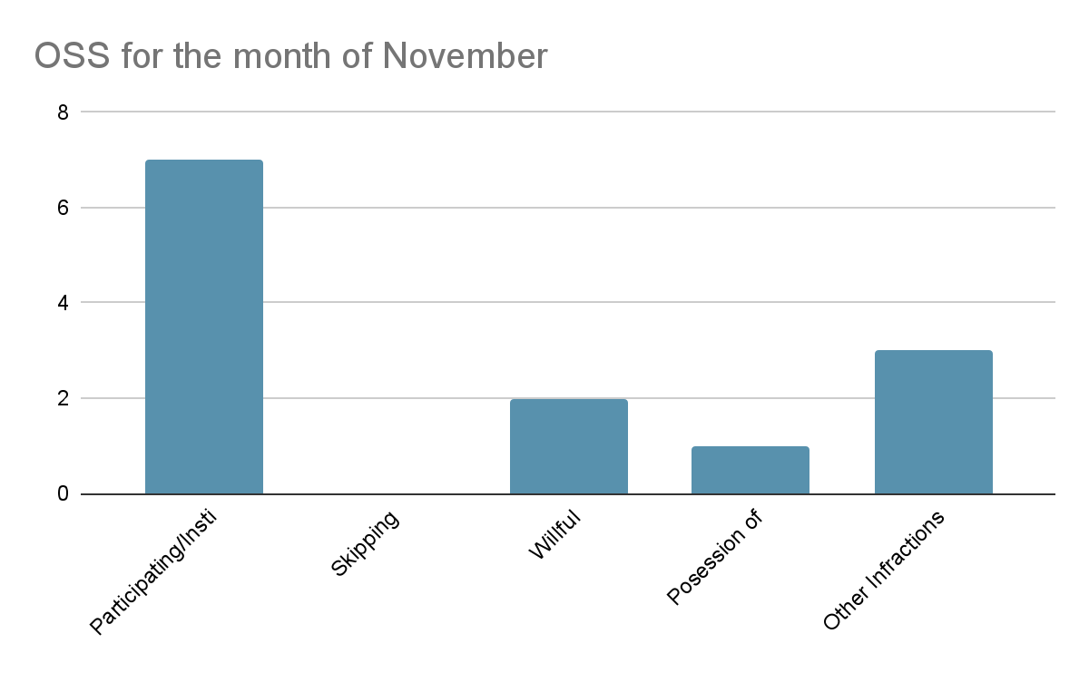
Culture - Month to Month Comparison for OSS
In comparison of November’s report of OSS, there has been about a 20% decrease students participating or instigating a fight, and about a 0% change in Possession of Vape. As well as about a 100% decrease in OSS for Willful Disobedience. However, there has been about a 100% increase in Skipping and almost half the percentage of increase in other infractions such as leaving off campus without consent

Slide 11
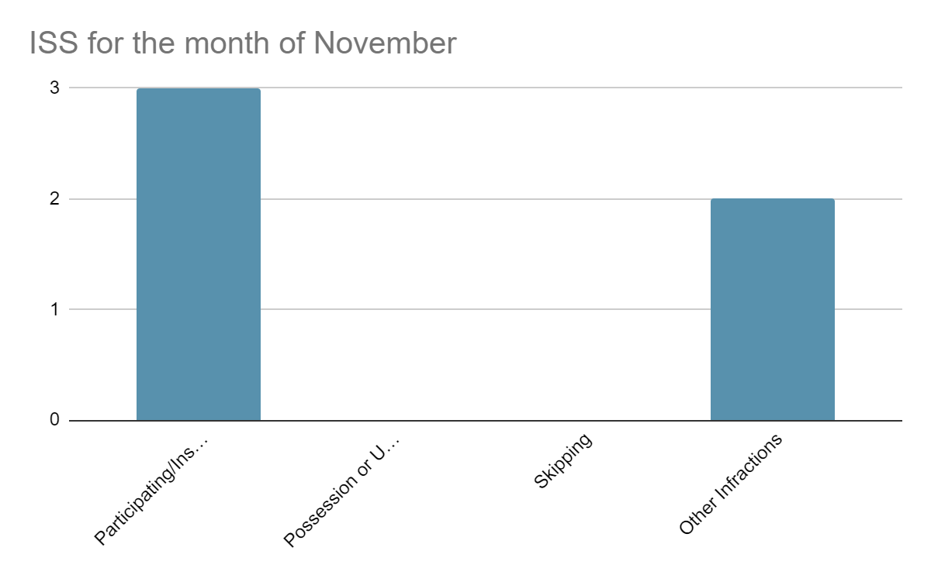
Culture - Month to Month Comparison for ISS
In comparison of November’s report of ISS, there has been an overall 100% decrease in students receiving ISS for the infractions presented in this bar graph. There was no ISS for the month of December due to the restorative practices that were used with students.

Slide 12
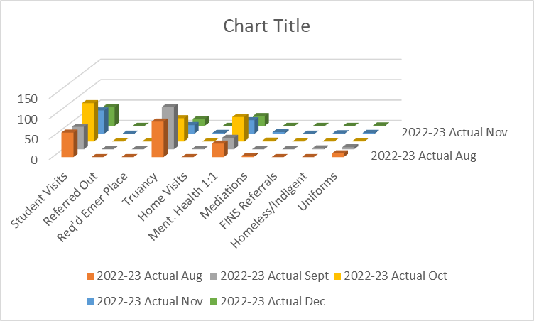
Social Work
Overall visits were the lowest this month as a result of the Christmas break.
Mental health visits were slightly greater than 50% this month.
Truancy numbers are not valid as a result of not being able to access a report that accurately count absences specific to days rather than periods.
Home visits are not being conducted in effort to minimize the absence of social services on the campus.

Slide 13
Counseling -Dual Enrollment
The course offerings for Spring 2023 semester for dual enrollment are listed:
College Success Skills
Calculus
Elementary Statistics
Criminal Justice
College Algebra
Students who meet the admissions requirement to enroll in college courses will complete an online application and parental consent form.

Slide 14
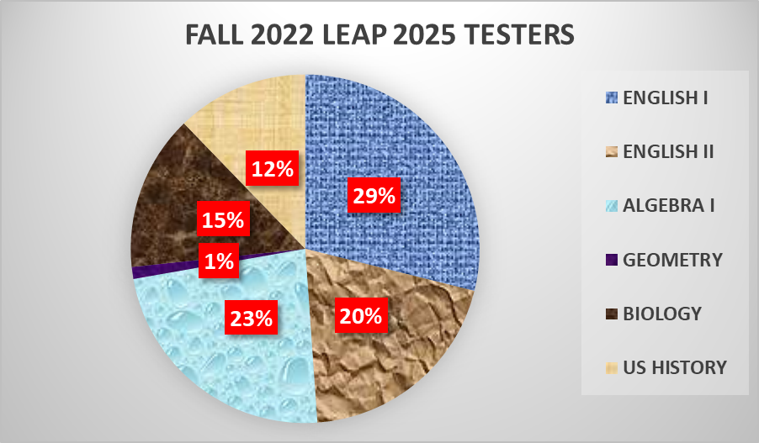
Counseling- Assessment

Slide 15
Counseling- Assessment
The Fall LEAP 2025 Testing window was a great success. The pie chart is reflective of the percentage of testers who participated in Fall 2022 test sessions. Seniors commitment to complete the LEAP assessment complimented one of the eligibility requirements for graduation.
The percentage rate for seniors passing one or more components of the LEAP Assessments was 50> percent.

