Slide 1
Academics Report
October 2022

Slide 2
IHSNO Enrollment
Enrollment | Sep 2021 | Oct 2021 |  | Sep 2022 | Oct 2022
9th | 141 | 145 |  | 102 | 101
10th | 88 | 89 |  | 126 | 124
11th | 64 | 67 |  | 77 | 79
12th | 86 | 82 |  | 82 | 82
Total | 382 | 383 |  | 387 | 386
This month’s data shows the comparison between last year’s enrollment and the current year during the same months. Last year’s enrollment for the month of September was 382. This year’s enrollment for September was 387, a gain of five (5) enrollees for the month of September. Last year’s enrollment for the month of October was 383. This year’s enrollment for October is 386, a gain of three (3) enrollees for the month of October.

Slide 3
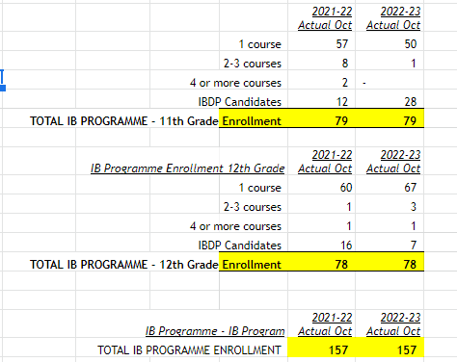
International Baccalaureate
IB First Quarter Celebration pizza party with 28 diploma candidates
DP Evaluation moving toward December 15 Preliminary Review Deadline

Slide 4
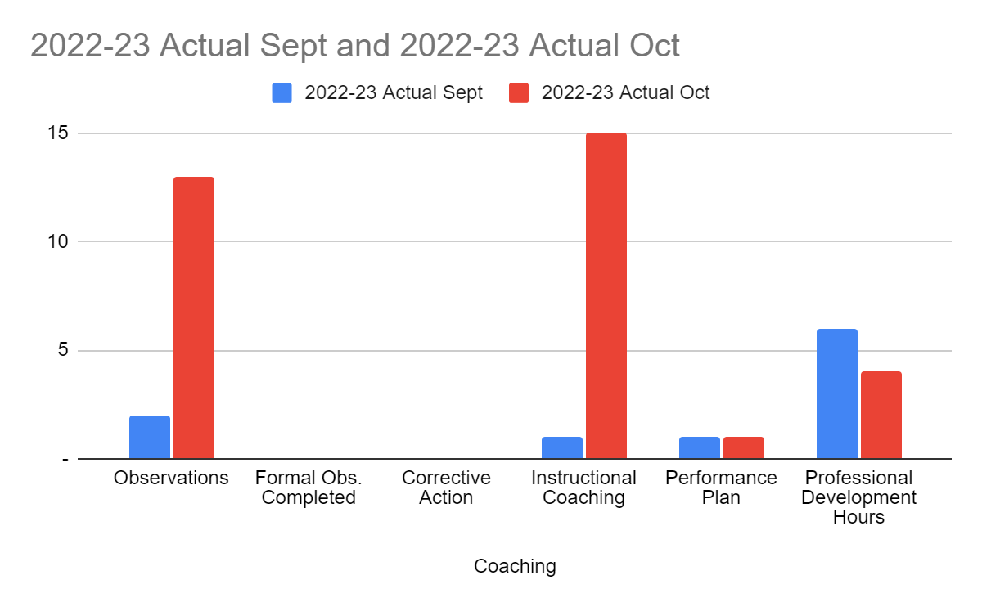
Staff Development (Sept to Oct)
Observations are usually a collective effort and the bus service disruption called for a lot of planning meetings which affected the number of team members who were able to regularly observe.
Instructional Coaching spent September doing the pre-meeting work for the actually October coaching cycle.
Professional development hours dropped as a result of the schedule change shifting PDs to the morning and reducing the allotted time to roughly 80 minutes.

Slide 5
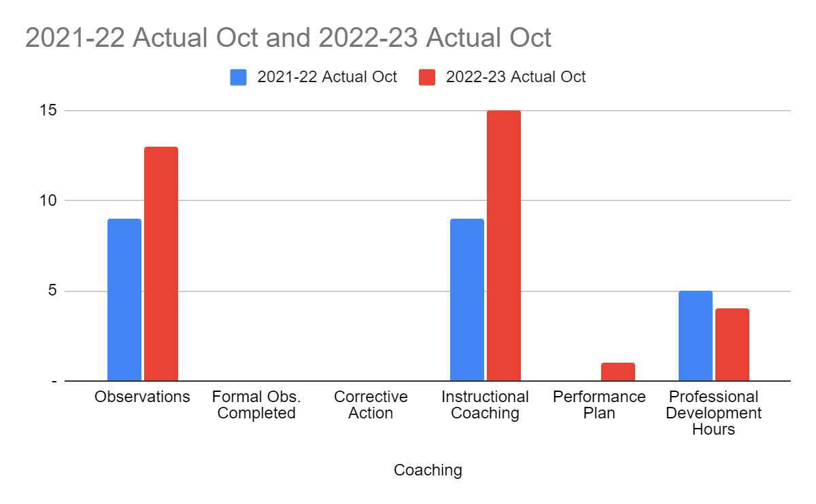
Staff Development (Oct ‘21 and Oct ‘22)
There is a bigger first-year cohort this year than last year which accounts for the difference in coaching occurrences
PD hours difference is, again, due to the shift in allotted time for weekly PD

Slide 6
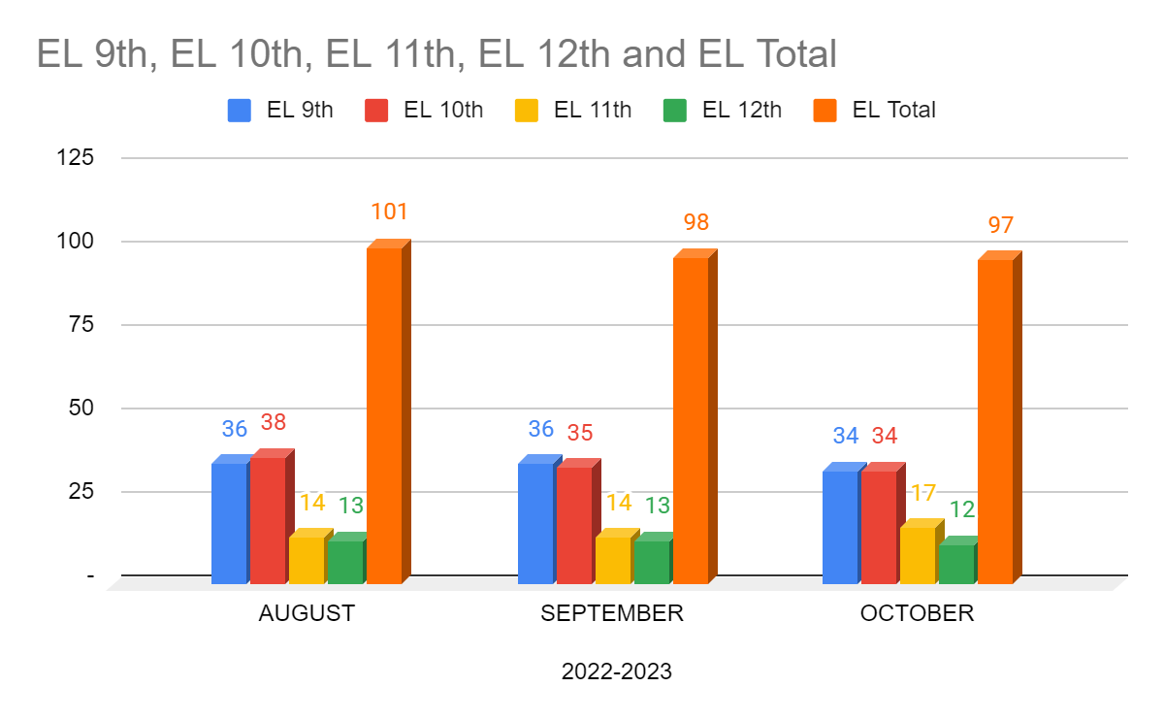
ESL- Month to Month Comparison
9th- Two new arrivers and four withdraws.
10th- One student promoted to 11th grade based on foreign transcript evaluation.
11th- Student mentioned before promoted from 10th, one student demoted from 12th (no show), one new arriver.
12th- Student mentioned before demoted from 12th

Slide 7
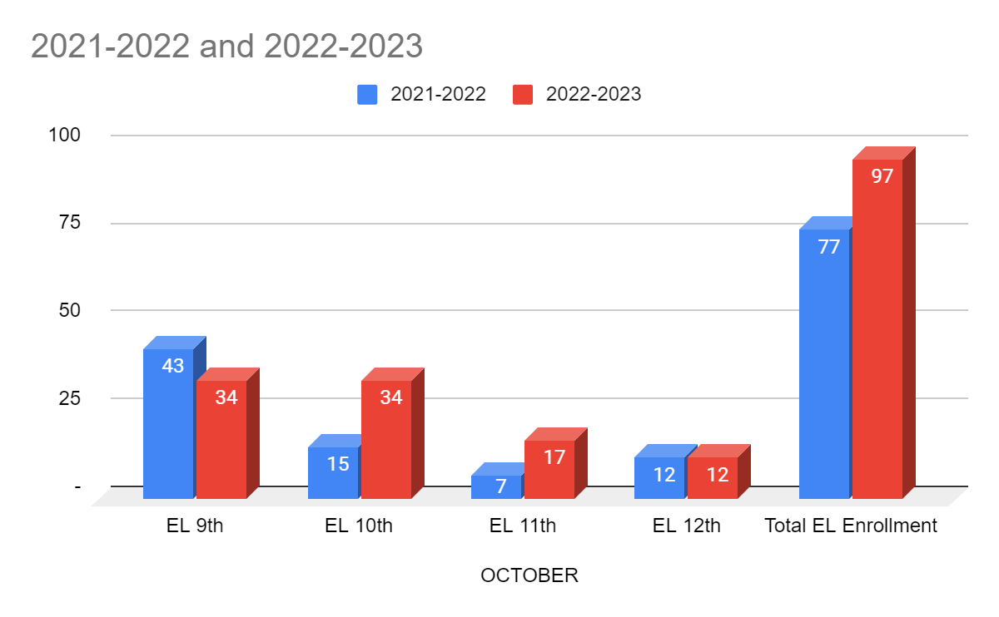
ESL- Year to Year Comparison
We are currently at a 26% increase in EL enrollment from last year. Our EL population is 25% of our total population. Previously our EL population has been between 10-18%. We are showing an increase on trend with increasing EL populations in Louisiana and other states nationwide.

Slide 8
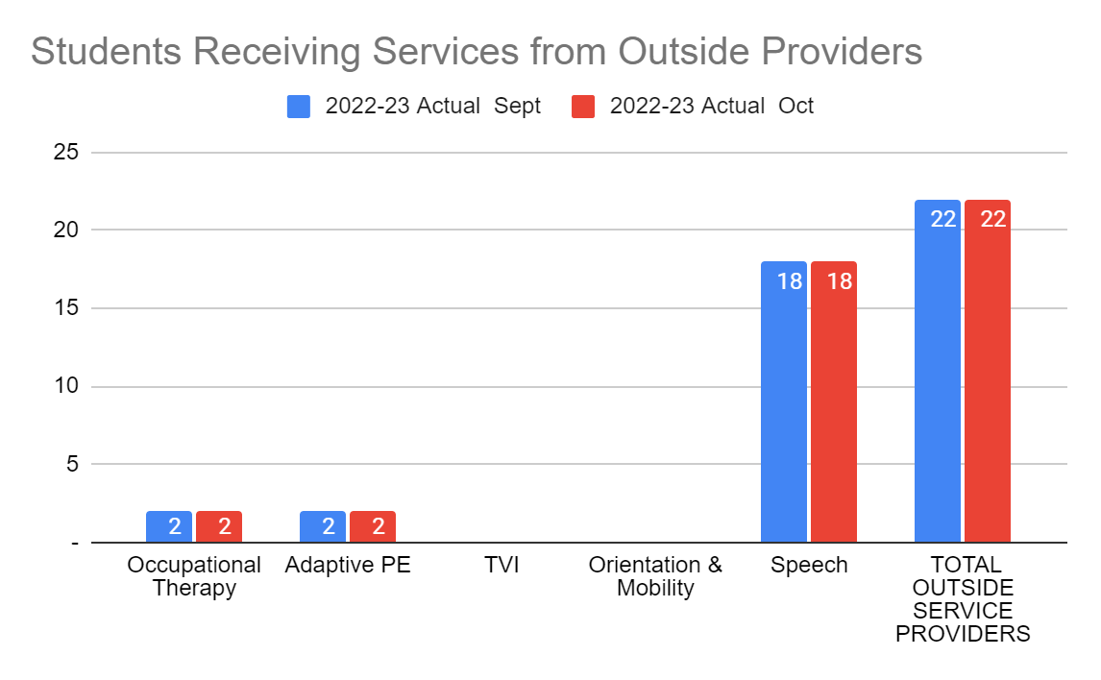
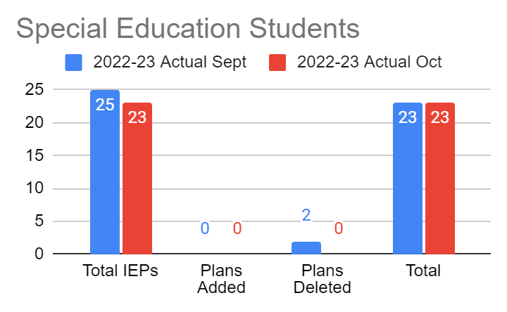
Special Education
For the month of October no data changed, 23 students remain with an IEP and 22 receive outside services.

Slide 9
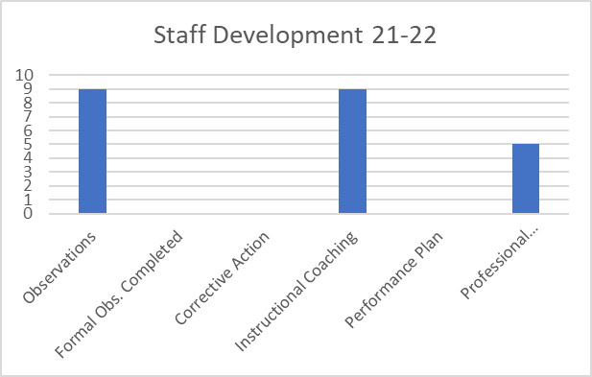
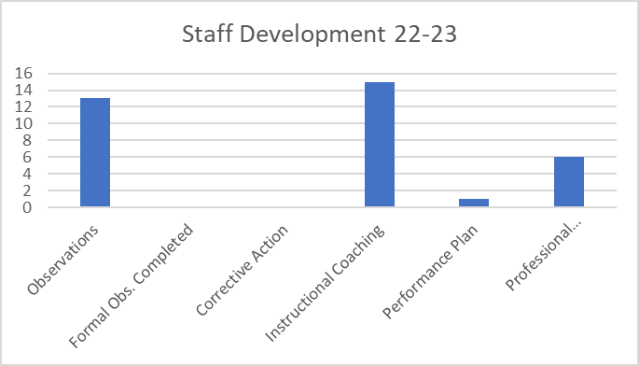
Staff Development
There are more members in the new teacher cohort this; more observations/instructional coaching is needed
There was less PD hours as teachers were given a records day

Slide 10
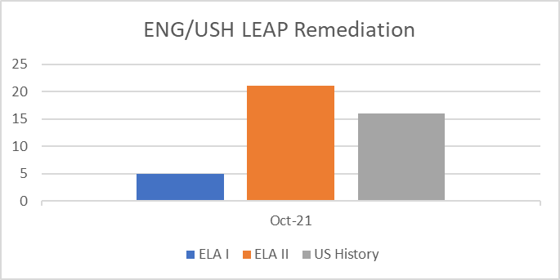
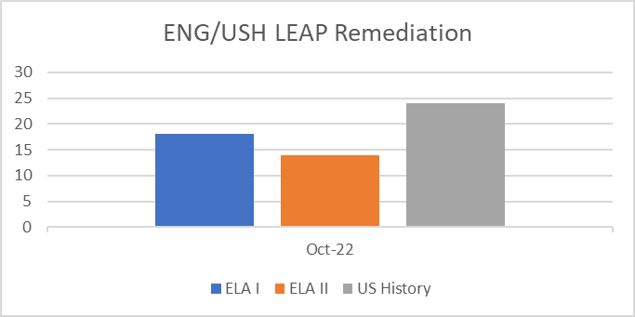
Remediation
There has been an increase in the number of ELA I and US History students receiving regular LEAP remediation services this year; a decline in ELA II students receiving remediation.

Slide 11
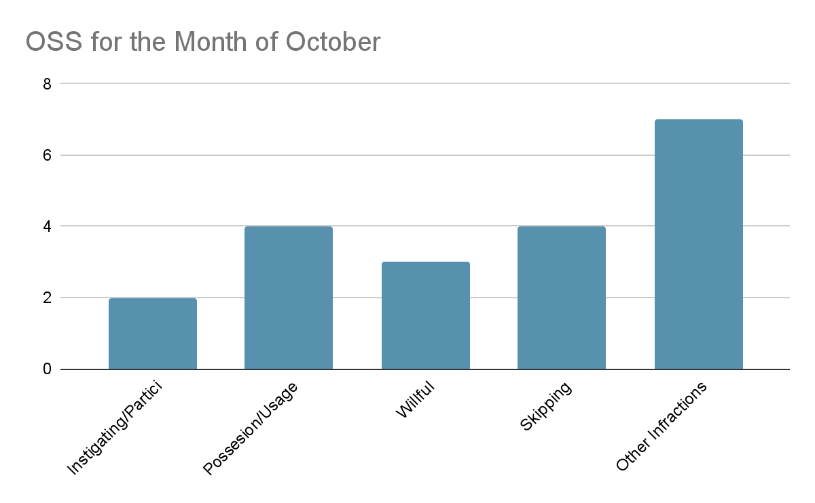
Culture
For the month of October, there has been an decrease in OSS for Possession of Vape Pens and other Infractions such as inappropriate language, pepper spray, etc. There has been a decrease in participating or instigating a fight, and willful disobedience. There has been an increase in skipping.

Slide 12
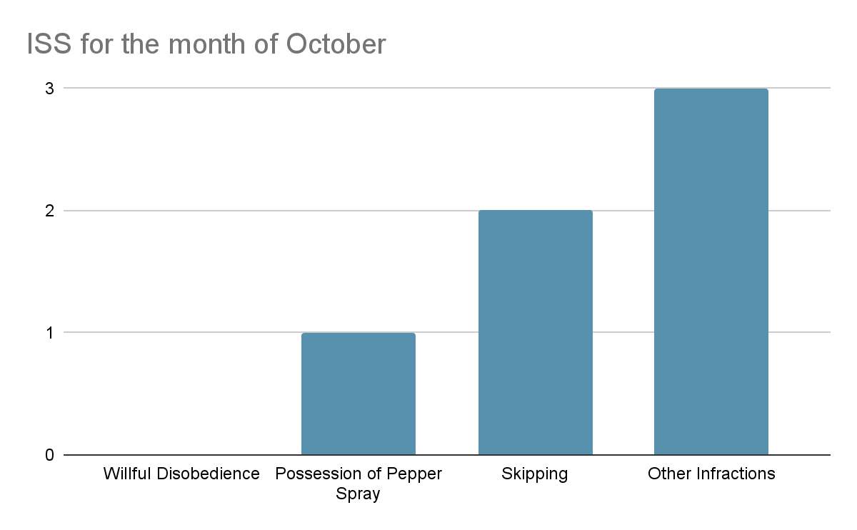
Culture
For the month of October, there has been a decrease in ISS for Willful Disobedience and other Infractions such as inappropriate language, pepper spray, etc. There has also been a decrease in Skipping.

Slide 13
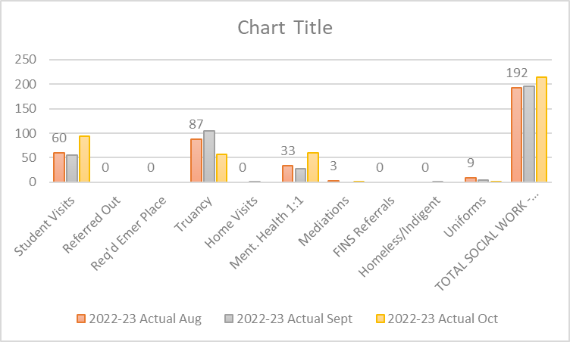
Social Work
Truancy numbers are not accurate due the the challenges of reports not being able to specify absent days vs absent blocks.
Mental health 1:1 visits are increasing as a result of absenteeism, grade decline, and dysfunctional home life among the student body.
Mediations are stable as a result of culture addressing behavioral concerns in a timely manner.
Overall, student visits have increase due to the support and acceptance students feeling in the SW department.

Slide 14
Counseling -Dual Enrollment
Students who are enrolled in the dual enrollment courses for Fall 2022 is working to complete online assignments and their Mid-Term exam.
The Fall semester will end prior to the December break.
Students will begin the registration process for the Spring semester to enroll in the dual enrollment courses.
Students are working to earn three carnegie units for each college course.

Slide 15
Counseling- Assessment
We had a great number of students to submit their ACT registration for the October test date.
ACT District Testing deadlines are approaching to submit request for accommodations for testers.
Seniors are encouraged to register for the December test date for SAT and ACT.
Collegiate partners are reviewing test scores to consider applicants for scholarship offers and admissions.

