Slide 1
Academics Report
August 2022

Slide 2
IHSNO Enrollment
Enrollment | August 2021 |  |  | Aug 2022
9th | 137 |  |  | 107
10th | 90 |  |  | 141
11th | 70 |  |  | 82
12th | 90 |  |  | 82
Total | 387 | --- |  | 412 | ---
This month’s data shows the comparison between last year’s enrollment and the current year during the same months. Last year’s enrollment for the month of August was 387. This year’s enrollment for August is 412, a gain of 25 enrollees for the first month of school.

Slide 3
International Baccalaureate
 | 2022-23 Actual Aug | 2021-22 Actual Aug
1 course | 50 | 57
2-3 courses | 1 | 8
4 or more courses | - | 2
IBDP Candidates | 28 | 13
TOTAL IB PROGRAMME - 11th Grade Enrollment | 79 | 80
IB Programme Enrollment 12th Grade | 2022-23 Actual Aug | 2021-22 Actual Aug
1 course | 67 | 60
2-3 courses | 3 | 2
4 or more courses | - | 1
IBDP Candidates | 8 | 16
TOTAL IB PROGRAMME - 12th Grade Enrollment | 78 | 79
IB Programme - IB Program | 2022-23 Actual Aug | 2021-22 Actual Aug
TOTAL IB PROGRAMME ENROLLMENT | 157 | 159
Highest number of 11th grade Diploma Candidates since 2016
5-year evaluation underway
Items for preliminary review being compiled for December 15th deadline
Self-study also taking place with submission deadline of March 1st

Slide 4
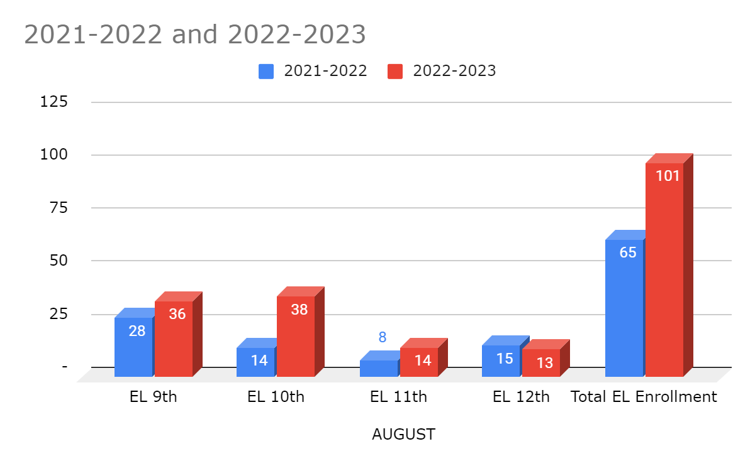
ESL- year to year comparison
9th- while 21-22 9th grade cohort was our largest ever, we see that this year’s cohort continues to grow. This number will decrease once no-show drops are made. As foreign transcripts are submitted and reviewed, students will be promoted.
10th- the 10th grade cohort is on track with last year’s 9th grade numbers, which were a historical high. This number will decrease once no-show drops are made.
11th- 11th grade numbers are on track with last year’s May count.
12th- 12th grade numbers are on track with last year’s may count.

Slide 5
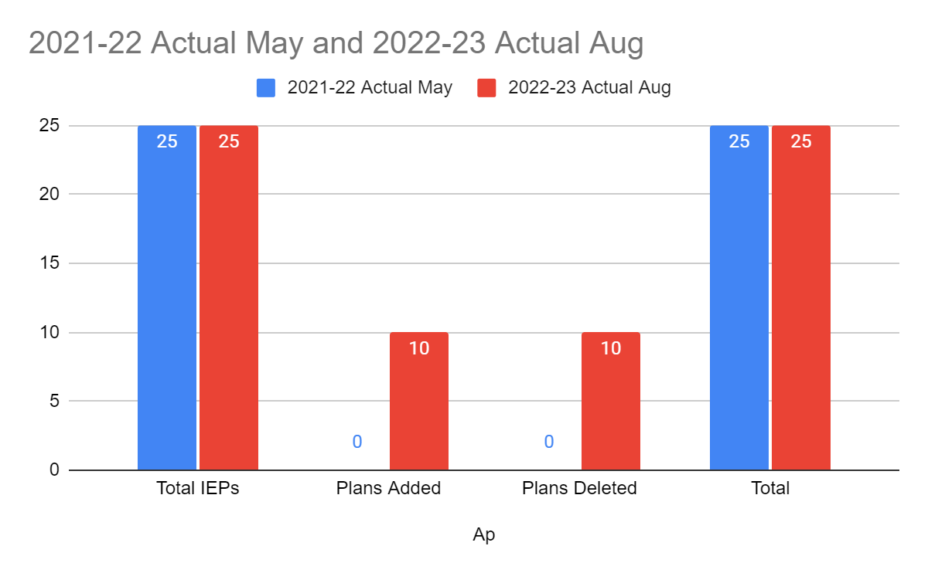
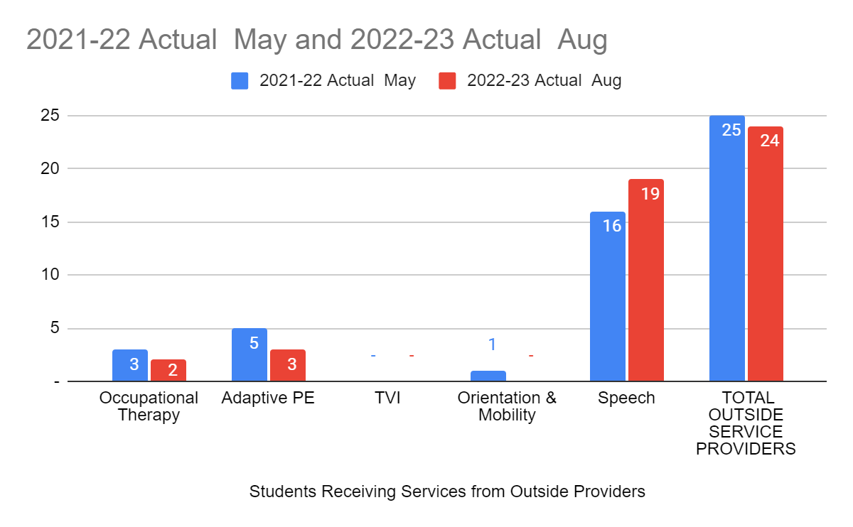
Special Education
21-22 cohort we ended with 25 students that had an IEP, and 25 whom received services from outside providers. Speech being the highest service. For the 22-23 school year we started with 25 IEPs, 8 students were exited out of SpEd due to graduation; 2 IEPs closed jurisdiction and transferred to another school. Making the total of 15 IEPs to start the month of August, 10 new IEPs were added to IHSNO Jurisdiction brining the total to start the year of 25. For services, it decreased by one, decrease in APE services and increase in Speech, no OT.

Slide 6
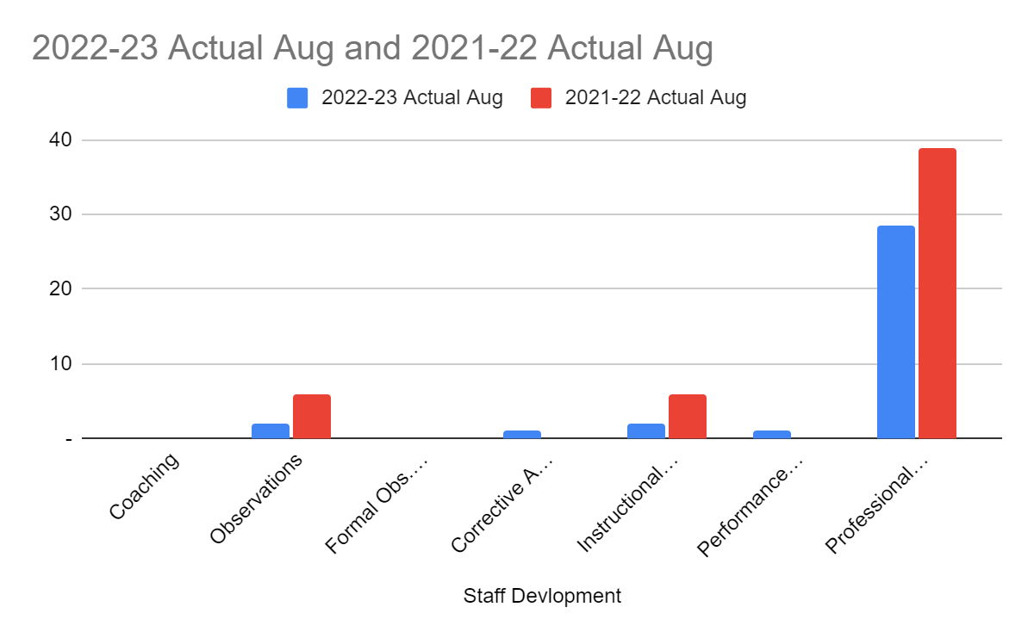
Staff Development

Slide 7
Staff Development
There were some slight differences in the start of the 2022-23 school year as compared to 2021-22
There were fewer PD hours as a result of the intention of having embedded records days in the Wednesday PD schedule rotation
Informal observations saw an uptick.
One mediation conversation was had, hence the corrective action indicator, and a performance plan from last year has rolled over into this year.

Slide 8
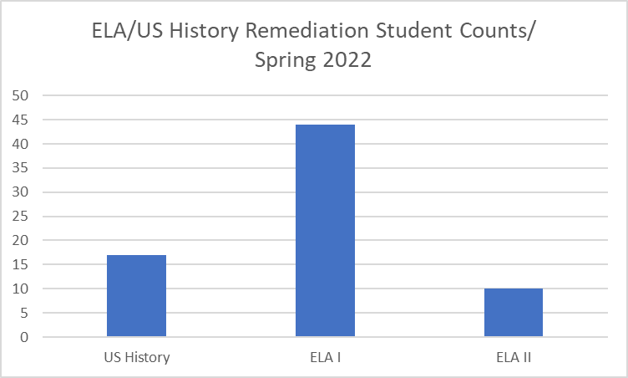
Remediation
ELA/SS Interventionist visited each ELA I, ELA II, and US History class to build rapport
Remediation candidates for each of the above LEAP courses will be created based on diagnostic assessment data, 3 week progress report grades, and teacher recommendation
Math/Sci Interventionist position is vacant, therefore there will be no remediation supports offered until vacancy is filled
Prediction of Fall 2022 remediation student counts based on the Spring 2022 ELA/USH remediation students counts means it is possible that 71 students will need to receive remediation services in ELA/USH courses.

Slide 10
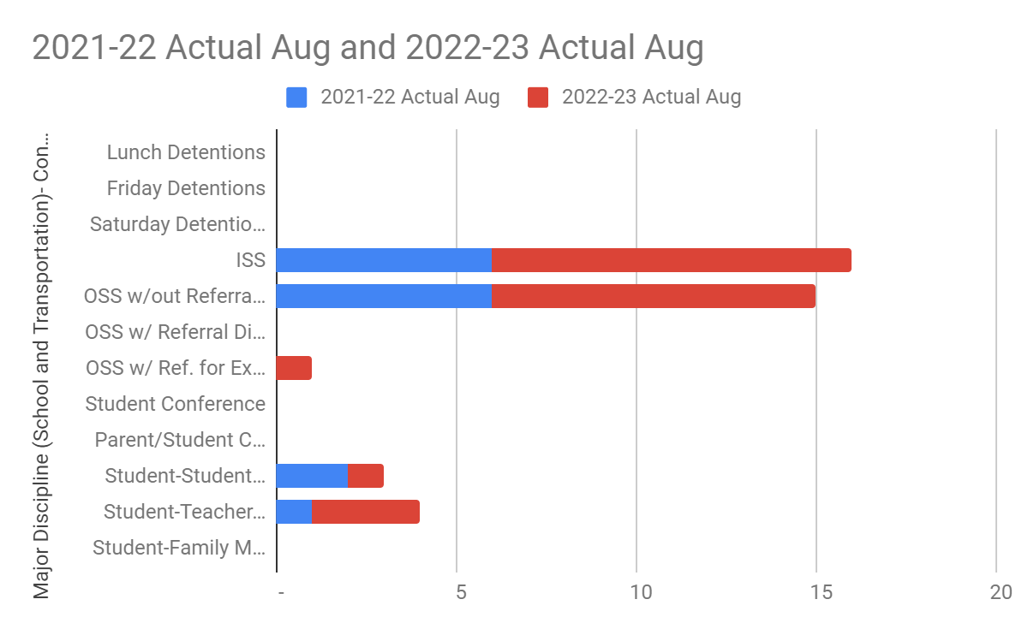
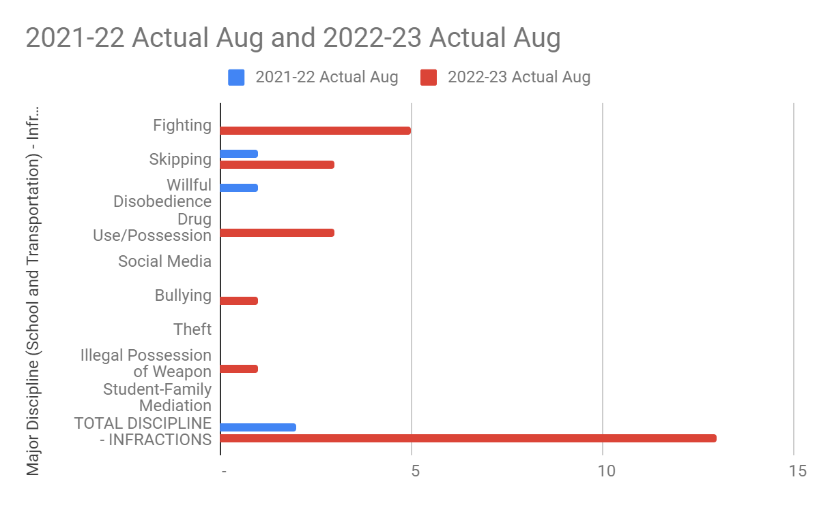
Culture

Slide 11
Culture
The marked increase from last year’s number of incidents is in part due to the conducting of searches as student’s enter the school building. Items have been confiscated resulting in suspensions for possession of OTC medications, vapes, tasers, etc. These items until this school year have gone undetected if they were in the possession of the student.
There should be a decrease in the number of incidents as student’s are aware of items not allowed to be carried on their person.
Mediations between students have been the direct result of social media postings.

Slide 12
Athletics
Sports are underway at IHSNO. The following sports are available for students:
Girls Basketball - C. Moore, Head Coach
Boys Basketball - K. Herbert, Head Coach
Volleyball - C. Thomas, Head Coach
Cross Country - K. Herbert, Head Coach
Track & Field - P. Recasner, Head Coach
Dance - TBA
Cheer - R. Stewart, Head Coach

Slide 13
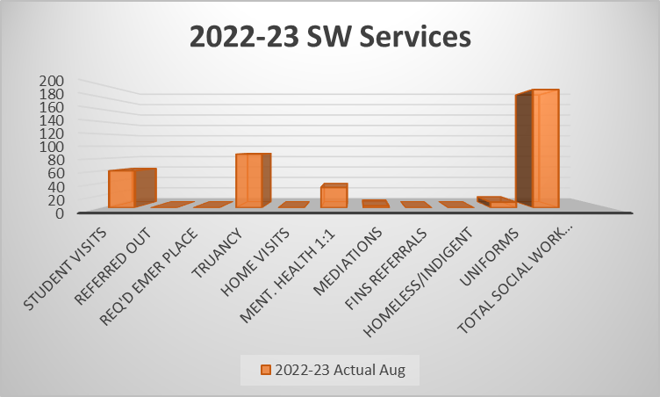
Social Work
SW services for SpEd students have not began due to limited access to IEP goals. Compensatory minutes will be provided to balance intended service minutes.
Truancy is high and is currently being addressed in Sept. by sending out attendance count letters through email to parents and planning meetings/home visits for increased truant scholars.
SW services reflect challenges with schedules, home life, grief, and environmental factors scholars’ face daily.
Many families have expressed the need for uniform assistance and make the need visible by scholar through non-compliance of uniform.
RAAPS assessment will be dispersed to scholars within the last two weeks of Sept. to gauge need of the population.

Slide 14
COLLEGE ADMISSIONS
Seniors are completing the profile section of the common application.
Seniors are creating a new username and password. The Common App information session with seniors is scheduled during the third week of August. College counselor will explain the step-by-step instructions for completing the common application.
Parent Common App Workshop will be held on September 7 @ 5:30 p.m. in the cafe.
Parents will be notified via email, phone and robo call to RSVP.

Slide 15
Counseling -Dual Enrollment
The dual enrollment partnership is with Southern University in New Orleans. Parents expressed an interest for their child to enroll in a college course.
Currently, we have ninety-two students who are enrolled in college courses. The grade level range is 9th-12tth graders. The course section types are Biology, English 101, English 102, Biology, Western Civilization, College Survival Skills, Criminal Justice and Evidence.

Slide 16
Counseling- Assessment
The assessments for the 2022-2023 school year will begin in September for the ACT national test administration. Also, students will register for the SAT test administration as well.
Seniors are currently registering for the September ACT test date to be prepared for all consideration for college admissions for Fall 2023.
Seniors are encouraged to review the composite score for the English and Math subscores that are listed on their score report.
Subscores > 50 percentile are an indicator of college readiness

