Slide 1
Academics Report
May 2022

Slide 2
IHSNO Enrollment
This month’s data shows the comparison between April 2021 and May 2021 enrollment. April 2021 was 382 and May 2021 enrollment was 381. A loss of one (1) student. Enrollment for April 2022 was 385, and May 2022 was 386, a gain of one (1) student.
Enroll ment | Apr 2021 | May 2021 |  | Apr 2022 | May 2022
9th | 111 | 111 |  | 148 | 149
10th | 90 | 90 |  | 78 | 78
11th | 91 | 91 |  | 80 | 78
12th | 90 | 89 |  | 79 | 81
Total | 382 | 381 |  | 385 | 386

Slide 3
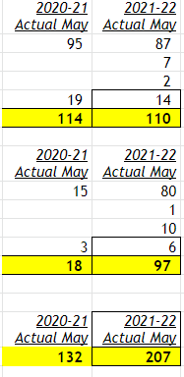
International Baccalaureate
May 2022 Examination Session Completed
Results released July 5th
6 Diploma Candidates
12 Certificate Course-Option Candidates
22 Examination Papers
11 days of testing
11 subjects examined
MYP Application for Candidacy in the 2022-23 in 9-10th started

Slide 4
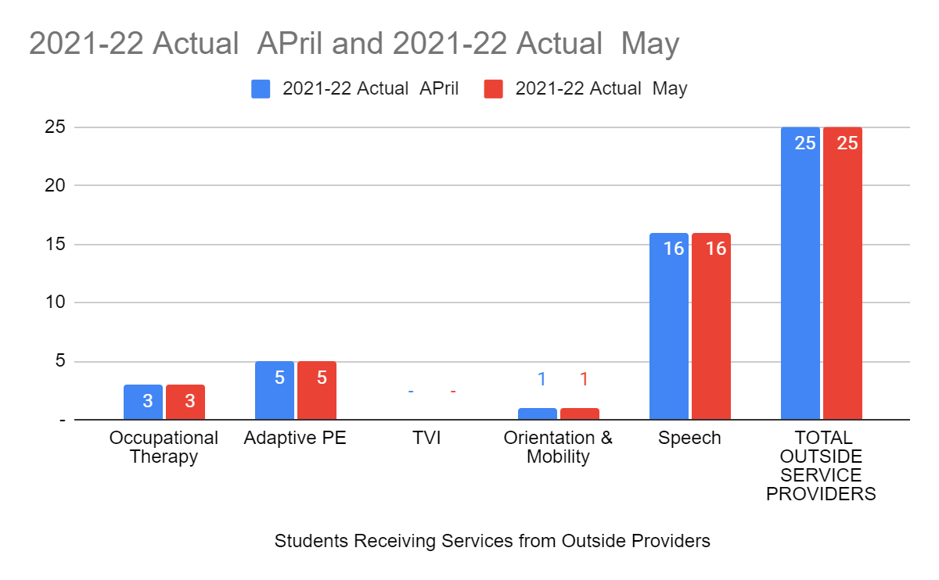
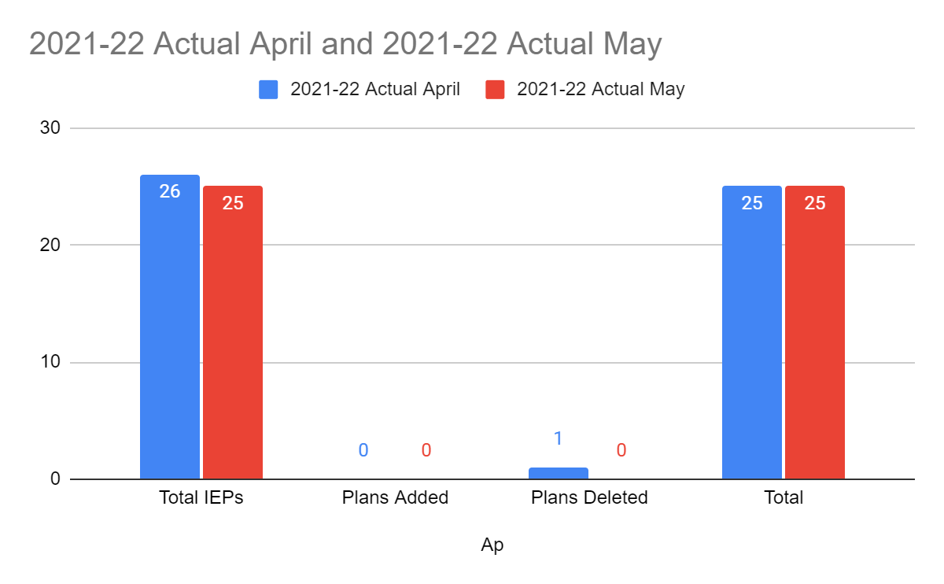
Special Education
For the month of May there were no changes. The amount of students remained the same for the month of April and May. The amount of students receiving services remained the same.

Slide 5
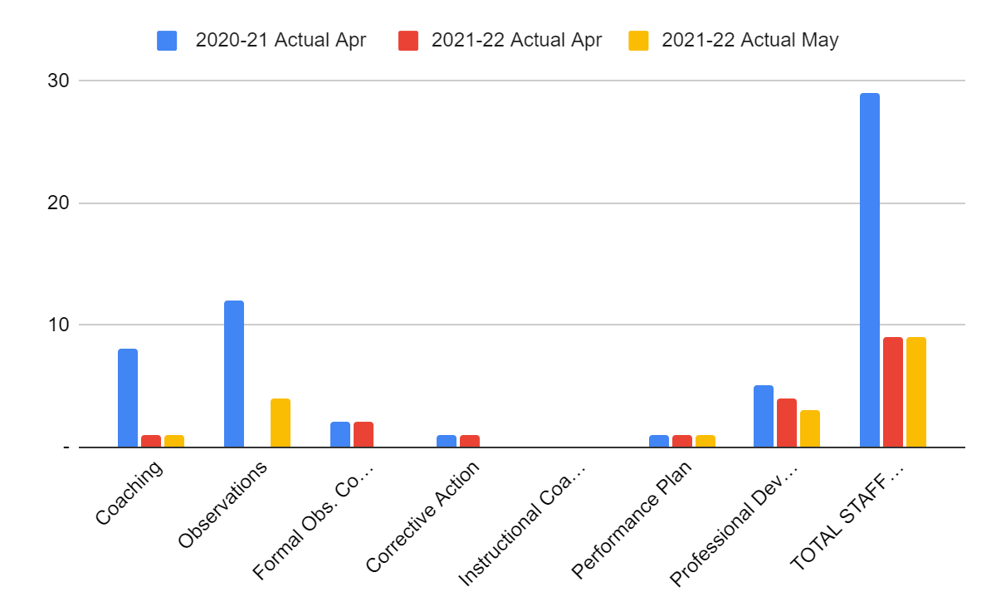
Staff Development
This month PD hours were less than last month. We focused on parent communication and preparation for exams. Teachers worked on study guides and review for finals during PD. All staff took Safe school training in deescalating techniques.
There was one PIP that was closed and resulted in a non-renewal for the 222-23 school year.

Slide 6
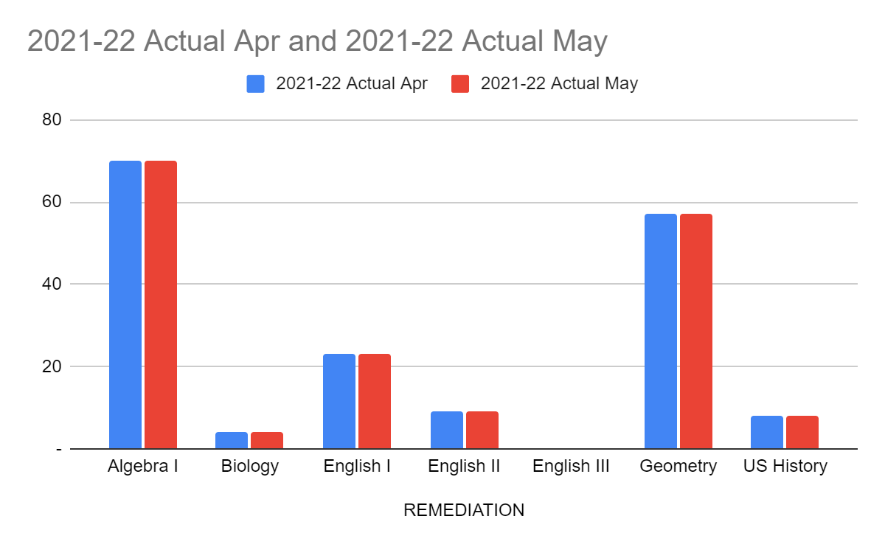
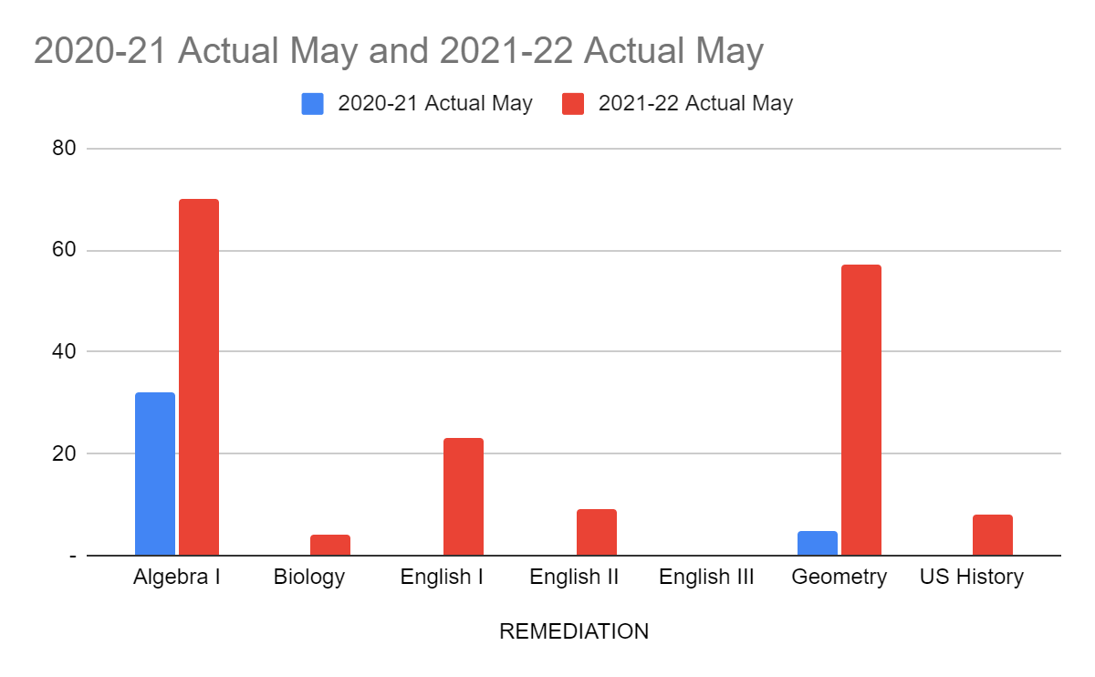
Remediation
The year closed out with the same numbers as the remediation specialists had to fill in for classes on a permanent basis. Even the remaining classes may have missed support because of coverage needed throughout the semester.
As staffing and other extenuating circumstances level off, having all LEAP preps covered will really show its benefits in the very near future.

Slide 7
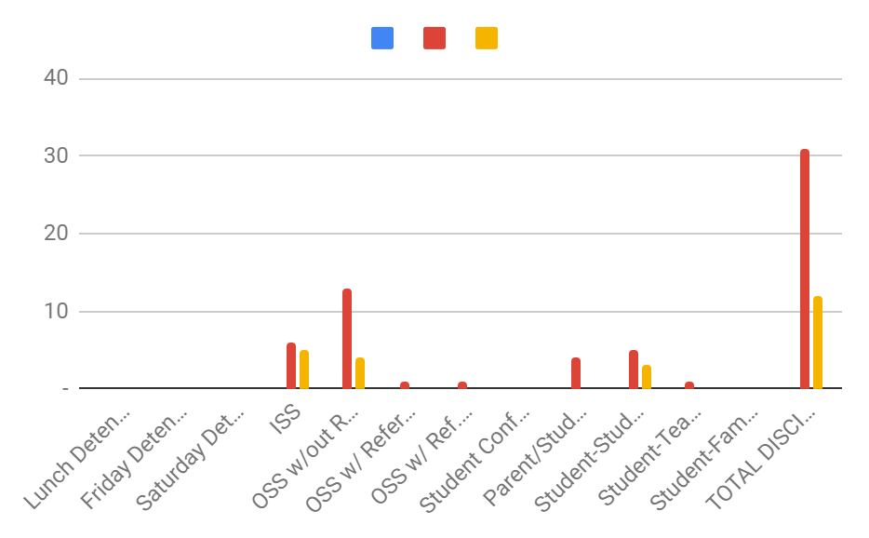
Culture
Major Discipline (School and Transportation)- Consequences
Lunch Detentions
Friday Detentions
Saturday Detentions
ISS
OSS w/out Referral Disc. Conf.
OSS w/ Referral Disc. Conf.
OSS w/ Ref. for Expellable Offense
Student Conference
Parent/Student Conference
Student-Student Mediations
Student-Teacher Mediations
Student-Family Mediation

Slide 8
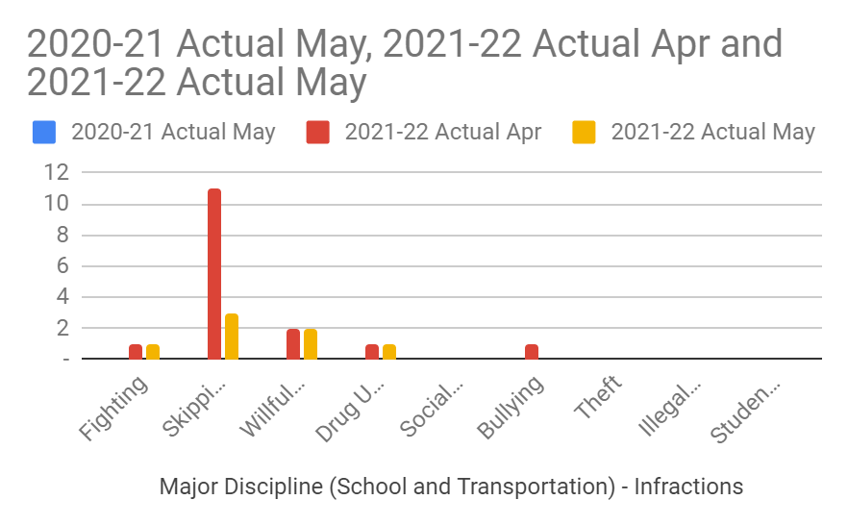
Culture
Major Discipline (School and Transportation) - Infractions
Fighting
Skipping
Willful Disobedience
Drug Use/Possession
Social Media
Bullying
Theft
Illegal Possession of Weapon
Student-Family Mediation
TOTAL DISCIPLINE - INFRACTIONS

Slide 9
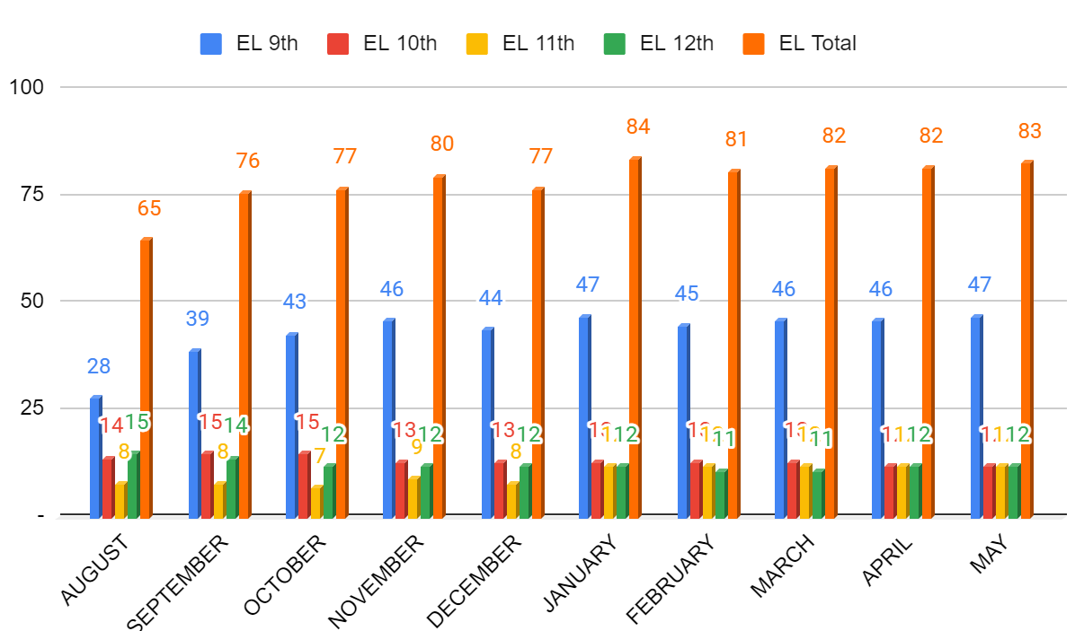
ELL- Month to Month Comparison
9th- we continued to increase through the end of the official school year with one additional new arriver. This is our largest EL cohort ever.
10th-11th- numbers remain steady at 12 for each grade level.
12th- all 12 Seniors will be rolled out as graduates!

Slide 10
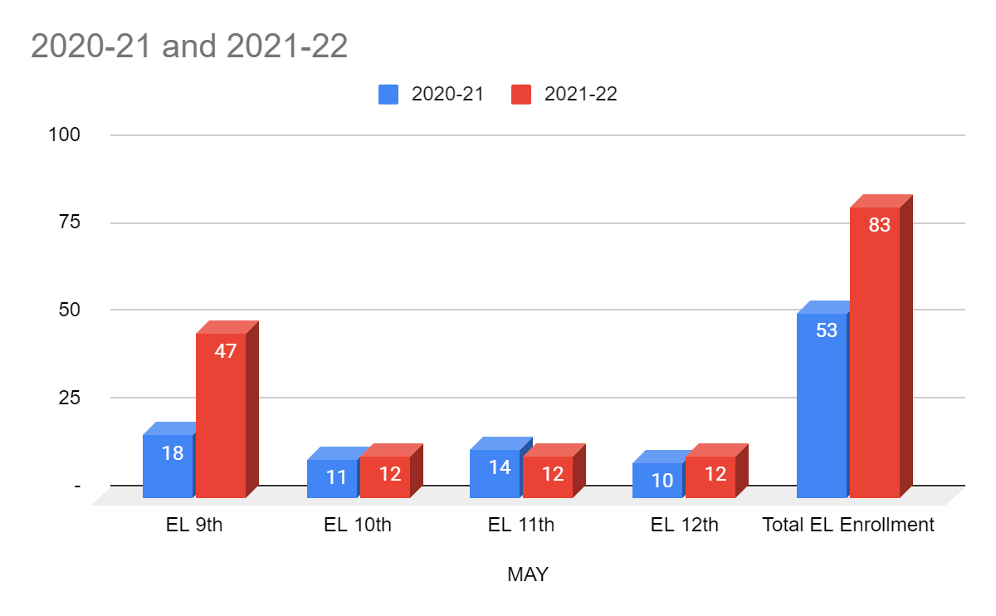
ELL- Year to Year Comparison
As we can see, our 9th grade EL cohort is as large as our entire EL enrollment was last year. Luckily the majority of this group is dedicated to their academic success. I will work to provide additional supports for teachers and students in order to ensure we support them in 10th grade as they move to more rigorous classes. Current 10th and 11th graders will also need additional support, especially in preparation to pass LEAP exams which has already started in SLP..

Slide 11
Counseling -Dual Enrollment
Thirty-one students successfully completed a dual enrollment course with Southern University in New Orleans. The dual enrollment courses were Criminal Justice, Biology, Western Civilization and English Composition I.
Students receive three carnegie units for each course section completed. Graduates will request their college transcript to present to their college advisor to be consider advance college credits.

Slide 12
Counseling - College Admissions
Seniors received ten or more college admissions for the upcoming school year.
Seniors received merit-based scholarship offered predicated on ACT composite score and cumulative grade point average.
Seniors worked diligently to composite score of 20 or higher.
Collegiate partners will process TOPS applications according based on graduates who have met the requirements for TOPs Honor, Opportunity and TEch Award.

Slide 13
Counseling- Assessment
The LEAP 2025 test sessions are complete. Graduates have successfully passed one of the pairs for as one of the graduation requirements.
Students in grades 9th-11th were required to complete the assessment based on their course enrollment status. Also, if the previous assessment performance level was “Unsatisfactory”.

