Slide 1
Equity Support at ANCS
Tilifayea L. Griffin, Interim K-8 Equity Support Coordinator

Slide 2
In the 2018-2019 school year, the following includes the role and responsibilities for the Interim K-8 Equity Support Coordinator:
Work with small team of equity support coaches to plan and lead professional development for teachers and staff related to ANCS’ diversity and equity goals
Serve on ANCS strategic planning committee with a particular focus on keeping diversity and equity goals at the forefront of plan development
Serve as a co-chair (with parent/caregiver co-chair) of diversity and equity action team
Work with Executive Director to determine long-term structure for ANCS equity support role
Serve on K-8 leadership team
Coach a faculty iGroup

Slide 3
How Has the Role Evolved?
In an effort to be responsive to the needs of the students, faculty, staff, parents/caregivers, and other stakeholders, the role has developed in the following areas:
School Leadership
Organizational Leadership
Human Assets Leadership
Professionalism and Communication

Slide 4
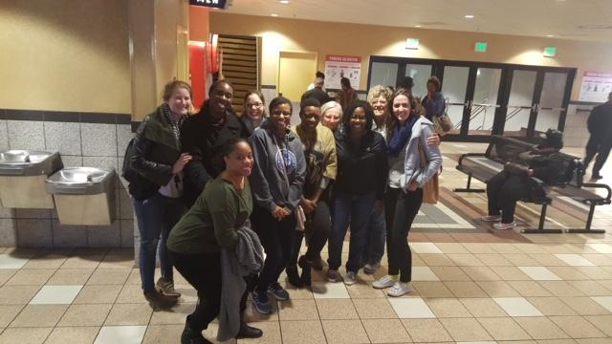
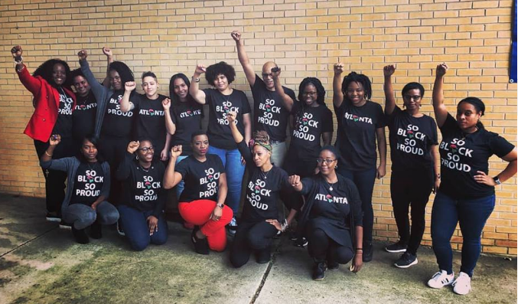
School Leadership
Fostering Relationships and School Culture
Staff Film Viewing & Debrief
Organized committee to plan events for underrepresented populations in school community
Instructional Leadership
Instructional practices & classroom management
Culturally responsive teaching resources

Slide 5
Organizational Leadership
Prospective Families Presentations at Local Preschools
State-wide Conference Presentations
Professional Learning for Educators

Slide 6
Organizational Leadership
Planning and Executing Strategically

Slide 7
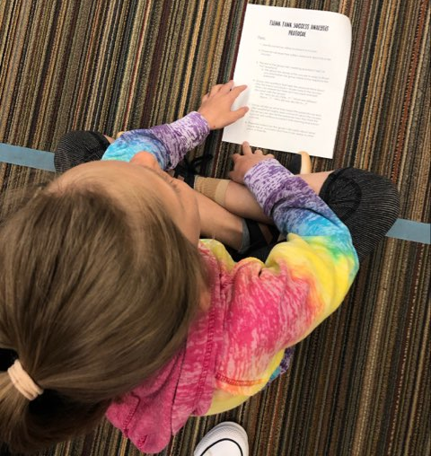
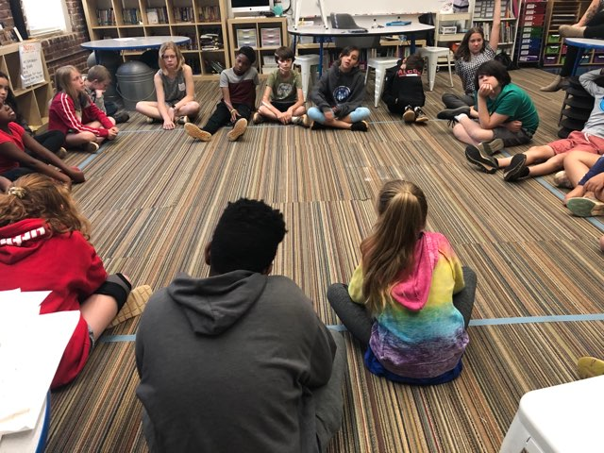
Human Assets Leadership
Developing and Supporting Others
iGroup Coaching and Support
Student Affinity Group in 5th Grade
Grade Level Team Support
Collaborating with Key Stakeholders
Strategic Planning Support
Executive Director Search Committee

Slide 8
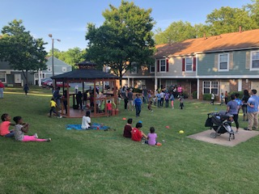
Professionalism and Communication
Communication and Community Relations
Diversity & Equity Action Team Parent and Community Events
Hispanic Heritage Month & Black History Month Celebration
Equity Support at ANCS webpage

Slide 9
MOVING FORWARD
PERMANENT
INTERIM
EXPANDED ROLE AND RESPONSIBILITIES
Notes:
Discuss link between the work I’ve done, inspiring revision for expanded role and responsibility

