Slide 1
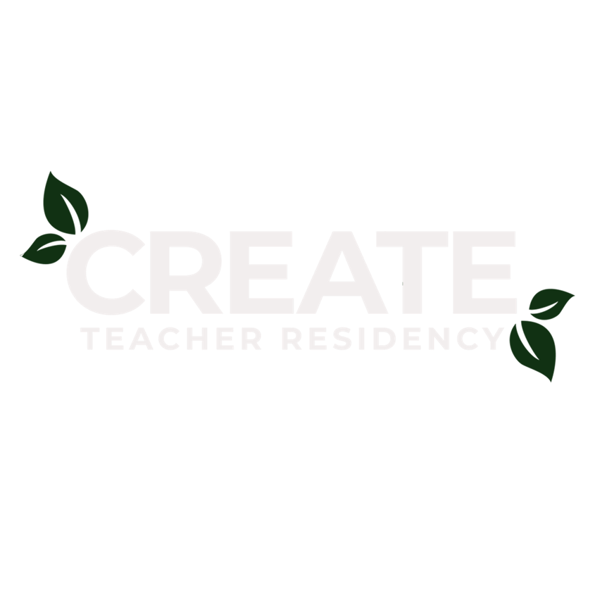

Slide 2
CREATE’s
Vision
A critically-conscious, compassionate, and skilled educator for every Student.
Notes:
I’m going to be talking today about how it is that CREATE landed on this as our vision statement. Our organizational learning process, our impacts, and why it is that we’re calling out these three components of teacher training as our focus: critical-consciousness, compassion and skill.
See the brochure for definitions

Slide 3
CREATE’s
Mission
To build and nurture a thriving community of educators committed to practices of teaching and learning that prioritize racial justice and interrupt inequities.

Slide 4
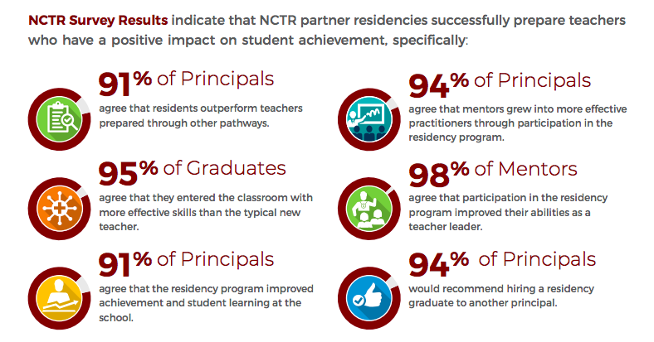
Notes:
Comprehensive data from National Center for Teacher Residencies
Residency programs in this country are a fairly recent phenomenon. They have arisen as a potential solution to the teacher pipeline problem. This data references some of the positive impacts seen nationally from teacher residencies.
But not all teacher residencies are alike – in fact many of the most effective programs use strategies that are responsive to local need.

Slide 5
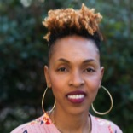
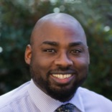
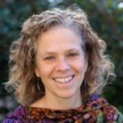
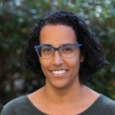
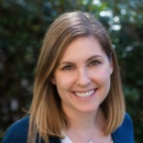
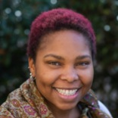
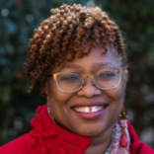
CREATE
Team Members
Kofi Kinney
Instructional Mentor
Ayodele Harrison
Assistant Director
Elizabeth Hearn
Director
Maya Jenkins
Instructional Mentor
\
Megan McKnight
Assistant Director
CaTia Daniels
Executive Assistant
Folami Prescott-Adams
Lead Facilitator

Slide 6
CREATE Schools

Slide 7
Cohort Data
3 cohorts in the program at a time; 50-60 residents
Entering cohort size: 20
76% non-White, 24% White
Notes:
The racial makeup of the teacher workforce nationally is between 70-80% White, whereas more than 50% of students are non-White. Broadly speaking, Georgia’s teacher workforce and student body matches the nation’s.
The result is that minority students in the nation’s schools increasingly lack minority adult role models and contact with teachers who understand their racial and cultural background and experience. The minority teacher shortage, it is held, is a notable contributing factor in the gap in scores between White and non-White students and, ultimately, unequal occupational and life outcomes for disadvantaged students.
Based on analysis of: two-and-a-half decades of data from 1987 to 2013 from the Schools and Staffing Survey (SASS) and its supplement, the Teacher Follow-Up Survey (TFS) –Ingersoll and May

Slide 8
CREATE has served.
From 2015 - Present
74
15
New Teachers
Schools
470+
experienced educators,
including 51school lead
8700+
Students

Slide 9
95%
of new teachers from CREATE have remained in teaching

Slide 10
94%
of mentors and cooperating teachers return to their role

Slide 11
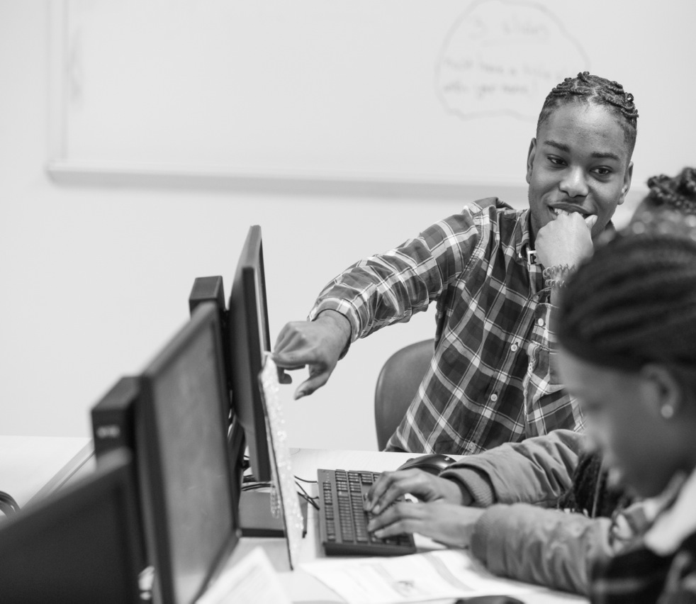
94%
of residents (and 100% of current first-year residents) recommend CREATE to a potential applicant.

Slide 12
100%
of school leaders request continued/expanded work
with CREATE

Slide 13
How many GSU graduates become GA
public school teachers?
82 %
GSU
99 %
GSU + CREATE
Annual average 2015-2017

Slide 14
“I would not have survived last semester without the CREATE Program.”
Testimonial
First-year CREATE resident, 2018

Slide 15
“Many of the best teachers in our building were trained by CREATE”
Testimonial
CREATE School Leader, 2019

Slide 16
Testimonial
“
This semester, CREATE has been my backbone and anchor for support. Often times I felt like walking away from all the work I had put out at GSU, however, it was those one-on-one meetings with the CREATE leadership team members, [cohort meetings], and being placed in a school that supported me and kept me going.
~ First-year resident, 2018

