Slide 1
Executive Director Report
October 2022

Slide 2
Agenda
01
02
03
Enrollment
Community
Academic Programs
04
05
Instructional Materials
Assessment & Dashboard Updates

Slide 3
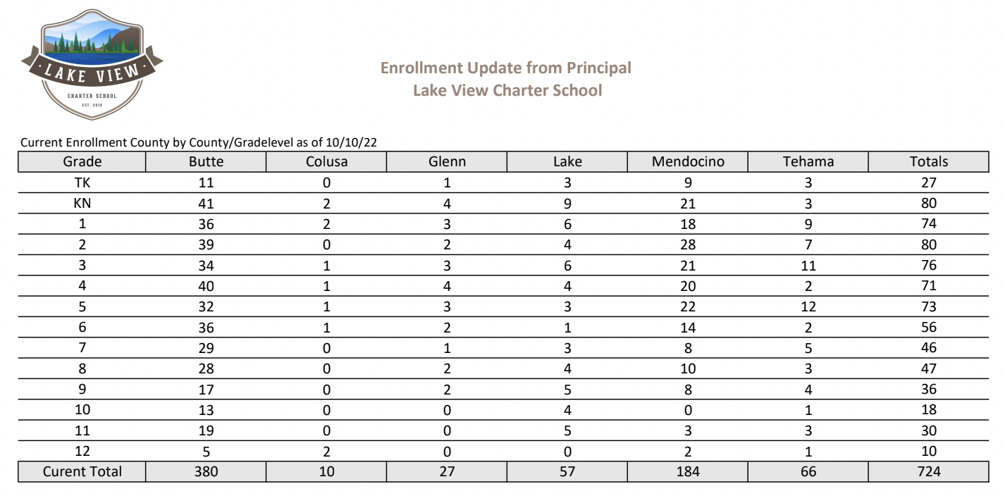

Slide 4
Session 1: 8/15-10/7
Total Session 1 class offerings: 56
Total Session 1 registrations: 637
Session 2 starts 10/17
Total Session 1 class offerings: 70
Total Session 1 registrations: 800+
8 Core Adventure Academy teachers
New PE Program
Classes that are EL and DIG approved
Parents now register through Sequoia Sign Up

Slide 5
HSVA
JHVA
HSVA leadership students hosted the first annual Fall Harvest Festival on October 14th - including trunk or treating for TK-8 students and a dance for High School Students!
School | Enrollment Semester 1
Clarksville | 200
Feather River | 328
Lake View | 58
Total | 586
Core classes for 7th & 8th grade students by single-subject credentialed teachers with two options:
​
JHVA-Live! - 2 day/week live instruction
JHVA-Edmentum - 100% asynchronous learning
Notes:
Unique students by school enrolled in at least one VA class

Slide 6
High School
We hosted the PSATs for our 10th and 11th graders on October 12th!
This is the first time we’ve been able to administer College Board exams ourselves.
The kids and families were very thankful!

Slide 7
Student Support
Intervention
Centervention
Cycle 1- Tier 1 & 2: 89 seats
Cycle 2- Tier 1 & 2: 95 seats
Reading Decoding Waitlist- 12
21 licenses assigned
Nessy
SEL
106 licenses assigned
Live Groups: 25 seats for Cycles 1 & 2
SEL Drop Ins: 59

Slide 8
Special Education
School | # SPED Students | % of Enrollment
Clarksville | 214 | 11.19%
Feather River | 196 | 8.42%
Lake View | 64 | 9%
Onboarding a new Speech and Language Pathologist
Applying to move from current SELPA to EDCOE SELPA
28 current initial special education assessments

Slide 9
Creating DIG inspired Fieldtrip series:
Wakamatsu Farms in October
California Indian Museum and Cultural Center in November
Notes:
Holding monthly Coffee & Conversations zoom events surrounding Diversity & Inclusion topics for staff to grow in empathy and understanding to better serve our minority population

Slide 10
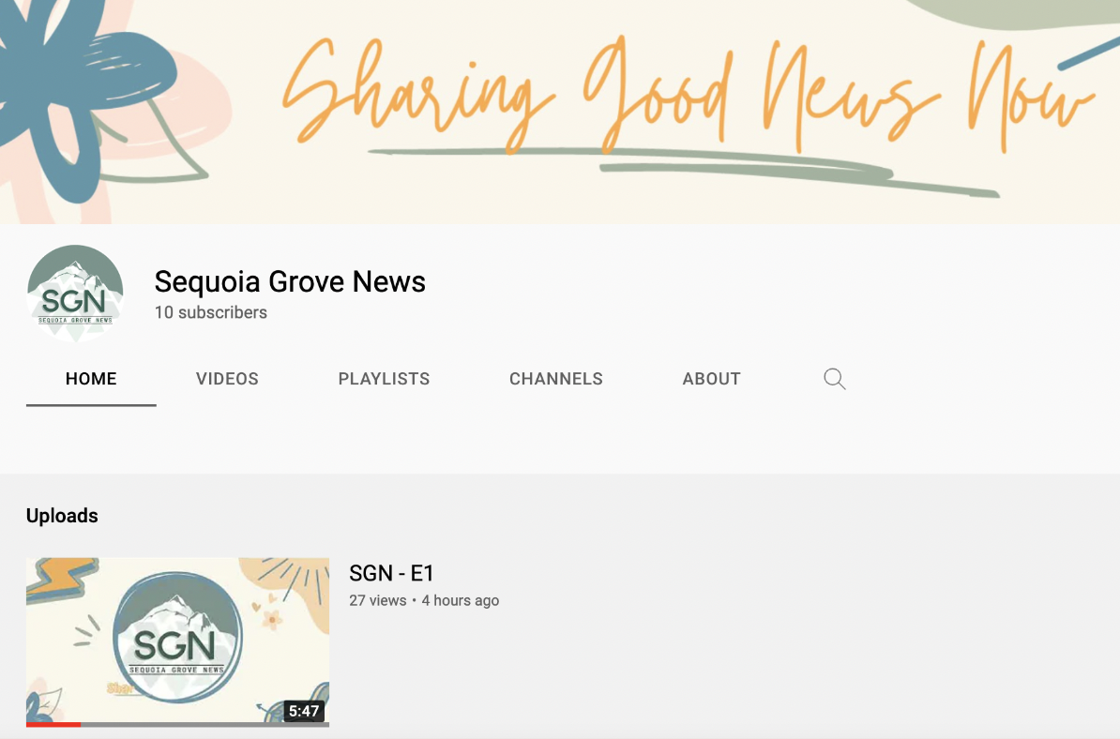
Sequoia Grove News
The first episode of Sequoia Grove News is ready to watch on our SGN YouTube Channel!

Slide 11
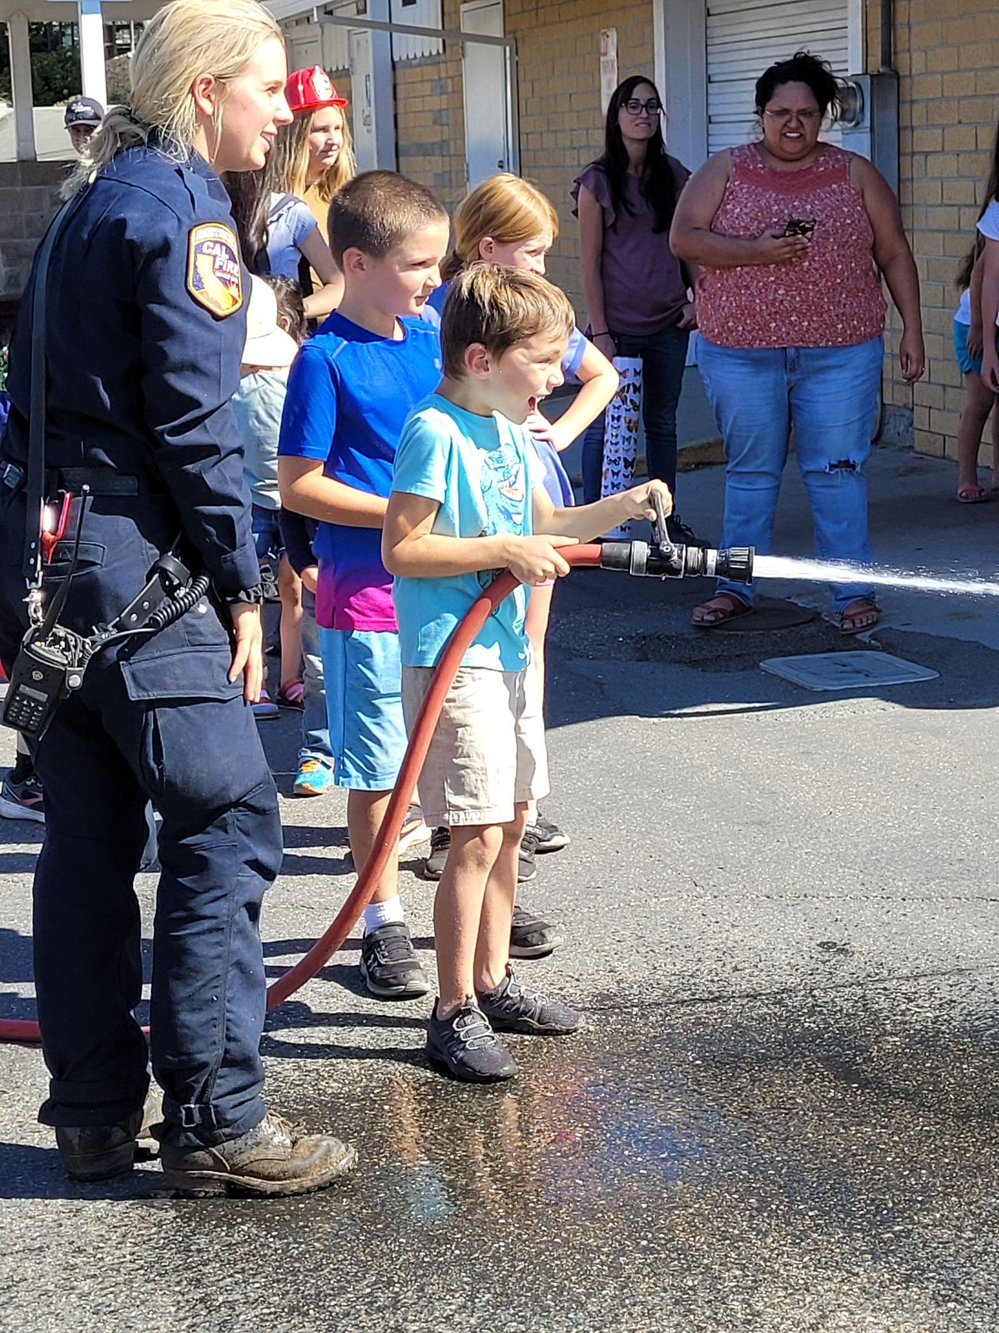
Field Trips
Field Trips have been VERY popular!
So far: 49 trips with 1702 registrations
Several offerings are selling out in a matter of minutes
Hired a new Field Trip Coordinator and looking to add a PT Field Trip Processor
Working on planning trips that can accommodate larger groups of people either by increasing capacity or offering the same trip over multiple days

Slide 12
THANK YOU to our Session 1 Club hosts! We had SO many students attend!
Here’s a quick peek at some of the upcoming Session 2 Clubs. In person and virtual club opportunities.

Slide 14
Instructional Materials
Vista System has been a great change!
Orders Processed
Product: 15,649
Services: 6,354
Curriculum: 1,638
Community Partners
Onboarded & active service partners: 402 unique
New this year: 130
ACH payments available this year
Library Services now offers shipping!

Slide 15
Tech Devices
One to One Chromebook Plan
2721 distributed
All remaining Chromebooks (~2300) prepped with our software, in the system, and ready for park day distribution/ shipping as requested via the Chromebook Request form.
New Staff Surface Laptops
Currently being distributed

Slide 16
Fall Assessments
STAR Assessment
Participation
Students took a Math and Reading Assessment
95% of students participated in the fall assessments
Results are used by teachers and parents to help drive learning plans and also used by our student support department to offer a robust series of intervention classes aligned with the needs of our students.

Slide 17
Changes to the CA State Dashboard: Restarting Accountability
Notes:
For the past two school years, California accountability requirements were waived or adjusted due to the impact of the COVID-19 pandemic.The requirements to hold districts and schools accountable for student outcomes resumes with the 2021–22 school year and release of the 2022 Dashboard. However, due to the restrictions imposed by Assembly Bill 130, California is required to only report current year data (or Status) for the 2022 Dashboard. Therefore, unlike in prior years, the 2022 Dashboard will not display the difference from prior year (also known as Change) or performance level colors. Results will fall into one of five Status levels, ranging from “Very High” to “Very Low.”
No color wheel this year! For 2022 only, the dashboard display will appear as “cell phone bars” . The color wheel will return next year.

Slide 18
Measures of Student Success
Six state measures allow for comparisons across schools and districts:
Academic Performance
Chronic Absenteeism
College/Career Readiness (not this year, will resume in 2023)
English Learner Progress
High School Graduation Rate
Suspension Rate
Schools and districts will receive one of five Status Levels on each of the state measures. Status levels are reflective of achievement during the 21-22 school year

Slide 19
Thanks!
It is an honor to work with you to make our school the best for our families. Thank you for your time and dedication.

